Slide 1
Virtualization
Ability to create and manage virtual environments (either virtual machines or containers), enabling the efficient use of hardware resources and the isolation of different workloads.

Slide 2
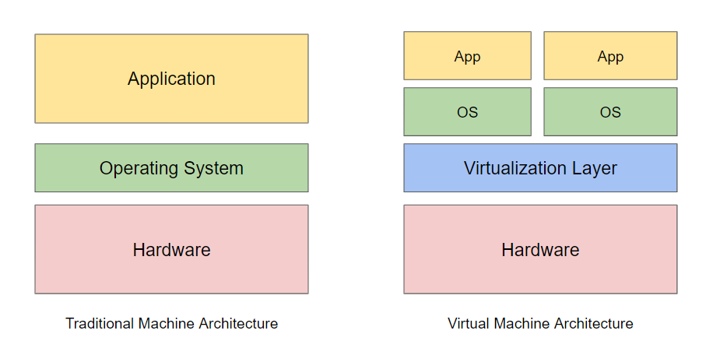

Slide 3
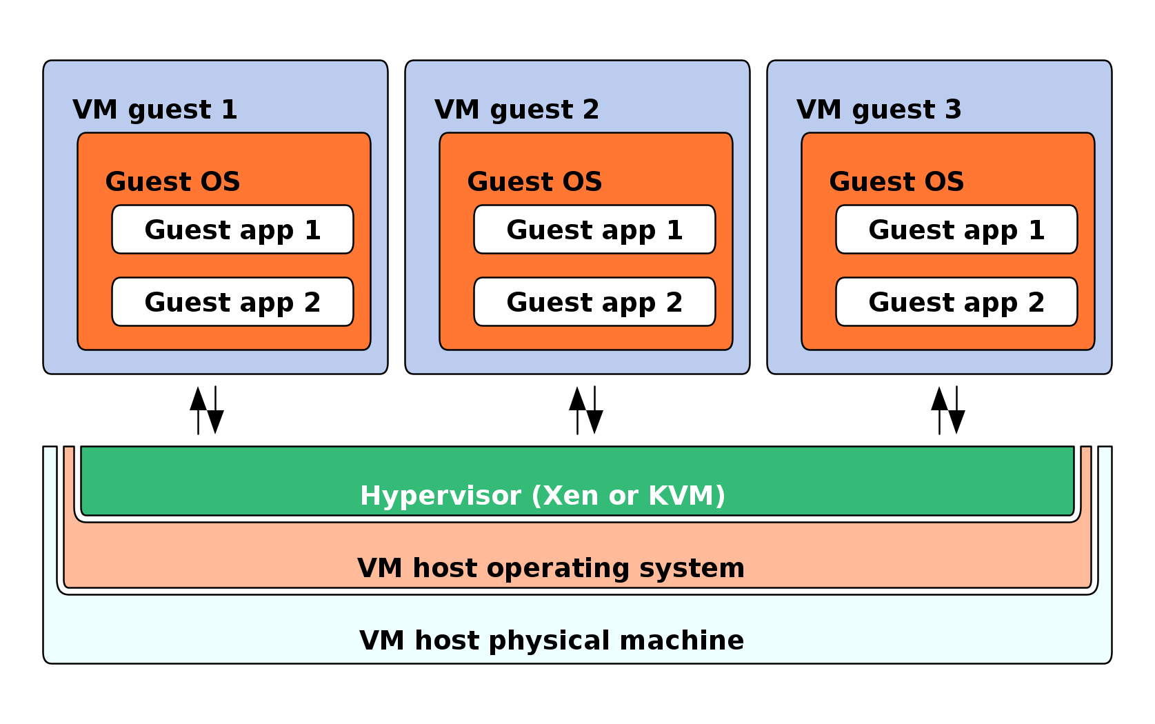
Architecture

Slide 4
Virtual Machine
Virtual environments that simulate a physical computer in software form.
Software-defined computer that runs on a physical computer with a separate operating system and computing resources.
Physical computer is called the host machine
Virtual machines are guest machines.
Multiple virtual machines can run on a single physical machine.

Slide 5
Hypervisor
Virtual machines are abstracted from the computer hardware by a hypervisor.
Runs directly on VM host server's hardware
Controls platform resources, sharing them among multiple VM guests and their operating systems
Interface between the VM and the underlying physical hardware, ensuring that each has access to the physical resources it needs to execute.
Ensures that the VMs don’t interfere with each other by impinging on each other’s memory space or compute cycles.

Slide 6
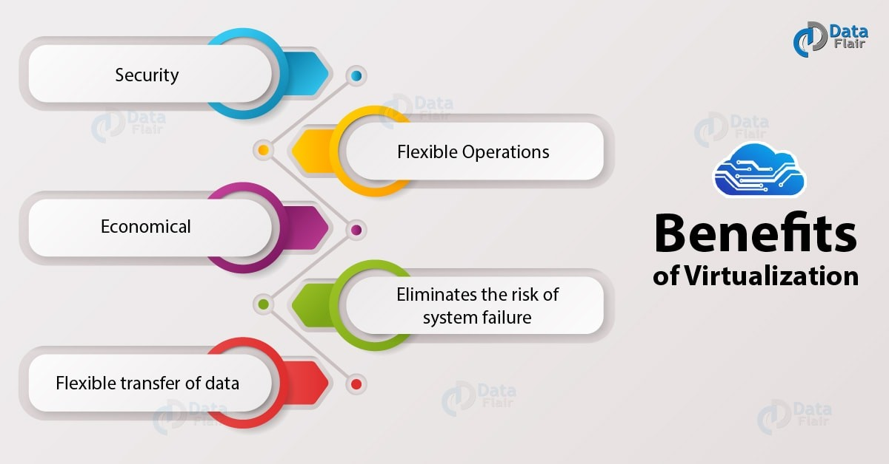
Benefits

Slide 7
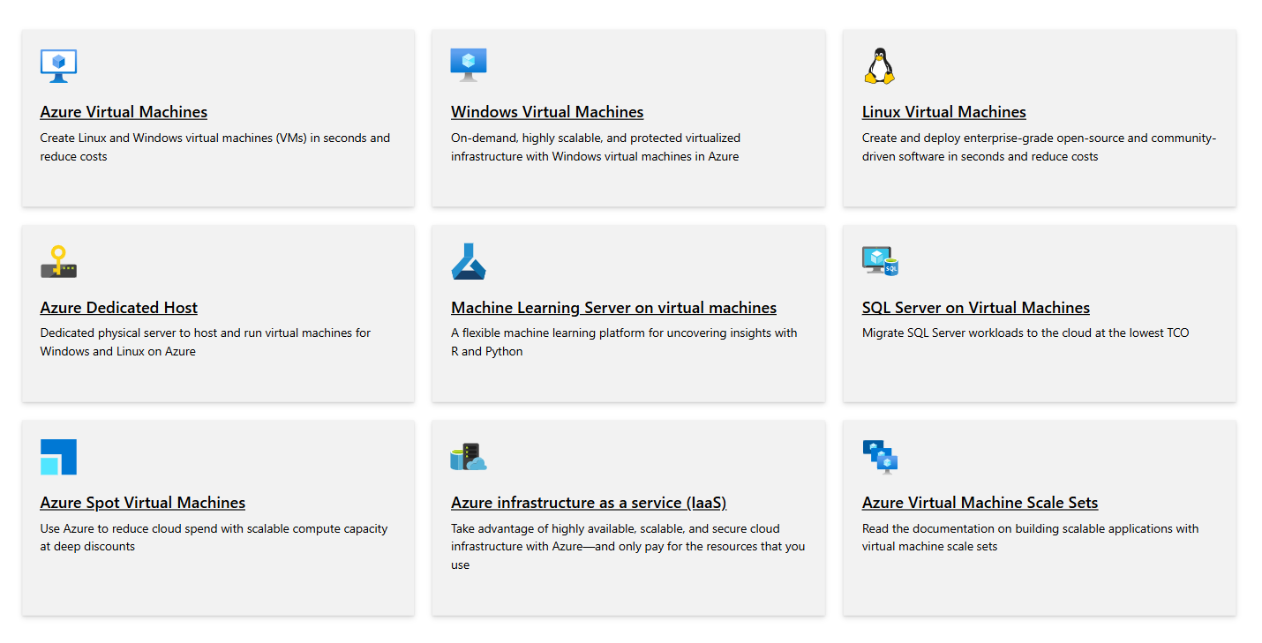
Azure Virtualization

Slide 8
Containerization

Slide 9
Packaging of software code with just the operating system (OS) libraries and dependencies required to run the code to create a single lightweight executable—called a container—that runs consistently on any infrastructure.

Slide 10
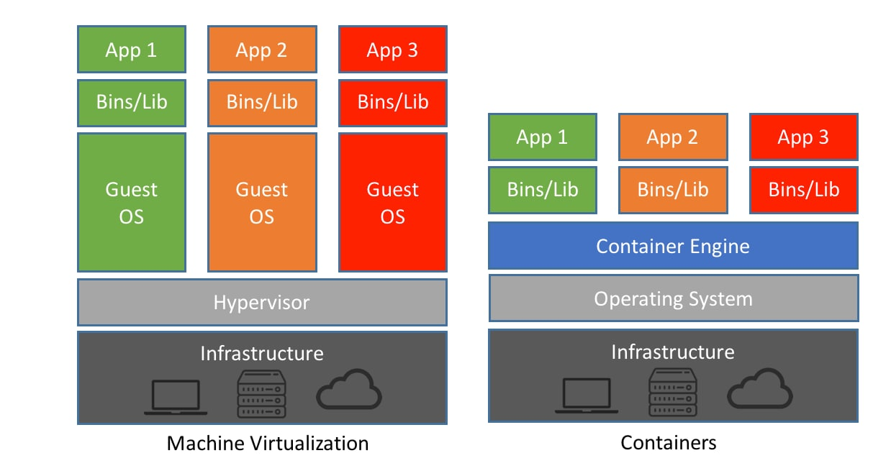
Virtualization vs Containerization

Slide 11
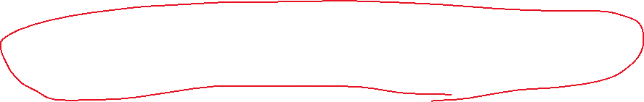
Bundles the application code with the related configuration files, libraries and dependencies required for it to run. This single software package or “container” is abstracted away from the host operating system. Hence, it stands alone and becomes portable—able to run across any platform or cloud, free of issues.

Slide 12
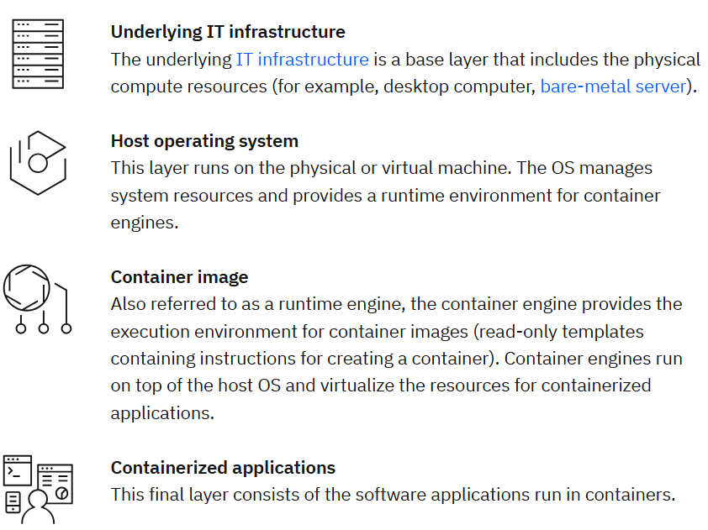

Components

Slide 13



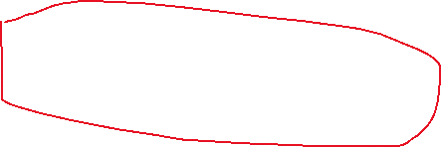
Benefits
Portability
Agility
Speed
Fault tolerance
Efficiency
Security
Ease of management
orchestration

Slide 14
Docker
Container
A loosely isolated environment that allows us to build and run software packages (IMAGE). These software packages include the code and all dependencies to run applications quickly and reliably on any computing environment.
DOCKER
Containerization platform used to develop, ship, and run containers.
Many clouds, including Azure, support Docker.

Slide 15
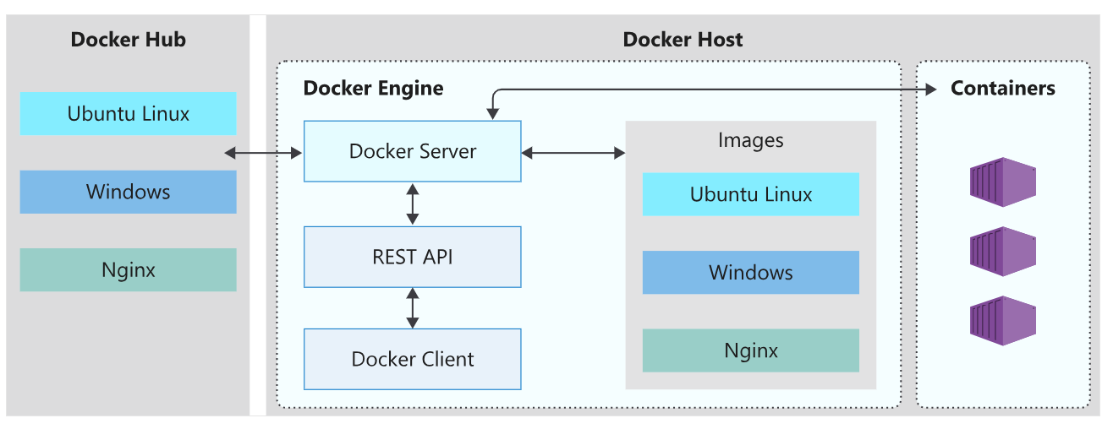
ARCHITECTURE

Slide 16

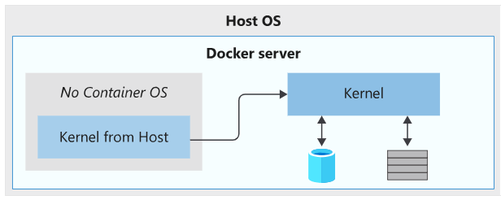
Host OS
The host OS is the OS on which the docker engine runs
Docker containers running on linux share the host os kernel
The container depends on the OS kernel to manage services such as the file system, network management, process scheduling, and memory management.

Slide 17
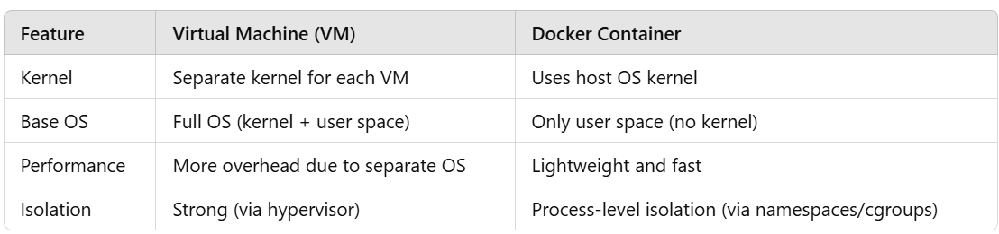
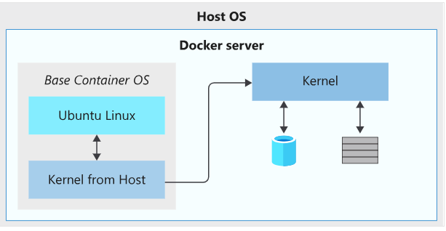
Container OS
OS that's part of the packaged image isolated form host OS
Flexibility to include different versions of linux or windows operating systems in a container.
Even though the base OS is "Ubuntu," it does not run its own kernel—only the user-space tools and libraries come from Ubuntu.

Slide 18
Dockerfile
A text file that contains the instructions we use to build and run a docker image. It defines the following aspects of the image:
The base or parent image we use to create the new image
Commands to update the base OS and install additional software
Build artifacts to include, such as a developed application
Services to expose, such as storage and network configuration
Command to run when the container is launched

Slide 19
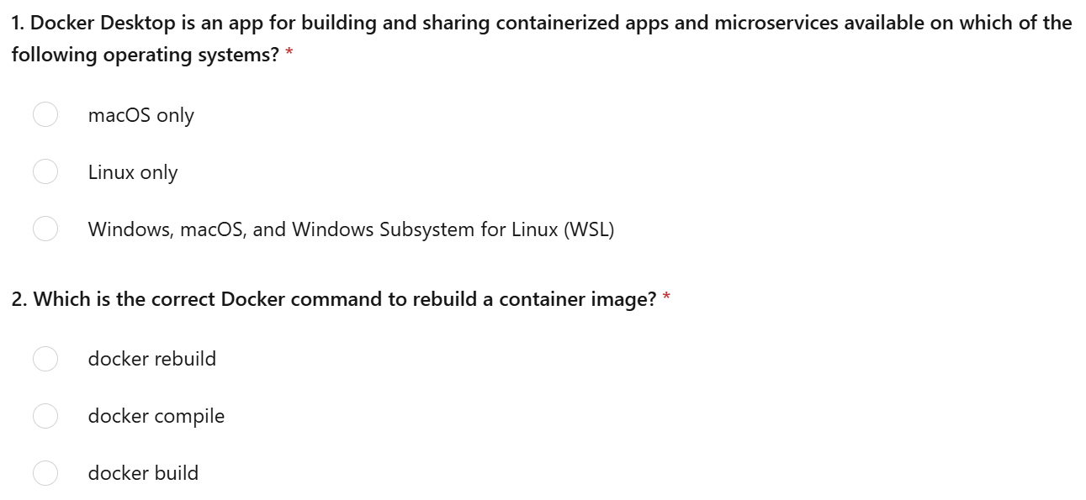
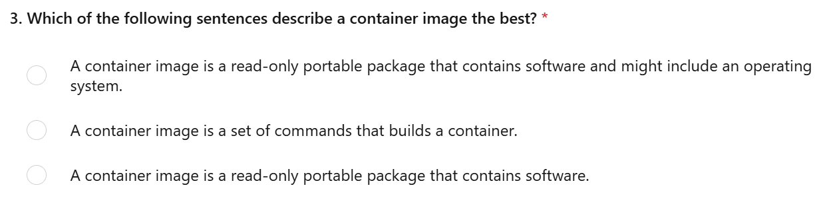
Test

Slide 20
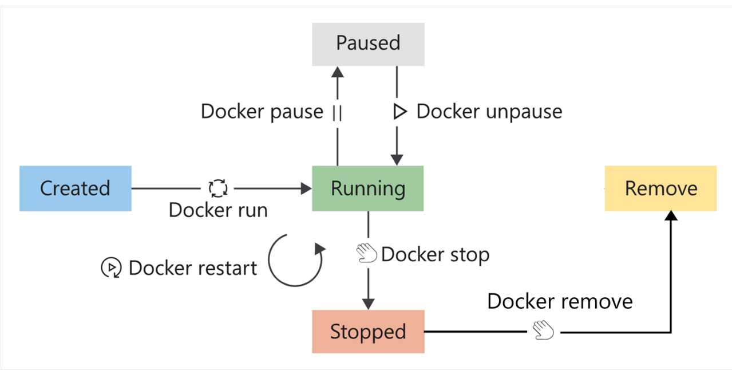
Container Lifecycle
docker run -d test
docker pause test
docker restart test
docker stop test
docker rm test
docker ps -a

Slide 21
Volumes
Container storage is temporary.
Container storage is coupled to the underlying host machine.
Containers implement a storage driver to allow your apps to write data. This driver introduces an extra abstraction to communicate with the host OS kernel
Docker mounts and manages the volumes in the container. After mounting, these volumes are isolated from the host machine.
Multiple containers can simultaneously use the same volumes. Volumes also don't get removed automatically when a container stops using the volume.

Slide 22
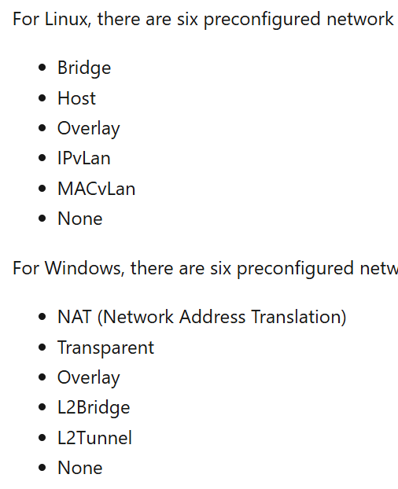
Network
Docker networking enables containers to communicate with each other, the host system, and external networks.

Slide 24
Practice
1. Run a Busybox container on your system
2. Try to print the environment variables present in a container
3. Try to run an nginx container in background mode
4. Try to pause both busybox and nginx containers/
5. Delete both the containers
6. Delete both the containers using single command
7. Delete the images from your machine
8. Pull an run ubuntu 22.04 image locally
9. Copy a configuration file from your local file system to the running container
10. Check logs of a running contianer

Slide 25
Practice
Clone the git repository locally and try running Node App container
https://github.com/reachabhi2412/azdevops/blob/main/README.md

