Slide 1



Mastering T-SQL: Window Functions
Steve Jones
SQLServerCentral
Red Gate Software

Slide 2
Agenda
Who Am I?
Prerequisites
What are Window functions?
Ranking Functions
Windowing with the OVER clause
Framing data
Looking back and peeking forward

Slide 3
Goals
Understand partitioning and framing of data
Learn how to control the size of the window
Rank, total, calculate values in windows

Slide 4





Get in touch
Editor and founder, SQLServerCentral
Evangelist, Red Gate Software
Working with SQL Server since 1991 (v4.2)
Author and speaker on many SQL Server topics
Steve Jones
http://voiceofthedba.wordpress.com/
sjones@sqlservercentral.com
@way0utwest
http://www.linkedin.com/in/way0utwest

Slide 5
Agenda
Who Am I?
Prerequisites
What are Window functions?
Ranking Functions
Windowing with the OVER clause
Framing data
Looking back and peeking forward

Slide 6
Pre-requisites
Familiar with connecting to SQL Server with SSMS and executing queries
Able to write SELECT, INSERT, UPDATE, DELETE queries
Understand how to join tables together and how the ON clause works.
Understand how WHERE clauses filter data from tables.
Understand ordering of data in queries
Can write simple aggregate queries that include a GROUP BY clause

Slide 7
Agenda
Who Am I?
Prerequisites
What are Window functions?
Ranking Functions
Windowing with the OVER clause
Framing data
Looking back and peeking forward

Slide 8
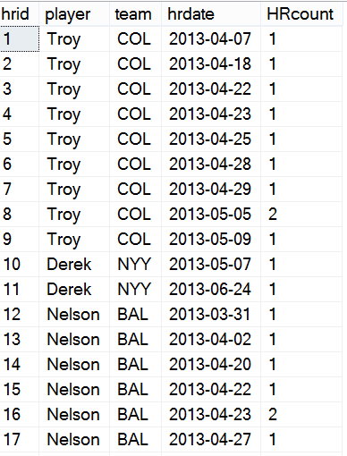
Window Functions

Slide 9
Window Functions

Slide 10
Window Functions

Slide 11
Window Functions

Slide 12
Window Functions

Slide 13
Window Functions

Slide 14
Window Functions
Row 1

Slide 15
Window Functions
Row 1
Row 1-2

Slide 16
Window Functions
Row 1
Row 1-2
Row 2-3

Slide 17
Window Functions
Row 1
Row 1-2
Row 2-3
Row 3-4

Slide 18
Window Functions
Rows 1, 2,3

Slide 19
Window Functions
Rows 1, 2,3
Rows 2, 3, 4

Slide 20
2005 Window Functions
Ranking Functions
ROW_NUMBER
RANK/DENSE_RANK/NTILE

Slide 21
Demo
ROW_NUMBER and RANK

Slide 22
SQL Server 2012
Additional Window Functions
Aggregates and OVER()
Framing (ROWS/RANGE)
LAG/LEAD
FIRST_VALUE/LAST_VALUE
PERCENT_RANK() and CUME_DIST()

Slide 23
First Value/Last Value
Find the beginning or end of a frame

Slide 24
LAG/LEAD
Look back (LAG) or peek forward (LEAD)
Parameters for offset and default
LAG 1
Current row
LEAD 2

Slide 25
Demo
Window Functions

Slide 26
Performance
Indexing (POC)
Partition By
Order By
Covering

Slide 27
The End
Thanks for coming
Questions?
More information
www.sqlmag.com
www.sqlservercentral.com
voiceofthedba.wordpress.com/
@way0utwest
sjones@sqlservercentral.com
http://www.linkedin.com/in/way0utwest

Slide 28
References
Articles
The Performance of the T-SQL Window Functions - https://www.simple-talk.com/sql/t-sql-programming/the-performance-of-the-t-sql-window-functions/
Window Functions in SQL - https://www.simple-talk.com/sql/t-sql-programming/window-functions-in-sql/
SQL Server 2012 Window Function Basics - https://www.simple-talk.com/sql/t-sql-programming/sql-server-2012-window-function-basics/
Working with Window Functions in SQL Server - https://www.simple-talk.com/sql/learn-sql-server/working-with-window-functions-in-sql-server/
Videos
T-SQL Power! SQL Server Windows That Open Doors - https://www.youtube.com/watch?v=YK-ufNpMeLU
Building Your T-SQL Toolkit: Window function Fundamentals - http://www.sqlbits.com/Sessions/Event12/Building_Your_T-SQL_Tool_Kit_Window_Function_Fundamentals
Using Window Functions to Solve Common T-SQL Challenges - http://channel9.msdn.com/Events/TechEd/NewZealand/TechEd-New-Zealand-2012/DBI309

Slide 29
Outline
Introduce Windows and Framing
Show examples of different windows
Introduce partitioning
Simple Examples
Old running total – get sum by games
New running total, just ORDER BY
Talk about performance, ref Adam’s video
Introduce partitions
Look at a simple partition, by team
Sum HRs
Multiple frames
Partition by teams and players, separate running totals
Range v rows
Default range
Show issues with range
Then change to rows, show preceding week,
Then show preceding and following week.
Compare exec plans, range v rows. Show rows matters
First/last values and rownumber
Show top n per group problems.
Watch out for default with first/last
43:42

