Slide 1


Intermediate T-SQL Window Functions DevConnections 2015
Steve Jones
SQLServerCentral
Red Gate Software

Slide 2
Agenda
Who Am I?
What are Window functions?
Ranking Functions
Analytic Functions
Framing data
Looking back and peeking forward
Notes:
This presentation explains the windowing functions that are available in SQL Server. Some of these functions were introduced in SQL Server 2005 and some in SQL Server 2012. We’ll start with a brief introduction of a window and how a partition works, and then we’ll look at ordering and framing of rows. Next, we’ll cover the various aggregates and framing options that are available with all the window functions.

Slide 3
Goals
Understand partitioning and framing of data
Learn how to control the size of the window
Rank, total, calculate values in windows

Slide 4


Steve Jones
www.voiceofthedba.com
sjones@sqlservercentral.com
@way0utwest
/in/way0utwest
Editor and founder, SQLServerCentral
Evangelist, Red Gate Software
Working with SQL Server since 1991 (v4.2)

Slide 5
Agenda
Who Am I?
What are Window functions?
Ranking Functions
Analytic Functions
Framing data
Looking back and peeking forward

Slide 6
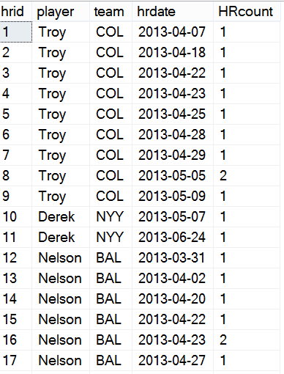
Window Functions

Slide 7
Window Functions

Slide 8
Window Functions

Slide 9
Window Functions

Slide 10
Window Functions

Slide 11
Window Functions

Slide 12
Window Functions
Row 1

Slide 13
Window Functions
Row 1
Row 1-2

Slide 14
Window Functions
Row 1
Row 1-2
Row 2-3

Slide 15
Window Functions
Row 1
Row 1-2
Row 2-3
Row 3-4

Slide 16
Window Functions
Rows 1, 2,3

Slide 17
Window Functions
Rows 1, 2,3
Rows 2, 3, 4

Slide 18
Agenda
Who Am I?
What are Window functions?
Ranking Functions
Analytic Functions
Framing data
Looking back and peeking forward

Slide 19
Window Functions
Ranking Functions
ROW_NUMBER – Sequencing
RANK/DENSE_RANK/NTILE – Ordering for ranks
SQL Server 2005 +

Slide 20
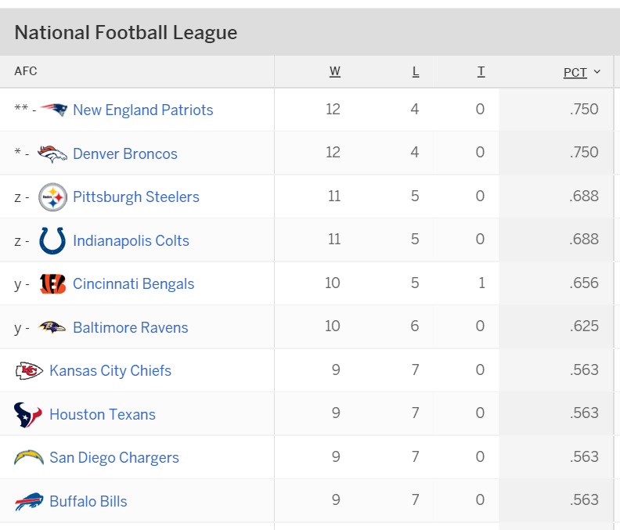
Ranking Functions

Slide 21
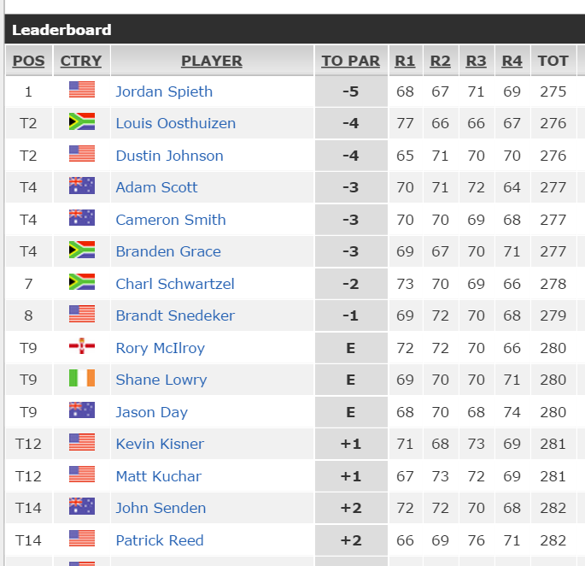
Ranking Functions

Slide 22
Demo
ROW_NUMBER and RANK

Slide 23
Agenda
Who Am I?
What are Window functions?
Ranking Functions
Analytic Functions
Framing data
Looking back and peeking forward

Slide 24
Analytic Functions
SQL Server 2012+
The OVER() clause expanded to Analytic Functions and NEXT VALUE FOR

Slide 25
Demo
More complex Window calculations

Slide 26
Agenda
Who Am I?
What are Window functions?
Ranking Functions
Analytic Functions
Framing data
Looking back and peeking forward

Slide 27
Framing Data
RANGE and ROWS for specifying the window
Default – RANGE UNBOUNDED PRECEEDING AND CURRENT ROW
The partition and ordering matter here
Performance is better with ROWS

Slide 28
Framing Data
First Value/Last Value
Find the beginning or end of a frame

Slide 29
Demo
Framing Demos

Slide 30
Agenda
Who Am I?
What are Window functions?
Ranking Functions
Analytic Functions
Framing data
Looking back and peeking forward

Slide 31
LAG/LEAD
Look back (LAG) or peek forward (LEAD)
Parameters for offset and default
LAG 1
Current row
LEAD 2

Slide 32
Demo
LAG/LEAD

Slide 33
Performance
Indexing (POC)
Partition By
Order By
Covering

Slide 34
Rate This Session Now!
Rate with Mobile App:
Tell Us What You Thought of This Session
Select the session from the Agenda or Speakers menus
Select the Actions tab
Click Rate Session
Be Entered to
WIN
Prizes!
Rate with Website:
Register at www.devconnections.com/logintoratesession
Go to www.devconnections.com/ratesession
Select this session from the list and rate it
#ITDEVCON

Slide 35
The End
Thanks for coming
Please fill out evaluations
Questions?
www.sqlservercentral.com/Forums
www.sqlservercentral.com/Window Functions
www.voiceofthedba.com
@way0utwest
sjones@sqlservercentral.com
/in/way0utwest

Slide 36
References
Articles
The Performance of the T-SQL Window Functions - https://www.simple-talk.com/sql/t-sql-programming/the-performance-of-the-t-sql-window-functions/
Window Functions in SQL - https://www.simple-talk.com/sql/t-sql-programming/window-functions-in-sql/
SQL Server 2012 Window Function Basics - https://www.simple-talk.com/sql/t-sql-programming/sql-server-2012-window-function-basics/
Working with Window Functions in SQL Server - https://www.simple-talk.com/sql/learn-sql-server/working-with-window-functions-in-sql-server/
Videos
T-SQL Power! SQL Server Windows That Open Doors - https://www.youtube.com/watch?v=YK-ufNpMeLU
Building Your T-SQL Toolkit: Window function Fundamentals - http://www.sqlbits.com/Sessions/Event12/Building_Your_T-SQL_Tool_Kit_Window_Function_Fundamentals
Using Window Functions to Solve Common T-SQL Challenges - http://channel9.msdn.com/Events/TechEd/NewZealand/TechEd-New-Zealand-2012/DBI309

Slide 37
Outline
Introduce Windows and Framing
Show examples of different windows
Introduce partitioning
Simple Examples
Old running total – get sum by games
New running total, just ORDER BY
Talk about performance, ref Adam’s video
Introduce partitions
Look at a simple partition, by team
Sum HRs
Multiple frames
Partition by teams and players, separate running totals
Range v rows
Default range
Show issues with range
Then change to rows, show preceding week,
Then show preceding and following week.
Compare exec plans, range v rows. Show rows matters
First/last values and rownumber
Show top n per group problems.
Watch out for default with first/last
43:42

