Slide 1


Intermediate T-SQL Window Functions DevConnections 2015
Steve Jones
SQLServerCentral
Red Gate Software

Slide 2
Agenda
Who Am I?
What are Window functions?
Ranking Functions
Windowing with the OVER clause
Framing data
Looking back and peeking forward

Slide 3
Goals
Understand partitioning and framing of data
Learn how to control the size of the window
Rank, total, calculate values in windows

Slide 4


Get in Touch
Steve Jones
www.voiceofthedba.com
sjones@sqlservercentral.com
@way0utwest
/in/way0utwest
Editor and founder, SQLServerCentral
Evangelist, Red Gate Software
Working with SQL Server since 1991 (v4.2)
Author and speaker on many SQL Server topics

Slide 5
Agenda
Who Am I?
Prerequisites
What are Window functions?
Ranking Functions
Windowing with the OVER clause
Framing data
Looking back and peeking forward

Slide 6
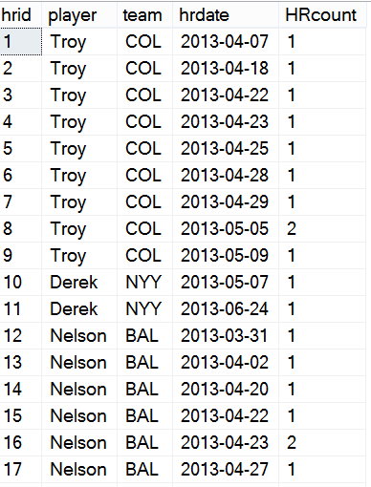
Window Functions

Slide 7
Window Functions

Slide 8
Window Functions

Slide 9
Window Functions

Slide 10
Window Functions

Slide 11
Window Functions

Slide 12
Window Functions
Row 1

Slide 13
Window Functions
Row 1
Row 1-2

Slide 14
Window Functions
Row 1
Row 1-2
Row 2-3

Slide 15
Window Functions
Row 1
Row 1-2
Row 2-3
Row 3-4

Slide 16
Window Functions
Rows 1, 2,3

Slide 17
Window Functions
Rows 1, 2,3
Rows 2, 3, 4

Slide 18
Agenda
Who Am I?
Prerequisites
What are Window functions?
Ranking Functions
Windowing with the OVER clause
Framing data
Looking back and peeking forward

Slide 19
Window Functions
Ranking Functions
ROW_NUMBER – Sequencing
RANK/DENSE_RANK/NTILE – Ordering for ranks
SQL Server 2005 +

Slide 20
Demo
ROW_NUMBER and RANK

Slide 21
Agenda
Who Am I?
Prerequisites
What are Window functions?
Ranking Functions
Windowing with the OVER clause
Framing data
Looking back and peeking forward

Slide 22
The OVER() Clause
SQL Server 2012+
The OVER() clause creates a window
The PARTITION BY defines the window
Aggregates take place inside the OVER() Partition

Slide 23
Demo
The Basic OVER() clause

Slide 24
Agenda
Who Am I?
Prerequisites
What are Window functions?
Ranking Functions
Windowing with the OVER clause
Framing data
Looking back and peeking forward

Slide 25
Framing Data
RANGE and ROWS for specifying the window
First Value/Last Value
Find the beginning or end of a frame
The partition and ordering matter here

Slide 26
Demo
Framing Demos

Slide 27
Agenda
Who Am I?
Prerequisites
What are Window functions?
Ranking Functions
Windowing with the OVER clause
Framing data
Looking back and peeking forward

Slide 28
LAG/LEAD
Look back (LAG) or peek forward (LEAD)
Parameters for offset and default
LAG 1
Current row
LEAD 2

Slide 29
Demo
LAG/LEAD

Slide 30
Performance
Indexing (POC)
Partition By
Order By
Covering

Slide 31
The End
Thanks for coming
Please fill out evaluations
Questions?
More information
www.sqlservercentral.com/Forums
www.sqlservercentral.com/Window Functions
www.voiceofthedba.com
@way0utwest
sjones@sqlservercentral.com
/in/way0utwest

Slide 32
References
Articles
The Performance of the T-SQL Window Functions - https://www.simple-talk.com/sql/t-sql-programming/the-performance-of-the-t-sql-window-functions/
Window Functions in SQL - https://www.simple-talk.com/sql/t-sql-programming/window-functions-in-sql/
SQL Server 2012 Window Function Basics - https://www.simple-talk.com/sql/t-sql-programming/sql-server-2012-window-function-basics/
Working with Window Functions in SQL Server - https://www.simple-talk.com/sql/learn-sql-server/working-with-window-functions-in-sql-server/
Videos
T-SQL Power! SQL Server Windows That Open Doors - https://www.youtube.com/watch?v=YK-ufNpMeLU
Building Your T-SQL Toolkit: Window function Fundamentals - http://www.sqlbits.com/Sessions/Event12/Building_Your_T-SQL_Tool_Kit_Window_Function_Fundamentals
Using Window Functions to Solve Common T-SQL Challenges - http://channel9.msdn.com/Events/TechEd/NewZealand/TechEd-New-Zealand-2012/DBI309

Slide 33
Outline
Introduce Windows and Framing
Show examples of different windows
Introduce partitioning
Simple Examples
Old running total – get sum by games
New running total, just ORDER BY
Talk about performance, ref Adam’s video
Introduce partitions
Look at a simple partition, by team
Sum HRs
Multiple frames
Partition by teams and players, separate running totals
Range v rows
Default range
Show issues with range
Then change to rows, show preceding week,
Then show preceding and following week.
Compare exec plans, range v rows. Show rows matters
First/last values and rownumber
Show top n per group problems.
Watch out for default with first/last
43:42

