Slide 1
Inheritance
ThanhNT

Slide 2

Introduction to inheritance
Inheritance in real life
We meet inheritance everywhere in real life. For example, the child inherited all the properties of his farther
Base class
Derived class
Inheritance

Slide 3
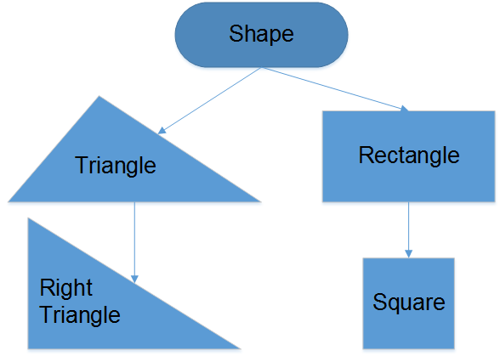
Introduction to inheritance
Inheritance in C++
Inheritance is capability of one class to acquire the attributes and behaviors from other classes.
Base class
Derived & Base class
Derived class

Slide 4
Introduction to inheritance
Why the need for inheritance in C++?
The existing code often does not do EXACTLY what we want, how do we reuse the code?
Change the existing code
  Cannot use the existing code for it’s original purpose.
Copy then change by search/replace
  Omitted or misplaced
  Inadvertently replace some thing you didn’t mean.
  Duplicate
Inheritance
  Reuse directly the existing code
  Add new features
  Redefine existing features
  Hide existing features

Slide 5
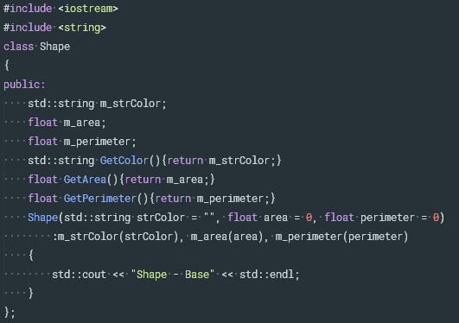
Basic inheritance in C++
Simple Base class
This base class hold information about shape(color, area, perimeter) that are common to all shapes

Slide 6
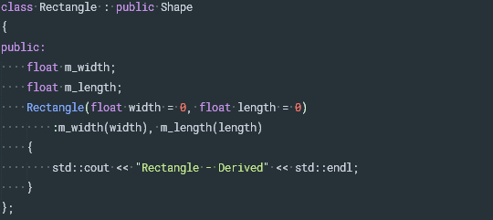
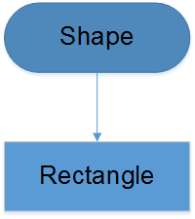
Basic inheritance in C++
Simple Derived class
Rectangle inherits from Shape, It automatically receives the function and variable from Shape. Thus Rectangle will have 5 member variables(m_width, m_length from Rectangle, and m_strColor, m_area, and m_perimeter from Shape)

Slide 7
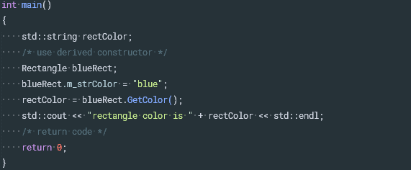

Basic inheritance in C++
Instantiate a derived class
Which prints the result
The base class is constructed first, then derived class is constructed

Slide 8

Constructor and initialization of derived classes
Constructor of derived classes
With non-derived class, constructors only have worry about their own members.
Memory for cShape is set aside
The appropriate Base constructor is called
The initialization list initializes variables
The body of the constructor executes
Control is returned to the caller

Slide 9

Constructor and initialization of derived classes
Constructor of derived classes
With derived classes, things are slightly more complex
Memory for blueRect is set aside (enough for both the Base and Derived portions).
The appropriate Derived constructor is called
The Base object is constructed first using the appropriate Base constructor
The initialization list initializes variables
The body of the constructor executes
Control is returned to the caller

Slide 10
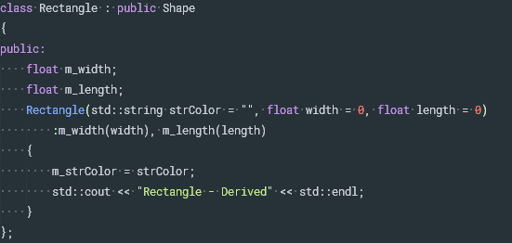
Constructor and initialization of derived classes
Initializing base class members
With current Rectangle derived class as written is that there is no way to initialize base class members when we create a derived class.
C++ allows inherited variables can still have their value changed in the body of constructor using an assignment.

Slide 11
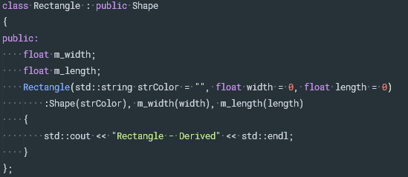
Constructor and initialization of derived classes
Initializing base class members
But the problem still persist if m_strColor is const or reference variable that requires initializing in the initialization list of the constructor.
C++ gives us the ability to explicitly choose which Base class constructor will be called.

Slide 12
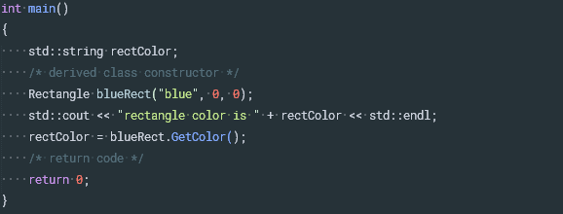
Constructor and initialization of derived classes
Initializing base class members
Now execute this code
Which prints the result

Slide 13
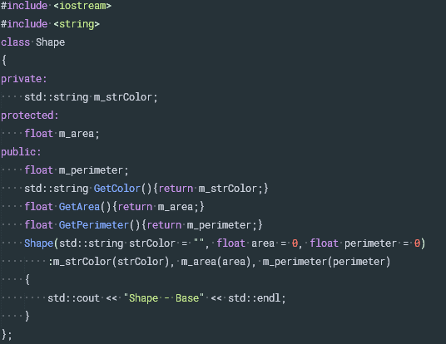
Inheritance and access specifier
In Shape class example, we mark all members(m_strColor, m_area, m_perimeter) are public. Now let’s do a little change.

Slide 14
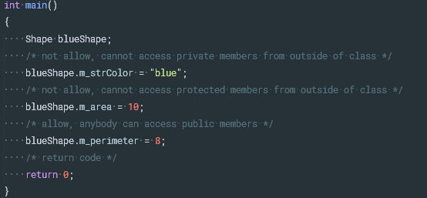
Inheritance and access specifier
Now instantiate a base instance with the change
From outside of class, user can only access public members.
How about derived class?

Slide 15
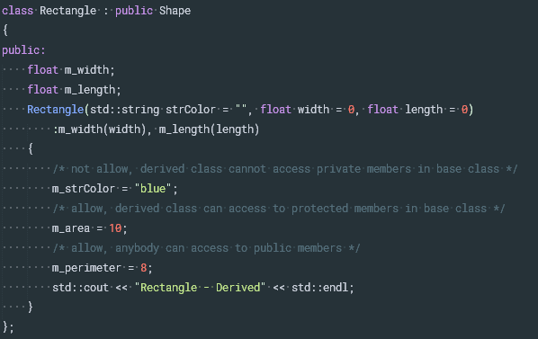
Inheritance and access specifier
Public inheritance
Derived class can access to public and protected members in base class.

Slide 16

Inheritance and access specifier
Public inheritance
Instantiate an instance of derived class
To summarize in table form:

Slide 17

Inheritance and access specifier
Private inheritance
Derived class can access to public and protected members in base class.

Slide 18
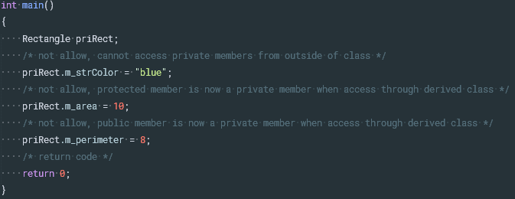

Inheritance and access specifier
Private inheritance
Instantiate an instance of derived class
To summarize in table form:

Slide 19

Inheritance and access specifier
Protected inheritance

Slide 20
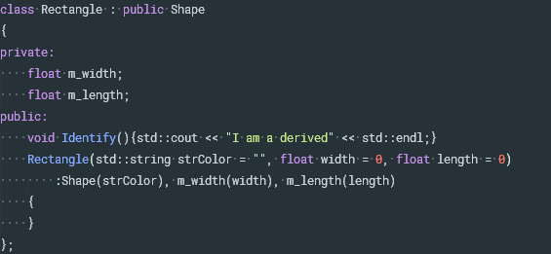
Adding, changing and hiding members in a derived class
Adding new functionality
To add new functionality to a derived class, simply declare that functionality in the derived class

Slide 21


Adding, changing and hiding members in a derived class
Adding new functionality
Now new public will be able to call Identify() to identify the class.
This produces the result

Slide 22
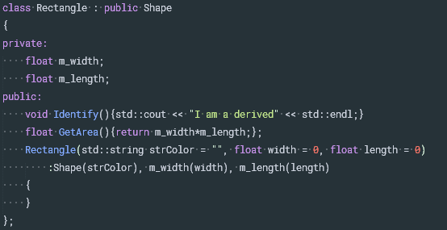
Adding, changing and hiding members in a derived class
Redefining functionality
Shape class defines GetArea() function, and we can redefine it in the derived class.

Slide 23


Adding, changing and hiding members in a derived class
Redefining functionality
Now use new functionality to calculate area of the rectangle
This produces the result

Slide 24
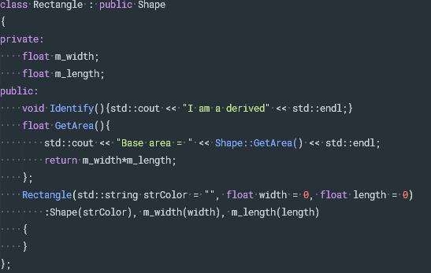
Adding, changing and hiding members in a derived class
Adding to existing functionality
C++ allows our Derived function to call the Base function of the same name.

Slide 25
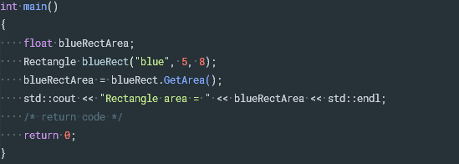

Adding, changing and hiding members in a derived class
Adding to existing functionality
Now consider the following example
This produces the result

Slide 26
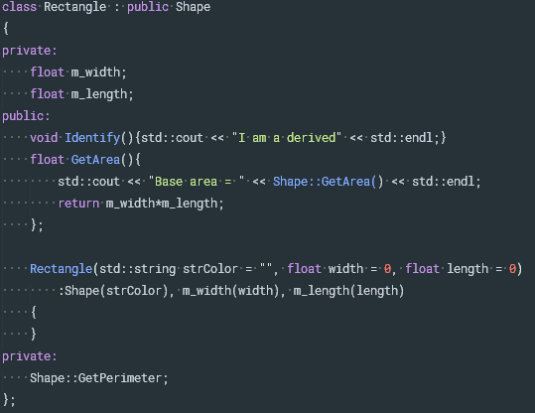
Adding, changing and hiding members in a derived class
Hiding functionality
In C++, it is possible to hide existing functionality from a class.
Notes:
Shape::GetPerimeter does not have function call operator () attached to it.

Slide 27
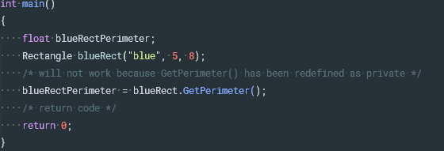
Adding, changing and hiding members in a derived class
Hiding functionality
Now try to call GetPerimeter() from public.
Of course, we can hide member variables by the same way.

Slide 28
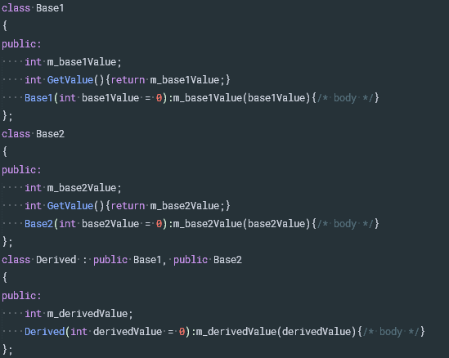
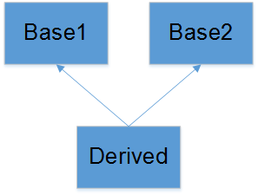
Multiple inheritance
C++ provides the ability to do multiple inheritance mean a Derived class can inherit members from more than one Base class

Slide 29
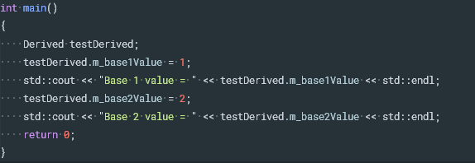

Multiple inheritance
Now instantiate a derived instance
Which prints the result

Slide 30

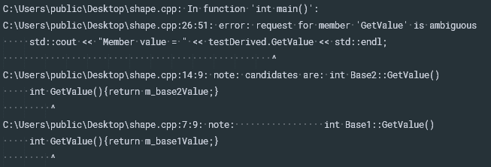
Multiple inheritance
Problems with multiple inheritance
Notice that both Base1 and Base2 classes have the same function GetValue() so which function will be called in below example?
The compiler will report error

Slide 31
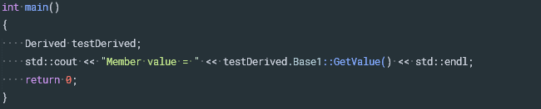

Multiple inheritance
Problems with multiple inheritance
However, we can explicitly specify which base class we meant to call to resolve above problem.
Which will print the result

Slide 32
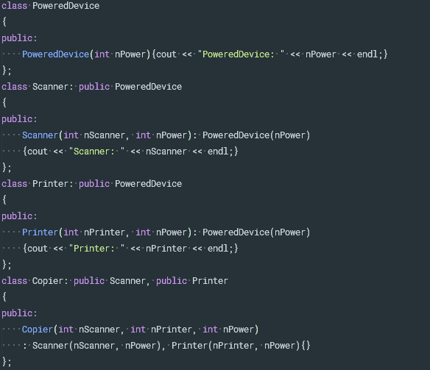
Virtual base classes
Virtual base classes example

Slide 33

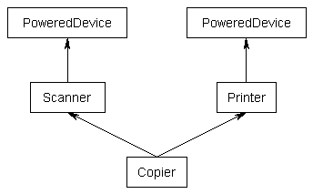

Virtual base classes
Now if you create a Copier class object, by default you would end up with two copies of the PoweredDevice class -- one from Printer, and one from Scanner
Which produces the result
PoweredDevice got constructed twice

Slide 34
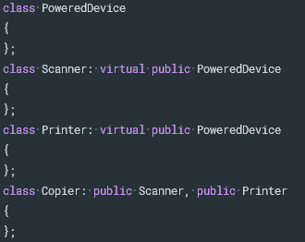
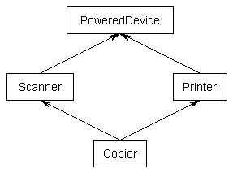
Virtual base classes
Sometime, we may want only one PoweredDevice to be shared by both Scanner and Printer and we create a virtual base class.
But who (Scanner or Printer) is responsibility for creating PowerdDevice base class? The answer is Copier.

Slide 35
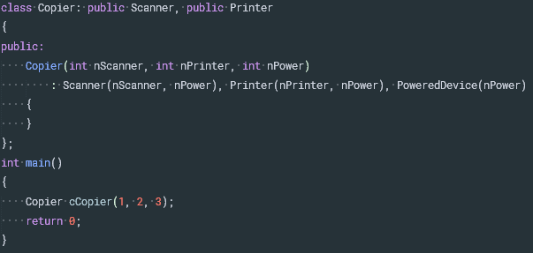

Virtual base classes
Which prints the result
Now PoweredDevice only gets constructed once

Slide 36
Virtual base classes
Virtual base classes are created before non-virtual base classes.
Note that the Scanner and Printer constructors still have calls to the PoweredDevice constructor. If we are creating an instance of Copier, these constructor calls are simply ignored.
If we were to create an instance of Scanner or Printer, the virtual keyword is ignored, and normal inheritance rules apply.
If a class inherits one or more classes that have virtual parents, the most derived class is responsible for constructing the virtual base class.

Slide 37

Thanks for your attention!

