Slide 1
Introduction to Polymorphism
ThanhNT

Slide 2
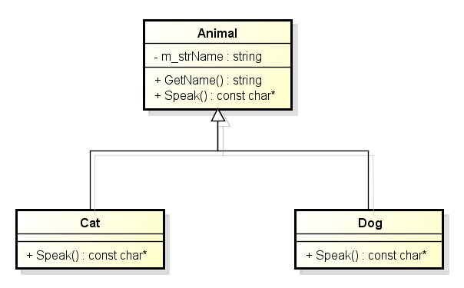
Introduction to Polymorphism
Consider an example of derived class.
Notes:
It is the result of assembling a certain number of architectural elements in some well-chosen forms to satisfy requirements of functionality, performance, reliability, scalability, portability, and availability.

Slide 3
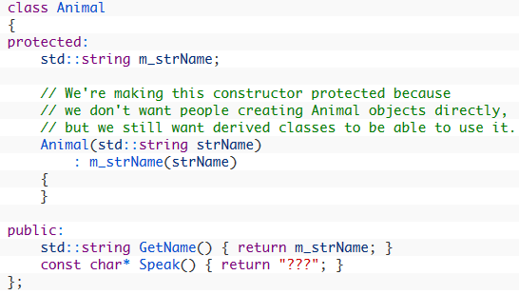
Introduction to Polymorphism
- Animal class definition.

Slide 4
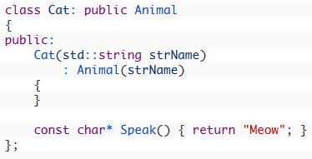
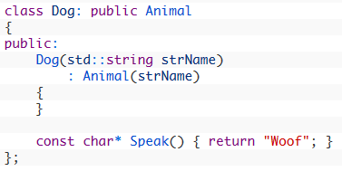
Introduction to Polymorphism
- Cat class definition:
- Dog class definition:

Slide 5
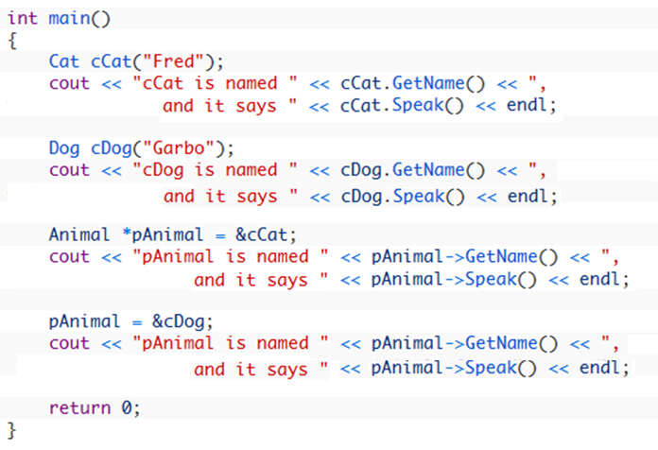
Introduction to Polymorphism
- Main function of using these classes.

Slide 6
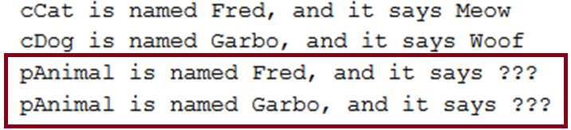
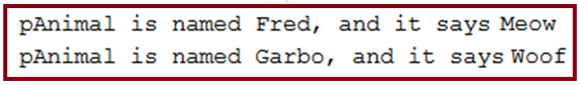
Introduction to Polymorphism
- Result:
- Expected:
- Issue: Because pAnimal is an Animal pointer, it can only see the Animal class. Consequently, pAnimal->Speak() calls Animal::Speak() rather than the Dog::Speak() or Cat::Speak() function.
Notes:
Why would I set a pointer or reference to the base class of a derived object when I can just use the derived object?

Slide 7
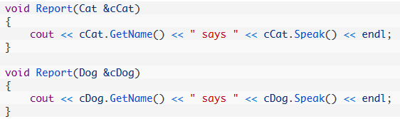
Introduction to Polymorphism
- Solution:
- Disadvantage: If we have 30 different animal types instead of 2, you’ll have to write 30 almost identical functions.
Notes:
First, let’s say you wanted to write a function that printed an animal’s name and sound without using a pointer to a base class.

Slide 8

Introduction to Polymorphism
- Because Cat and Dog are derived from Animal, it makes sense that we should be able to do something like this:
- How we can do that while we have the issue of calling parent method instead of child method?
Notes:
First, let’s say you wanted to write a function that printed an animal’s name and sound without using a pointer to a base class.

Slide 9
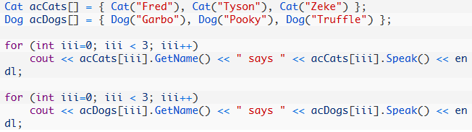
Introduction to Polymorphism
- If we have many cats and dogs:
- Disadvantage: If we have 30 different animal types instead of 2, you’ll need 30 arrays.

Slide 10
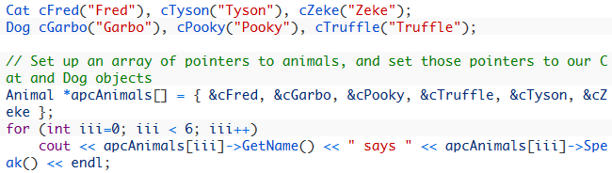
Introduction to Polymorphism
- Because both Cat and Dog are Animal, it makes sense that we should be able to do something like this:
- How we can do that while we have the issue of calling parent method instead of child method?

Slide 11
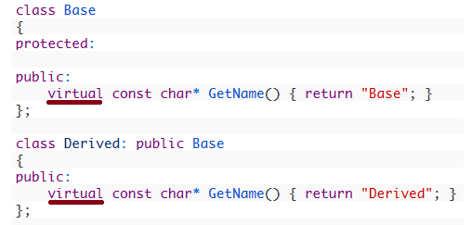
Virtual function
A virtual function is a special type of function that resolves to the most-derived version of the function with the same signature. This capability is known as polymorphism.
To make a function virtual, simply place the “virtual” keyword before the function declaration.

Slide 12
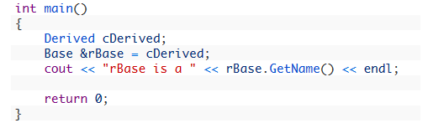
Virtual function
Usage:
Result:

Slide 13
Virtual function
Usage:
Result:
Notes:
- Because rBase is a pointer to the Base portion of a Derived object, when rBase.GetName() is evaluated, it would normally resolve to Base::GetName().
- However, Base::GetName() is virtual, which tells the program to go look and see if there are any more-derived versions of the function available.
- Because the Base object that rBase is pointing to is actually part of a Derived object, the program will check every inherited class between Base and Derived and use the most-derived version of the function that it finds. In this case, that is Derived::GetName()!

Slide 14
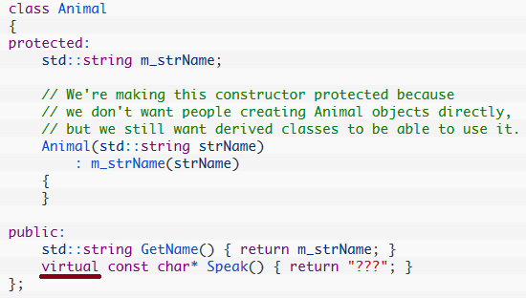
Introduction to Polymorphism
- Animal class definition with virtual function:

Slide 15
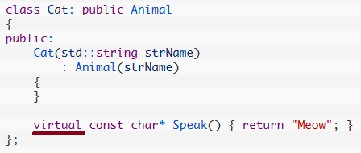
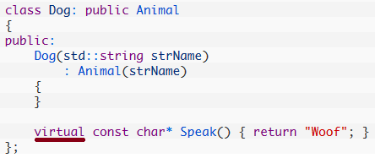
Introduction to Polymorphism
Cat class definition with virtual function:
- Dog class definition with virtual function:

Slide 16
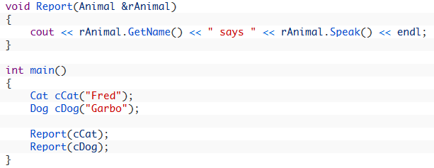

Introduction to Polymorphism
- Using these classes.
- Result:
- Advantage: If we have 30 different animal types instead of 2, you’ll need only one Report function.

Slide 17
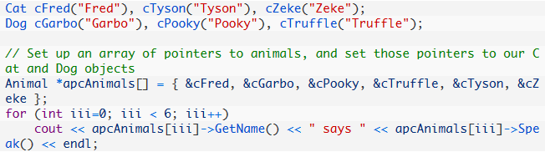
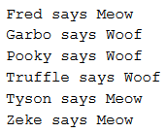
Introduction to Polymorphism
- If we have many cats and dogs:
- Result:
- Advantage: If we have 30 different animal types instead of 2, you’ll need only 1 array and 1 “for” loop.

Slide 18
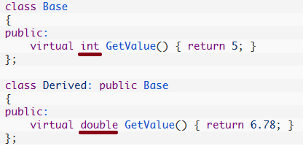
Return types of virtual functions
- The return type of a virtual function and its override must match. Thus the following will not work:

Slide 19
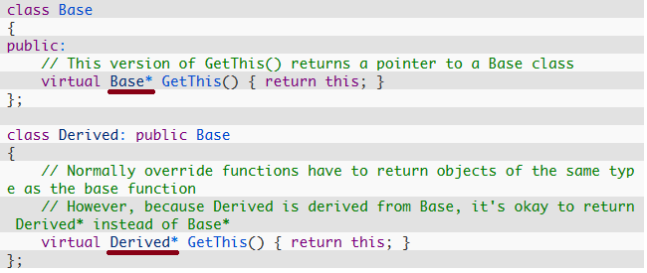
Return types of virtual functions
- Except a special case of pointer or a reference to a class:

Slide 20
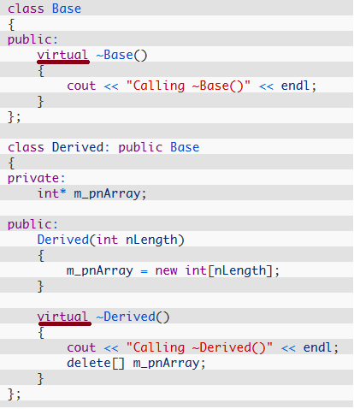
Virtual destructors
- Make Base’s destructor virtual:

Slide 21
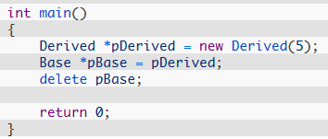

Virtual destructors
- Delete function to call Derived’s destructor (which will call Base’s destructor in turn):
- Result:

Slide 22
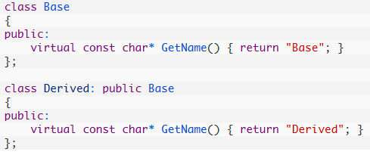
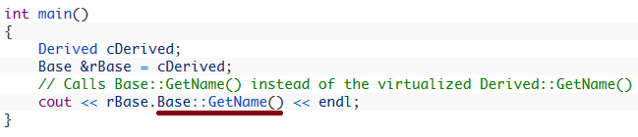
Overriding virtualization
- When you want a Base pointer to a Derived object to call Base::GetName() instead of Derived::GetName(), use the scope resolution operator:

Slide 23
The downside of virtual functions
Why not just make all functions virtual?
The answer is because it’s inefficient:
Resolving a virtual function call takes longer than a resolving a regular one.
Furthermore, the compiler also has to allocate an extra pointer for each class object that has one or more virtual functions.

Slide 24
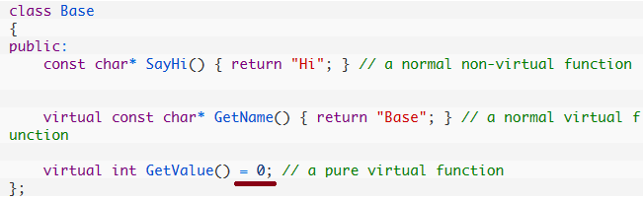
Pure virtual (abstract) functions
Pure virtual function (or abstract function) that has no body.
Simply acts as a placeholder that is meant to be redefined by derived classes.
To create a pure virtual function, rather than define a body for the function, we simply assign the function the value 0.
Notes:
When we add a pure virtual function to our class, we are effectively saying, “it is up to the derived classes to implement this function”.

Slide 25

Abstract base class
Any class with one or more pure virtual functions becomes an abstract base class, which means that it can not be instantiated.
What would happen if we could create an instance of Base:
Error when compiling.
- Any derived class must define a body for this function, or that derived class will be considered an abstract base class as well.

Slide 26
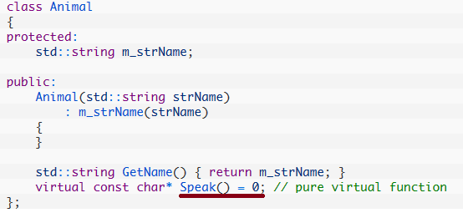
Abstract base class
Make Animal class abstract:
Speak() is now a pure virtual function. This means Animal is an abstract base class, and can not be instantiated.
We do not need to make the constructor protected any longer to prevent people from allocating objects of type Animal.

Slide 27
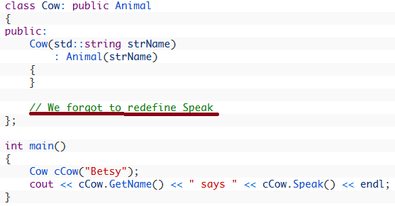
Abstract base class
What happen when Cow class is a derived class and we did not define Cow::Speak(), Cow is also an abstract base class:
The compiler will give us an error because Cow is an abstract base class and we can not create instances of abstract base classes.
This remind us don’t forget provides a body for Speak().

Slide 28
Abstract base class
A pure virtual function is useful when:
We have a function that we want to put in the base class, but only let derived classes know what it should return.
We want the base class can not be instantiated.
The derived classes are forced to define these function before they can be instantiated. This helps ensure the derived classes do not forget to redefine functions that the base class was expecting them to.

Slide 29
Interface classes
An interface class is a class that has no members variables and all of the functions are pure virtual.
In other words, the class is purely a definition, and has no actual implementation.
Interfaces are useful when you want to define the functionality that derived classes must implement, but leave the details of how the derived class implements that functionality entirely up to the derived class.

Slide 30
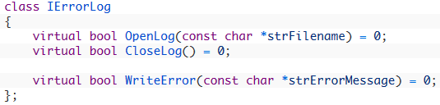
Interface classes
An example of an interface class:
Any class inheriting from IErrorLog must provide implementations for all three functions in order to be instantiated.
You could create derived classes named:
FileErrorLog, where OpenLog() opens a file on disk, CloseLog() closes it, and WriteError() writes the message to the file.
ScreenErrorLog, where OpenLog() and CloseLog() do nothing, and WriteError() prints the message in a pop-up message box on the screen.

Slide 31
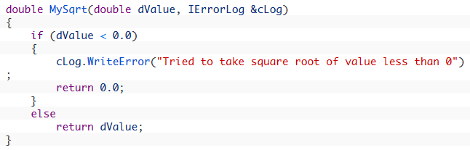
Interface classes
Now, let’s say you need to write some code that uses an error log:
You don’t need to work with FileErrorLog or ScreenErrorLog directly so that you won’t stuck using that kind of error log.
Now the caller can pass in any class that conforms to the IErrorLog interface: If they want the error to go to a file, they can pass in an instance of FileErrorLog. If they want it to go to the screen, they can pass in an instance of ScreenErrorLog.

Slide 32
Interface classes
Interface classes have become extremely popular because they are easy to use, easy to extend, and easy to maintain.
Use multiple interfaces rather than multiple inheritance.
Because interfaces have no data and no function bodies, they avoid a lot of the traditional problems with multiple inheritance while still providing much of the flexibility.

Slide 33

Thanks for your attention!

