Slide 1
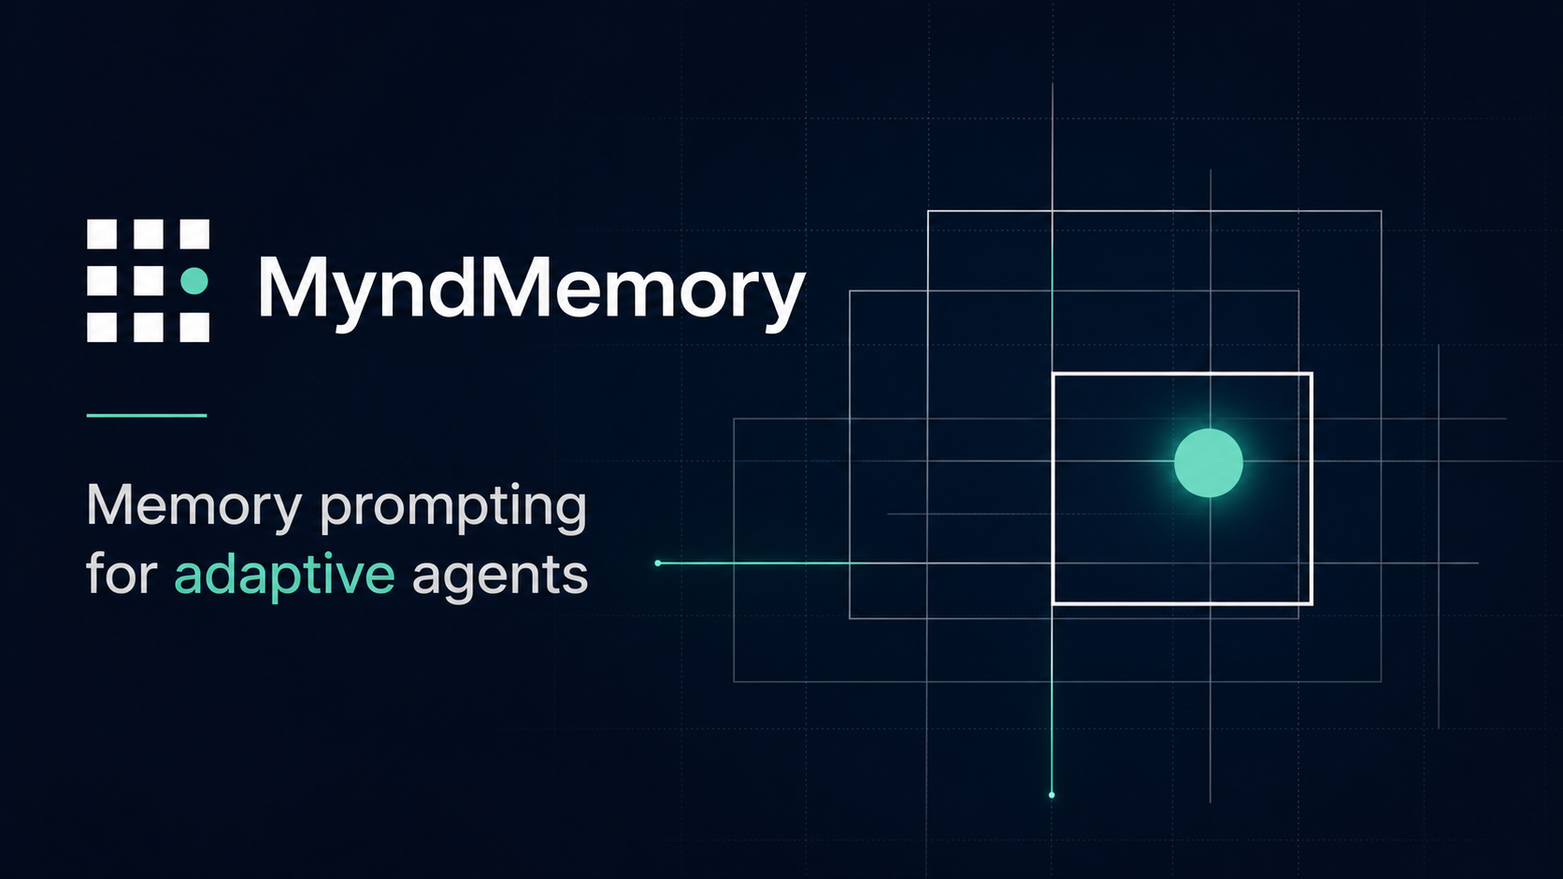
MyndMemory
MEMORY PROMPTING FRAMEWORK
Build agents that remember, learn, and evolve.
MyndMemory gives builders a framework and Studio console for configuring human-like memory on top of HydraDB.
Pitch deck • 2026

Slide 2
MyndMemory
THE PROBLEM
AI apps forget too much context.
Context is scattered
Important user state lives across events, documents, conversations, and app data.
Retrieval is not memory
Search can return facts, but it does not decide what should be learned, updated, or forgotten.
Builders lack a control plane
Teams need a way to inspect and tune how agents remember across real workflows.
Agents can chat, but most products still treat memory as logs, prompts, or fragile retrieval glue.
MyndMemory pitch deck
02

Slide 3
MyndMemory
THE PRODUCT
The framework layer for adaptive agent memory.
Application events
MyndMemory runtime
Agent response
It turns app events into scored, durable, inspectable memory prompts that agents can use in future reasoning.
Capture → score → persist → retrieve → assemble context
MyndMemory pitch deck
03

Slide 4
MyndMemory
ARCHITECTURE
HydraDB is the substrate. MyndMemory is the behavior.
Framework
HydraDB
Nebius Token Factory
Runtime policies, memory lifecycle, context assembly, and Studio controls.
Durable persistence, hybrid retrieval, metadata, and memory state history.
Inference, semantic scoring, summarization, and recall assistance.
The system separates durable storage from memory policy, lifecycle, scoring, and human-readable inspection.
MyndMemory pitch deck
04

Slide 5
MyndMemory
MEMORY STUDIO
A dedicated console for configuring agent memory.
Agent profile
Memory states
Policy tuning
Recall trace
Studio gives builders a visible interface for inspecting memory states, tuning policies, and reviewing why context was recalled.
MyndMemory pitch deck
05

Slide 6
MyndMemory
USE CASES
Personal copilots
For teams building agents into real workflows.
Remember goals, preferences, active projects, and past decisions.
Support and success agents
Carry account context across tickets, calls, and product events.
Developer agents
Retain project architecture, repo decisions, bugs, and review history.
Ops agents
MyndMemory fits wherever an AI system needs persistent context, evolving preferences, and transparent recall.
Track incidents, playbooks, ownership, and repeated operational patterns.
MyndMemory pitch deck
06

Slide 7
MyndMemory
WHY NOW
The next agent platform needs memory as a product surface.
Framework, not one-off glue
A reusable memory runtime instead of bespoke prompt and retrieval code per app.
Inspectable by design
Teams can see what the agent learned, why it recalled it, and how policies affected output.
Built for adaptive behavior
Memory can be strengthened, decayed, corrected, merged, or scoped across identities.
As agents move from chat windows into applications, memory becomes infrastructure, UX, governance, and differentiation.
MyndMemory pitch deck
07

Slide 8
MyndMemory
THE ASK
Help us turn agent memory into an interface builders can trust.
Next milestones: ship the Studio workflow, harden HydraDB adapters, publish the developer framework, and onboard pilot builders.
MyndMemory
Memory prompting for adaptive agents

