Slide 1
Computational Photography Assignment #1
Hieu Nguyen
Fall 2015

Slide 2
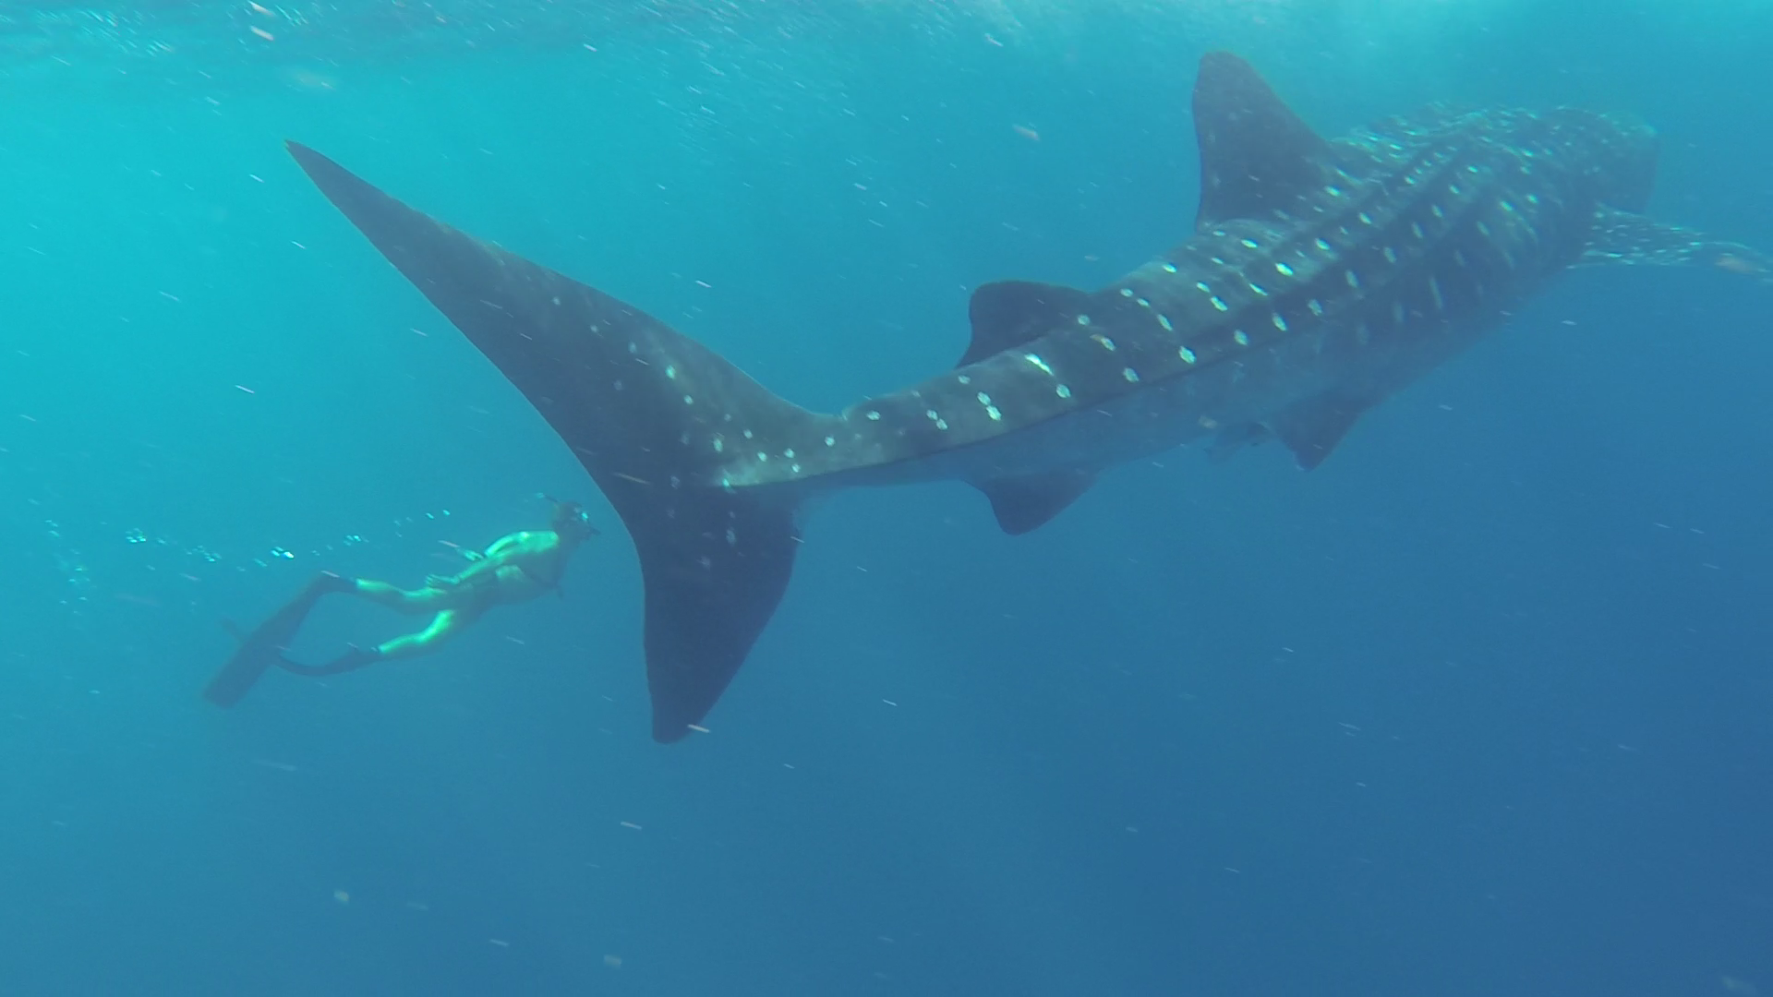
“Deep Pursuit”

Slide 3
Details of the Picture
A Caption:
“Deep Pursuit”
Location/Time/Context (i.e. what is it?):
Cancun, Mexico. August 7, 2015. ~10am.
Diving amongst whalesharks as they migrate through Isla Mujeres, off the coast of the Yucatan Peninsula.

Slide 4
What was the goal?
What were you trying to capture?
I wanted to capture the sheer magnitude of this “gentle giant.”
Did you succeed?
Yes. By including a fellow diver swimming in the frame for comparison, the viewer can infer the shark’s gargantuan size.
Did you do anything special?
No special effects. I just used a GoPro camera in its waterproof enclosure for taking the wide angle and FOV.

Slide 5
Discuss the shot
Did you plan the shot? Tell us about it.
Yes, we spent the entire day searching for whalesharks. Whenever the sharks are feeding near the surface, their dorsal fins become visible from above. This visual cue gives us a short window to jump off the boat and chase after them… until they dive deep or outswim us.
It was difficult to get the right perspective as the “subjects” were constantly moving. Free diving and breath holding also presented their own challenges. Luck was definitely involved!
How many pictures of the same scene did you take? Why did you choose to share this one?
About 50 over the course of the day.
I took photos from several different angles, but this one seemed the most majestic with a diver in active pursuit.
Did you do any post-processing? (i.e. used some computer app to improve the picture?)
No, unfortunately. I am not very skilled (yet) with photo editing.

Slide 6
What else can be done?
What else would you have done to make this picture better?
The image isn’t very clear. Better resolution and lighting would have helped. Perhaps an underwater flash strobe?
The framing could be improved; part of the whale is cut off on the right side of the image.
Using a faster shutter speed could improve the clarity of the moving subjects.
Do you wish there was some computational photography process that you can use to make it better or worse?
Computational illumination to adjust for changes in ambient lighting for underwater conditions, at different depths.
Gimbal or some other component to move optics/sensor for improved image stabilization while swimming and diving against ocean current. Adjusted for motion in a liquid medium.

Slide 7
Any other details.
Feel free to share other thoughts associated with this picture
Despite the difficulties of taking this picture in an underwater environment, I think the photograph came out nicely. I especially love the parallel between man and beast. Whenever I look at this picture, it immerses me back into the memory of diving next to this magnificently beautiful creature, creating a sort of overview effect in cognitive awareness.
The blurriness kind of adds to the overall mystique of the scene.

