Slide 1
Comp Photography (Fall 2015)
HW 10
Hieu Nguyen
Computational Photography @ GT
Notes:
Photosynth:
Panorama: Mt. Bonnell at sunset
Walk: line at Franklin’s BBQ, 6th street on Halloween, drone approach
Wall: graffiti wall
Spin: dronie at Doug Sahm Hill Summit

Slide 2
Describe the Sites you chose
Site 1: Photosynth of HOPE Outdoor Gallery in Austin, TX
A collection of graffiti wall art in a residential area.
Site 2: Panorama taken at Doug Sahm Hill in Austin, TX
A scenic hilltop in a park near downtown.
Site 3: Zilker Park panorama
Flyby at Zilker Park in Austin, TX.
Site 4: Walk Photosynth at Mount Bonnell
Not really a “walk”, but a “fly”. Drone selfie at the tallest point in Austin, TX.
Computational Photography @ GT

Slide 3
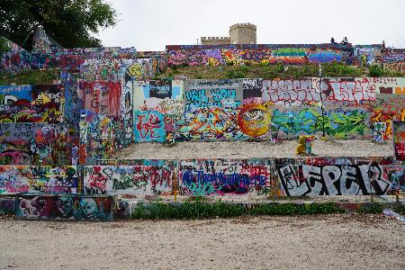
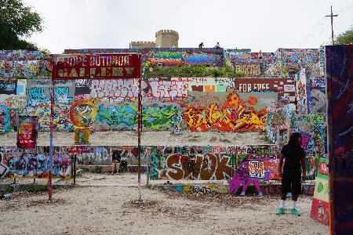
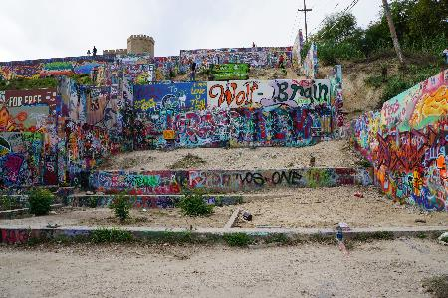
Site 1: Photosynth of HOPE Outdoor Gallery
This wall photosynth consisted of 21 photographs.
Computational Photography @ GT

Slide 4
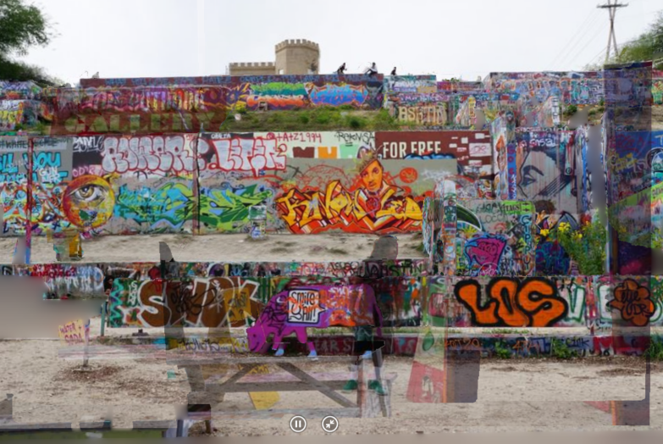
Site 1: Photosynth of HOPE Outdoor Gallery
Photosynth 3D: https://photosynth.net/preview/view/e905a76e-77e6-4eba-b9d8-c4980d1888e6
Computational Photography @ GT

Slide 5
Site 2: Panorama of Doug Sahm Hill
How many photographs? 23 photographs
How much of a FOV change was this? ~15° FOV change
What kind of a Panorama is this? 360° Rotational
What software did you use? Microsoft ICE and Photosynth
Computational Photography @ GT

Slide 6
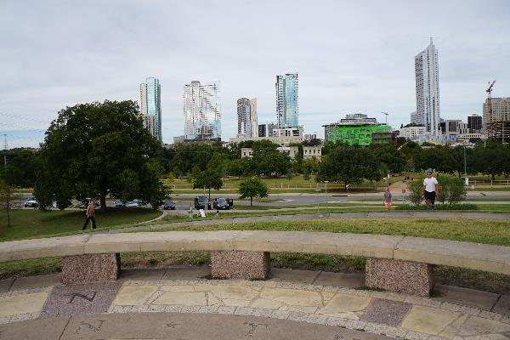
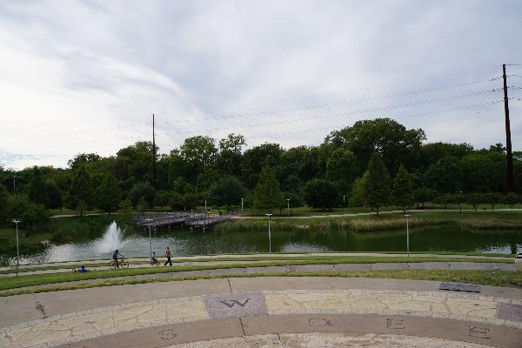
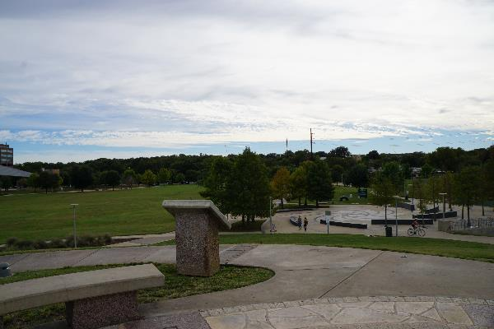
Site 2: Panorama Input
Computational Photography @ GT

Slide 7
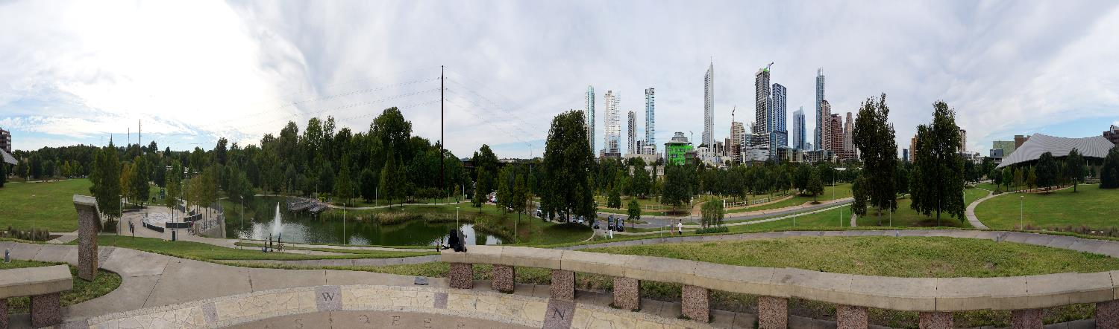
Site 2: Panorama Output (aspect ratio not preserved)
High res: https://drive.google.com/file/d/0B-9-oKYR8vK2dG16QmlJN2tGekE/view?usp=sharing
Photosynth: https://photosynth.net/view.aspx?cid=145bf411-bc03-42f6-ade2-9feeb05889f3
Photosynth 3D: https://photosynth.net/preview/view/ac66ea6f-e3e2-4dcc-90fa-7f15ad819541
Computational Photography @ GT

Slide 8
Feel free to add more details
We are aware that getting this to work is not trivial, so please discuss what you did and what worked, what did NOT.
Computational Photography @ GT
Notes:
Artifacts in Site 1 Photosynth, take more pictures? Occlusions, dynamic objects (people) make for a cooler, livelier effect and adds to 3-dimensioanal

Slide 9
More details
Details
Computational Photography @ GT

Slide 10
Even more, as needed
Details
What would you do differently?
Computational Photography @ GT

Slide 11
Any other details.
Feel free to share other thoughts associated with this assignment!
Computational Photography @ GT

