Slide 1
Comp Photography
(Fall 2015)
Final Project
Hieu Nguyen
hieu@gatech.edu
Computational Photography @ GT
http://compphotography.wordpress.com/

Slide 2
Bokeh Panorama
Panoramas are typically used to represent a wide-angle view of a scene, such as an expansive landscape or skyline. Bokeh is commonly used in portraiture photography to make the subject stand out against a blurred background. This project attempts to combine these two photographic techniques to create a bokeh panorama, also known as the Brenizer Method.
Computational Photography @ GT

Slide 3
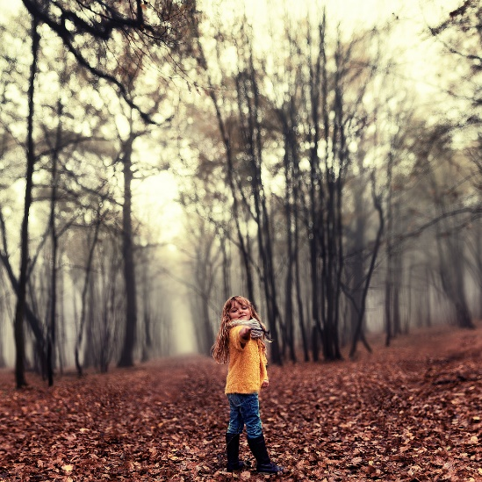
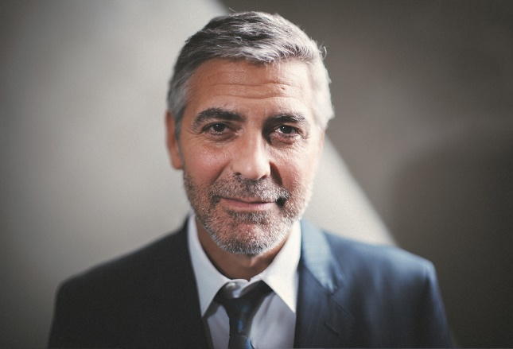
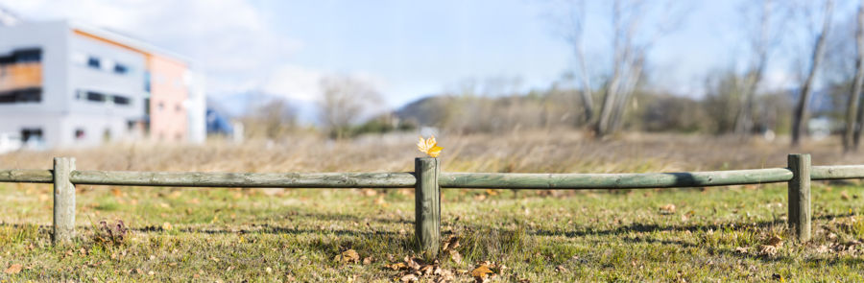
The Goal of Your Project
The motivation for this project was simply just seeing some brilliant examples of the Brenizer Method. Some of my favorite examples are shown here. This photographic technique utilizes panoramic stitching to create stunning portraits with a shallow depth of field and wide angle of view. It provides a way of imitating a generally traditional film-based process with digital equipment. The final result looks like a picture taken with a very large sensor and/or a very fast lens (aperture < f/1).
The goal is to do this computationally.
Computational Photography @ GT
Notes:
A short paragraph or two describe your project. Also point to what motivated you to do this project
The Brenizer Method (or Bokeh panorama) is a photographic technique, which utilizes panoramic stitching to create a stunning portrait with a shallow depth of field and wide angle of view. It is typically accomplished by locking manual camera settings such as white balance, ISO, aperture, shutter speed, and focus to maintain a uniform exposure. There are several online tutorials, which demonstrate how to achieve the effect by using fast lenses and expensive software. Unfortunately, I have neither of these... So, for my final project, I will attempt to recreate the Brenizer Method effect using computational methods. I believe I can leverage techniques learned in the panorama and image blending assignments, and perhaps look for advanced open source software for generating panoramas which are not left-to-right.
Q. What makes a bokeh panorama different? A. The basic panorama is usually taken with standard or wider lens at small apertures. Bokeh panorama uses standard or longer lenses with wide apertures to create a thin depth of field.

Slide 4
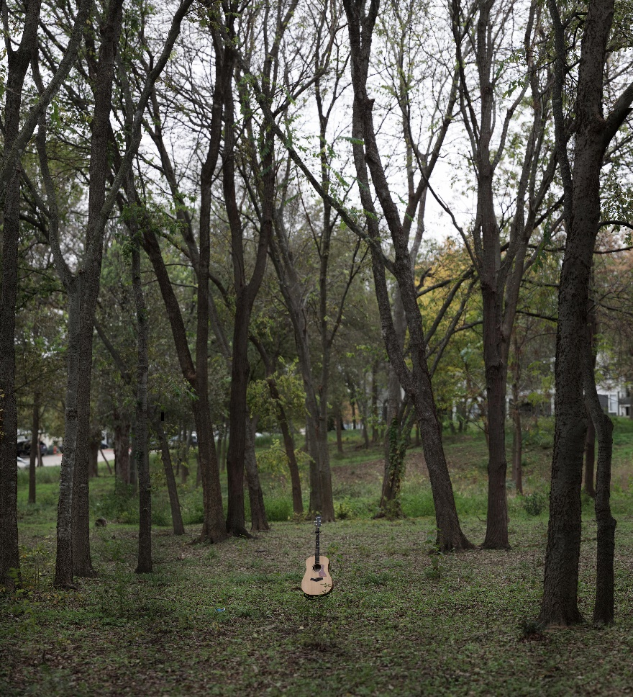
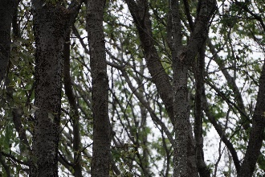
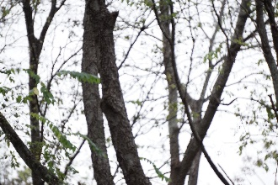
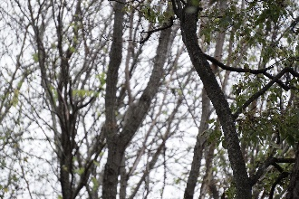
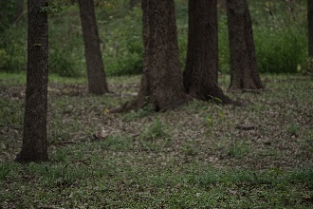
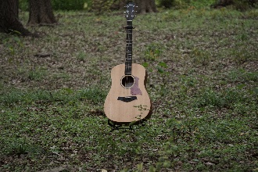
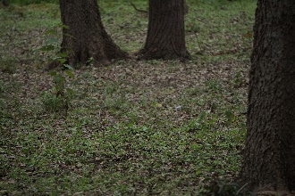
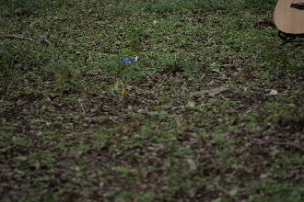
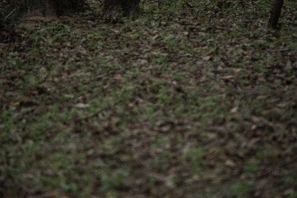
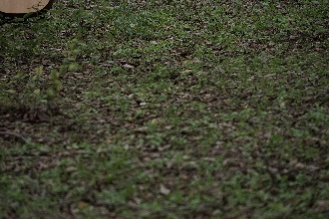
Showcase what you did. This could be many images, but this single slide should be a good pictorial of your work
Input
Output
Computational Photography @ GT

Slide 5
Showcase your pipeline
Input
Stitch
Crop
Output
The high level pipeline is very similar to the panorama pipeline used in Assignment 8. However, for bokeh panorama, the input images are critical. For the best results, the inputs must have uniform exposure. This can be accomplished by locking manual camera settings such as white balance, ISO, aperture, shutter speed, and focus. I utilized my camera’s Auto Exposure Lock (AEL) button to maintain the same exposure between shots. It is important to keep the camera stationary (e.g. tripod) and overlap each frame to improve feature matching in the stitching process. I also used my longest lens at the widest aperture to help reduce parallax errors.
Computational Photography @ GT
Notes:
Stitch images together
For Brenizer panorama, the source images are taken by rotating the camera around its nodal point (different than orthogonal/planar panorama)
Each source image gets a set of spherical coordinates (yaw, pitch, roll) and is then projected on the base sphere to match the surrounding images
The texture covering the base sphere is projected onto a plane to create a rectilinear/planar projection (different than traditional cylindrical or spherical projection)
Rectilinear image projections have the primary advantage that they map all straight lines in three-dimensional space to straight lines on the flattened two-dimensional grid.
Find matches between images
Find homography
Blend image pair
Warp image pair
Crop
Feature extraction, matching, warping, blending
Compute all pairwise homographys for warping
Select one anchor image (first image), which position will remain fixed (homography matrix = identity
Find image that best aligns with the anchor image based on max number of consistent matches
Update the homography between this image pair
Repeat feature matching, warping for other pairs
Bundle adjustment to globally optimize alignment

Slide 6
Showcase your pipeline
Input
Stitch
Crop
Output
The stitching algorithm I developed for Assignment 8 was not good enough to process the amount and types of input images for this bokeh panorama. However, the high level concepts are still there. Feature detection and matching, homography projection, warping, and blending. I took advantage of OpenCV’s Stitcher class, which brings in a more robust pipeline for registration and compositing. It includes advanced features such as wave correction, exposure compensation, and seam masking. I also tried stitching with Microsoft’s Image Composite Editor (ICE), and also stitching from video.
Computational Photography @ GT
Notes:
Stitch images together
For Brenizer panorama, the source images are taken by rotating the camera around its nodal point (different than orthogonal/planar panorama)
Each source image gets a set of spherical coordinates (yaw, pitch, roll) and is then projected on the base sphere to match the surrounding images
The texture covering the base sphere is projected onto a plane to create a rectilinear/planar projection (different than traditional cylindrical or spherical projection)
Rectilinear image projections have the primary advantage that they map all straight lines in three-dimensional space to straight lines on the flattened two-dimensional grid.
Compute all pairwise homographys for warping
Select one anchor image (first image), which position will remain fixed (homography matrix = identity
Find image that best aligns with the anchor image based on max number of consistent matches
Update the homography between this image pair
Repeat feature matching, warping for other pairs
Bundle adjustment to globally optimize alignment

Slide 7
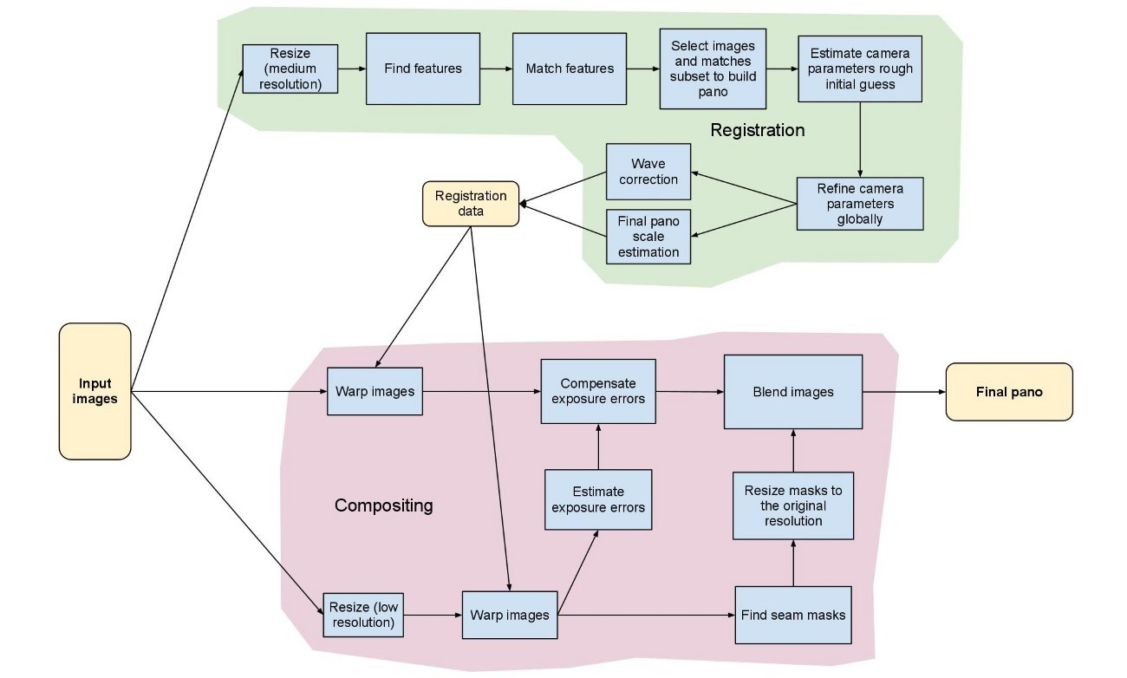
OpenCV’s Stitching Pipeline
Computational Photography @ GT

Slide 8
Showcase your pipeline
Input
Stitch
Crop
Output
The result from the stitching process is then cropped to an appropriate dimension to avoid undesired holes or warping effects. I also experimented with ICE’s auto complete feature. This auto complete software is able to identify patterns in the image and fill in the gaps (similar to Adobe Photoshop’s content-aware fill).
Computational Photography @ GT

Slide 9
Showcase your pipeline
Input
Stitch
Crop
Output
The output image is then exported to disk, ready to be viewed and shared on teh interwebs!
Computational Photography @ GT

Slide 10
What is the best way to see your project?
Here are some of my results:
Between Two Trees (49 image bokeh panorama)
If a Guitar Falls in a Forest (99 image bokeh panorama)
Cloudy Hat (31 image bokeh panorama)
Saw on Fence (8 image bokeh panorama)
Full resolution cropped outputs:
https://drive.google.com/folderview?id=0B-9-oKYR8vK2TUd0LVZhdkx2TDA&usp=sharing
Computational Photography @ GT
Notes:
Provide links, pictures, describe it, give details.

Slide 11
What worked
The stitching process was successful for the most part. I based my code off OpenCV’s C++ stitching_detailed example. This code was able to handle multiple images in different orientations without any problems. My algorithm from Assignment 8 fails for multiple images not in a cylindrical order, and the blending was subpar. With OpenCV’s stitcher class, the blending is seamless! The final output bokeh panoramas look great and are much higher resolution than their single shot counterparts. I love the Brenizer Method’s effect on portraits; it really brings out the subject in an artistic, aestetically-pleasing way.
Computational Photography @ GT
Notes:
The image stitching process generally introduces a great deal of distortion. To recover a square or rectangular shape, cropping generally needs to be applied
While the aesthetics of this form of imaging most closely resemble large format analog photography
First stitch
2173 - 2198 = 26 pictures
Planar projection
Complete
Compare 2200, 2201
Second stitch
2202 – 2229 = 28 pictures
Planar projection
Complete
Compare 2201
Third Stitch
2231 – 2279 = 49 pictures
Planar projection
Complete
Compare 2230
Fourth Stitch
2281 – 2379 = 99 pictures
26962 x 38257 = 1.03 gigapixels area
Planar
Compare 2380, 2381, 2, 3, 4
Fifth Stitch
2388 – 2437 = 50 pictures
Stereographic
2438 compare
Sixth Stitch
2439 – 2471 = 32
Stereographic
Seventh stitch
2473 – 2504 = 31
2505 compare
Transverse Mercator
Auto complete
Eighth stitch
2507 – 2514 = 8 pictures
2517 compare
Auto complete
cylindrical
Ninth Stitch
2520 – 2575
Video
8391x8299, 69.64 megapixels
Import -> Stitch (align, composite images, projection) -> crop -> export
Cylindrical, transverse cylindrical, Mercator, transverse Mercator, spherical, transverse spherical, orthographic, fisheye, stereographic, perspective
Auto complete

Slide 12
What did not work? Why?
There were some instances where I needed to adjust the input files or tweak the stitching parameters (such as warp_type) to generate a useable output. A lot of trial and error went into playing with the OpenCV stitcher class. There were several exceptions thrown and errors of insufficient memory. For the OutOfMemoryError cases, I turned to Microsoft ICE to perform the stitching. It is a more robust software that resizes images and manages memory better, handling nearly 100 images for my “If a Guitar Falls in a Forrest” bokeh panorama. However, on the low end, my OpenCV code had faster execution times than ICE, probably due to ICE’s graphical user interface attributes.
Computational Photography @ GT
Notes:
My CPU was faster than GPU
hieu@ubuntu:~/opencv-2.4.9/bin$ time ./cpp-example-stitching 8_stitch_input/* --try_use_gpu no --output pano_cpu.jpg
real 0m39.950s
user 0m32.574s
sys 0m6.355s
hieu@ubuntu:~/opencv-2.4.9/bin$ time ./cpp-example-stitching 8_stitch_input/* --try_use_gpu yes --output pano_gpu.jpg
real 0m42.686s
user 0m32.168s
sys 0m7.376s
Not enough memory
hieu@ubuntu:~/opencv-2.4.9/bin$ time ./cpp-example-stitching 3_stitch_input/* --try_use_gpu no --output 3_cv_stitch.jpg
OpenCV Error: Insufficient memory (Failed to allocate 486420484 bytes) in OutOfMemoryError, file /home/hieu/opencv-2.4.9/modules/core/src/alloc.cpp, line 52
terminate called after throwing an instance of 'cv::Exception'
what(): /home/hieu/opencv-2.4.9/modules/core/src/alloc.cpp:52: error: (-4) Failed to allocate 486420484 bytes in function OutOfMemoryError
Aborted (core dumped)
real 21m28.351s
user 21m5.793s
sys 0m10.918s

Slide 13

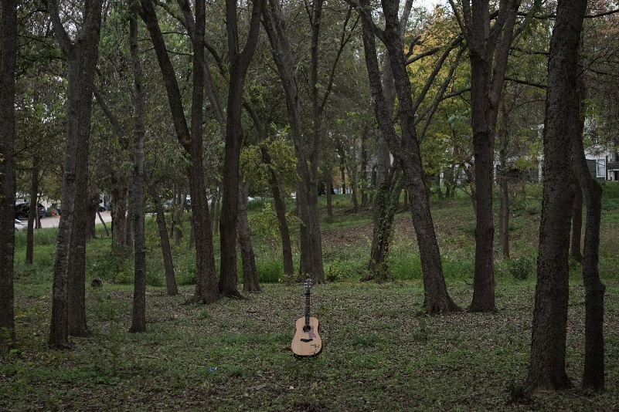
Comparison with Single Shot
It may be difficult to tell here, but the bokeh panoramas result in a higher resolution image with a more shallow DOF and wider angle of view, when compared with a single shot. Can you tell which is which?
Computational Photography @ GT

Slide 14
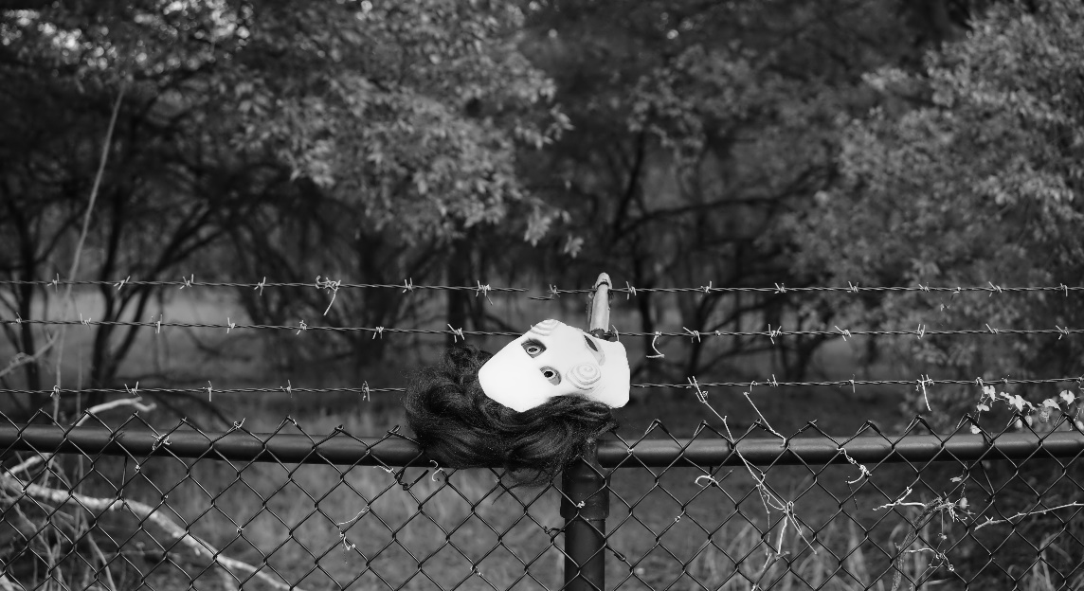
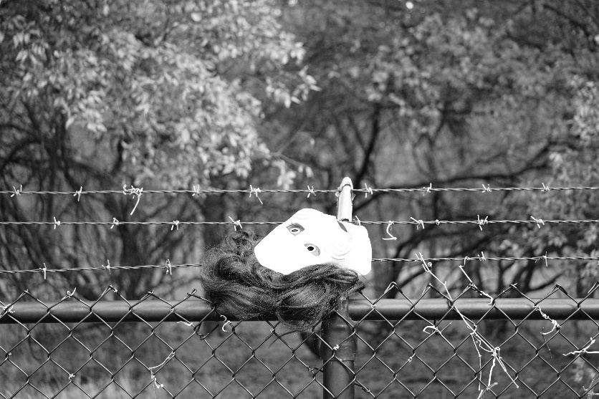
Comparison with Single Shot
Computational Photography @ GT

Slide 15
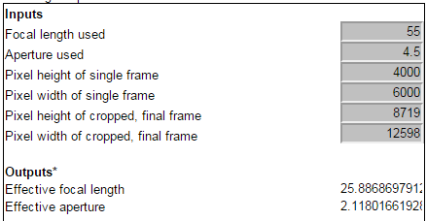
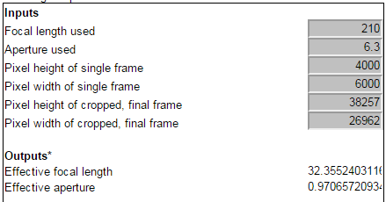
Effective Lens
Brett Maxwell has a calculator on his website that tells you the focal length and aperture that your bokeh panorama has effectively accomplished when stitching multiple photos together. This is the lens that would be needed to achieve the same photo (composition, perspective, and depth of field) in a single shot.
My camera is a Sony a6000 with Sony 18-55mm, f/3.5-f/5.6 and 55-210mm, f/4.5-f/6.3 lenses.
For my “If a Guitar Falls in a Forest” panorama, the effective lens is a 32.35mm, f/0.97! The cheapest 35mm, f/0.95 lens I found was $600 on eBay.
Computational Photography @ GT
Notes:
http://brettmaxwellphoto.com/Brenizer-Method-Calculation/
This calculator will tell you the focal length and/or aperture you have effectively accomplished when stitching multiple photos together.
The lens that would be needed to achieve the same photo (composition, perspective, and depth of field) in a single shot.
Lens I used is 18-55mm, f/3.5-f/5.6
55-210mm, f/4.5-f/6.3
8_stitch -> 25.88mm, f/2.118
4_stitch -> 32.3mm, f/0.97
Long telephoto 300mm and large aperture f/2.8 to achieve portraiture photography
Compare with photos at shorter focal length, smaller aperture

Slide 16
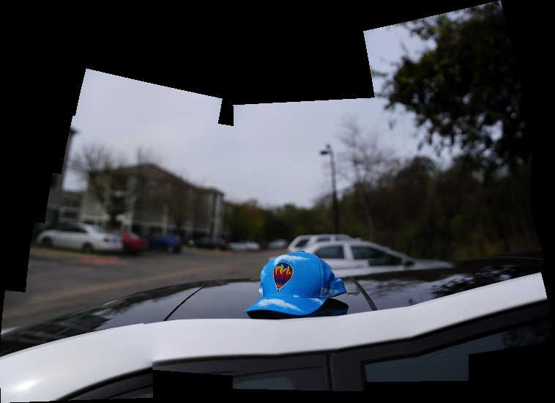
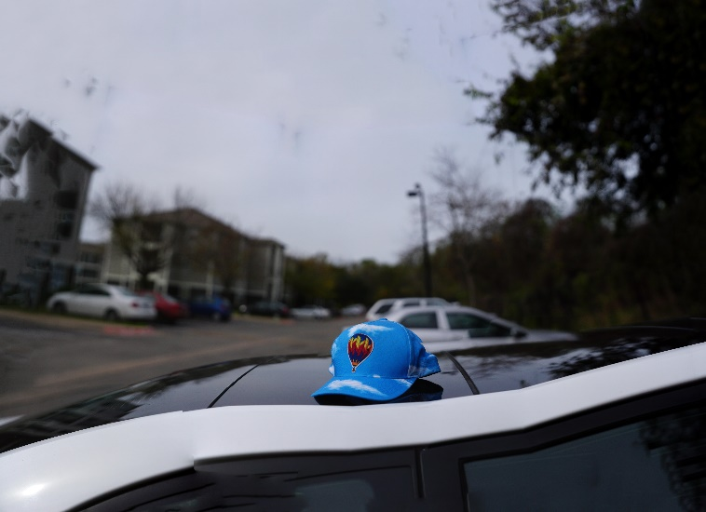
ICE Auto Complete
Microsoft ICE has an auto complete feature, which is able to identify patterns in the stitched image and fill in the gaps. This allows for a larger region to be cropped, accounting for image sections that might have been missed in the input process.
Computational Photography @ GT

Slide 17
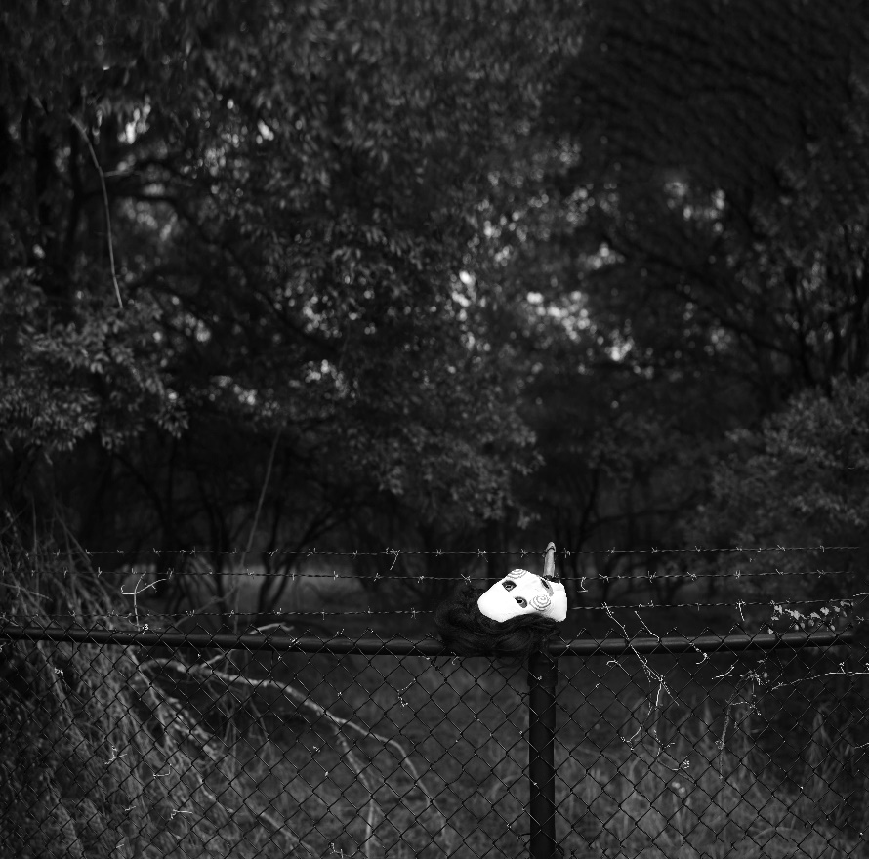
Bokeh Panorama from Video
Microsoft ICE has a neat feature that allows you to create a panorama from a video. I took a video with locked exposure settings and panned around the entire scene. The result turned out great! It also allows for auto complete. ICE is really cool!
Computational Photography @ GT

Slide 18
Conclusion
I enjoyed this project because I really wanted to explore the Brenizer Method. I’ve got a low-tier camera with a couple of mountable lens options, but I’m too cheap to invest in better equipment. The Brenizer Method allows you to effectively emulate these complex, expensive photography setups to achieve an impressive portrait.
In the future, I’d like to explore automating the input process. It can be quite cumbersome to take a collection of images, keeping the camera very still. This does not bode well for moving subjects or brief moments. Perhaps there is a good way to do this on smartphone cameras, in conjunction with the phone’s accelerometer, magnetometer, and gyroscope sensors.
I’d also like to try photographing humans with this method.
Computational Photography @ GT

Slide 19
References / Pointers
Background Info:
https://en.wikipedia.org/wiki/Brenizer_Method
https://www.flickr.com/groups/brenizermethod/
http://brettmaxwellphoto.com/Brenizer-Method-Calculation/
Stitching:
http://docs.opencv.org/2.4/modules/stitching/doc/stitching.html
http://research.microsoft.com/en-us/um/redmond/projects/ice/
Bokeh Panorama Examples from “Goal” Slide:
http://www.samhurdphotography.com/2012/editorial/epic-portait-george-Clooney
https://www.flickr.com/photos/keochkeriandavid/
http://www.kolor.com/wiki-en/action/view/Autopano_Brenizer_Method
Computational Photography @ GT
Notes:
Here you should provide references to all the source and other information you used.

Slide 20
Team
Unfortunately, this was a solo project.
Computational Photography @ GT

Slide 21
Credits/Thanks
Thanks to Prof. Essa and the TA’s for a great course! I’ve been taking pictures for pretty much my entire life, but I now finally understand how digital photography works. My future photographs will definitely benefit from the things I’ve learned.
This was my first semester in the OMSCS program, and I loved it!
Computational Photography @ GT

