Slide 1
Scrape Board
AI-Powered Web Content Analyzer & Management Tool
React · TypeScript · Supabase · Google Gemini · Firecrawl · Deployed to GoDaddy Shared Hosting
http://webscraper.ensconce.in/
Scrape Board — Portfolio Overview
1

Slide 2
Problem / Context
Manual task entry
Reference material goes to waste
Two AI capabilities, one workflow
Lightweight trackers require every task to be typed by hand — slow and repetitive.
Turning a spec page, article, or competitor site into to-dos is manual, repeatable work.
Test whether generative breakdown and structured web extraction can live inside the core task-manager flow, not as bolt-on tools.
Scrape Board — Portfolio Overview
2

Slide 3
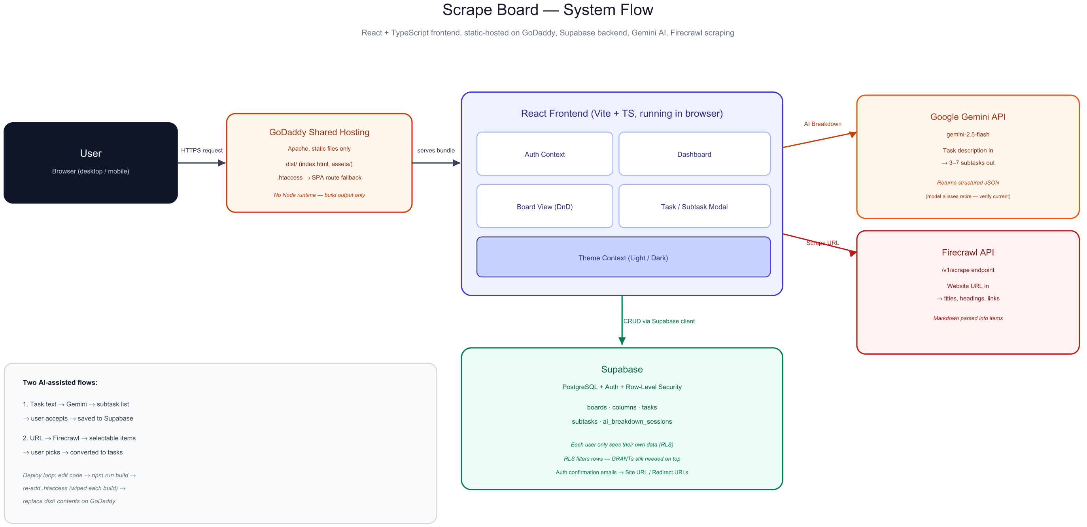
System Flow
Scrape Board — Portfolio Overview
3

Slide 4
Key Decisions & Trade-offs
1
Schema-first, RLS everywhere
Five tables designed before UI; Row-Level Security enabled on every table so authorization lives in Postgres, not the frontend.
2
One contract for both AI/automation paths
Gemini and Firecrawl calls share the same pattern: structured input in, typed output out, fail loudly on bad keys or malformed responses.
3
Client-side API keys — accepted trade-off
Keys are baked into the public bundle for fast, simple shipping. A production version would proxy both through a backend/edge function.
4
Shared hosting instead of Vercel/Netlify
Deployed to existing GoDaddy hosting by treating the Vite build output as what it is — plain static files, no Node runtime required.
5
RLS ≠ GRANTs
Disabling Supabase's table auto-exposure (the secure default) blocks all API access until table privileges are explicitly granted — RLS only filters after access is already permitted.
Scrape Board — Portfolio Overview
4

Slide 5
Getting It Running: Accounts & Deployment
Third-Party Accounts
Deploying to GoDaddy Shared Hosting
Supabase — new project; Enable Data API on, auto-expose tables off; run schema migration; GRANT table privileges to authenticated role
Firecrawl (firecrawl.dev) — free-tier API key for the /v1/scrape endpoint
Google Gemini (aistudio.google.com) — free API key; targets gemini-2.5-flash (model aliases retire periodically)
All keys set as VITE_* vars in .env, baked into the build at compile time
npm run build → produces plain static files in dist/ (no Node runtime needed on the host)
Create a subdomain with its own isolated document root (never share it with the main site)
Upload only the contents of dist/ — not src/, node_modules/, or .env
Add .htaccess to fall back to index.html so React Router deep links don't 404 on Apache
Every rebuild wipes dist/ (including .htaccess) — re-add and re-upload after each change
Scrape Board — Portfolio Overview
5

Slide 6
Outcome
What Held Up
What I'd Do Next
RLS enforced multi-user isolation even under direct console query attempts
Defensive parsing on AI responses mattered more than prompt engineering — LLM output shape was the real reliability risk
Static-file deployment model made shared hosting a viable, low-cost target for a Vite/React SPA
Move Gemini and Firecrawl keys behind a backend/edge function instead of the public bundle
Add retry/backoff on AI calls and cache scrape results per URL
Automate the GoDaddy upload step (currently manual File Manager) with an FTP/SFTP deploy script
Scrape Board — Portfolio Overview
6

