Slide 1
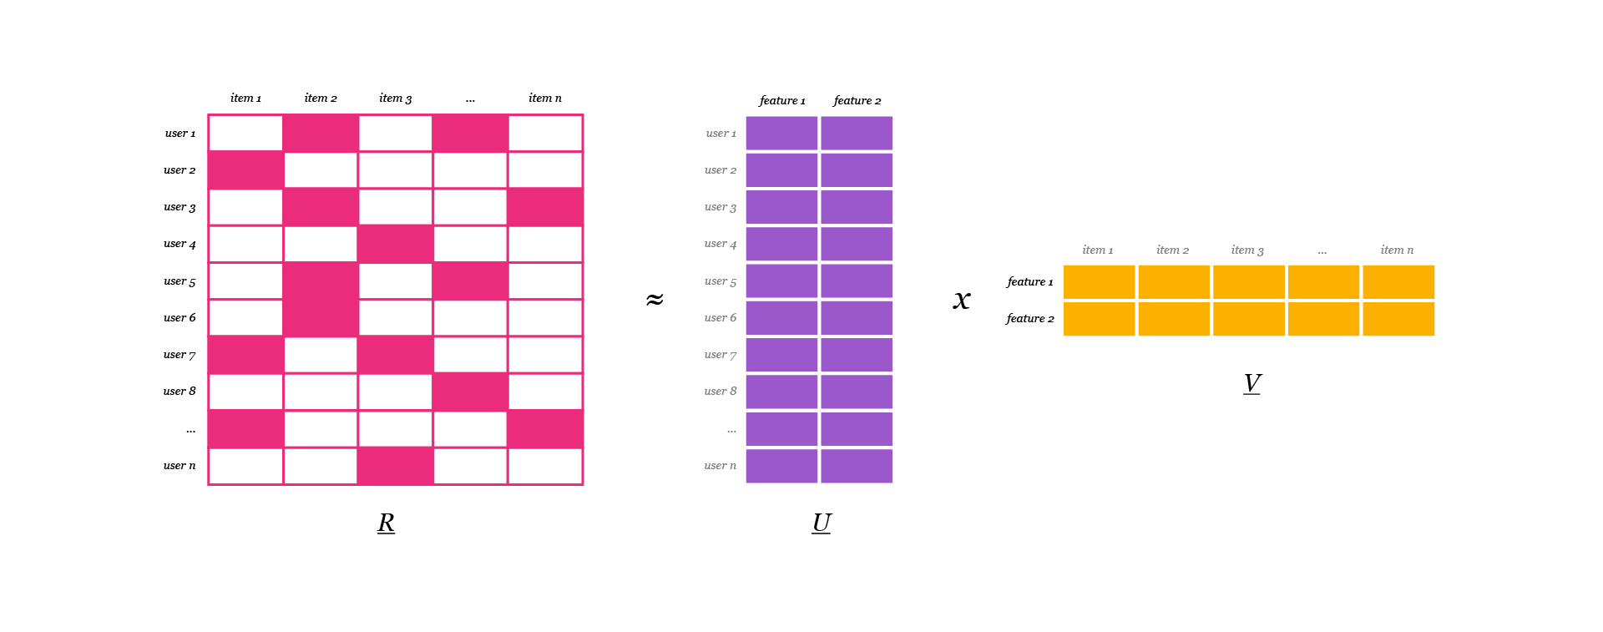
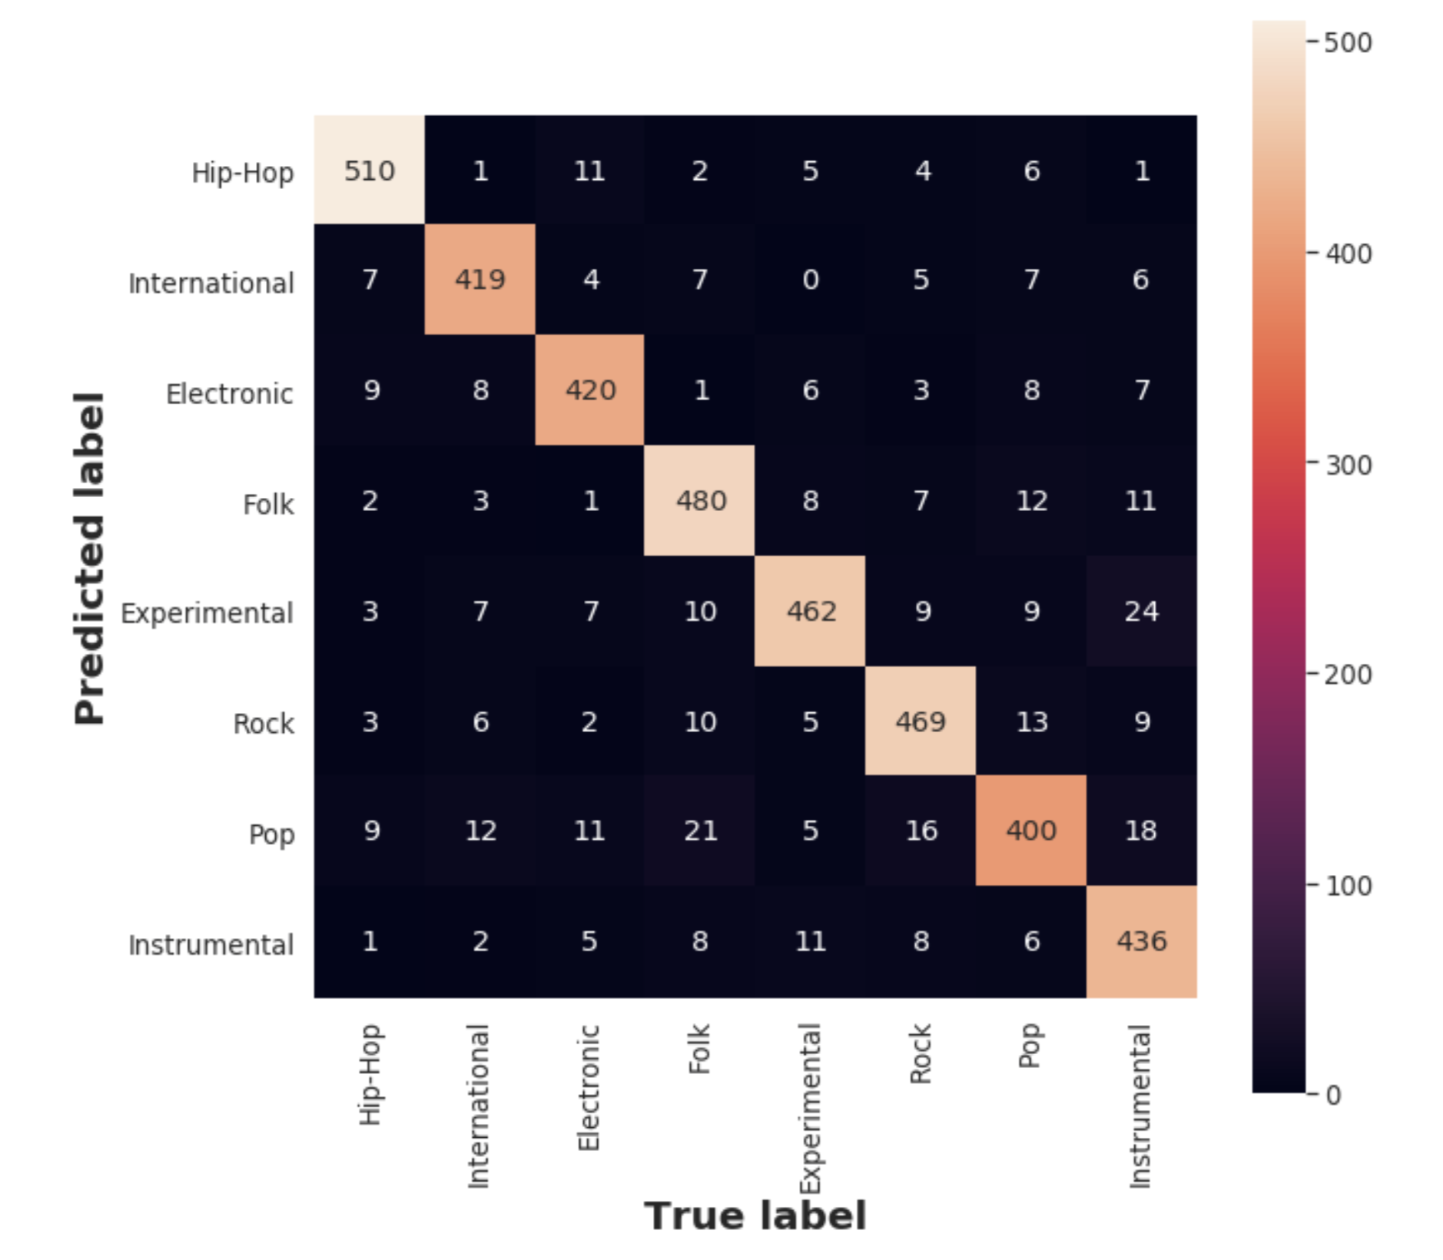
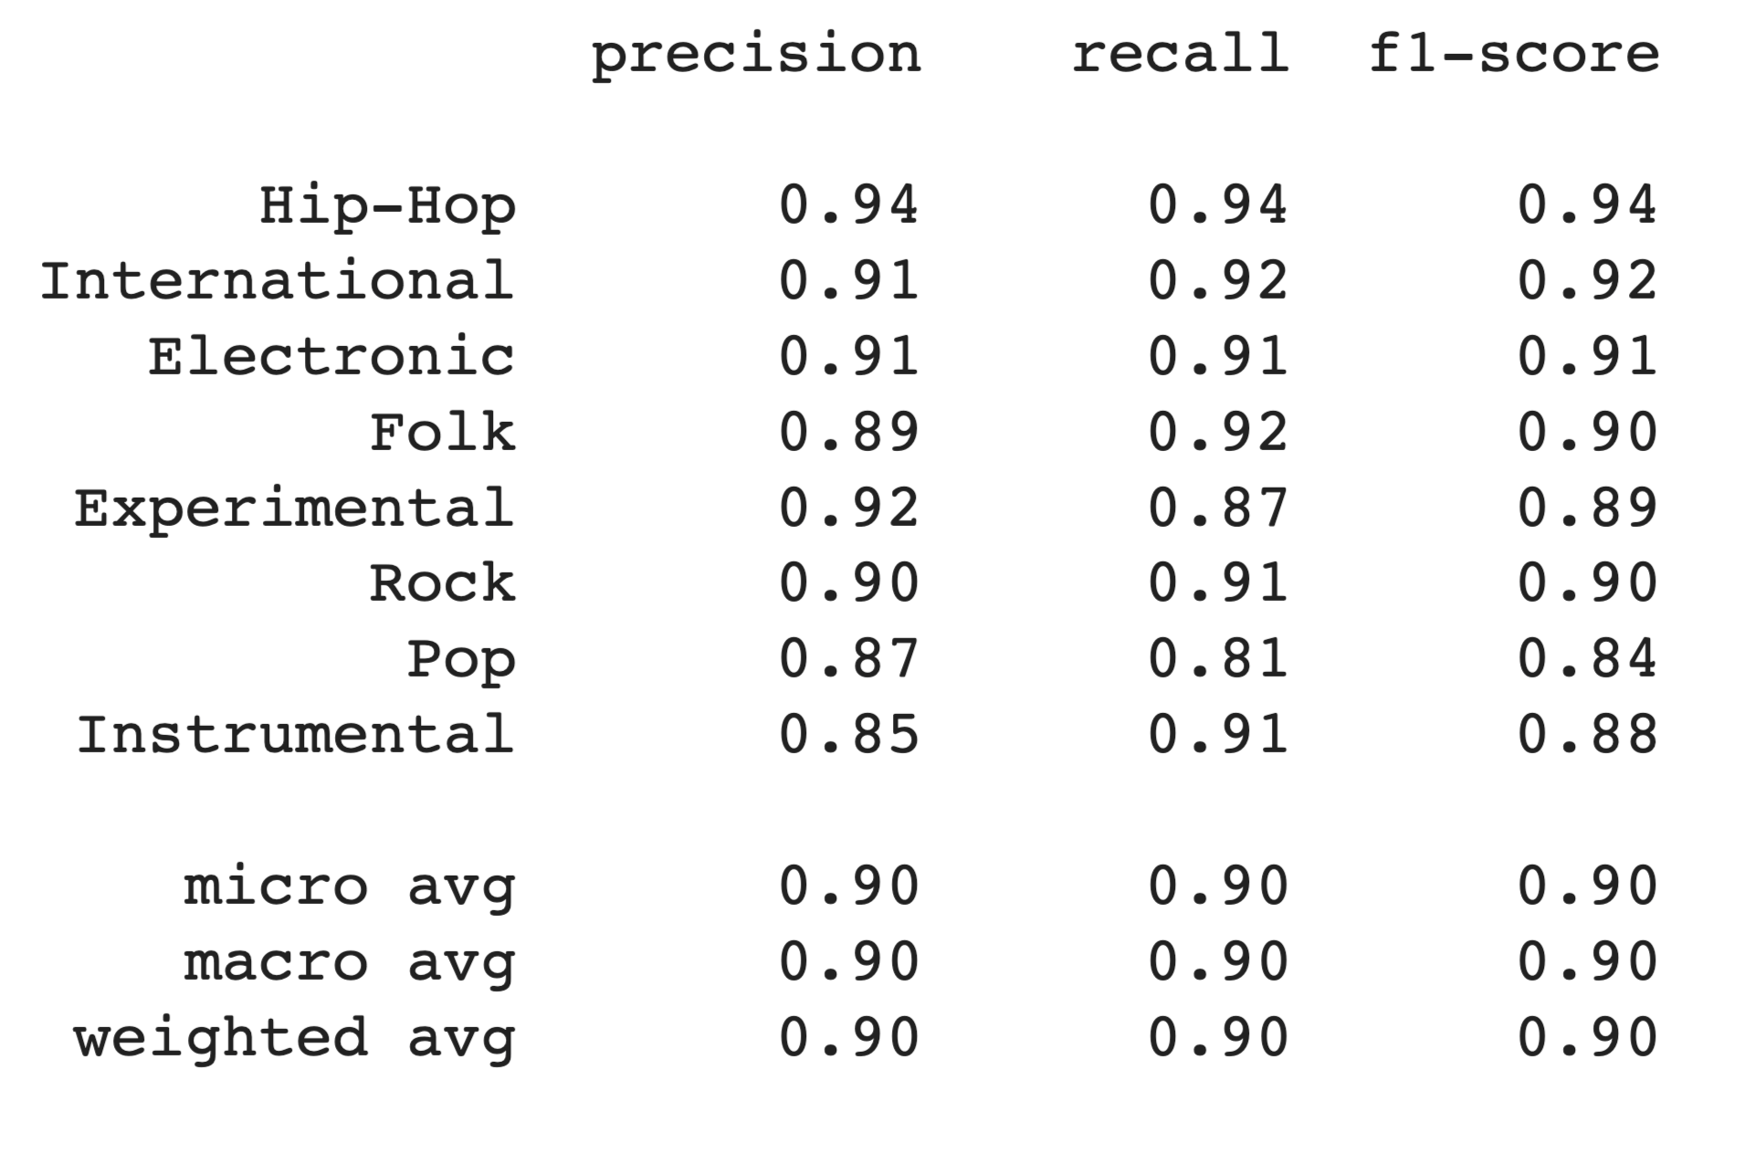


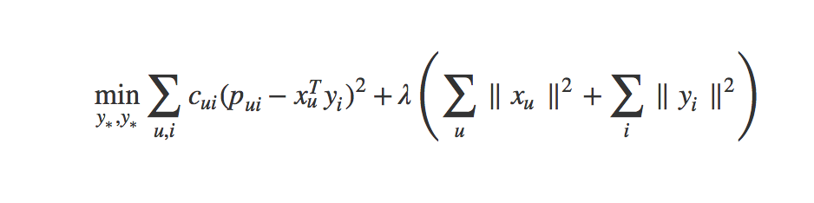
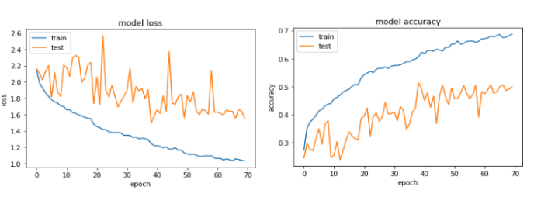

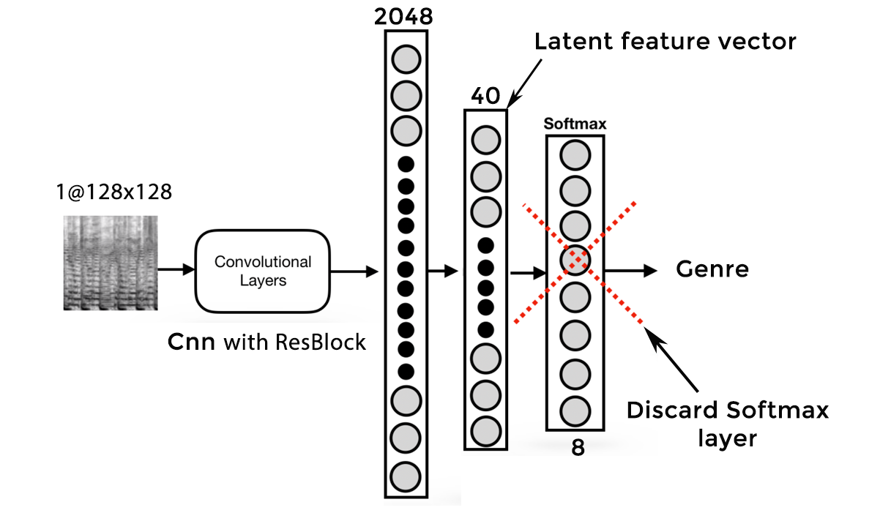
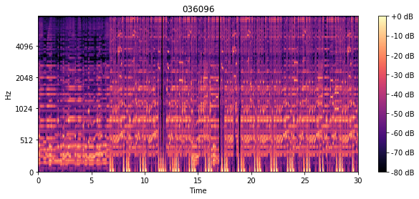
Building a Music Recommendation System
Gautam Dudeja, Stephen Weldon, Chitta Mahapatra, Siddhartha Maharana and Tanmay Sahoo Georgia Tech
Goodreads is a social platform where users can
discuss and rate books on a scale from 1 to 5. We want to build a Book Recommender and find an efficient way to predict book ratings.
Materials
Results
Conclusion
Abstract
With the rise of digital content distribution, we have access to a large music collection. With millions of songs to choose from, we sometimes feel overwhelmed. Thus, an efficient music recommender system is necessary in the interest of both music service providers and customers.
Dataset:
● 384,000 unique songs dataset
● 48 million user ratings from 1 Millions users U (average of 30 ratings per user)
● 5000 audio files crawled The dataset is split between train (80% + 20% for cross validation) and test (20%).
Add your information, graphs and images to this section.
Add your information, graphs and images to this section.
Matrix Factorization turned out to be the best model to predict individual ratings (RMSE) and obtain the most ideal ranking
Neural Networks results confirmed the intuition that the content of the book is a better predictor of ratings and book quality than the cover image alone. Results were still good for both models. Content based recommendation was able to address cold start problem and able to recommend music from different languages and artists from different parts of the world.
Next steps: An hybrid model from all our different approaches could be an interesting way to combine each model’s strength into a robust recommender system. We would also work on leveraging the Neural Network model to individual users.
We would like to include lyrics data from different music and use that to train model for more contextual recommendations like patriotic songs, love songs or socio political songsl.
Methodology : Collaborative Filtering
Evaluation Metrics
Idea:
Listening histories are influenced by a set of factors specific to the domain
(e.g. Genre, artist...)
Matrix Factorization [2] consists in assuming there exist d latent features that can allow
us to approach our U x V rating matrix R as the product of two matrices: Q of size U x d
(users) and P of size d x V (Songs).
R = U x V
Preference and Confidence function[1]
Our solution follows [1], where preference (p) for an item with the confidence (c) we have for that preference.
Here the confidence is calculated using the magnitude of r (the feedback data) giving us a larger confidence the more times a user has played, viewed or clicked an item. The rate of which our confidence increases is set through a linear scaling factor α.
Loss Function:
The goal now is to find the vector for each user (xu) and item (yi) in feature dimensions which means we want to minimize the loss function.
X and Y: Our randomly initialized user and item matrices. These will get alternatingly updated.
Cu and Ci: Our confidence values.
λ: Regularizes to reduce overfitting (we’re using 0.1).
p(u) and p(i): The binary preference for an item. One if we know the preference and zero if we don’t.
I (eye): The identity matrix. Square matrix with ones on the diagonal and zeros everywhere else.
Confusion Matrix
Methodology : Neural Networks
Content Based Recommendation:
Content-based recommendation attempts to model similarity using latent features derived from Mel Spectrogram analysis on the raw audio signal.
Model trained on 1000 songs from MSD and scraped 30 sec audio clips from https://wasabi.i3s.unice.fr
User Librosa library to convert mp3 to mel-spectrograms
Slice spectrogram into smaller slices to generate 40 latent factor feature for each slice.
Used CNN to process mel spectrogram slices to classify music into 8 different genres like Hip-Hop, International, Electronic, Folk, Experimental, Rock, Pop, and Instrumental.
Model Evaluation was done by splitting data in 70%-30% training-testing.
Model was able to predict ~90% of genres accurately in test data.
Recommendation Algorithm
The trained network then modified by removing SoftMax layer which is responsible to assign multiple classes for input trained tensors.
Now our network acts like latent factor representation of multiple slices for a song.
We average those latent factors for a song and use cosine similarity to with remaining songs to recommend songs with maximal similarity.
What is Mel Spectrogram?
A signal is a variation in a certain quantity over time. For audio, the quantity that varies is air pressure.
We took samples of air pressure over time to digitally represent an audio signal
We mapped the audio signal from the time domain to the frequency domain using the fast Fourier transform, and we performed this on overlapping windowed segments of the audio signal
We mapped the y-axis (frequency) onto the mel scale to form the mel spectrogram.
Loss Function and model accuracy validation

