Slide 1
MATCHSNAP
INDIA-FIRST • VERSION 1
A safer path from
missing to found
Concept, product direction and execution plan for a partner-led India pilot.
Remote face matching • Human review • Protected connection
Planning document — not a production-readiness or legal-compliance claim
MatchSnap India • Concept & execution plan • Version 1
01

Slide 2
THE CONCEPT
Turn two disconnected photos into one reviewed lead
MatchSnap searches a shared missing/found repository and gives authorized people a candidate to review.
MISSING REPOSITORY
FOUND REPOSITORY
Someone is being sought
REMOTE
MATCHING
Someone has been found
A family or authorized partner submits a verified case and suitable photograph.
A trained finder or partner submits a sighting or found-person record.
CANDIDATE, NOT IDENTITY PROOF
Outcome: an authorized reviewer checks the candidate before any notification, handoff or connection.
MatchSnap India • Concept & execution plan • Version 1
02

Slide 3
THE OPPORTUNITY
The gap is not another public database
The opportunity is a secure matching layer that fits authorized workflows and keeps people in control.
01
02
03
Time separates records
Photos are compared manually
A lead needs safe handling
A found-person image may arrive hours, days or months after the original missing report.
People cannot reliably review growing photo collections across locations and time periods.
A similarity score is useful only when verification, safeguarding and an official handoff follow.
Existing police and child-protection systems remain the backbone; MatchSnap should complement them.
MatchSnap India • Concept & execution plan • Version 1
03

Slide 4
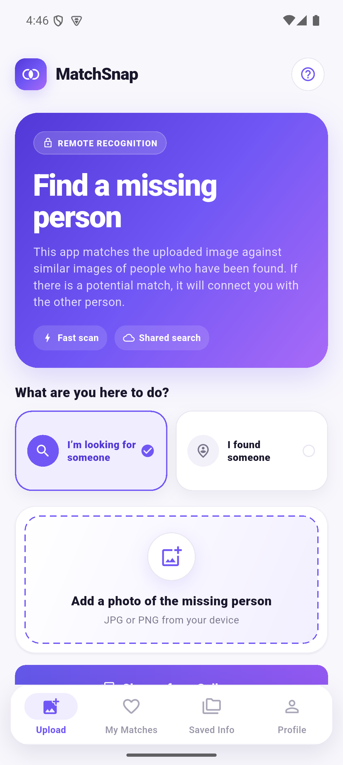
THE PRODUCT
A simple user flow with a controlled decision point
The mobile experience stays simple; sensitive decisions move to authorized reviewers.
1
Choose intent
2
Submit photo
Looking for someone or found someone
Quality and consent checks
3
Search remotely
4
Persist candidates
Only the opposite repository
Immediate plus scheduled reconciliation
5
Human review
6
Protected handoff
Partner verifies the lead
No automatic contact disclosure
CURRENT PROTOTYPE UI
MatchSnap India • Concept & execution plan • Version 1
04

Slide 5
CURRENT FOUNDATION
The remote matching proof of concept already works
The prototype demonstrates the core technical loop; it does not yet provide production safeguards.
InsightFace
Flutter app
FastAPI
Detect + embed
Android + iOS
Remote recognition
PostgreSQL
MinIO
pgvector search
Private photo store
Immediate
Every 15 min
Opposite side
Persisted
Matching on upload
Restart-safe reconciliation
Missing searches found, and vice versa
Candidates remain reviewable
PROTOTYPE — NOT PRODUCTION READY
MatchSnap India • Concept & execution plan • Version 1
05

Slide 6
INDIA-FIRST POSITION
Start as a partner tool, not a nationwide consumer launch
A narrow launch creates a safer path to trust, evidence and eventual integration.
Mission Vatsalya
TrackChild
Child-protection framework
MATCHSNAP
PILOT
Existing official record workflow
DCPU / CWC
Child Helpline 1098
District review and safeguarding
Recommended first shape
1 population • 1 district • 1 accountable partner
Crisis and escalation channel
MatchSnap India • Concept & execution plan • Version 1
06

Slide 7
SAFETY MODEL
Recognition proposes; people decide
The service must reduce search effort without turning a sensitive database into an open surveillance tool.
DESIGN FOR
NEVER ENABLE
Authorized, role-based access
Public or unrestricted face search
Verified cases and trained reviewers
A score presented as confirmed identity
Human review before contact or escalation
Automatic disclosure of phone or location
Private images, audit logs and deletion
Direct unknown-adult-to-child connection
Plain-language consent and grievance handling
Silent reuse of biometric data
MatchSnap India • Concept & execution plan • Version 1
07

Slide 8
INDIA READINESS
Legal, safeguarding and licensing are product requirements
Qualified Indian counsel and the pilot partner must approve the real-data workflow.
DPDP
Notice, consent, rights, grievance, safeguards, breach response and current enforcement timeline.
CHILDREN
Guardian authority, child-data duties, safeguarding and Mission Vatsalya / JJ workflows.
DATA LIFECYCLE
Purpose limits, processor contracts, India-region hosting, retention, erasure and backup deletion.
MODEL LICENCE
Resolve commercial rights for pretrained weights or select an acceptable alternative.
No real-person pilot until counsel, the partner and a named safety owner approve the controls.
MatchSnap India • Concept & execution plan • Version 1
08

Slide 9
PHASE 1 DECISION
Choose the smallest responsible pilot
Population determines consent, safeguarding, partner type and product workflow.
A
B
C
Children only
Adults only
Children + adults
Highest safeguarding burden; strongest fit with Mission Vatsalya, DCPU, CWC and 1098.
Simpler first consent model; requires police/NGO verification and vulnerable-adult safeguards.
Broadest mission, but doubles workflow, policy and partner complexity for an initial pilot.
Recommendation: select one population, one city/district and one accountable institutional partner.
MatchSnap India • Concept & execution plan • Version 1
09

Slide 10
EXECUTION ROADMAP
Nine phases, with evidence gates between them
Do not scale engineering or outreach faster than safety, partner and evidence readiness.
FOUNDATION
BUILD & PROVE
FUND & SCALE
1
Scope
India charter
4
Harden
Secure pilot MVP
7
Model
Operations + budget
2
Validate
Interviews + partner
5
Measure
Accuracy + security
8
Package
Deck + data room
3
Approve
Legal + safeguarding
6
Pilot
Closed real workflow
9
Fund
Targeted outreach
GATE 1
Partner confirms the workflow is useful and safe to explore.
GATE 2
Counsel and partner approve real-data pilot controls.
GATE 3
Pilot evidence supports a costed funding request.
MatchSnap India • Concept & execution plan • Version 1
10

Slide 11
SECURE PILOT MVP
What must be added before real cases
The next engineering milestone is controlled access and case handling—not more matching demos.
IDENTITY & ACCESS
CASE GOVERNANCE
OTP login
Partner membership
Case verification
Assignment + closure
Reviewer/admin roles
Rate limits
Audit trail
Duplicate handling
PRIVACY & SAFETY
INDIA EXPERIENCE
Consent records
Retention + deletion
Low-bandwidth upload
Retry + draft
Private images
Protected handoff
English + Hindi
Launch-state language
MatchSnap India • Concept & execution plan • Version 1
11

Slide 12
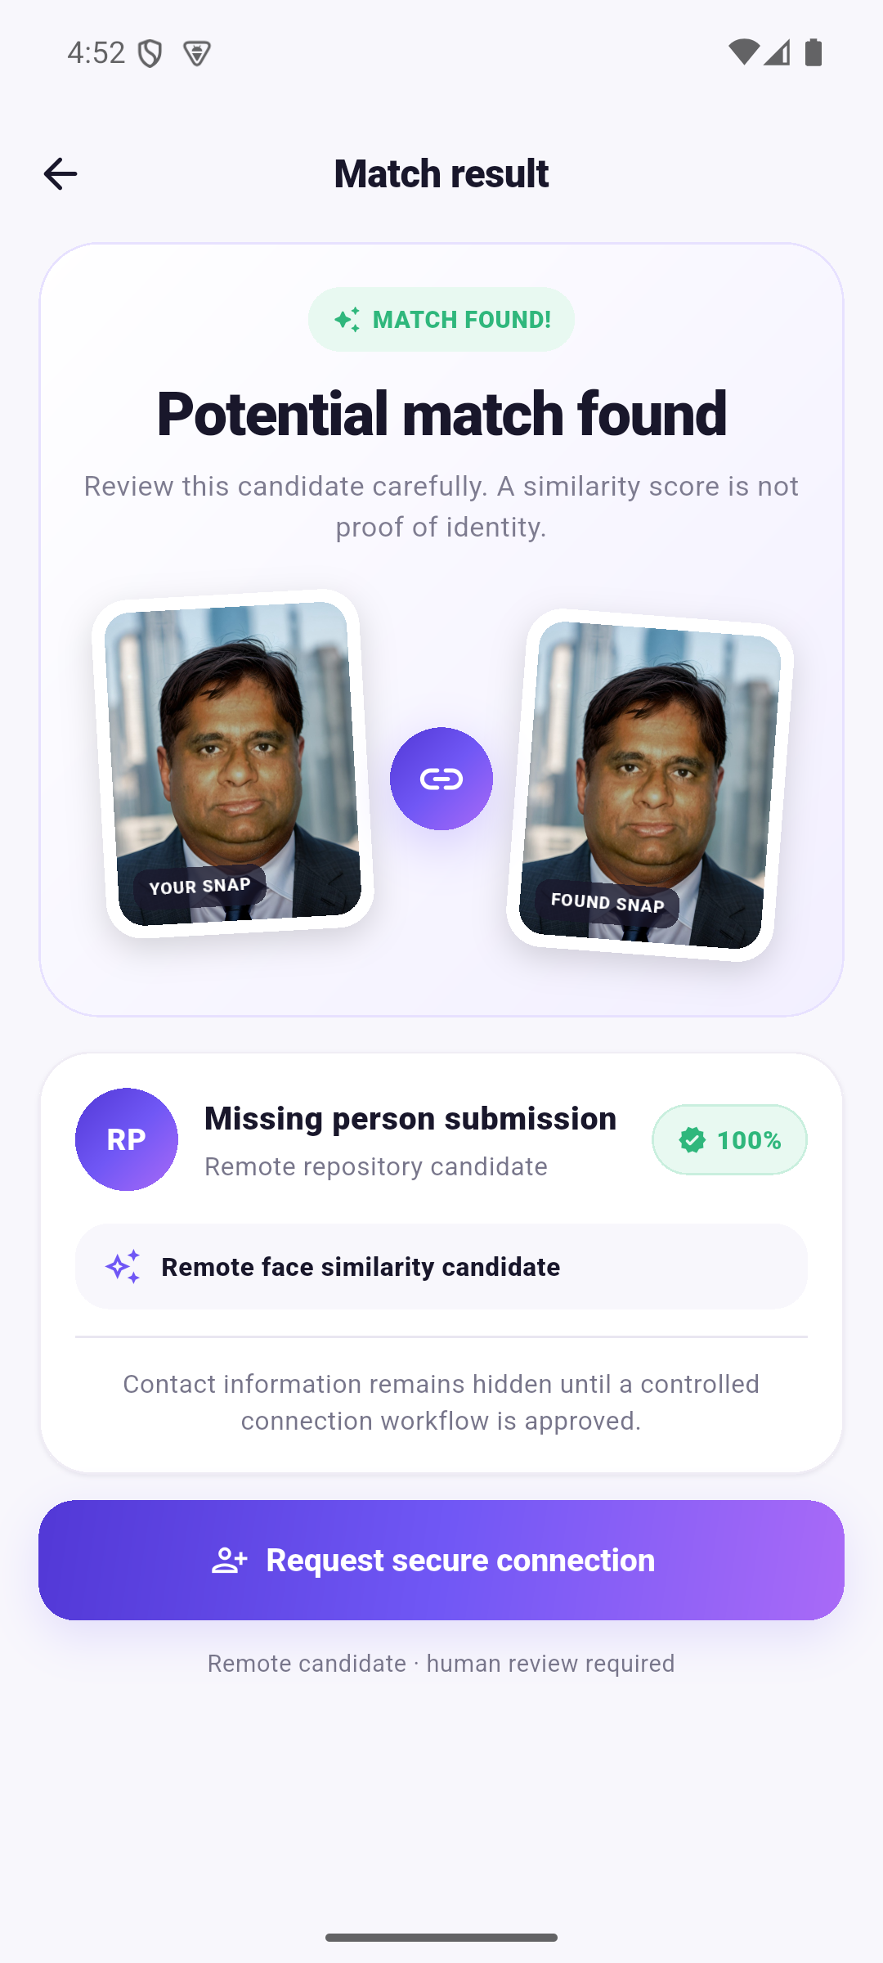
RECOGNITION EVIDENCE
Measure failure modes, not just impressive matches
Thresholds must be calibrated on consented, representative Indian pilot conditions.
TAR @ FAR
Correct matches at a stated false-accept rate
Rank recall
Whether the right person appears in the review list
False candidates
Reviewer burden and harm potential per case
Group performance
Age, skin tone, gender and image-quality differences
Quality rejection
No face, multiple faces, blur, pose and occlusion
Latency + cost
End-to-end processing time and infrastructure cost
HUMAN REVIEW REQUIRED
Stop if any group shows unacceptable error, reviewer burden or safety risk.
MatchSnap India • Concept & execution plan • Version 1
12

Slide 13
CLOSED PILOT
Prove usefulness inside one supervised workflow
The pilot is an operational study with a kill switch—not a public launch.
01
02
03
04
SETUP
OPERATE
LEARN
DECIDE
One location
One partner
Named reviewers
Verified cases
Controlled candidates
Partner handoff
Weekly safety review
Support log
Participant feedback
Continue
Revise
Or stop
Publish impact claims only when the partner verifies the outcome and approves communication.
MatchSnap India • Concept & execution plan • Version 1
13

Slide 14
PILOT SCORECARD
Success combines product, safety and operations
A single recognition score cannot demonstrate funder readiness.
PRODUCT
SAFETY
OPERATIONS
Verified cases completed
False candidates per case
Reviewer time per case
Valid-photo upload rate
User understanding
Notification + handoff rate
Processing + review time
Deletion + grievance SLA
Partner satisfaction
Candidate-list usefulness
Privacy/safeguarding incidents
Cost per processed case
PRE-AGREE THRESHOLDS AND STOP CONDITIONS
MatchSnap India • Concept & execution plan • Version 1
14

Slide 15
OPERATING MODEL
Funders will ask who is accountable after the demo
The organization, partner and technology roles must be explicit before money is requested.
MATCHSNAP
Product, security, cloud, support and incident response
12-MONTH USE OF FUNDS
01
Legal, privacy and safeguarding
PILOT PARTNER
Case verification, trained review, handoff and safeguarding
02
Secure product + cloud
03
Evaluation and security review
ADVISORS
Indian privacy, child protection, ethics and recognition quality
04
Partner pilot operations
05
Core team and support
Entity options to evaluate
Social enterprise • Section 8 • NGO/government partner
MatchSnap India • Concept & execution plan • Version 1
15

Slide 16
FUNDER READINESS
Evidence first, then targeted outreach
The same story is packaged differently for government, CSR, grants, incubators and investors.
THE PACKAGE
INDIA OUTREACH CHANNELS
Two-minute working demo
DPIIT / Startup India
Recognition, incubators and suitable schemes
Partner letter and pilot workflow
IndiaAI
Current startup financing and acceleration opportunities
Measured recognition and safety results
CSR + foundations
Child protection, public safety and social impact
Privacy, safeguarding and licence path
12-month budget and exact funding ask
Government innovation
Relevant central and state programs
Roadmap, team plan and risk register
Impact capital
Mission-aligned angels, funds and accelerators
MatchSnap India • Concept & execution plan • Version 1
16

Slide 17
NEXT 30 DAYS
Turn the concept into an India project charter
These actions should happen before more real-data collection or nationwide planning.
WEEK 1
WEEK 2
WEEK 3
WEEK 4
Decide
Validate
Partner
Scope
Population
State + district
Partner type
Interview guide
4–6 stakeholder calls
Workflow map
Pilot owner
Written interest
Safeguarding review
Legal brief
MVP requirements
Pilot budget
First decision: missing children, missing adults, or both?
MatchSnap India • Concept & execution plan • Version 1
17

Slide 18
OFFICIAL STARTING REFERENCES
India sources used for Version 1
Digital Personal Data Protection Act, 2023
Digital Personal Data Protection Rules, 2025
https://www.indiacode.nic.in/handle/123456789/22037?view_type=browse
https://www.meity.gov.in/documents/act-and-policies/digital-personal-data-protection-rules-2025-gDOxUjMtQWa?hl=en-US
Mission Vatsalya
Child Helpline 1098
https://www.wcd.gov.in/child/mission_vatsalya
https://www.wcd.gov.in/offerings/mission-vatsalya-child-helpline-1098
TrackChild
Startup India Seed Fund Scheme
https://trackthemissingchild.gov.in/trackchild/
https://seedfund.startupindia.gov.in/
DPIIT startup recognition
IndiaAI startup financing
https://www.startupindia.gov.in/content/sih/en/startupgov/startup_recognition_page.html
https://indiaai.gov.in/hub/indiaai-startup-financing
Confirm current law, scheme eligibility and program deadlines before acting.
MatchSnap India • Concept & execution plan • Version 1
18

