Slide 1
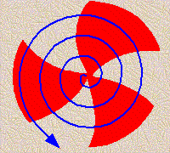

Investigation of nuclear reactions for the applications in Advance reactor, ADSS facility and nuclear data management
Prof. Surjit Mukherjee
Department of Physics,
The Maharaja Sayajirao University of Baroda
Vadodara, Gujarat-390002. INDIA

Slide 2

Outline OF THE PRESENT TALK -
Introduction (Nuclear Reaction Data & Related Applications)
Applications in Accelerator Driven Subcritical systems (ADSs) & International Thermonuclear Experimental Reactor (ITER)
Literature data for reactor fuel (Th) and structural and other materials
Recent work in the field of neutron & proton induced reactions related to reactor development
Co-variance analysis

Slide 3
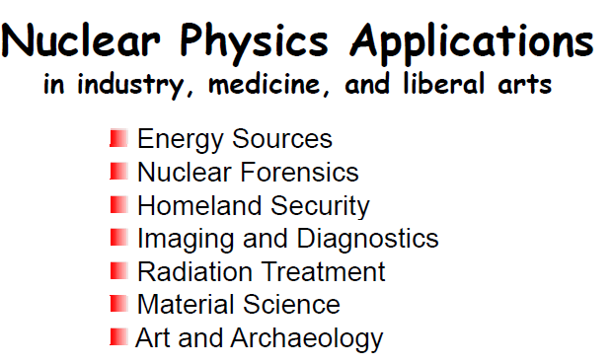
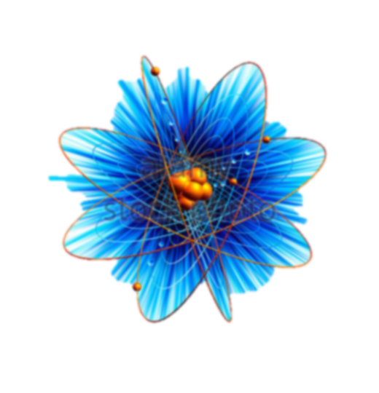

Slide 4

Nuclear REACTOR Physics for rapidly increasing
green energy demand

Slide 5
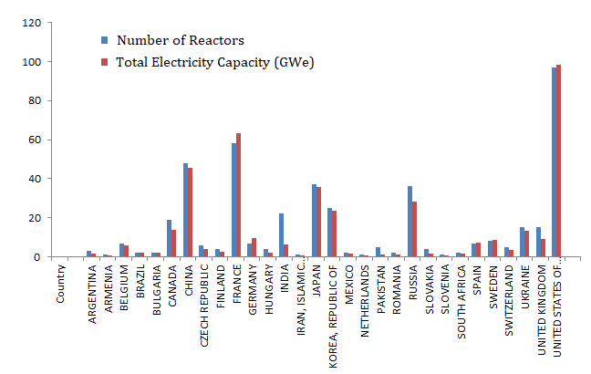
Worldwide Operational Reactors
Despite the number of reactor across the globe, they contribute only about 3% of the total energy demand.
A total number of 451 reactors are operational worldwide with net production of 400 Giga Watt energy (GWe) energy. It also produces a large amount of nuclear waste which arises a problem of disposal of dangerous waste.
Rest depend on the conventional sources of energy.
India

Slide 6
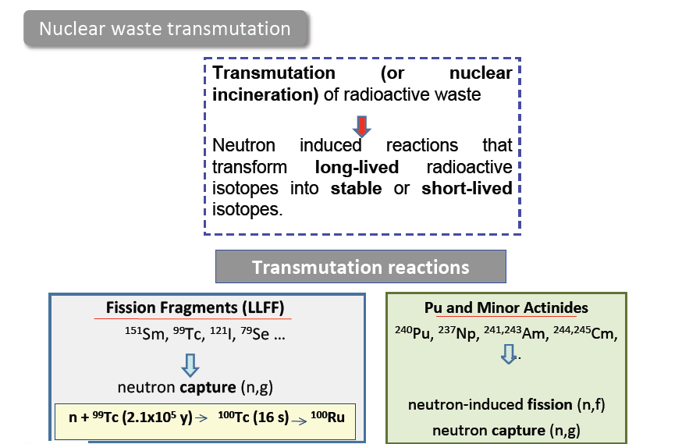

Slide 7
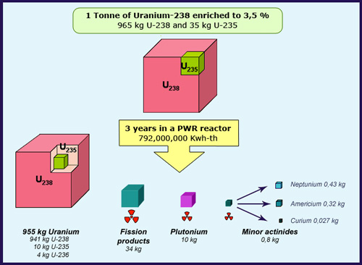
Nuclear Waste Generated Through 1 Ton of Uranium
Production of such high amount of reactor waste is really a big problem which needs to be tackled down by developing either fission or fusion based advanced reactor systems.
Work is being carried out in order to develop Accelerator Driven Subcritical System (ADSs) and International Thermonuclear Experimental Reactor (ITER).

Slide 8
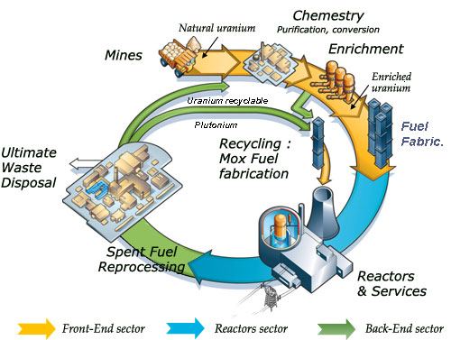
Nuclear Fuel Processing
and Recycling
Nuclear fuel recycling is tedious process and it takes hundreds of years to reduce the radioactive dose from nuclear waste to come to a safe limit. High energy accelerators can be used to convert these long-lived isotopes into stable or short-lived isotopes.

Slide 9
Accelerator Driven System (ADS) for MA Transmutation
Super-conducting LINAC
Proton beam
Max.30MW
100MW
To accelerator
800MW
170MW
Fission energy
To grid
Spallation target(LBE)
MA: Minor Actinides
LBE: Lead-Bismuth Eutectic
270MW
Power generation
Transmutation by ADS
MA-fueled LBE-cooled subcritical core
Utilizing chain reactions in subcritical state
Proton
Spallation target
Fission neutrons
Fast neutrons
Characteristics of ADS:
Chain reactions stop when the accelerator is turned off.
LBE is chemically stable.
➔ High safety can be expected.
High MA-bearing fuel can be used. ➔ MA from 10 LWRs can be transmuted.
Short-lived or stable nuclides
Long-lived nuclides (MA)

Slide 10
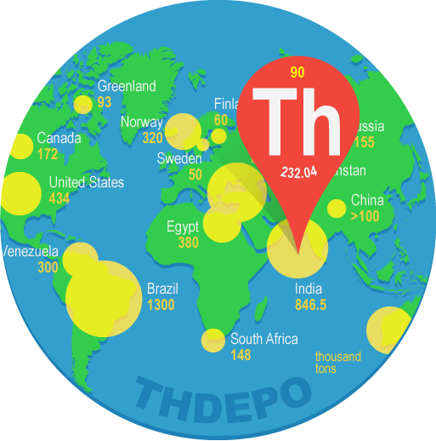
World Natural Thorium Reserve
India has the second largest Thorium (Th) reserve in the world.
Th can be used in advanced reactors to generate Uranium fuel for conventional reactors and to generate electricity.
The advantage of using Th as fuel, is that, it does not produces radiotoxic waste in larger quantities as compared to conventional U fuel operated reactors.
India
846.5
thousand tons

Slide 11
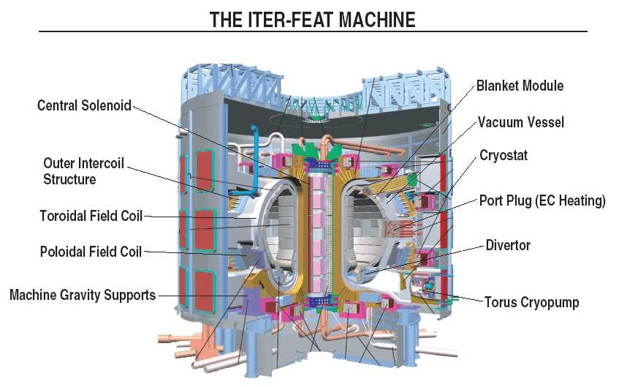
Conditions to sustain a fully operational ITER device…
• Very high temperature of the order of 1.5 x10⁸ Celsius.
• Sufficient plasma particle density to ensure collision occur.
• Sufficient plasma confinement time to increase the effective volume.

Slide 12
Importance of Tin (Sn) in Fusion devices
In ITER, Nb₃Sn conductor is selected for making ITER toroidal field coils, which are able to carry higher current and produce stronger magnetic field plasma confinement.
Tin (Sn) has a wide range of applications in reactor technology. Zircaloy-2 and zircaloy-4 with 1.5% Sn is the commonly used structural alloy in nuclear reactors.
The precise data for the reaction cross section is important from the view point of its nuclear applications, transmutation, shielding effect, radiation damage, long term activation etc.

Slide 13
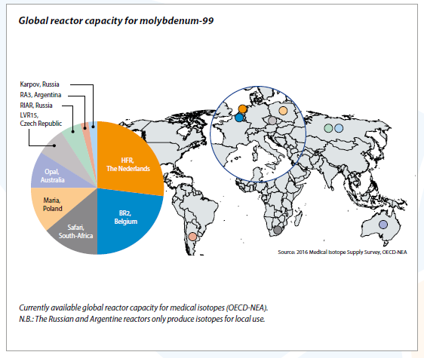

⁹⁹Mo,
The most demanded
medical isotope in world
Production Routes -
“⁹⁹Mo, ¹³¹I, ¹³³Xe, and other radioactive materials are used in the radiopharmaceuticals for diagnostic and therapeutic procedures or for research and development.” This is so because:
1.The decay product of ⁹⁹Mo, ^{99m}Tc, is used in about two-thirds of all diagnostic medical isotope procedures.
2.Between 95 and 98 percent of ⁹⁹Mo is currently being produced using highly enriched uranium (HEU) targets.
3.Other medical isotopes such as ¹³¹I, ¹³³Xe are by-products of the ⁹⁹Mo production process and will be sufficiently available if ⁹⁹Mo is available.

Slide 14
Important reactor materials
FISSION reactor based fuel materials
FUSION reactor based structural materials
Thorium
Uranium
Tin (Sn)
Niobium (Nb)
Neutron and proton induced reaction cross-section data are required for damage studies top the surrounding toroidal field coils
Neutron induced reaction cross-section data are required for advanced reactor design
Structural materials
Nickel
Zirconium
Molybdenum
Tantalum
Titanium
Gadolinium
Etc.
n, p, and γ induced reaction cross-section data are required for designing and radiation damage studies for the advanced reactor systems

Slide 15
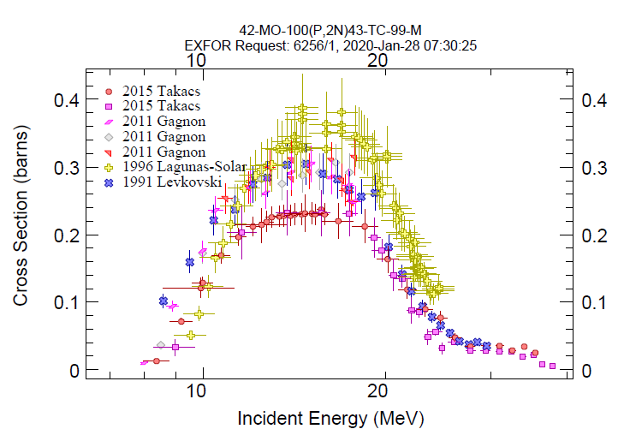
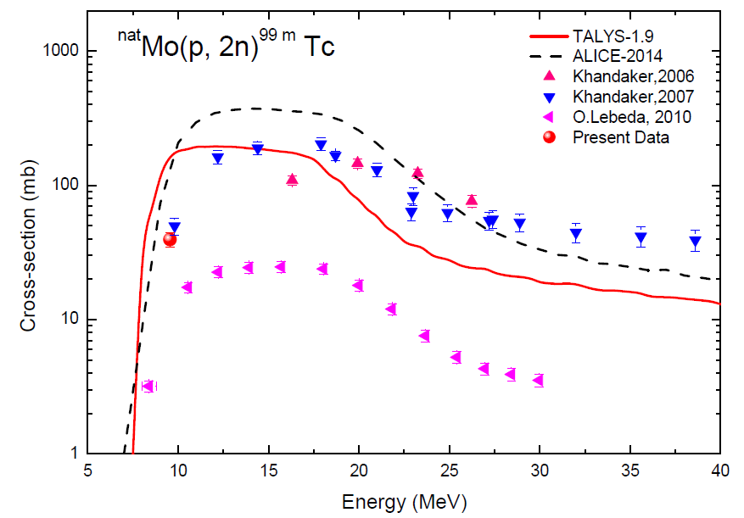
Nuclear Data trend for different isotopes having vast Discrepancies…
Discrepancies in data

Slide 16
Data from EXFOR library
Cross-section Data
are required
Cross-section Data
are required
²³²Th(n, γ) ²³³Th ²³³Pa
²³²Th(n, 2n) ²³¹Th

Slide 17
Data from EXFOR library
Cross-section Data
are concentrated
around 14 MeV
Cross-section Data
are concentrated
around 14 MeV

Slide 18
Data from EXFOR library
Large Discrepancies in
Cross-section Data
⁵⁸Ni(n, p) ⁵⁸Co
⁹⁰Zr(p, n) ⁹⁰Nb

Slide 19
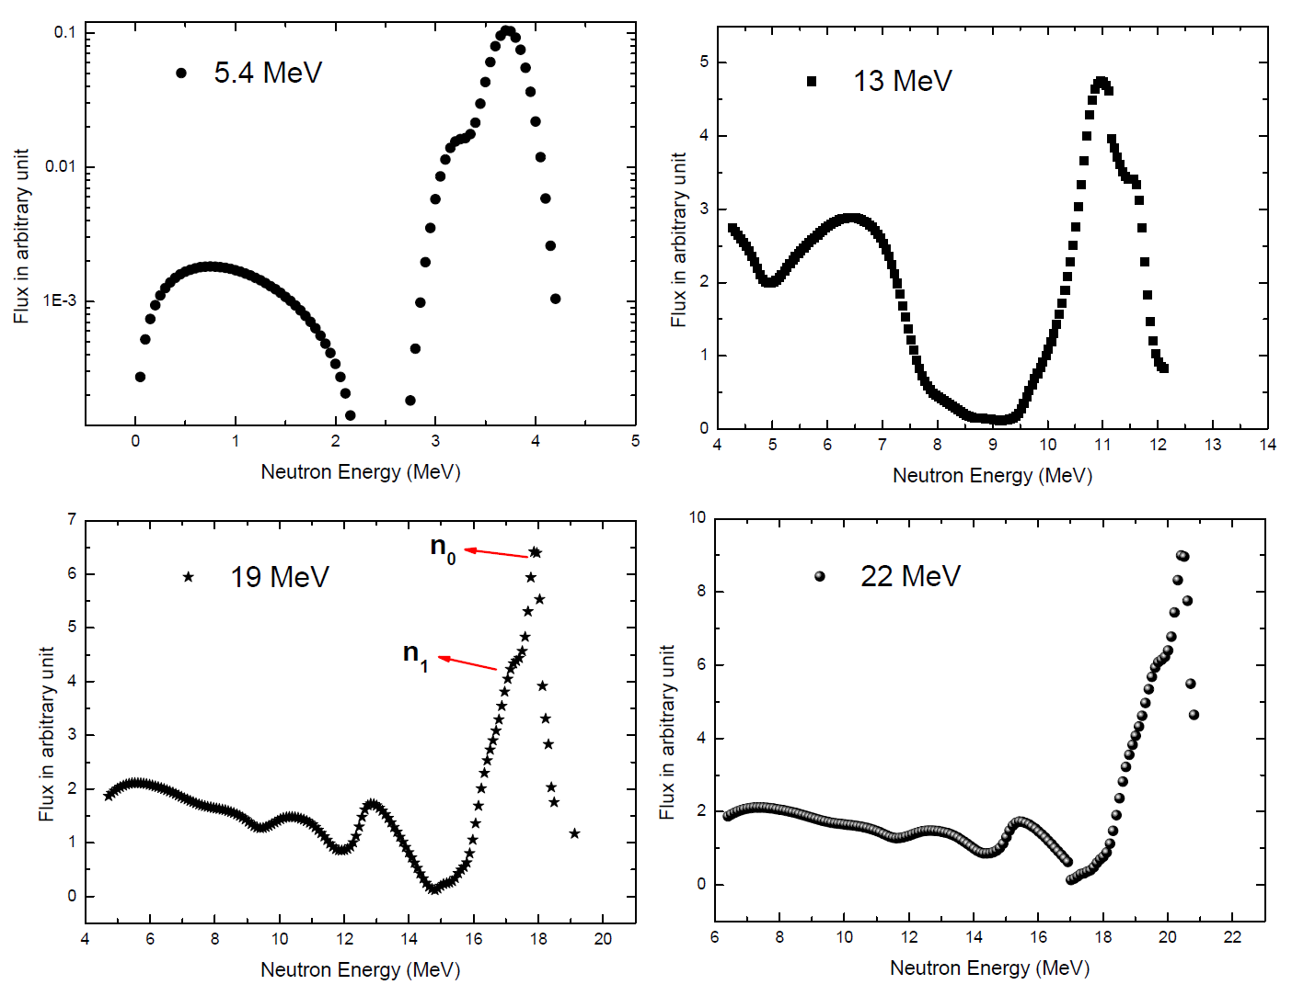
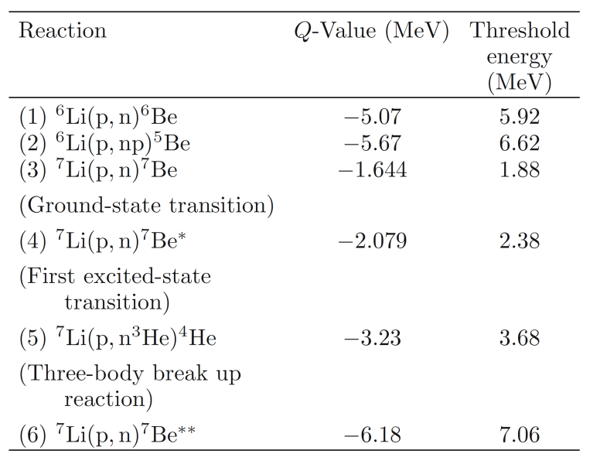
Neutron Production using Accelerators
^{nat}Li(p, n) Neutron generator reaction

Slide 20

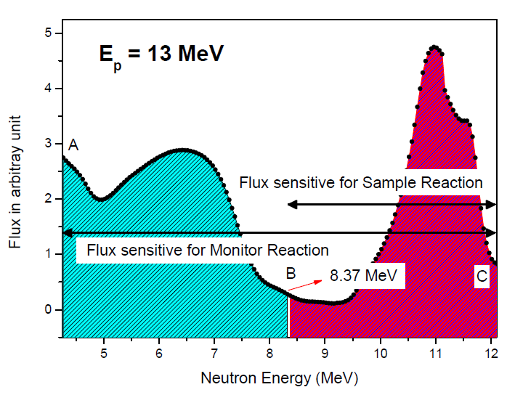
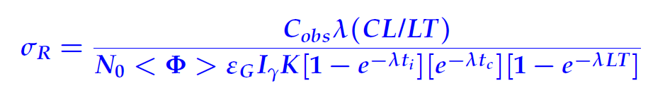
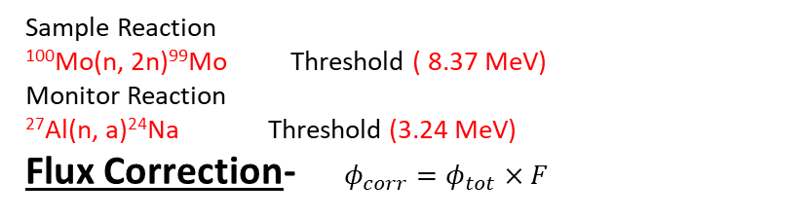
Sample Reaction
¹⁰⁰Mo(n, 2n)⁹⁹Mo Threshold ( 8.37 MeV)
Monitor Reaction
²⁷Al(n, a)²⁴Na Threshold (3.24 MeV)
Flux Correction- $φ_{corr}=φ_{tot}×F$
Cross-section calculations
Activation Formula,
Flux was obtained by taking the ratio of the area from the threshold to maximum neutron energy, and total area from the neutron spectra.
The cross section calculated using this neutron flux is spectrum averaged neutron cross section (σ_{R}) from threshold to neutron maximum energy.
By subtraction of this cross section from the σ_{R} is the actual experimental cross section.

Slide 21
Neutron spectra generated using MCNP code
Input file of MCNP divided into five cards
1) Cell cards
2) Surface cards
3) Source description
4) Material
5) Tally specification

Slide 22
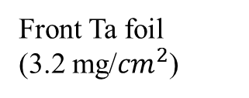
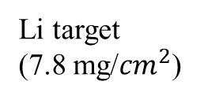
Li target
(7.8 mg/${cm}^{2}$)
2.1 cm
3.5 cm
Proton source
6 mm diameter
Front Ta foil
(3.2 mg/${cm}^{2}$)
Back Ta foil (0.025 mm)
Total neutron flux fall om target
Process of generating a neutron spectra from MCNP code

Slide 23
Neutron spectra (MCNP)
N₀ group
n₁group
Rajnikant Makwana et al., Phys. Rev. C 96, 024608 (2017)

Slide 24
Experimental Methodology
Energy of proton beam : 1 MeV to 22 MeV (200-400 nA)
Neutron Production : ⁷Li(p, n)⁷Be reaction.
p + ⁷Li → n + ⁷Be –1. 64 MeV (E_{th}=1. 880 MeV)
The Li foil is wrapped and kept in between the proton beam and sample.
Experimental samples are placed at 0˚ angle with respect to incident neutron and proton beams.

Slide 25
Measurement of ¹⁰⁰Mo(n,2n)⁹⁹Mo reaction cross-sections :
^{99m}Tc is used for about 80% of the imaging procedures like; single photon emission computed tomography (SPECT).
About 90% of ⁹⁹Mo is produced in about five nuclear reactors around the globe from high enriched uranium (HEU, 93%) and 10% is produced from ⁹⁸Mo(n, γ) reaction.
Siddharth & Mukherjee et. al., Physics Review C 99 (2019) 044602

Slide 26
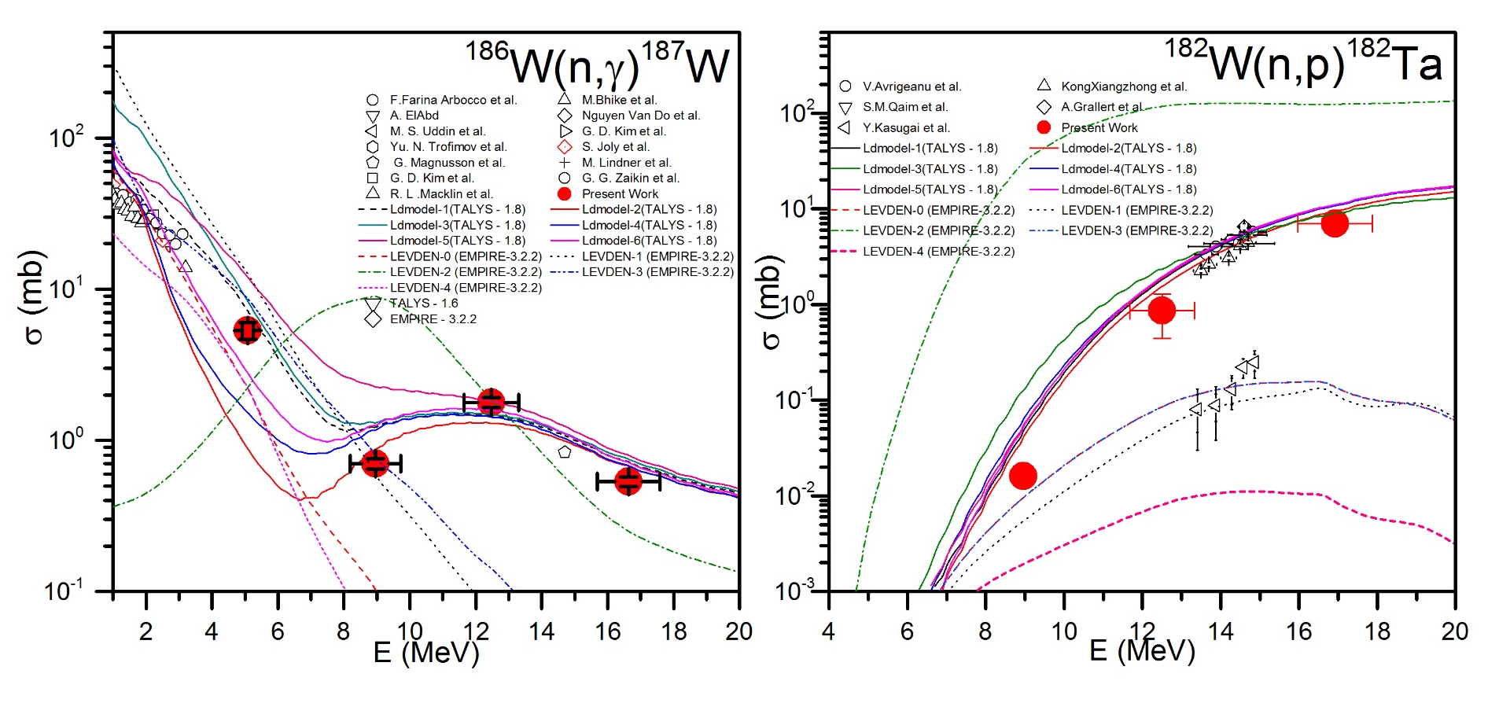
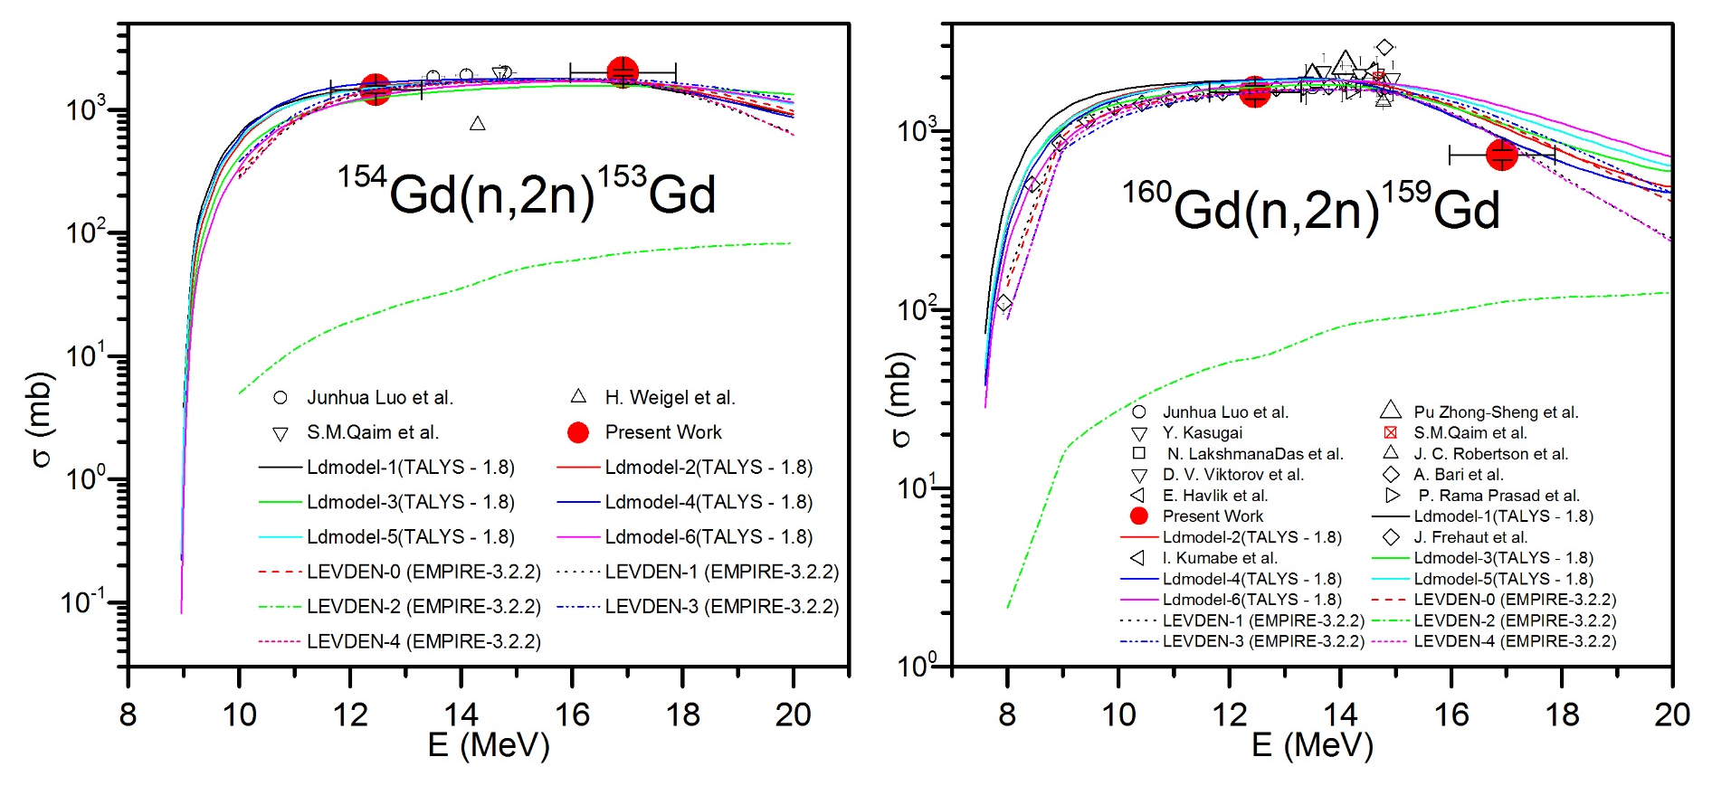
Neutron induced reaction cross-sections of structural materials like Gd, W and Tb:
Makwana & Mukherjee et al., Phys. Rev. C 96, 024608 (2017)

Slide 27
Co-variance Analysis
Uncertainty in detector efficiency-
Sandwich Formula
We brake the efficiency into four main attributes
The Counts (C) for different gamma lines are uncorrelated as they were measured separately. Therefore, S_{ijr} for counts will be an identity matrix.
The gamma abundance for gamma lines of ¹⁵²Eu are the characteristic property of each gamma line and hence they are assigned as uncorrelated.
Since, each gamma line will be following same half life (T_{1/2}) during the decay, therefore, they are correlated. The S_{ijr} matrix in such case would be a square matrix having all the elements as 1.
The initial activity (N₀) will be common for each gamma line therefore it would be treated as correlated quantity.

Slide 28
Co-variance Analysis
Assumptions made to find the correlation among different quantities-
Counts for both the sample (r) and the monitor (m) reactions, at four neutron energies were taken as uncorrelated.
Parameters related to spectroscopic data for both the reactions were taken as correlated as they are common for all the four measurements.
Since, the yield of ⁹⁷Zr for monitor cross-section was taken for 14 MeV neutrons and is kept constant (3.14 ± 0.15, B.S. Shivashankar et al., Nucl. Sci. Eng. 179, 423 (2015)) in each measurement, therefore, it is correlated within four neutron energies.
The monitor reaction cross-sections were taken as independent for each measurement, therefore, assigned as uncorrelated.
²³²Th(n, γ)²³³Pa reaction
(%)
Error (%)
21.2
10.9
20.8
16.1

Slide 29
Theoretical Calculations
TALYS-1.9
EMPIRE-3.2.3-Malta
ALICE-2014
Nuclear Model Codes can be used -
Fitting of the Data with TALYS-1.9 optimized parameters:
The level density parameter (a) varies with the energy as,
Parameter | CTM Default
α | 0.06926
β | 0.28269
γ₁ | 0.43309
The damping parameter γ can be given as,

Slide 30
Possible Outcomes -
The demand of accurately measured data can be fulfilled by performing a series of experiments with different enriched or natural isotopes.
The produced data would be helpful to encourage medical isotopes production at lower scale for day to day use within the medical facility or in a transit radius of few hundred kilometers.
The nuclear model codes can also be upgraded based on the update of their input parameter libraries.
The produced results will also be helpful to generate more evaluated data and to give more confidence over different nuclear model codes to generate and use the theoretical data in future.
These kind of studies will also be helpful to make new cheaper production routes for the medical isotopes.

Slide 31
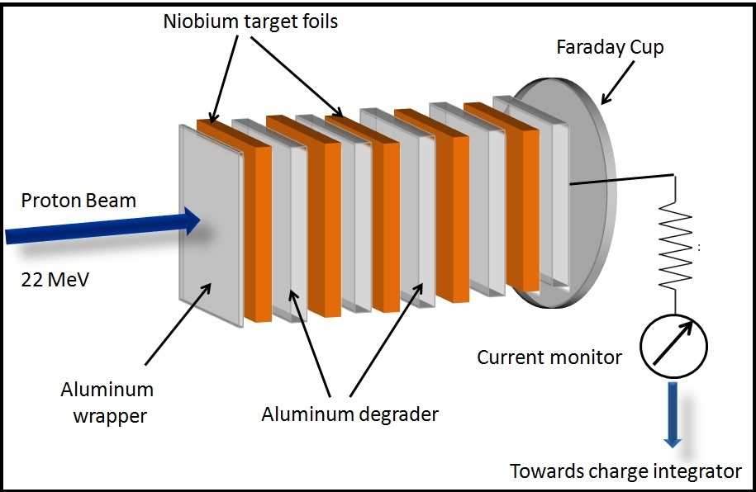
Proton Induced Reactions
Activation & off-line γ-ray spectroscopy
Proton beam of 22 MeV was used
Al degraders of appropriate thickness after each target foil
Current was monitored using the Faraday cup
The measured cross-sections are independent of monitor reactions, therefore, the errors were found to be <10%.
Schematic representation of the target irradiation geometry

Slide 32
Excitation functions for p+⁹³Nb reactions
The excitation functions for ⁹³Nb(p, x) reactions were experimentally determined using stack foil activation technique at five proton energies of 21.85±0.14, 19.53±0.16, 16.98±0.17, 14.13±0.20 and 11.56±0.23 MeV, respectively.
Three residues, ⁹³Nb(p, n)^{93m}Mo, ⁹³Nb(p, pn)^{92m}Nb and ⁹³Nb(p, αn)^{89g}Zr respectively were found to populate as the result of the p+⁹³Nb reaction.
The pre-equilibrium (PE) contribution was also calculated for the (p, xn) channels to understand the dependence of PE emission process on Q-value of the reaction.
Siddharth Parashari et al., Nucl. Phys. A. 978 (2018) 160.

Slide 33
Excitation function for p+^{nat}Ag reactions
The ^{nat}Ag(p, x) reaction cross-sections have been measured for the five proton energies 21.82±0.17, 19.48±0.18, 16.77±0.20, 13.90 ±0:23 and 11.13±0.28 MeV, respectively.
Two residues have been found to be populated as the result of p+ ^{nat}Ag reaction.
The pre-equilibrium (PE) contribution was also calculated for the (p, xn) channels to understand the dependence of PE emission process on Q-value of the reaction.
A comparative study is also planned between proton and neutron induced Ag reactions.
Siddharth & Mukherjee et al., Nucl. Phys. A. 979 (2018) 102.

Slide 34
Measurement of ¹⁰⁰Mo(p, 2n)^{99m}Tc reaction cross-sections :
In addition to ¹⁰⁰Mo(n, 2n)⁹⁹Mo, we have also measured the proton induced channel for the direct production of ^{99m}Tc.
The direct production of ^{99m}Tc allows us to use the isotope for within the short durations.
The results for the present case were presented in the DAE symposium 2018.
Siddharth Parashari et. al., Presented in the DAE symposium 2018.

Slide 35
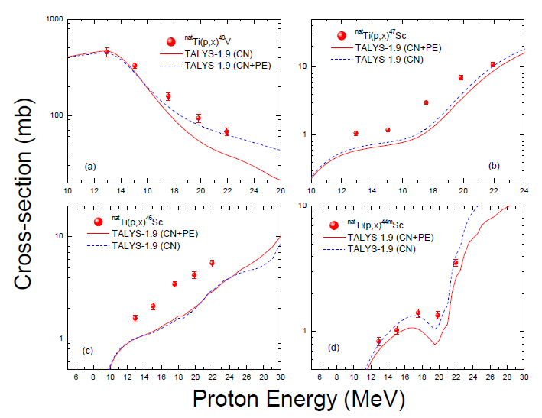
Measurement of ^{nat}Ti(p, x)⁴⁸V,^{47,46,44m}Sc reaction cross-sections :
Pre-equilibrium contributions have been extensively studied in the proton induced reactions with ^{nat}Ti isotopes.
The theoretical calculations were performed using the TALYS-1.9 code.
The uncertainties in the data have been reduced significantly within 10%.
Siddharth & Mukherjee et al., Nuclear Physics A 987 (2019) 128–143

Slide 36
On-going Work
We are analyzing the data regarding the proton and neutron induced reactions for Ni, Ta, Ti, Sn and Mo isotopes.
The detailed analysis for the error propagation has been planned for each case under investigation.
Another experiment has been planned for the fast neutron energies of around 35 MeV at Center of Accelerators and Nuclear Analytical Methods (CANAM), Czech Republic.
The entries will be made into the EXchange FORmat (EXFOR) data library for all the recently measured data during the meeting proposed to be held at MSU Baroda, next year.

Slide 37
Final Remark
Since, there are massive developments for the productions of Nuclear medicine and reactor isotopes for the betterment of present technology, therefore, more experimental studies should be carried out

Slide 38
Recent Publications -
1. Measurements of Thorium and Uranium neutron capture cross section in the energy range 5 to 17 MeV
S. Mukherjee, Vibha Vansola, et al., App. Rad. Iso. 143 (2019) 72–78.
2. Measurement of the ⁵⁸Ni(n, p)⁵⁹Co and ⁵⁸Ni(n, 2n)⁵⁷Ni reaction cross-sections for the fast neutron energies upto 18 MeV
Siddharth Parashari, et al., European Physical Journal A 55 (2019) 51.
3. Systematic analysis of the neutron induced reaction cross sections for ^{nat}Mo isotopes within 10-20 MeV
Siddharth Parashari, et al., Physical Review C 99 (2019) 044602.
4. Excitation function of the p +^{nat}Ag reactions in the energy range 10-22 Me Siddharth Parashari, et al., Nucl. Phys. A 979 (2018) 102-112.
5. Excitation functions of the p +⁹³ Nb reaction in the energy range 10-22 MeV Siddharth Parashari, et al., Nucl. Phys. A 978 (2018) 160–172.
6. Measurement of ²³²Th(n, γ) reaction cross sections in the neutron energy range of 11–19 MeV
Siddharth Parashari, et al., Phys. Rev. C 98 (2018) 014625.
7. Investigation of (n, p), (n, 2n) reaction cross sections for Sn isotopes for fusion reactor applications
Siddharth Parashari, et al., Applied Radiation and Isotopes 133 (2018) 31–37.
8. Neutron capture cross-sections for ¹⁵⁹Tb isotope in the energy range of 5 to 17 MeV
B.K. Soni et al., App. Rad. Iso. 141 (2018) 10–14.
9. Measurements of the cross sections of the ¹⁸⁶W(n,γ )¹⁸⁷W, ¹⁸²W(n, p) ¹⁸²Ta, ¹⁵⁴Gd(n,2n)¹⁵³Gd, and ¹⁶⁰Gd(n,2n)¹⁵⁹Gd reactions at neutron energies of 5 to 17 MeVRajnikant Makwana et al., Physical Review C 96 (2017) 024608.

Slide 39
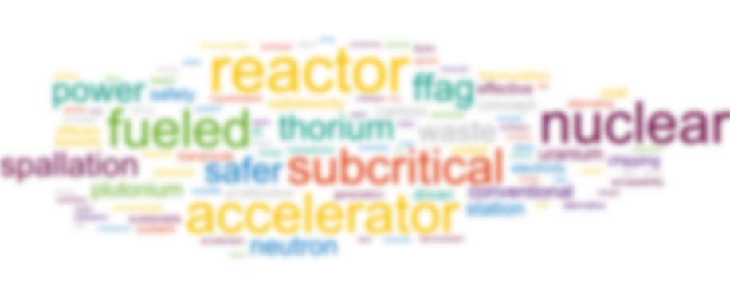
Thank You !!

