Slide 1
Update to LLM App in the Curator Tool
4/9/2025

Slide 2
Computational Evaluation: data sources
Reactome Database Version 90
Reactome Database Version 71
545 Genes Annotated in v90, but not v71
Nathan Boyer

Slide 3
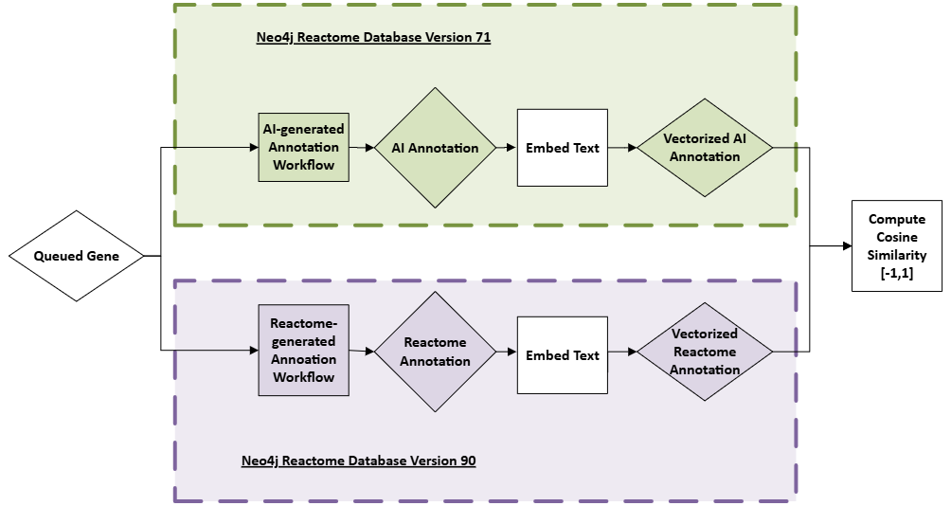
Computational Evaluation: workflow
Nathan Boyer

Slide 4
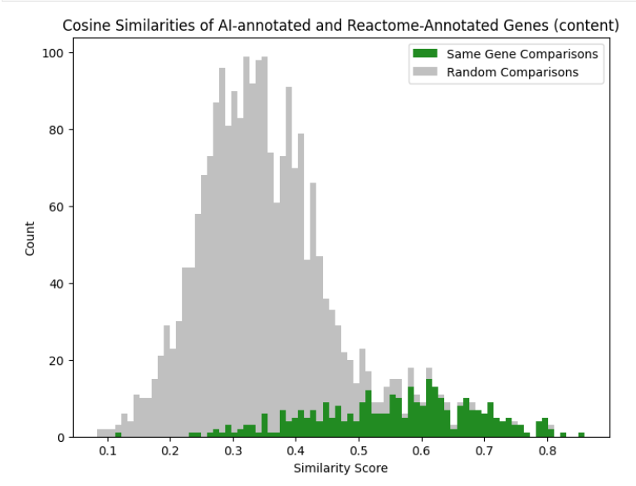
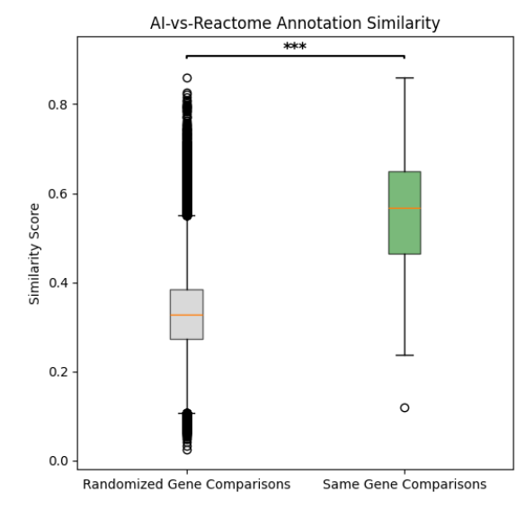
Computational Evaluation: results
545 total genes queued → comparable results for 326 genes ~ 60% successful ( limited by Reactome annotated pathways, some not applicable for summary)
Nathan Boyer
Notes:
545 total genes queued → comparable results for 326 genes ~ 60% successful ( limited by Reactome annotated pathways, some not applicable for summary)…move to slide previous
Of the 326 genes successfully ran, 227 reach FDR significance of 0.05.
Two sample t-test, p-value < 0.0001

Slide 5
Curation Manual Evaluation
LLM feature testing log
Good: 4
Ok: 7
Bad: 9
Ok or good: 55%

Slide 6
Curation Manual Evaluation: Summary
The source of interactions is not supported by PMIDs: may need to switch to IntAct or other manually annotated interaction data source or interactions with literature supported. Right now FIs are used, some of which are predicted. Also the interactions should be displayed together with the summary text.
Some match between a pathway and PMID is too vague or wrong: May need to increase the threshold for semantic similarity. Also need to provide this score in the output for curators to evaluate.
Synonyms sometimes are mixed: need to make sure they are matched.
The output may be too high level, more like for a pathway summary, instead of focusing on the molecular mechanisms, which actually should be extracted from the full text paper as originally designed.
Need to provide configurations: e.g. FI cutoff, interaction pathway cutoff, interaction data source, LLM model etc.
Software bugs?

Slide 7

RAG-based Workflow for LLM App in Curator Tool
*
Prompt
LLM
for each
Genes-related Abstracts
Pathway-matched Abstracts
PubMed
Abstract & Pathway Summary
merge into one
Gene not annotated
Interacting pathways
Pathway Summaries
Prompt
Interacting genes
LLM
idg.reactome.org
Reactome Neo4j
Final Summary
Retrieval
Generation

Slide 8
RAG-based Workflow for LLM App in Curator Tool
*
Prompt
LLM
for each
Genes-related Abstracts
Pathway-matched Abstracts
PubMed
Abstract & Pathway Summary
merge into one
Gene not annotated
Interacting pathways
Pathway Summaries
Prompt
Interacting genes
LLM
FIs
idg.reactome.org
Reactome Neo4j
Final Summary
PPIs in IntAct and BioGrid
Retrieval
Generation

Slide 9
RAG-based Workflow for LLM App in Curator Tool
Local MangoDB
*
Prompt
LLM
Download from PubMed
for each
Genes-related Abstracts
Pathway-matched Abstracts
PubMed
Abstract & Pathway Summary
merge into one
Gene not annotated
Interacting pathways
Pathway Summaries
Prompt
Interacting genes
LLM
FIs
idg.reactome.org
Reactome Neo4j
Final Summary
PPIs in IntAct and BioGrid
Retrieval
Generation

Slide 10
RAG-based Workflow for LLM App in Curator Tool
Local MangoDB
*
Prompt
LLM
Download from PubMed
for each
Genes-related Abstracts
Pathway-matched Abstracts
PubMed
Abstract & Pathway Summary
VectorStore
Direct comparison
merge into one
Gene not annotated
Interacting pathways
Pathway Summaries
Prompt
Interacting genes
LLM
FIs
idg.reactome.org
Reactome Neo4j
Final Summary
PPIs in IntAct and BioGrid
Retrieval
Generation

Slide 11
RAG-based Workflow for LLM App in Curator Tool
Local MangoDB
*
Prompt
LLM
Download from PubMed
for each
Genes-related Abstracts
Pathway-matched Abstracts
PubMed
Abstract & Pathway Summary
VectorStore
Direct comparison
merge into one
Gene not annotated
Interacting pathways
Pathway Summaries
Ask LLM to score
Prompt
Interacting genes
LLM
FIs
idg.reactome.org
Reactome Neo4j
Final Summary
PPIs in IntAct and BioGrid
Retrieval
Generation

Slide 12
RAG-based Workflow for LLM App in Curator Tool
Local MangoDB
*
Prompt
LLM
Download from PubMed
for each
Genes-related Abstracts
Pathway-matched Abstracts
PubMed
Abstract & Pathway Summary
VectorStore
Direct comparison
merge into one
Gene not annotated
Interacting pathways
Pathway Summaries
Ask LLM to score
Prompt
Interacting genes
LLM
FIs
idg.reactome.org
Reactome Neo4j
Final Summary
PPIs in IntAct and BioGrid
Retrieval
PPI abstracts
Final Output
Generation

Slide 13
RAG-based Workflow for LLM App in Curator Tool
Local MangoDB
*
Prompt
LLM
Download from PubMed
for each
Genes-related Abstracts
Pathway-matched Abstracts
PubMed
Abstract & Pathway Summary
VectorStore
Direct comparison
merge into one
Gene not annotated
Interacting pathways
Pathway Summaries
Ask LLM to score
Prompt
Interacting genes
LLM
FIs
idg.reactome.org
Reactome Neo4j
LLM summary of annotation
Final Summary
PPIs in IntAct and BioGrid
Retrieval
PPI abstracts
Final Output
Generation

