Slide 1
LLM Use Cases for Curation

Slide 2
A gene that has not been annotated in Reactome
Should we expand an existing Reactome pathway(s) or reaction(s) to accommodate this gene (Use_Case_1)?
  Find the best pathway(s) or reaction(s) for this gene?
  Find the most relevant papers about this gene and the pathway or reaction
  Write text summary for a new reaction
  Structure the text summary in a format as similar as possible to Reactome’s format: {input} -> {output}, catalyzed by {}, inhibited by {}, and activated by {}
If not, we need to create a new pathway. What pathway should we create?

Slide 3
A gene that has not been annotated in Reactome
If not, we need to create a new pathway. What pathway should we create (Use_Case_2)?
  Find the most pathway-relevant papers about this gene
    Semantic similarity analysis between the papers and Reactome summary text
    May enhance the Reactome knowledge graph by including all publicly papers (abstracts only)
  Write text summary about the selected papers
    Prompt to list as many genes or proteins as possible
    Come with a title of the pathway
    Citations
  Is there any way to break down the pathway into multiple small parts???
    Need more research

Slide 4
Annotate a new pathway (Use_Case_3)
Variant of Use_Case_2 but no gene specified

Slide 5
Annotate crosstalk between pathways
Variant of Use_Case_1:
  Pull the most pathway-relevant papers covering two Reactome pathways
  Write text summary for a new reaction
  Structure the text summary in a format as similar as possible to Reactome’s format: {input} -> {output}, catalyzed by {}, inhibited by {}, and activated by {}

Slide 6
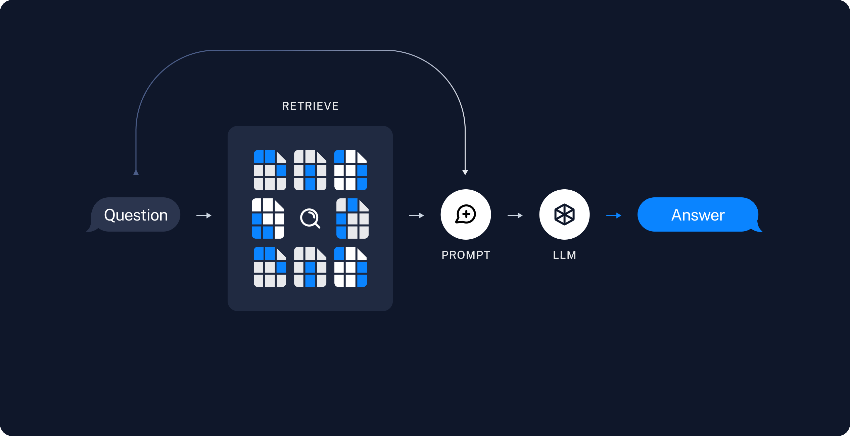
Retrieval Augmented Generation (RAG)
PubMed Abstracts (All)
VectorDB_1
PMC Full Text (To be fetched, updated on-the-fly)
VectorDB_2
Summary Text
https://python.langchain.com/docs/use_cases/question_answering/
Reactome Neo4j
Sources for retrieval

Slide 7
Retrieval Augmented Generation (RAG)
Use pathway text to select abstracts
Use selected abstracts to pull out the full text
Optional: Provide the context for other related tokens (e.g. neighboring events, genes, etc)
PubMed Abstracts (All)
VectorDB_1
PMC Full Text (To be fetched, updated on-the-fly)
2
1
Question
VectorDB_2
Prompt
LLM
Summary Text
3
Reactome Neo4j
Extraction
Answer
Sources for retrieval
Persist
To determine if a gene should be placed in the existing pathway (Use_Case_1):
1). Analyze the similarity distribution between Reactome’s text summary and abstracts and see if there is a pattern.
2). If there is a pattern, get the threshold (e.g. mean or medium). A gene having abstracts with any similarity larger than this threshold should be considered to be added into that pathway.
3). If not, compare the summary of the gene and Reactome’s pathway text. Ask LLM or manually check.

Slide 8
Other Use Cases in Curation
Use text to finish some common tasks in curation
  E.g. Create a Reaction having ATP in cytosol as one input. This Reaction’s compartment is cytosol, and the reaction’s species is human.
    Need to make LLM to understand Reactome’s data model, which may be easy.

Slide 9
Use Cases for the Production Service
Summarize the annotation for {gene} (e.g. EGFR) in Reactome
  Need links to individual pathways and/or reactions
Summarize the analysis result in a text paragraph
  Based on significant pathways (FDR < 0.01 or 0.05, can be set by users) for the analysis
If a gene is not annotated in Reactome, predict potential interacting pathways and write a summary about these pathways
  Similar to the second use case here
  Use IDG predicted interacting pathways

Slide 11
Gene-based Workflow
Annotated
yes
Annotated Pathway Summary
PubMed Literature Summary (Full Text)
1
4
check
Gene
query
query
2
Interacting Pathway
yes
Interacting Pathway Summary
query
PubMed Literature Summary (Abstract)
3
no
query
Output:
1). Summary of a gene in Reactome
2). Summary of interacting pathways for a gene (annotated or not)
3). Summary of literature references for interacting pathways (expanding Reactome pathways or create new pathways)
4). Detailed mechanistic summary from full text papers

