Slide 1

Presented by Aleksey Bragin
aleksey@reactos.org
Notes:
Quick intro – 30s
Hello, my name is Aleksey Bragin, I am coordinator of and developer for ReactOS project.
In this talk I’m going to give you a brief overview of ReactOS, components it consists of, technical aspects of the kernel and the bootloader, and perform a small demonstration of what ReactOS really is.

Slide 2

Agenda
1. Introduction
2. NT/ROS System Design
3. ReactOS Kernel
4. Bootloader
5. Summary
6. Demonstration
Notes:
All – 30s
Briefly outline the topics which will be discussed
If anyone is unclear on anything please interrupt me, but can you leave any general questions until the end.

Slide 3
Introduction
What is ReactOS?
  History
  Complete Windows replacement
  100% compatable with Windows
  Licenced under GPL
  ~20 active developers
  Freely available to everyone
Notes:
All – 300 sec
1 - What is ReactOS? – 10 sec
2 – History – 180 sec
Back in the 1970’s and 80’s, the dominant operating system was Unix. However Unix was costly, and out of the reach of your average home user.
In the early 90’s, a computer science student named Linus Torvalds, who was fascinated by hardware and operating systems started a project to rewrite the Unix kernel.
His progress was documented online and quickly aroused the interest of other developers. Development on this free version of Unix grew into what many of you know today as Linux. A dominant presence in the server market, and a potential threat to Windows in the client market.
However, this potential domination in the client market has never really taken hold as the major Linux players continually hope for. Therefore, there is still a huge niche in the market with Microsoft maintaining their stranglehold on end users, at the users cost. This is where ReactOS comes in, with an aim to do with Windows what Linux did with Unix.
ReactOS originally emerged as FreeWin95, encouraged by the growth of Linux, its goal was to write a free implementation of Windows 95. The original project didn’t get very far. There was too much talk about methodologies and not enough coding and it eventually withered away.
In 1997, one of the FreeWin95 developers put out a call out to regroup with a new goal of Windows NT, and an emphasis on writing code as opposed to emails. A new name was decided upon as a reaction to the Windows domination, and ReactOS was born.
The initial years were painfully slow. Low level coding of the kernel mode components was left to specialist developers. With no eye-candy to show to the world, the project remained relatively unknown making it difficult to attract new developers. Initial foundations for the NT kernel and HAL were put in place, and basic generic drivers were written, paving the way for the beginnings of a new operating system.
3 – Complete Windows replacement – 20 sec
ReactOS is an effort to produce a complete rewrite of the Windows NT5 operating system. Thus, ReactOS is not Linux based, but a completely new operating system.
The whole operating system is being written from the ground up, with the entire architecture simulating the NT5 architecture.
We believe most home users are so used to Windows and have become so reliant on it, that a move to a completely different operating system is simply out of the question. There is also the fact that the majority of home users simply don’t have the necessary computer skills to run Linux, or a desire to learn it.
Whilst Linux only provides a kernel with all the other components available as add-ons, ReactOS is a full operating system distribution as Windows is. This means it will not only include system architecture above the kernel, but also apps such as Explorer, Notepad and a paint package.
4 - 100% compatible with Windows – 20 sec
The aim of ReactOS is to take any Windows software off the shelf, and have it successfully install and run in ReactOS. This doesn’t just apply to software such as MS Office or Photoshop, but also applies to games and even drivers.
5 – Licensed under the GPL – 20 sec
The majority of the ReactOS codebase is licensed under the GPL. This means the full source code is available online, and freely available for anyone to download and modify at their leisure. Some parts of the source which have been incorporated from projects such as Wine or BSD are licensed according to their project.
6 – ~20 active developers – 20 sec
Our central code repository is located in Russia and is controlled via a CVS system called SVN. We have active developers from Europe, America and Canada working on ReactOS, and a strong list of contributors from all around the world.
7 – Freely available to everyone – 20 sec
Being that ReactOS is licensed under the GPL, it ensures it will always be freely available, both as in speech, and as in beer.

Slide 4
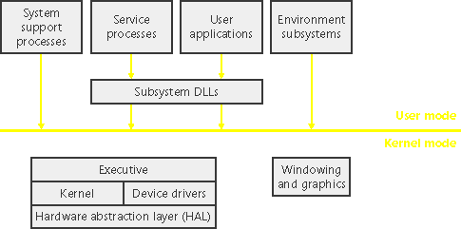
NT / ROS System Design
Notes:
All – 240 sec
Let's take a look at the key system components that make up its architecture.
A simplified version of this architecture is shown, keep in mind that this diagram is basic, it doesn't show everything. (For example, the networking components and the various types of device driver layering are not shown.)
The four basic types of user-mode processes are described as follows:
Fixed system support processes such as the logon process and the session manager, that are not Windows services. (That is, they are not started by the service control manager)
Service processes that host Windows services, such as the Task Scheduler and Spooler services. Services generally have the requirement that they run independently of user logons. Many Windows server applications, such as Microsoft SQL Server and Microsoft Exchange Server, also include components that run as services.
User applications, dealing with 32 only at present with ReactOS
Environment subsystem server processes, which implement part of the support for the operating system environment, or personality presented to the user and programmer. Windows NT originally shipped with three environment subsystems: Windows, POSIX, and OS/2. OS/2 was dropped as of Windows 2000. As of Windows XP, only the Windows subsystem is shipped in the base product—an enhanced POSIX subsystem is available as part of the free Services for Unix product.
Notice the "Subsystem DLLs" box below the "Service processes" and "User applications" boxes. Under Windows, user applications don't call the native Windows operating system services directly; rather, they go through one or more dlls. The role of the subsystem DLLs is to translate a documented function into the appropriate internal (and generally undocumented) Windows system service calls. This translation might or might not involve sending a message to the environment subsystem process that is serving the user application.
The kernel-mode components of Windows include the following:
The Windows executive contains the base operating system services, such as memory management, process and thread management, security, I/O, networking, and interprocess communication.
The Windows kernel consists of low-level operating system functions, such as thread scheduling, interrupt and exception dispatching, and multiprocessor synchronization. It also provides a set of routines and basic objects that the rest of the executive uses to implement higher-level constructs.
Device drivers include both hardware device drivers that translate user I/O function calls into specific hardware device I/O requests as well as file system and network drivers.
The HAL is a layer of code that isolates the kernel, device drivers, and the rest of the Windows executive from platform-specific hardware differences (such as differences between motherboards).
The windowing and graphics system implements the graphical user interface (GUI) functions (better known as the Windows USER and GDI functions), such as dealing with windows, user interface controls, and drawing.

Slide 5
Brief Overview of the OS
Kernel, HAL, Device Drivers
Win32 Subsystem (csrss.exe, win32k.sys, user32.sys, …)
Networking (device drivers, helper DLLs, protocols implementations)
GDI & User Interface (gdi32.dll)
DirectX & OpenGL (a set of dx DLLs, Mesa as an OpenGL alternative is used)
Notes:
All – 20 sec
Ok, I’m gonna move away from the architecture design, and speak about key components which the majority of people are interested in, and the state of these components in ReactOS.
Executive, including HAL, Kernel and device drivers
Win32 subsystem, comprising of both kernel and usermode components
The network model, from layer 2 to layer 7
GDI, windowing and the user interface
Gaming, provided by both DirectX and OpenGL.

Slide 6
HAL
Hardware Abstraction Library
  Physically done as a HAL.DLL file which is referenced by NTOSKRNL.EXE
  Technically, exported API tries to correspond to the one of Windows® 2003 SP1
  But, there are a couple of ReactOS-specific functions, and HAL<->Kernel interface is not compatible with Windows® NT
  UP and MP versions exist, but currently only UP is being actively worked on
  XBOX version exists too, but currently it’s outdated

Slide 7
NTOSKRNL.EXE: Overview
The Kernel, named NTOSKRNL.EXE (for compatibility reasons)
  Physically done as a PE executable, which references a few other helper DLLs (hal.dll, bootvid.dll, in future kdcom.dll)
  Kernel is developed from scratch (not based on Linux or any other kernel)
  Bootloader does all the work on loading kernel, its DLLs, and passing control

Slide 8
Architecture of the Kernel
Architecturally and technically ReactOS kernel aims Windows® 2003 SP1 kernel
  Exported APIs and internal functions are named the same as Windows®’s kernel exported APIs and internal functions (when it’s possible to obtain names from .PDBs or OpenRCE.org)
  Books really help a lot (Windows internals, File System internals, etc etc)
Kernel consists of a quite a few “modules”
  They are referred to by using short acronyms
  Cc, Cm, DbgK, Ex, FsRtl, Inbv, Io, IoMgr, PnpMgr, Kd, Ke, LPC, Mm, Ob, Po, Ps, Rtl, Se, VDM and Wmi
  Let’s look what those letters are…

Slide 9
Kernel modules
Cc – Cache Controller, manages caching and prefetching operations. ROS: Stubbed
Cm – Configuration Manager (“Registry support”), provides high-level routines to manipulate with registry. ROS: Simplified implementation, needs bugfixing
DbgK – User-mode debugging support. ROS: Implemented
Ex – Executive (system init, info, sync objects, resources, atoms, etc). ROS: Implemented
FsRtl – File-system runtime library (File locks, Notifications, MCBs, etc). ROS: Partly implemented
Inbv – Initialization Boot Video, contains mostly forwarders to bootvid.dll’s functions. Manages nice boot time images and animation.
Notes:
Say the most important modules of the kernel, not all

Slide 10
Kernel Modules 2
Kd – Kernel Debugger interface. In ReactOS it’s implemented as an embedded kernel debugger called KDBG (while in NT it’s only an interface to the standalone debugger)
Ke – Low-level kernel arch (scheduler, exceptions, IRQ, APC, DPC, etc)
Lpc – Local Procedure Call, a mechanism used mostly by subsystems (csrss, smss, etc)
Mm – Memory Manager. ReactOS implementation is completely different from NT.
Ob – Object Manager, manages all objects inside kernel
Po – Power Manager, for ReactOS it’s a low priority atm
Ps – Process Support (thread & process creation / deletion, state changes, etc)

Slide 11
Kernel Modules 3
RTL – Run-Time Library, shared between the kernel, a bootloader and various libraries
Se – Security Reference Monitor (access states, privileges, SIDs)
VDM – Virtual DOS Machine implementation in kernel-mode. Unimplemented in ReactOS
Wmi – Windows Management Instrumentation. Stubbed in ReactOS.

Slide 12
Summary of kernel compatibility
How compatible our implementations are to Windows?
Bootloader
  Unable to boot Windows (though some work has been done in a branch, so it’s able to boot Windows NT4)
HAL
  Incompatable with Windows HAL
  Only APIs used by ReactOS kernel and most device drivers are implemented
Kernel (in terms of architecture similarities and API implementation)
  Ps, Ob, Ke, IoMgr, Ex = 90% Compatible.
  Rtl= 70% Compatible.
  Se = 60% Compatible.
  Mm, FsRtl, Lpc, Cm = 40% Compatible.
  Po, Vdm= 5% Compatible.
  Dbgk = 80% Compatible.
  Kd= 10% Compatible
  Cc = 0%.
  Wmi = 0%
  AVERAGE COMPATIBILITY = 55%
Notes:
All – 120 sec
The ReactOS HAL is incompatible with the Windows equivalent, although some work has recently been done to make it more compatible regarding calls into the kernel. It has a minimal set of APIs which drivers use to communicate with hardware which are compatible (like read/write to ports, delay execution, etc)
however, higher stuff like initialization, apic/pic support / irq handling, video init/deinit, is quite different from windows.
Discuss kernel compatability
Process Support…
Object Manager…
Kernel…
IO Manager…
Executive…
RunTime lib…
Security…
Memory Manager…
FileSystem Manager
Power Manager…
Cache Controller…
Kernel debugger + usermode debug APIs
ReactOS drivers are similar to windows versions and uses the same mechanisms (i.e. a IRP which is passed from driver to driver in the device driver stack) so we can currently support (a few) XP windows drivers (except storage stack which still uses the NT4 format)
Basics are now in place to run all XP drivers, you can install drivers with the wizard, and driver will run if it doesn't use unimplemented/buggy functions in ntoskrnl and if it doesn't use WMI as it’s not implemented yet.
The pnpmgr pretty much feature complete. It will detect the addition of new hardware and popup the install wizard, whereby you can install drivers by pointing them at the .inf file. However, it currently doesn't support the removal of a device.

Slide 13
Bootloader
What does a bootloader do?
  Prepare environment so kernel can work
  Load kernel and pass control to it
Is it really so simple?
In case with Linux – yes, it is (LILO – 4 chars, 4 stages…)
In case with ReactOS (and Windows® NT) – no, it’s not (FREELOADER – try to count the letters / boot stages ☺)
A problem: ntldr boot-process is poorly documented, so lot of experiments has been done

Slide 14
FreeLdr
FreeLoader is the default (and only) bootloader which is able to directly/natively boot ReactOS kernel
Features
  Completely unique design (not similar to either GRUB or Microsoft’s ntldr / ntdetect.com)
  Portable architecture
  Powerful abilities inside
Aims to provide the same environment to the Operating System kernel which ntldr does, but using different technology

Slide 15
Boot process
So what’s that complex? Load a kernel into the memory, switch to protected mode and pass control to it?
But what about:
  Filesystems support
  Kernel consists of a few files (ntoskrnl.exe, linked to bootvid.dll, hal.dll, plus boot-time drivers, each of them may have its own dependencies)
  Memory Manager
  Hardware configurations
  Setting up virtual paged mode with two address spaces
  Registry hive loading
  National Language support

Slide 16
Boot process 2
The boot process consists of the following steps
  Load freeldr.sys into memory, initialize it’s memory manager
  Load settings from an ini file and show a menu to a user (if needed)
  When user selects “boot”, and type of the kernel is set to Windows, LoadAndBootWindows() is called
  If user selects ReactOS, then LoadAndBootReactOS() is called. Right now, ReactOS boot process is different from the Windows-one, but is being slowly improved to be the same (in future the will be smth. like LoadAndBootNTAlike(version) )

Slide 17
LoadAndBootWindows()
Open filesystem where the kernel resides
Get parameters (if any) to be passed to the kernel
Allocate and initialize LoaderParameterBlock structure
Perform hardware detection and build a hardware configuration tree
Load NTOSKRNL.EXE
Load HAL.EXE

Slide 18
LoadAndBootWindows() - 2
Scan import descriptor tables for the kernel and HAL, and load all referenced DLLs
Load system hive into the memory
Compile a boot-time drivers list (using an information from the system hive)
Get file names of the NLS tables and load the data
Load boot drivers

Slide 19
LoadAndBootWindows() - 3
Load boot drivers (and their dependencies)
Initialize more fields of the LoaderParameterBlock
  Device names
  Options
  Arc devices list
  Extension
Prepare some memory structures (allocated pages for PCR, TSS, GDT and IDT)
Prepare video mode (change to 0x12 videomode)
Turn on paging (to be explained!)
Call the kernel’s KiSystemStartup(LoaderParameterBlock)

Slide 20
“Turn on paging”
One of the most complex things throughout the whole bootloading process
Windows NT’s kernel Memory Manager is very picky about things
Roughly speaking, kernel wants to get:
  Memory descriptors list
  PDE + PTEs properly describing all the stuff allocated during boot process
  Special “HAL” PTE for special mapping, and PCR+TSS mapped via it
  CPU in protected and paged mode

Slide 21
Memory Mapping
A few things must be kept in mind:
Only the first 16Mb must be mapped to PDE (thus occupying 4 PDE entries – all other must be nulls)
Memory descriptors list must cover all available memory
Quantity of memory descriptors in the list must not be over 30 (otherwise the kernel bugchecks)

Slide 22
Memory Mapping - 2
Lower 2Gb of virtual address space are identity contiguously mapped to the physical memory (user-space)
Higher 2Gb map only what is described as non-free memory in the descriptors list (kernel-space)
Thus: user-space is contiguous, kernel-space has holes

Slide 23
Selector filling
Properly filling GDT and IDT tables
Setting CS to 0x8, DS & ES to 0x10
Loading TSR
Clearing GS to 0
FS points to PCR (0x30)
That’s it! We convert all pointers to the virtual address mode (including all lists) and call KiSystemStartup() and pass a pointer to LoaderParameterBlock. The kernel [should] load ☺

Slide 24
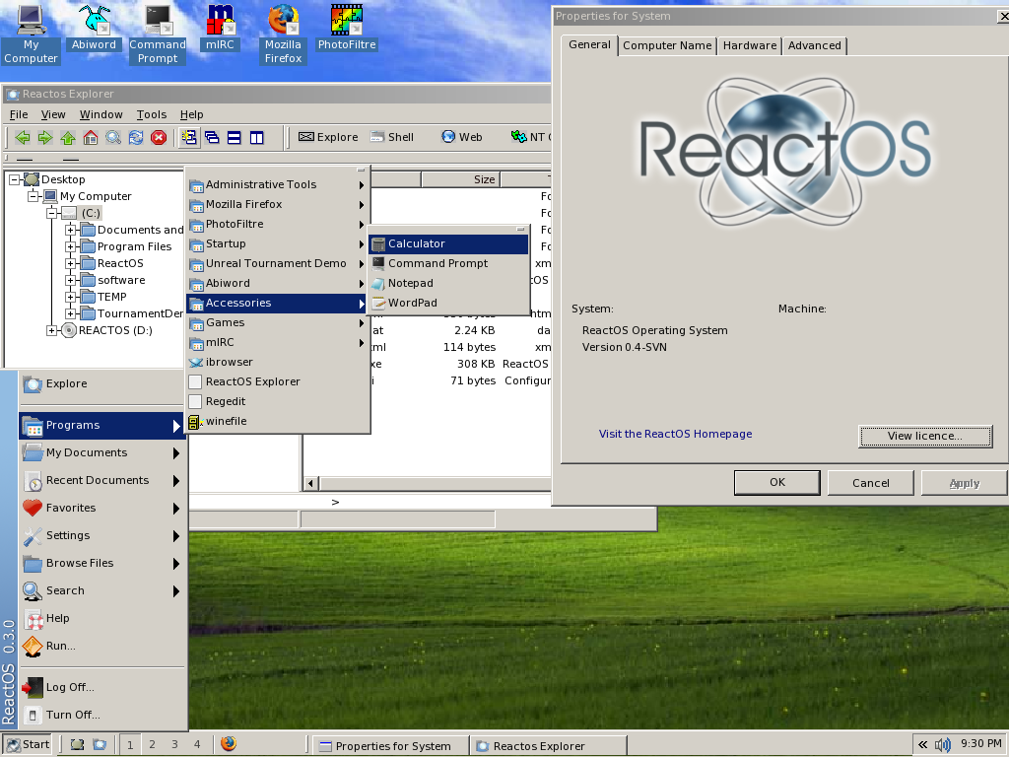
ReactOS User Interface
Notes:
All – ? sec
1 – Familiarity - 90 sec
Windows users are familiar with the Windows desktop. They know what the start menu does, they know how to change the wallpaper, they know how to set up an IP address, they understand the workings of the control panel.
In order to make the switch from Windows to ReactOS as painless as possible, ReactOS provides a Windows style desktop so users immediately feel at home.
Explorer.exe arrived for the release of 0.2 and immediately pushed ReactOS into the spotlight. Up to that point Midnight Commander had been used as an interface to ReactOS, however the introduction of the GUI opened up ReactOS to a new group of developers and users alike.
Explorer is one of the few parts of ReactOS developed in C++ in order to take advantage of the OO features. Although it lacks the fancy features of XP, the taskbar, start menu, titles bars and window designs provide a familiar interface for would be users. Control panel applets are starting to take shape allowing configuration of the desktop in the same manner as Windows. Additional quirks include a task manager and NT service manager with many more in development.

Slide 25
Summary
100% Windows compatible replacement
NT system architecture
ReactOS equivalent and their status
Roadmap
Education and Careers
Notes:
All – 60s
1 100% Windows compatible replacement – 10s
…

Slide 26
Demonstration!
Questions?
Notes:
Question time!
A demonstration of ReactOS!

