Slide 1
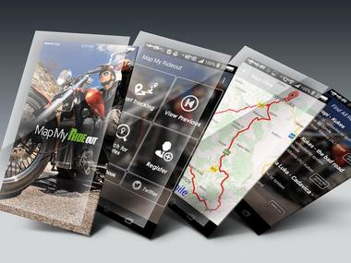

Send Case Me
Log in
Sign up
<
>
About Helen
I have been doing Mobile & Web development for the past 10+ years, I have plenty of experience and a great eye for software development.
I had already completed all job perfectly on and I have many exper-ience of developing mobile app and ba-ck end communication server building
,etc.
I am able to offer competitive prices and deliver great work.

