Slide 1
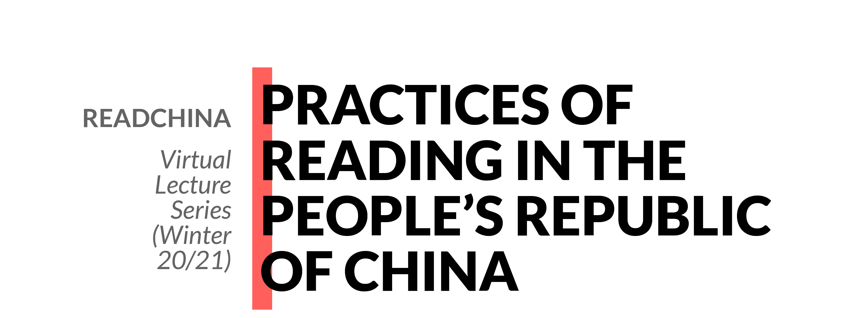

Dust Hunters in the Confucius-dot-com Era - Identity, Materiality and Sensory Attachments in Second-hand Book-reading Culture in the Time of the Internet in China
Lara Yuyu Yang 杨玉宇 17 November 2020

Slide 2
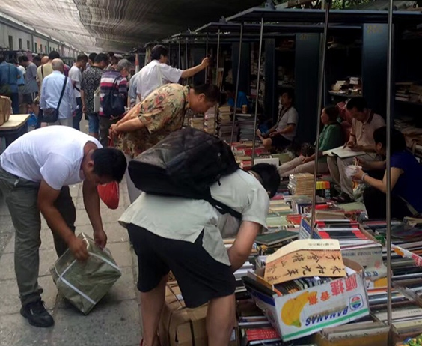
Dust Hunters in the Confucius-dot-com Era - Identity, Materiality and Sensory Attachments in Second-hand Book-reading Culture in the Time of the Internet in China
Structure
Definitions
Second-hand Book-reading Culture
Identity Ecology of the Dust Hunters
The Changing Concept of Materiality and Sensory Attachements
Dust hunters at Panjiayuan, photographed by Laopao, Shanghai Book Review, 20 March 2017, https://m.thepaper.cn/quickApp_jump.jsp?contid=1633373

Slide 3
Dust Hunters in the Confucius-dot-com Era - Identity, Materiality and Sensory Attachments in Second-hand Book-reading Culture in the Time of the Internet in China
Sources
Data from Kongfz.cn and Deja vu

