Slide 1





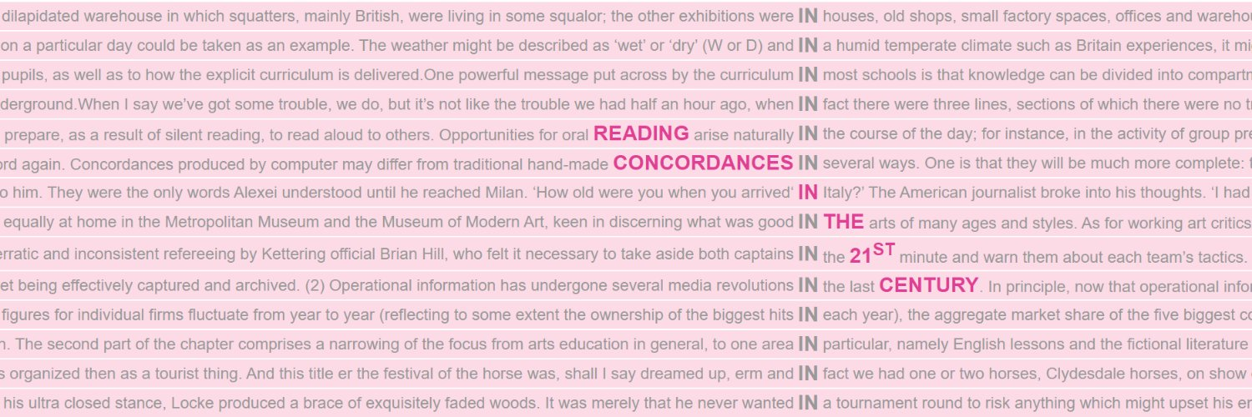
2
Reading Concordances with Algorithms:
a training course in key corpus linguistics methodology
Working with concordance tools
UTN Computational Linguistics Fall School
21–25 September 2026
Stephanie Evert & Michaela Mahlberg

Slide 2
What we have learned so far
Concordances collect occurrences of a node for “vertical reading”
Help (corpus) linguists to identify recurrent patterns
It is not always easy to spot patterns in concordances
(except for educational and famous examples)

Slide 3
Recap: Theoretical foundations
Lexicogrammatical level:
  Lexical item
  Patterns (as in Pattern Grammar)
Textual level
  Local textual functions
  Lexical Priming (Hoey 2005)
Purpose of the analysis:
  The study of fiction requires a “fiction-specific” approach, different from analysing socio-political debate around environmental issues

Slide 4
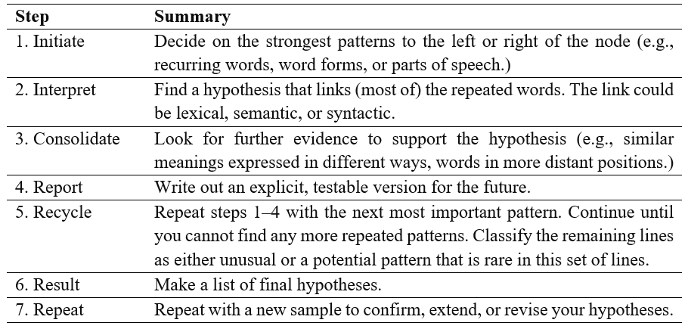
Methodology: a reading procedure (Sinclair 2003)

Slide 5
Concordancing tools
Are created for different purposes
Follow different traditions (cf. yesterday’s origin stories)
Use different terminology (cf. concordance vs contexts)
Combine functionalities (key words, n-grams, etc.)
Can be specialised or general-purpose
Can be web-based or standalone
Often come with corpora
Are continuously developed (until they aren’t)
Provide user support (hopefully)

Slide 6
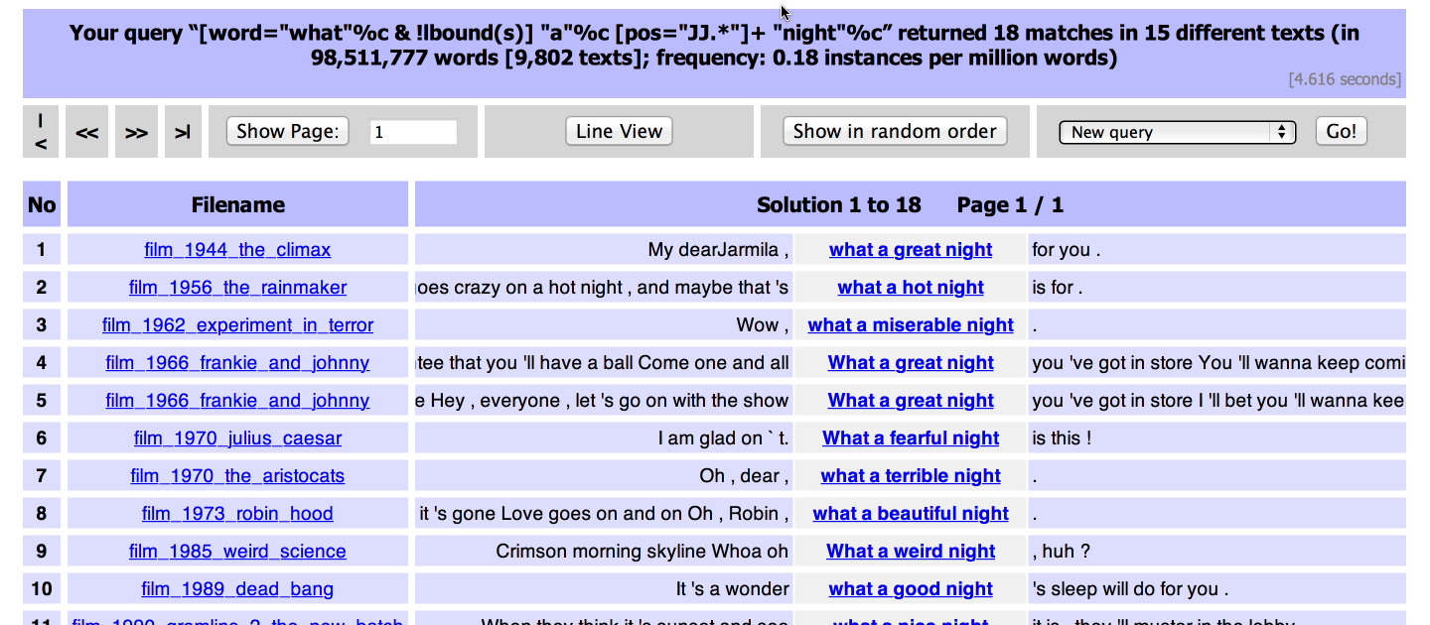
Concordancing tools: CQPweb

Slide 7

CQPweb: A hands-on example
Goal: Understand this [➞] guy's rhetoric,
terminology, phraseology and topics
We need a large collection of texts written
by Trump, e.g. the Trump Twitter Archive [www.thetrumparchive.com]
Step 1: Compile a linguistic corpus 🗸
Step 2: Upload to indexing & search engine 🗸
Step 3: Analyse through concordance reading

Slide 8

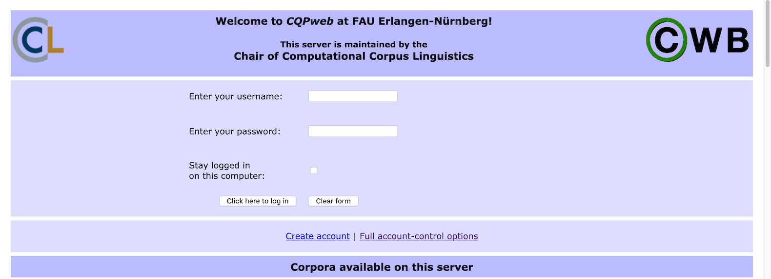
CQPweb: A hands-on example
CQPweb server @ FAU:
https://corpora.linguistik.uni-erlangen.de/cqpweb/
Login: student1 … student15 | password: ••••••••

Slide 9
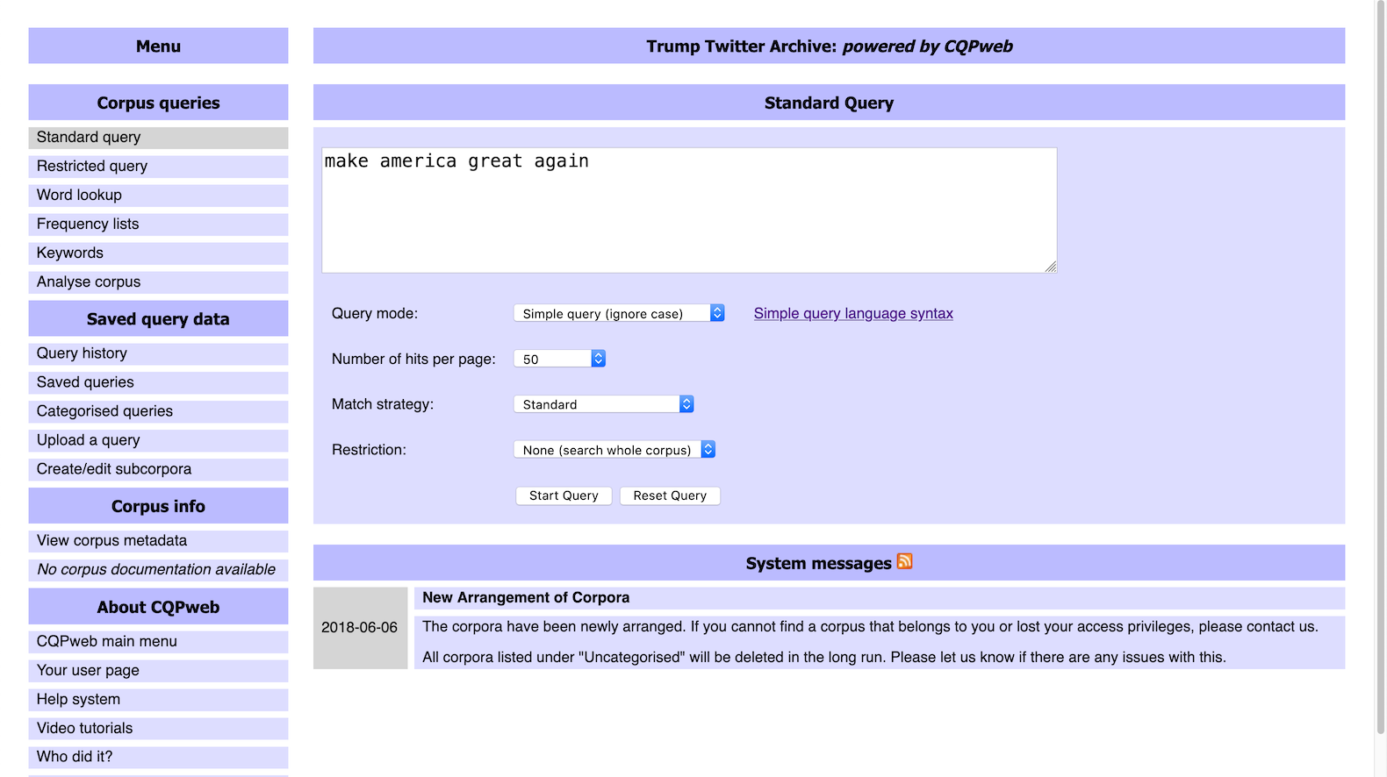
Simple search

Slide 10
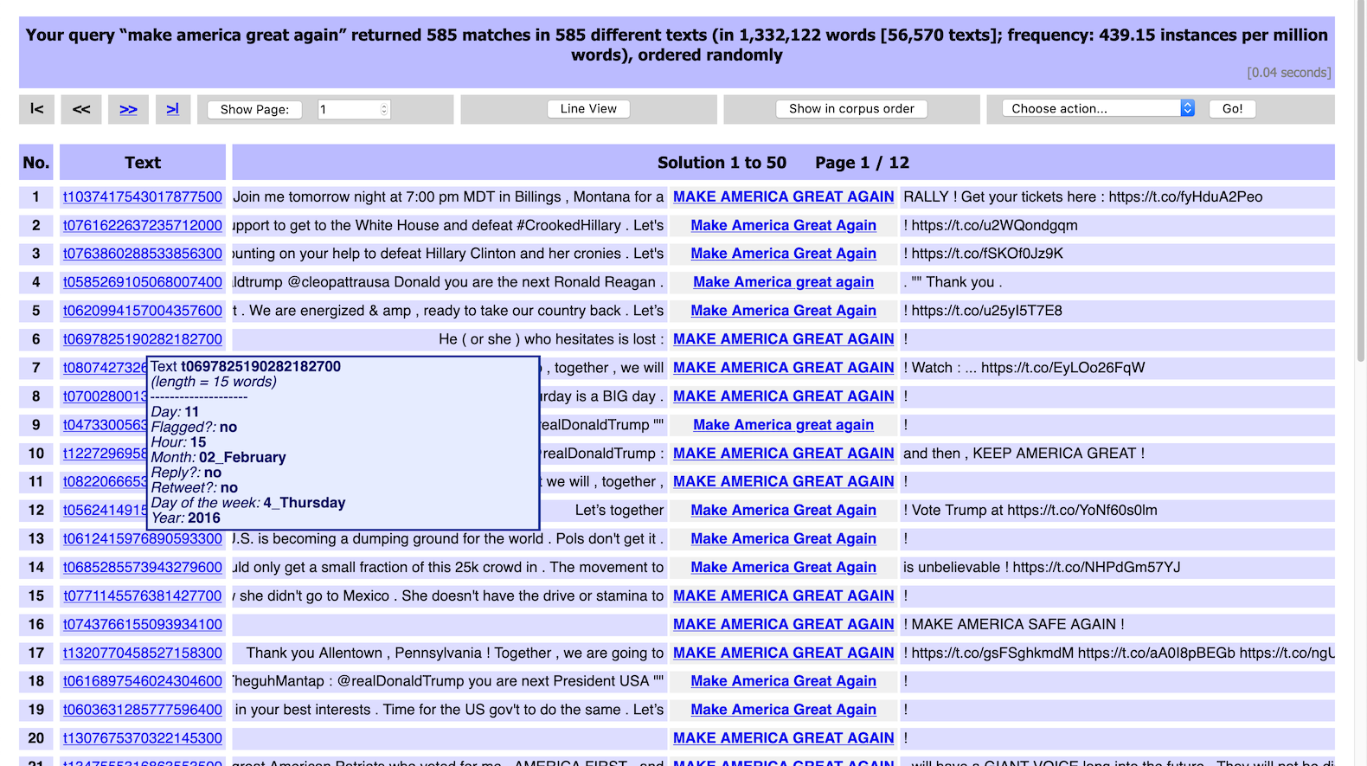
Concordance (kwic = key word in context)
frequency information
random ordering
click for context
click / hover
for metadata

Slide 11
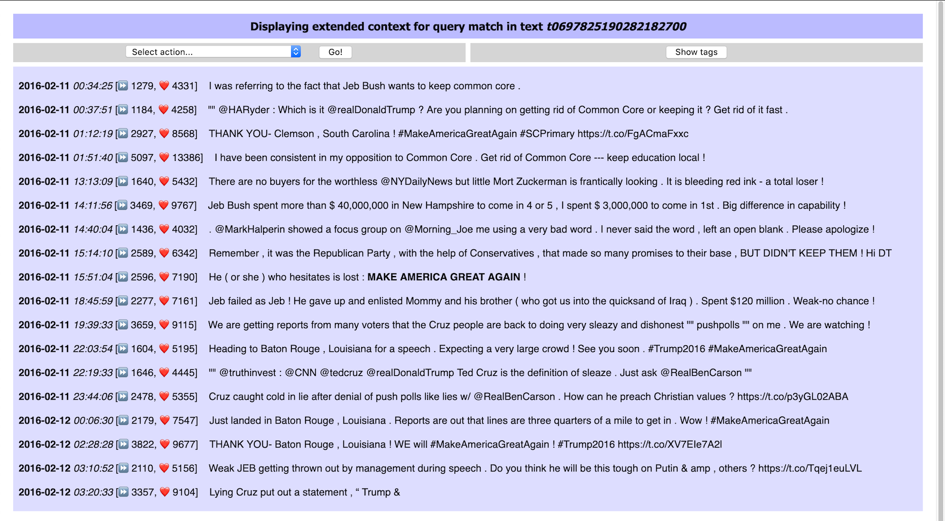
Extended context display with formatting
this is the match

Slide 12
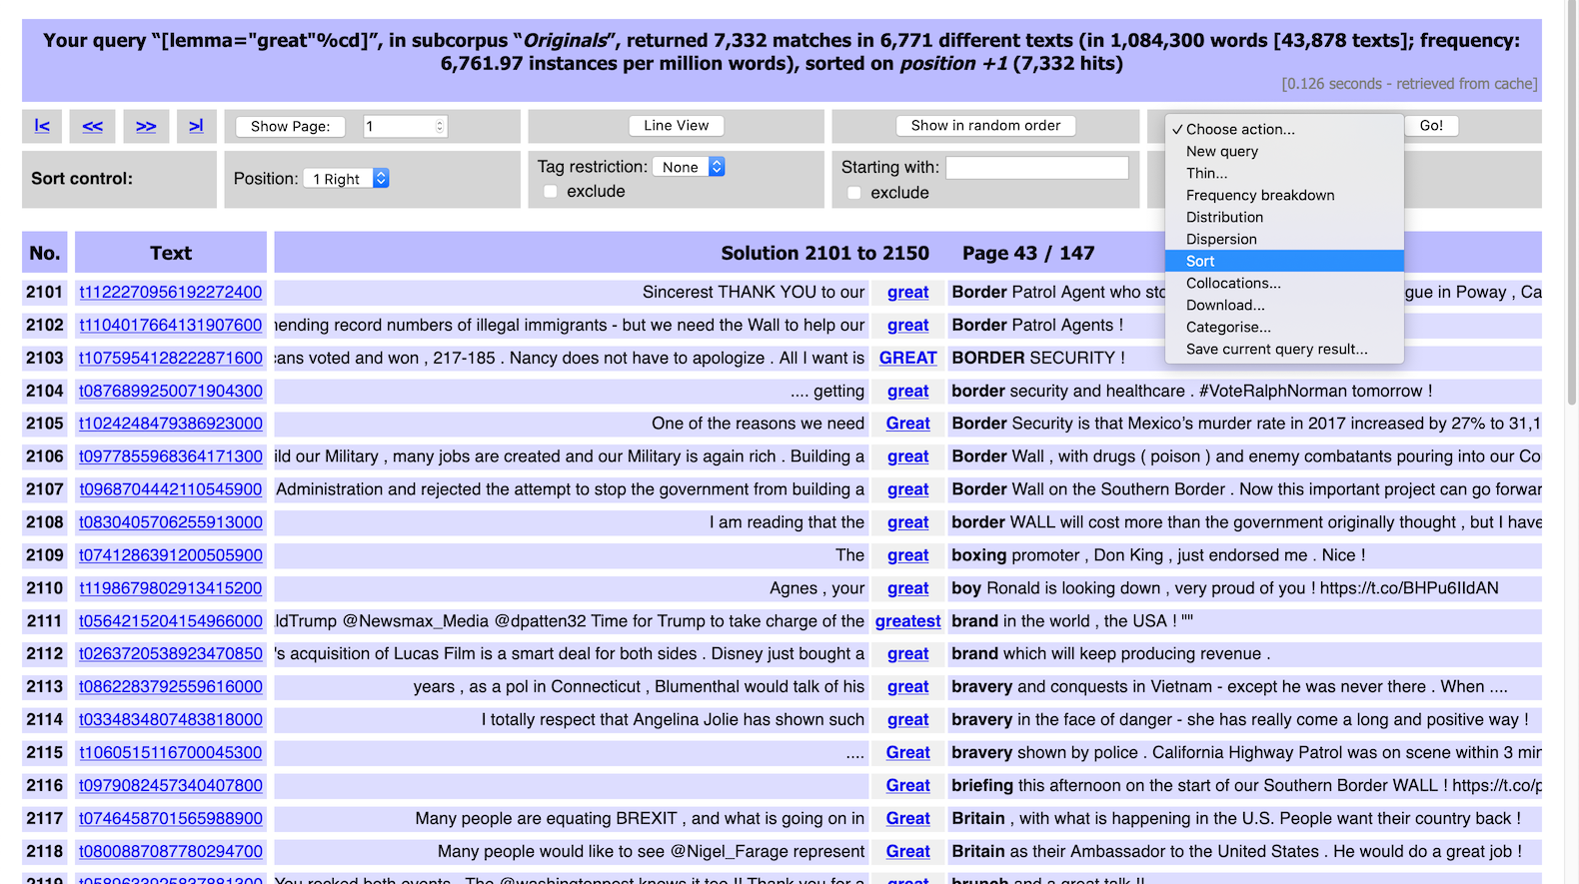
Sorted concordance: great
action menu

Slide 13
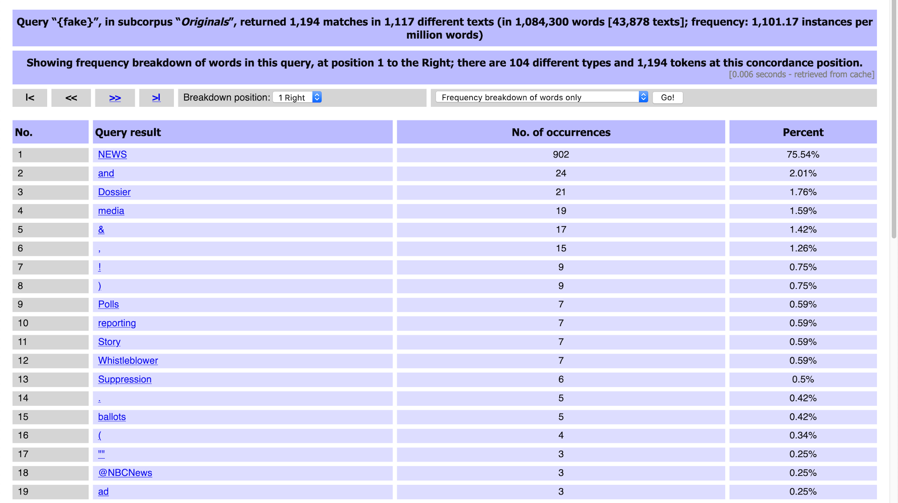
Frequency breakdown: fake
full process history

Slide 14
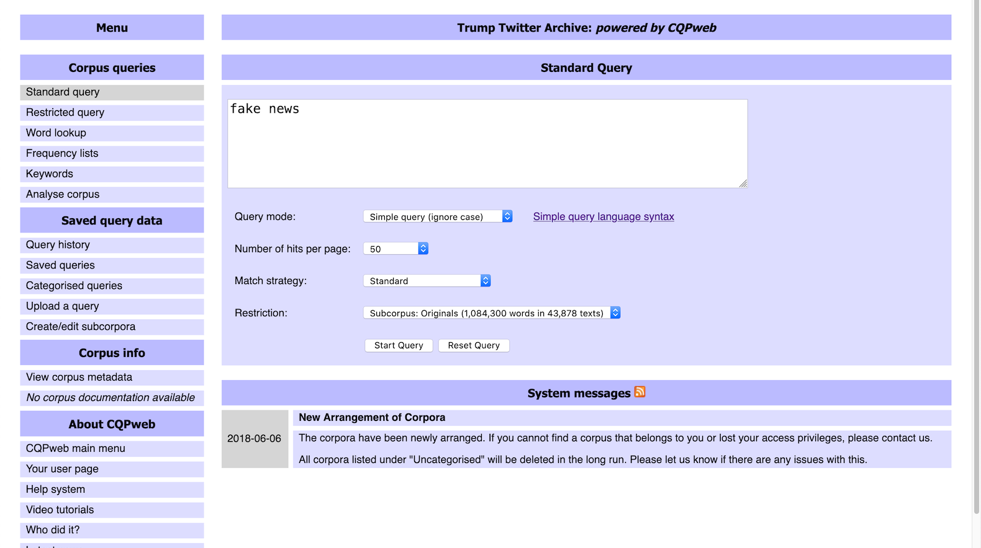
Time for a closer look: fake news

Slide 15
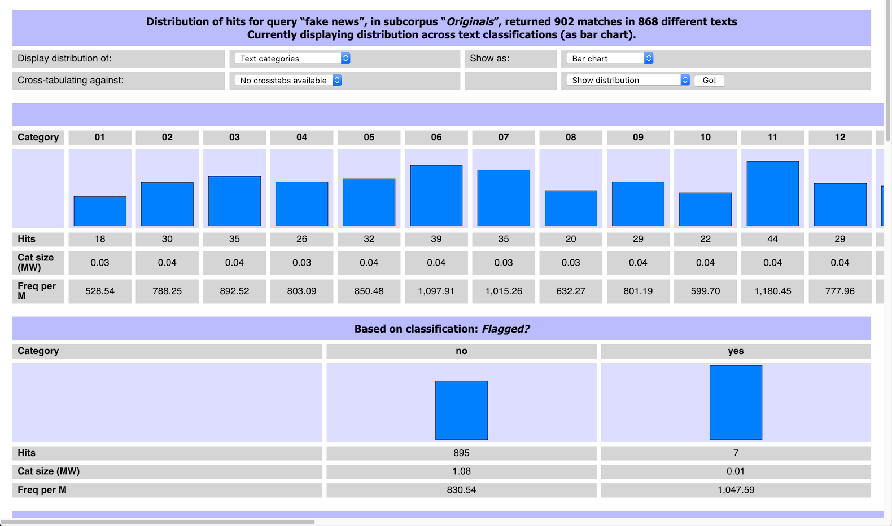
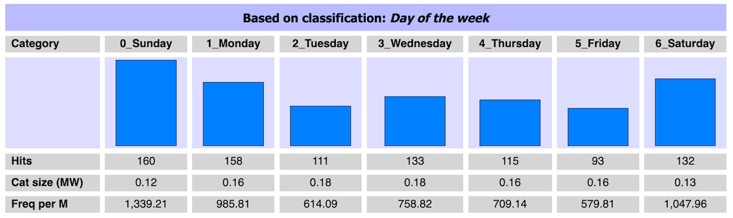
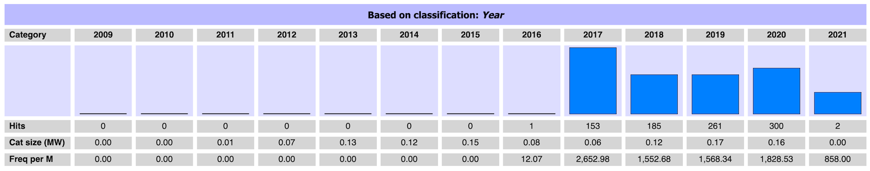
Distribution across metadata categories

Slide 16
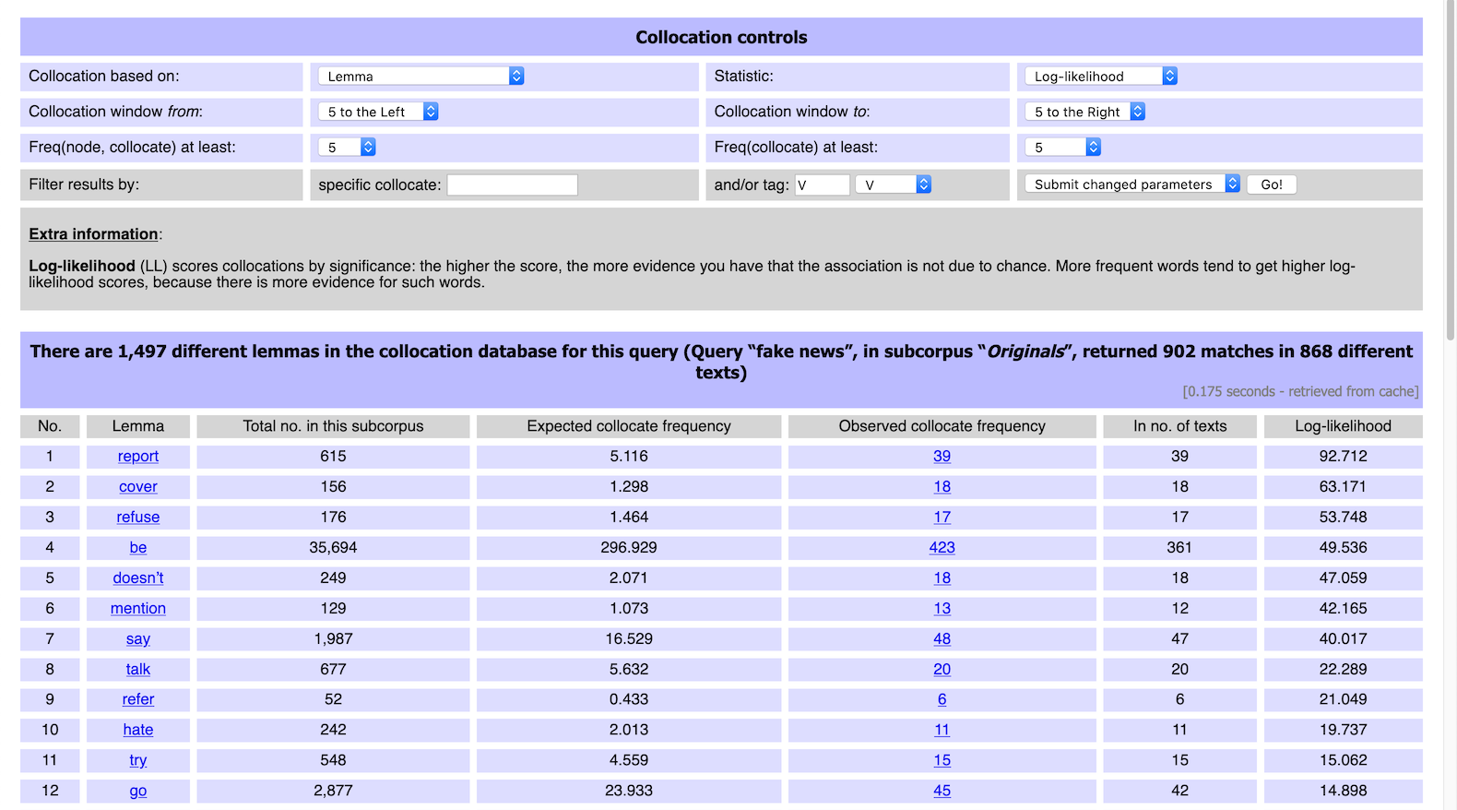
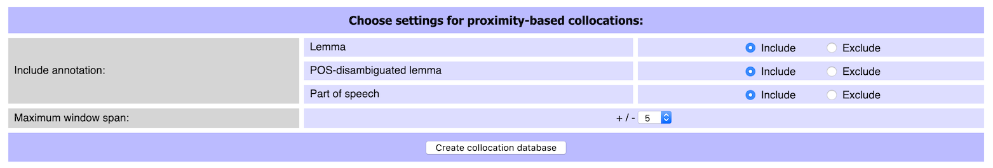
Collocation analysis
key parameters
click for examples

Slide 17
CQPweb exercise
Activate corpus ParlSpeech UK
  corpus of debates of the UK parliament 1988–2019
  Rauh, C. & Schwalbach, J. (2020). The ParlSpeech V2 data set: Full-text corpora of 6.3 million parliamentary speeches in the key legislative chambers of nine representative democracies. https://doi.org/10.7910/DVN/L4OAKN
  ~ 2 M turns with a total of ~ 400 M tokens
Concordance analysis for query: water and sanitation
  what recurrent patterns can you identify?
  can you find evidence for larger units of meaning?

Slide 18

Time for a break …
Coffee

Slide 19
What we have learned so far from using
CLiC & CQPweb?
What strategies have you applied?
How do you describe what you do?

Slide 20
Practices in different disciplines: survey of strategies
10 articles / case studies per discipline (40 total)
  Lexicography
  Data-driven learning
  Corpus-assisted discourse studies
  Literary stylistics
  post-2000 publication; concrete examples
  not included: studies using parallel or learner corpora
Content analysis of methods sections (not literature review)
Challenge: no systematic standards for describing methodology, mix of tool and method
Notes:
How are these disciplines different, what do you expect?

Slide 21
Selecting
Sampling
A random sample of 100 concordances of each pair was, subsequently, closely examined for semantic prosody. (Lexicography)
Filtering
A concordance query for carry out with research in the context of three tokens to the left and to the right returned 160 hits, and most lines indeed exhibited the collocation carry out research, as exemplified in Figure 8, …. (Lexicography)

Slide 22
Selecting
Cleaning
As we were interested in lexical compounds linked to carbon dioxide rather than carbon as an element, such lexical combinations as, for example, carbon molecule or carbon fibre were removed. Nonsensical combinations as well as duplicates arising from differences in spelling such as carbon offset and carbon-offset were also eliminated. (CADS)
Threshold
We analysed the first 500 concordances of seguire chosen as “good examples” by the Sketch Engine (cf. Kilgarriff et al., 2008) (Lexicography)

Slide 23
Ordering
Sorting
WordSmith Tools was mainly used for sorting and categorising concordances because it allows the analyst to assign values to lines and to move easily from concordance to text. [Figure 3 shows sorting by 1R] (CADS)
The students were then instructed to search for the preceding underlined word friendship using IntelliText, and to examine the concordance lines to identify which preposition should follow friendship in this context, by sorting right or left contexts in keyword-in-context (KWIC) lines. (DDL)

Slide 24
Ordering
Ranking
We analysed the first 500 concordances of seguire chosen as “good examples” by the Sketch Engine (cf. Kilgarriff et al., 2008) (Lexicography)

Slide 25
Reading Concordances R21 Project
What do users do to organise concordance lines for interpretation? What drives the choices they make, beyond their intuition and the features of concordancing tools they are familiar with?
Our goals:
Develop a consistent methodology of concordance reading strategies and suggesting a transparent terminology that describes tool-independent principles of reading concordances.
Develop a concordance software framework and new algorithms that support a consistent concordance reading methodology: the FlexiConc library
Conduct case studies to illustrate the usefulness of the approach

Slide 26
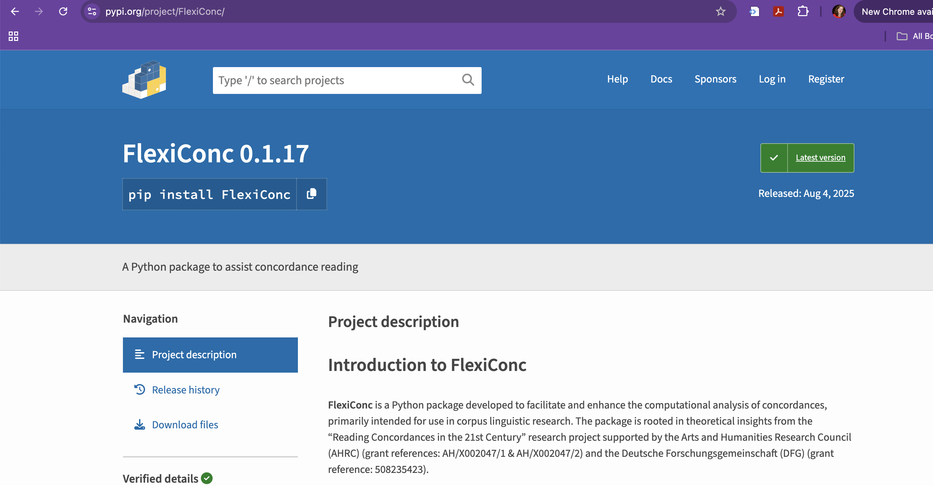

Slide 27
The FlexiConc approach
Selecting
  “zoom in” on a subset of the concordance lines
  either focus on specific pattern or discard unwanted lines
Ordering
  Sorting: reorder lines based on pairwise comparison
  Ranking: reorder lines based on preference score
Grouping
  Partitioning: groups based on common property
  Clustering: (nested) groups based on pairwise similarity
subset
arrangement

Slide 28
DNOV-CWB
Corpus
"eyes" %c
Query
Analysis Tree
Partition / Cluster ▼
⨁
Make selection ▼
🎔 Bookmark
Welcome to
CandyConc
images do not represent actual gameplay

Slide 29
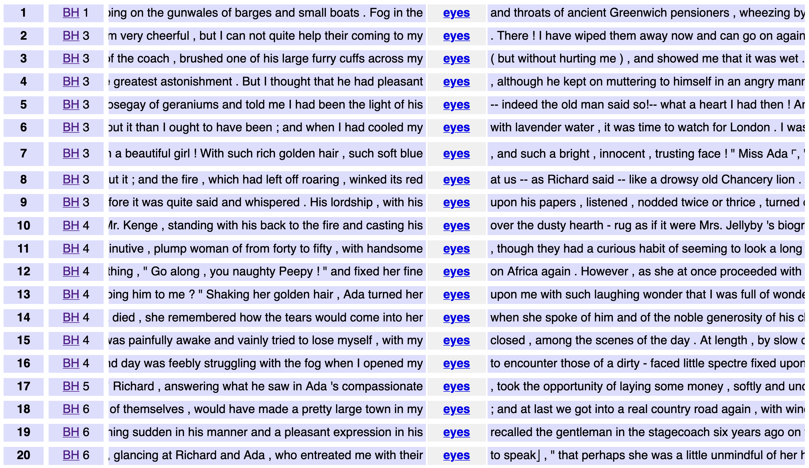
DNOV-CWB
Corpus
"eyes" %c
Query
root node
Partition / Cluster ▼
Analysis Tree
Query result (4031)
⨁
Make selection ▼
🎔 Bookmark
images do not represent actual gameplay

Slide 30
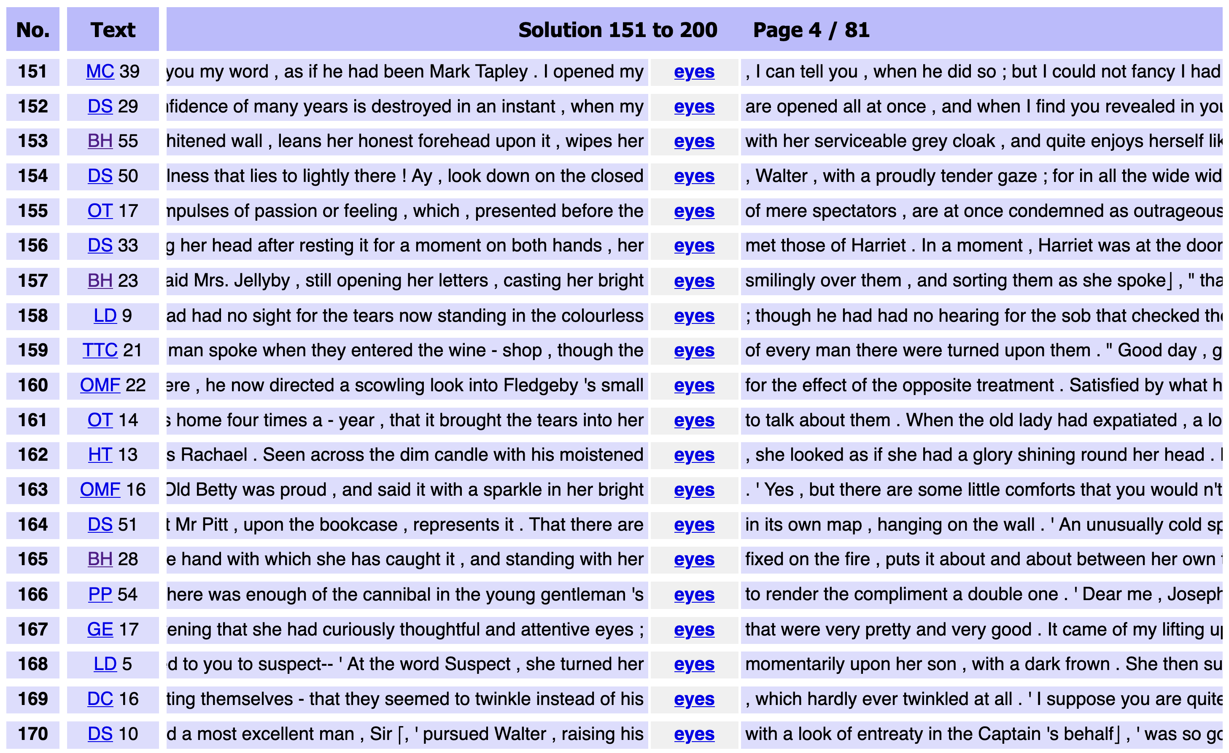
DNOV-CWB
Corpus
"eyes" %c
Query
root node
Partition / Cluster ▼
Analysis Tree
Sort
⨁
arrangement node
random ❎
Query result (4031)
• sort: random
Make selection ▼
🎔 Bookmark
images do not represent actual gameplay

Slide 31
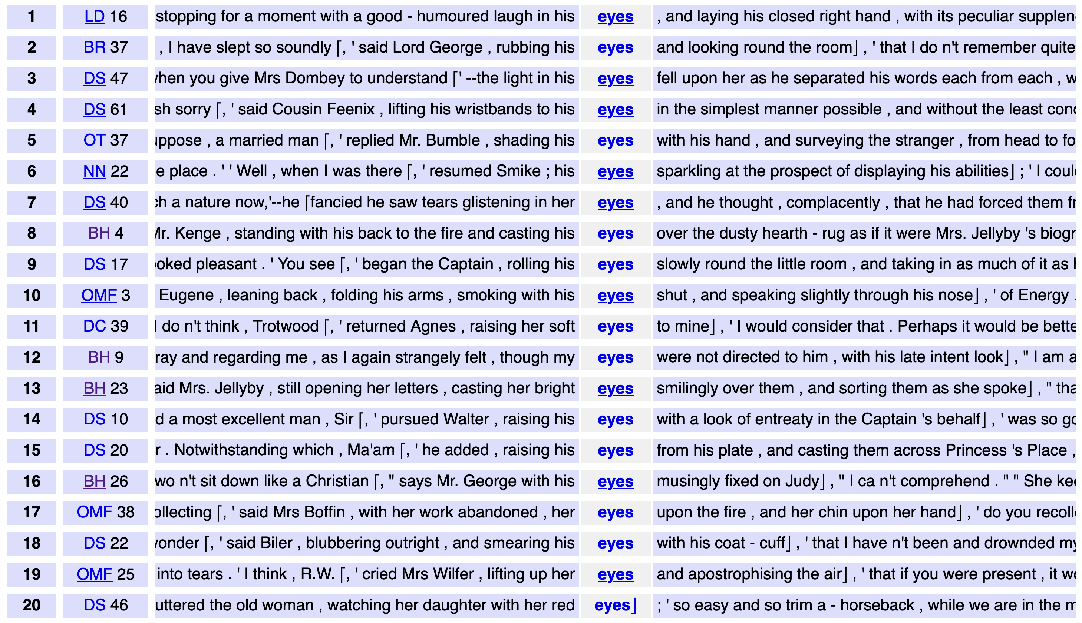
DNOV-CWB
Corpus
"eyes" %c
Query
root node
Partition / Cluster ▼
Analysis Tree
Sort
⨁
arrangement node
random ❎
Query result (4031)
▸ sort: random
• select: within suspension (276)
Make selection ▼
🎔 Bookmark
subset node
images do not represent actual gameplay

Slide 32
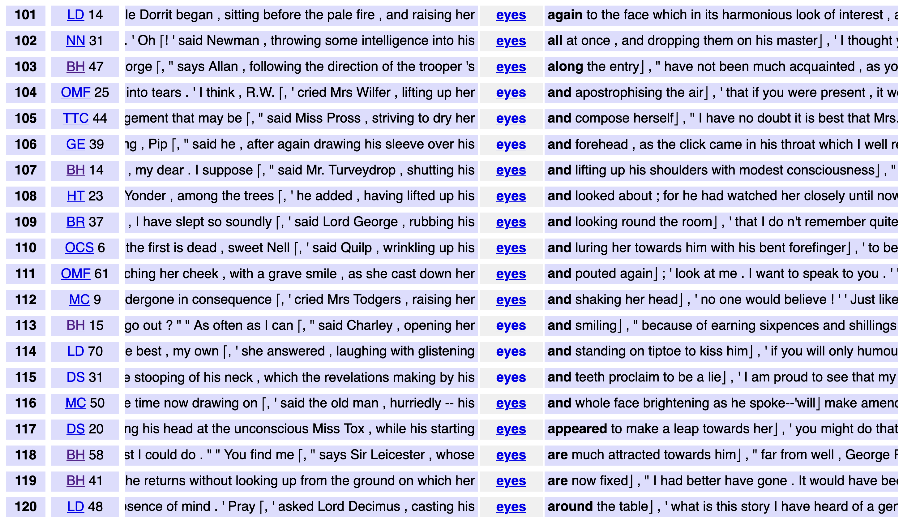
DNOV-CWB
Corpus
"eyes" %c
Query
root node
Partition / Cluster ▼
Analysis Tree
by right context ❎
⨁
arrangement node
Sort
Query result (4031)
▸ sort: random
▸ select: within suspension (276)
• sort: right context
Make selection ▼
🎔 Bookmark
subset node
images do not represent actual gameplay

Slide 33
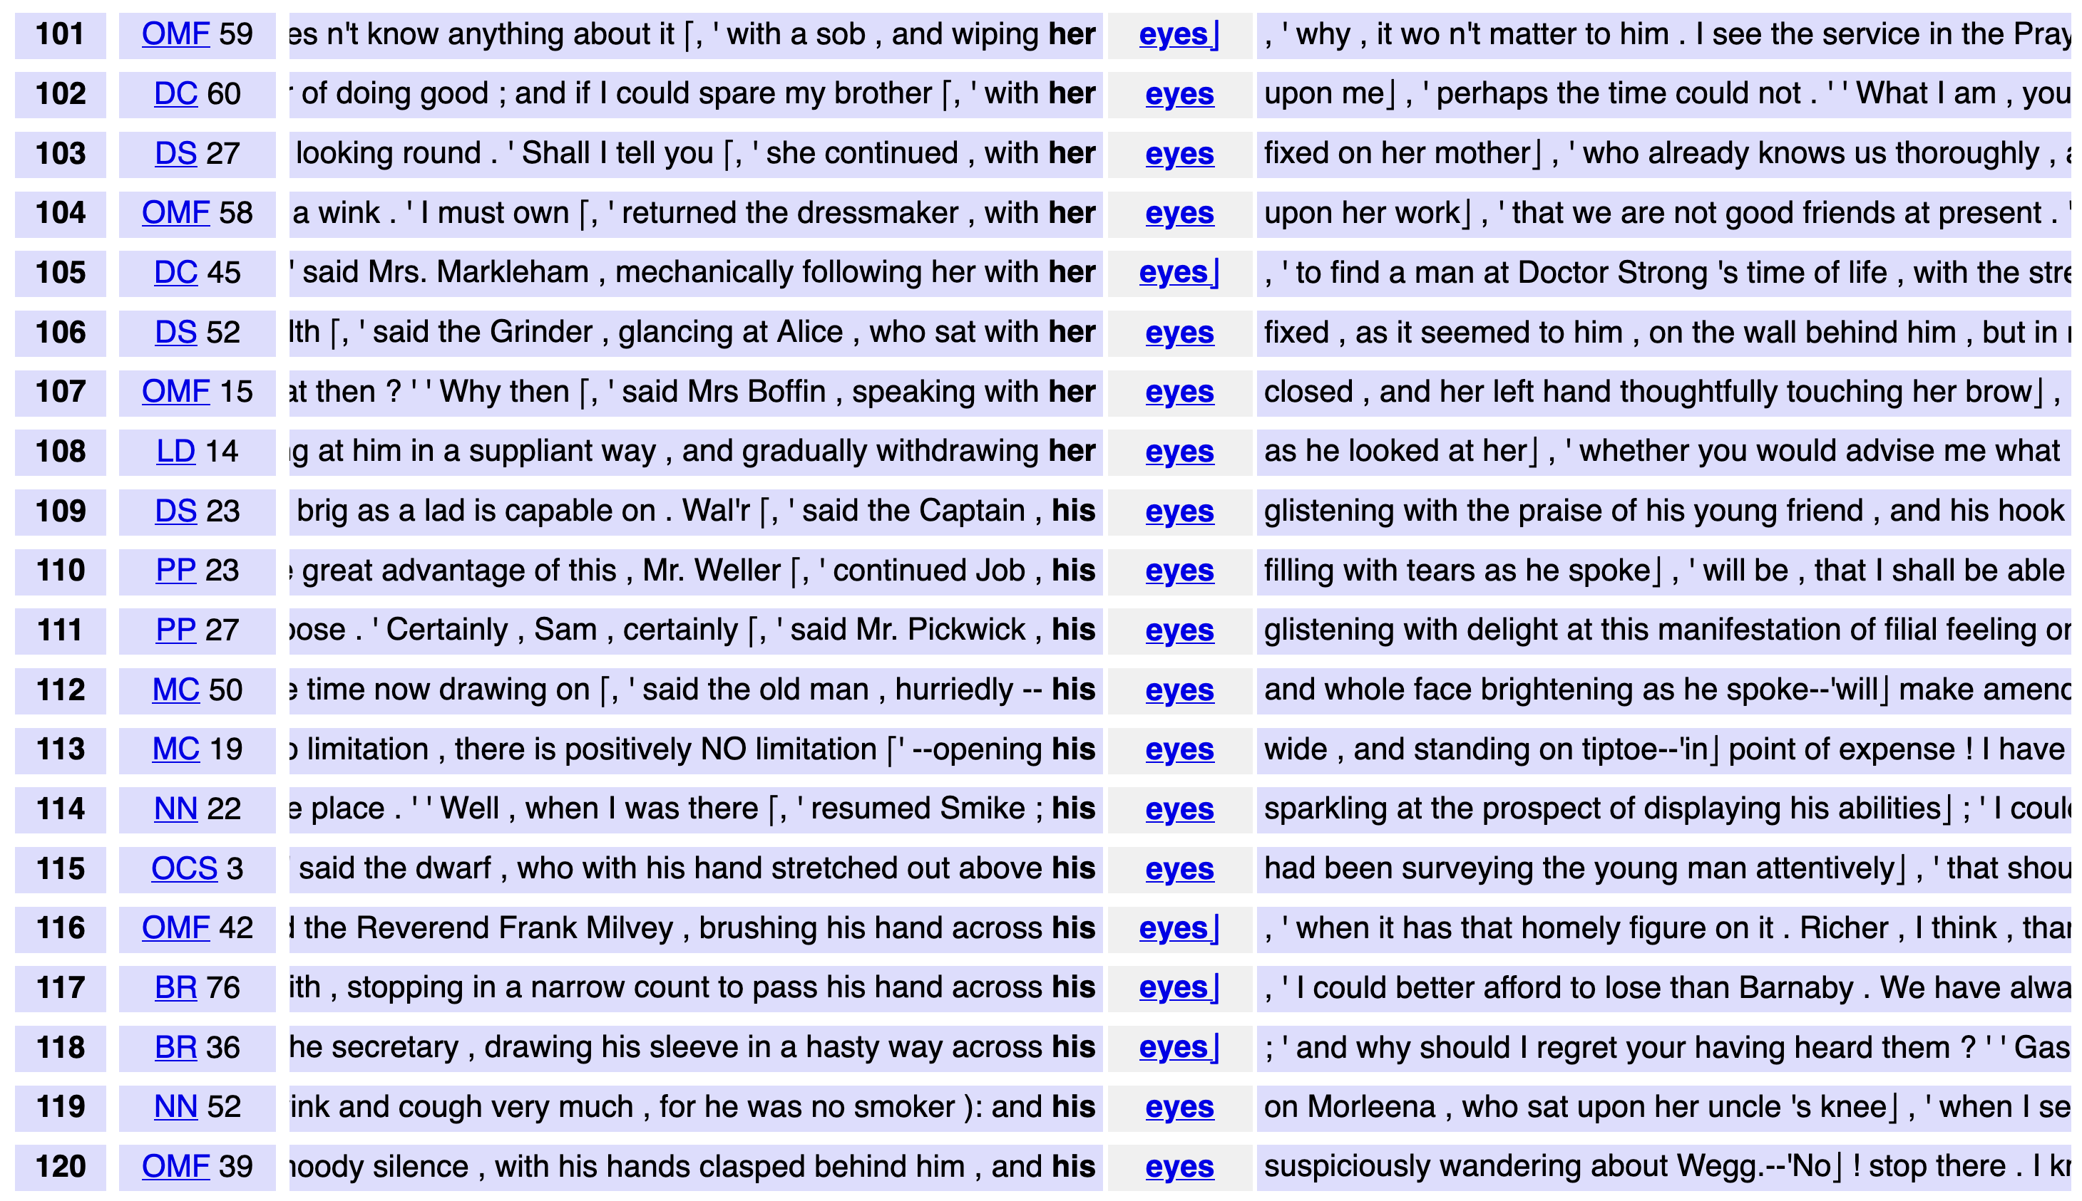
DNOV-CWB
Corpus
"eyes" %c
Query
root node
Partition / Cluster ▼
Analysis Tree
by left context ❎
⨁
arrangement node
Sort
Query result (4031)
▸ sort: random
▸ select: within suspension (276)
• sort: right context
• sort: left context
Make selection ▼
🎔 Bookmark
siblings
subset node
images do not represent actual gameplay

Slide 34
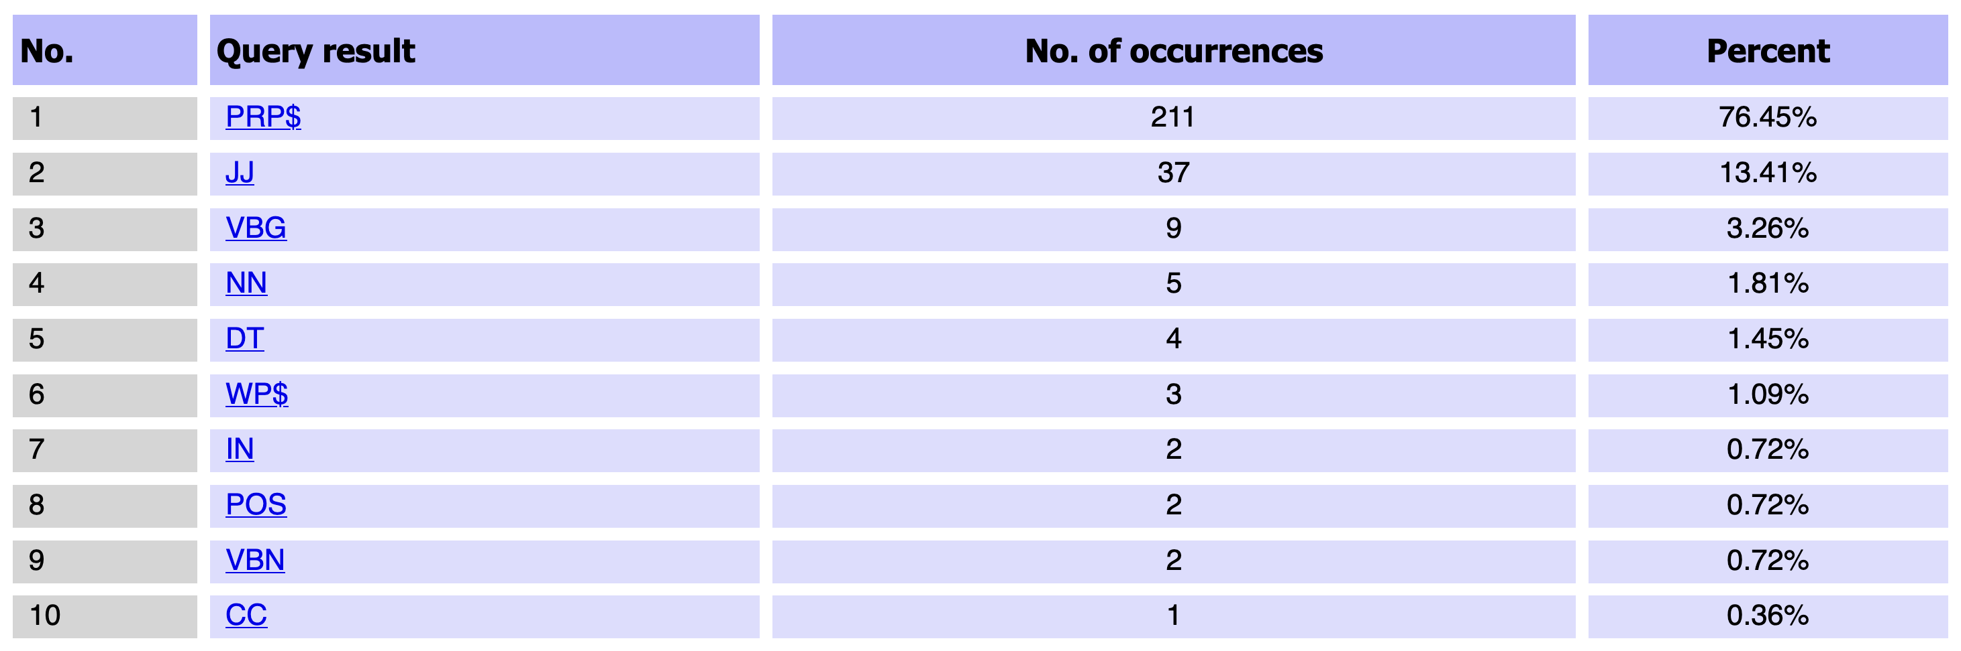
DNOV-CWB
Corpus
"eyes" %c
Query
root node
partition by POS tag of token L1
Analysis Tree
Partition / Cluster ▼
by left context ❎
⨁
arrangement node
Sort
Query result (4031)
▸ sort: random
▸ select: within suspension (276)
• sort: right context
• sort: left context
• partition: by POS tag @ L1,
sort: left context
Make selection ▼
🎔 Bookmark
siblings
subset node
images do not represent actual gameplay

Slide 35
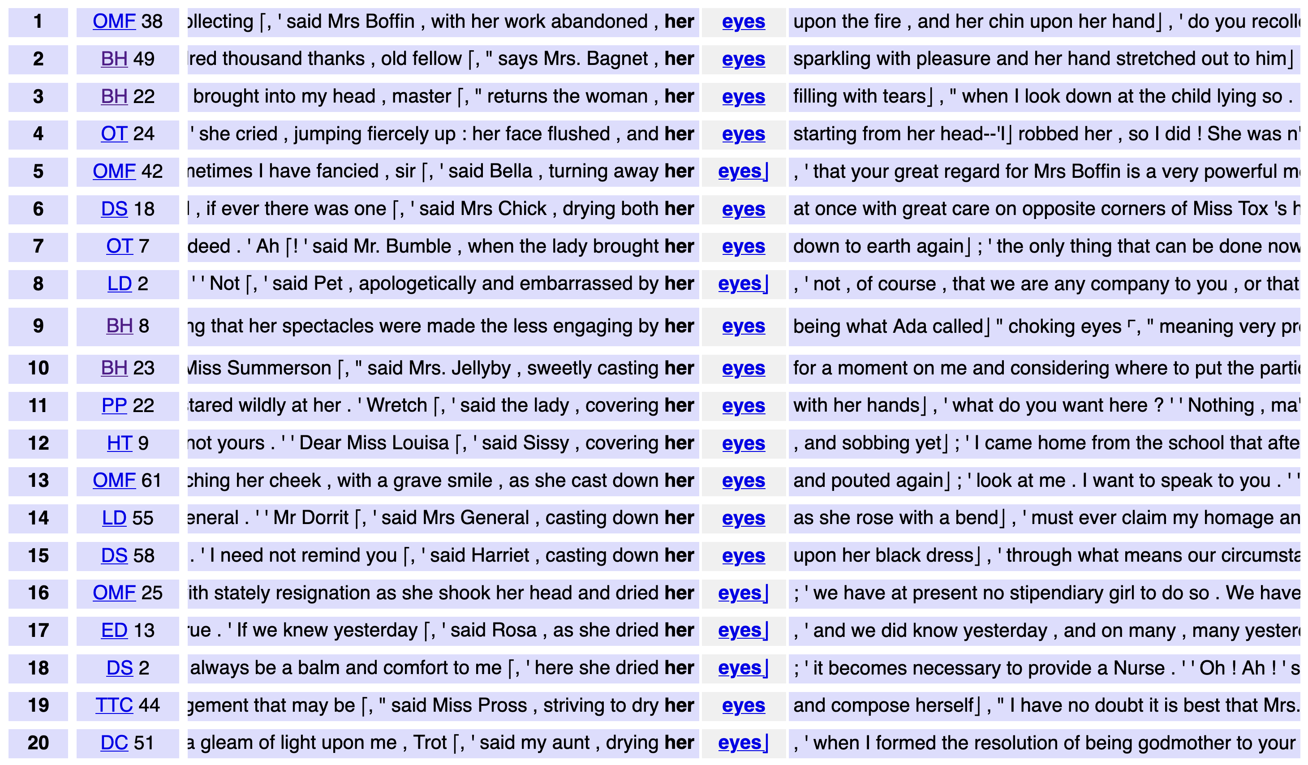
DNOV-CWB
Corpus
"eyes" %c
Query
root node
Partition / Cluster ▼
Analysis Tree
by left context ❎
⨁
arrangement node
Sort
Query result (4031)
▸ sort: random
▸ select: within suspension (276)
• sort: right context
• sort: left context
• partition: by POS tag @ L1,
sort: left context
▸ select: set [PRP$] (211)
Make selection ▼
🎔 Bookmark
siblings
subset node
subset
images do not represent actual gameplay

Slide 36
DNOV-CWB
Corpus
"eyes" %c
Query
root node
Partition / Cluster ▼
Analysis Tree
by L1 ❎
⨁
arrangement node
Sort
Query result (4031)
▸ sort: random
▸ select: within suspension (276)
• sort: right context
• sort: left context
• partition: by POS tag @ L1,
sort: left context
▸ select: set [PRP$] (211)
• sort: by L1
Make selection ▼
🎔 Bookmark
siblings
subset node
subset
images do not represent actual gameplay

Slide 37
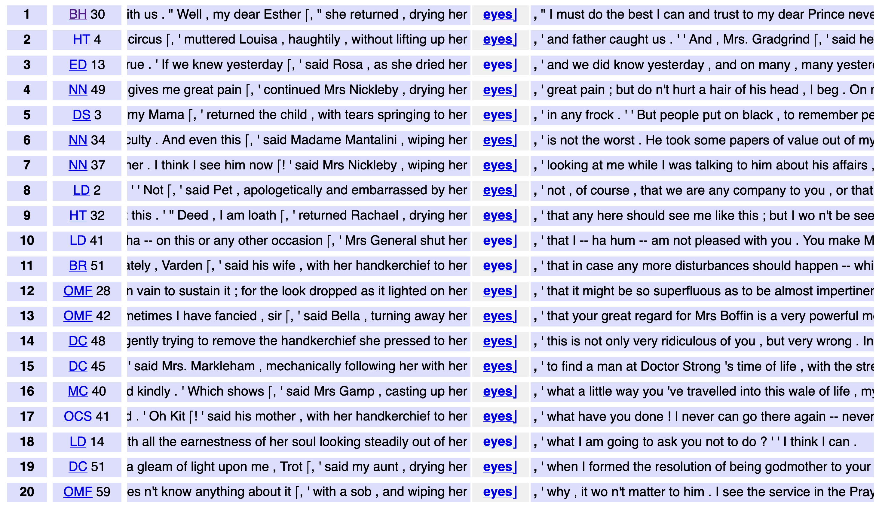
DNOV-CWB
Corpus
"eyes" %c
Query
root node
Partition / Cluster ▼
Analysis Tree
by L1 ❎
⨁
Sort
by right context ❎
arrangement node
Sort
Query result (4031)
▸ sort: random
▸ select: within suspension (276)
• sort: right context
• sort: left context
• partition: by POS tag @ L1,
sort: left context
▸ select: set [PRP$] (211)
• sort: by L1
• sort: by L1,
sort: right context
Make selection ▼
🎔 Bookmark
siblings
subset node
subset
images do not represent actual gameplay

Slide 38
DNOV-CWB
Corpus
"eyes" %c
Query
root node
Partition / Cluster ▼
Analysis Tree
by L1 ❎
⨁
Sort
by right context ❎
arrangement node
Sort
Query result (4031)
▸ sort: random
▸ select: within suspension (276)
• sort: right context
• sort: left context
• partition: by POS tag @ L1,
sort: left context
▸ select: set [PRP$] (211)
• sort: by L1
• sort: by L1,
sort: right context 🎔
Make selection ▼
🎔 Bookmark
siblings
subset node
subset
path from root node
bookmark
images do not represent actual gameplay

Slide 39
Hands-on: FlexiConc in CLiC basics
We go back to the eyes in CLiC examples to think about extending the ways of looking at the data.
With the help of various algorithms provided by FlexiConc.
https://github.com/reading-concordances/teaching/blob/main/course/
handouts/flexiconc_clic_handout_2026.pdf
https://clic-fiction.com/

Slide 40
Extending the search for body language patterns
Search words: cheeks, cheek, neck, fingers, ear
Focus on non-quotes

Slide 41
