Slide 1





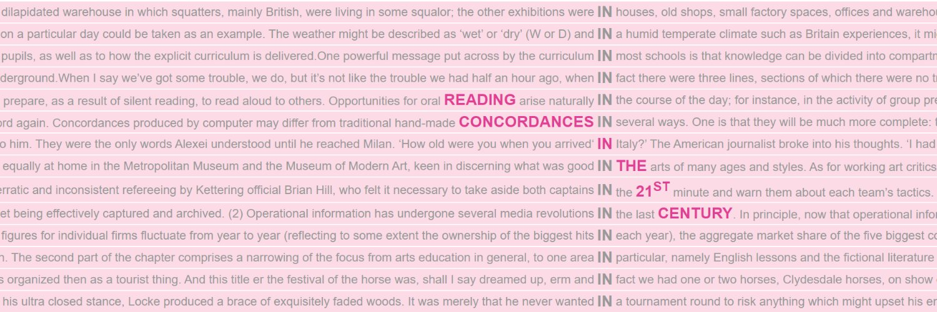
4
Reading Concordances with Algorithms:
a training course in key corpus linguistics methodology
Reading with algorithms: FlexiConc
UTN Computational Linguistics Fall School
21–25 September 2026
Stephanie Evert & Michaela Mahlberg

Slide 2
Orientation
What we have learned so far …
Reading concordances with (and without) the help of software tools
How to identify recurrent patterns and interpret them
Strategies and algorithms for organising concordance lines
What we're going to look at now …
A mathematical framework for reading concordances with algorithms
What further algorithms could be useful?
How can we document the concordance reading process?

Slide 3
Our goal
Goal: Develop mathematical framework for computational algorithms used to organise concordance lines in the concordance reading process.
Tightly connected to kwic-style display of concordance lines
Limitation: only algorithms that can be understood as a rearrangement of concordance lines ➞ makes generic UI possible
Focus on three main general strategies in current practice

Slide 4
But why?
Why not just invent some really cool new algorithms
and implement them in #FAUbox or EverConc?

Slide 5
But why?
Community needs general framework, not another app
Make novel algorithms available in many (all) concordancers
Specify precise semantics of algorithms
Combining algorithms: limitations
Consistent visualisation in UI
Formal model of organising concordances
Research documentation

Slide 6
Concordance reading strategies
Selecting
Ordering
Sorting / Ranking
Grouping
Partitioning/Clustering

Slide 7
From strategies to algorithms
Selecting
  “zoom in” on a subset of the concordance lines
  either focus on specific pattern or discard unwanted lines
Ordering
  change sequential ordering of concordance lines in the display
  may want to combine multiple ordering criteria to break ties
Grouping
  form groups of related concordance lines
  requires structured kwic display in UI

Slide 8
From strategies to algorithms
Selecting
  “zoom in” on a subset of the concordance lines
  either focus on specific pattern or discard unwanted lines
Ordering
  Sorting: reorder lines based on pairwise comparison
  Ranking: reorder lines based on preference score
  combine multiple Sorting and Ranking algorithms to break ties
Grouping
  form groups of related concordance lines
  requires structured kwic display in UI

Slide 9
From strategies to algorithms
Selecting
  “zoom in” on a subset of the concordance lines
  either focus on specific pattern or discard unwanted lines
Ordering
  Sorting: reorder lines based on pairwise comparison
  Ranking: reorder lines based on preference score
  combine multiple Sorting and Ranking algorithms to break ties
Grouping
  Partitioning: groups based on common property
  Clustering: (nested) groups based on pairwise similarity
  requires structured kwic display in UI

Slide 10
Combining algorithms
Selecting
  “zoom in” on a subset of the concordance lines
  either focus on specific pattern or discard unwanted lines
Ordering
  Sorting: reorder lines based on pairwise comparison
  Ranking: reorder lines based on preference score
  combine multiple Sorting and Ranking algorithms to break ties
Grouping
  Partitioning: groups based on common property
  Clustering: (nested) groups based on pairwise similarity
  requires structured kwic display in UI
subset
arrangement

Slide 11
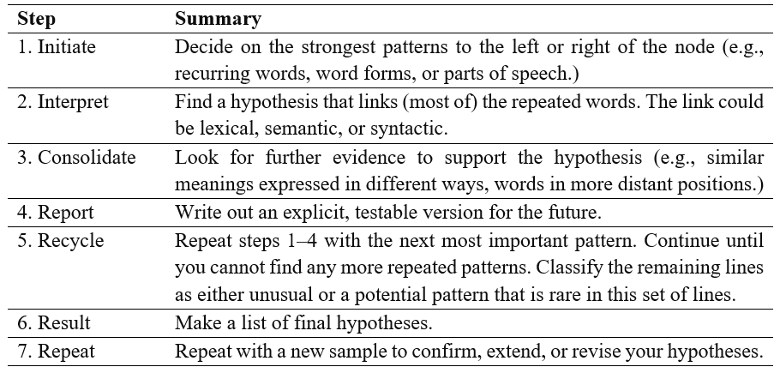
Methodology: a reading procedure (Sinclair 2003)
arrangement
subset

Slide 12
The analysis tree
Our model of concordance reading: analysis tree
Selecting creates branches that “zoom in” on a subset of lines
➞ subset node
  investigate different patterns with each branch
  turns history of operations into a hierarchical tree structure
Ordering and Grouping algorithms change how this subset is displayed to the analyst ➞ arrangement node
  different arrangements of the same subset are siblings in the tree
  default arrangement: original corpus order
Each node corresponds to a concordance view
  defined as subset of concordance lines + their arrangement

Slide 13
Combining algorithms
Subset operations can either be nested or form different branches
  consecutively narrow down to smaller subsets ➞ structure of tree
Arrangement operations form alternative views of a subset
  consequence: can't “stack” multiple arrangements
  combine sequence of Ordering algorithms as tie-breakers
  multiple Grouping algorithms cannot (or should not) be combined
Arrangement node = ≤ 1 Grouping + sequence of Ordering algo's
  Grouping determines main structure, Ordering applies within groups

Slide 14
DNOV-CWB
Corpus
"eyes" %c
Query
Analysis Tree
Partition / Cluster ▼
⨁
Make selection ▼
🎔 Bookmark
Welcome to
CandyConc
images do not represent actual gameplay

Slide 15
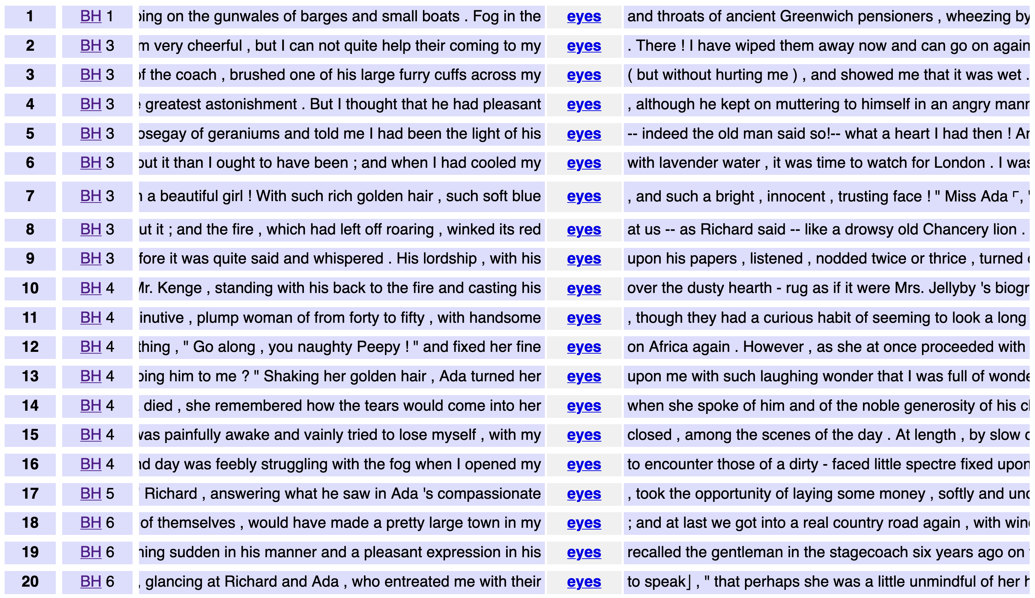
DNOV-CWB
Corpus
"eyes" %c
Query
root node
Partition / Cluster ▼
Analysis Tree
Query result (4031)
⨁
Make selection ▼
🎔 Bookmark
images do not represent actual gameplay

Slide 16
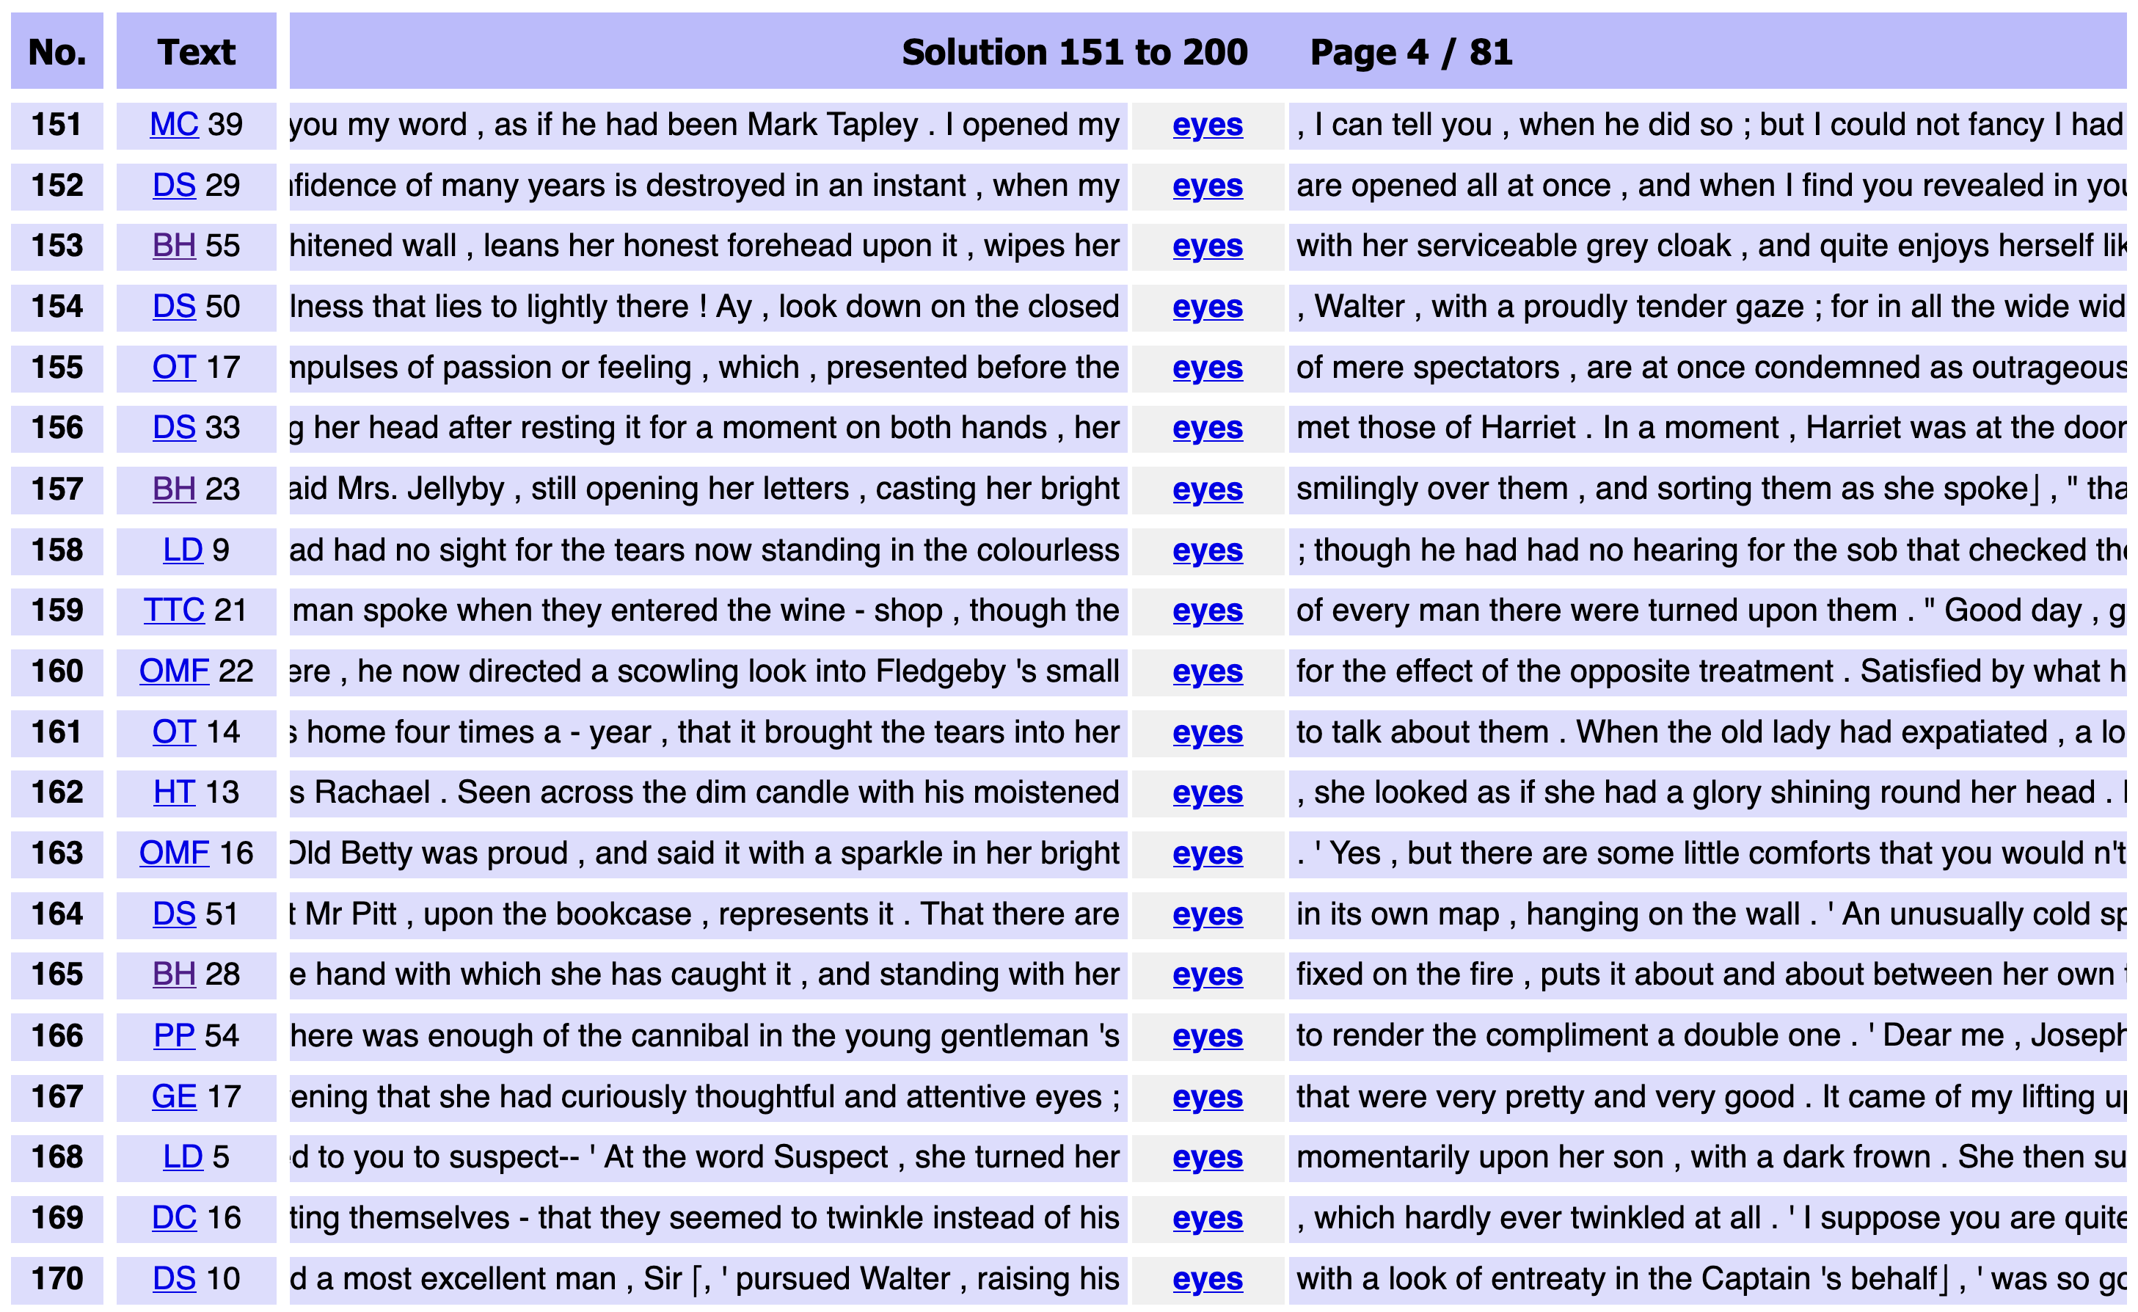
DNOV-CWB
Corpus
"eyes" %c
Query
root node
Partition / Cluster ▼
Analysis Tree
Sort
⨁
arrangement node
random ❎
Query result (4031)
• sort: random
Make selection ▼
🎔 Bookmark
images do not represent actual gameplay

Slide 17
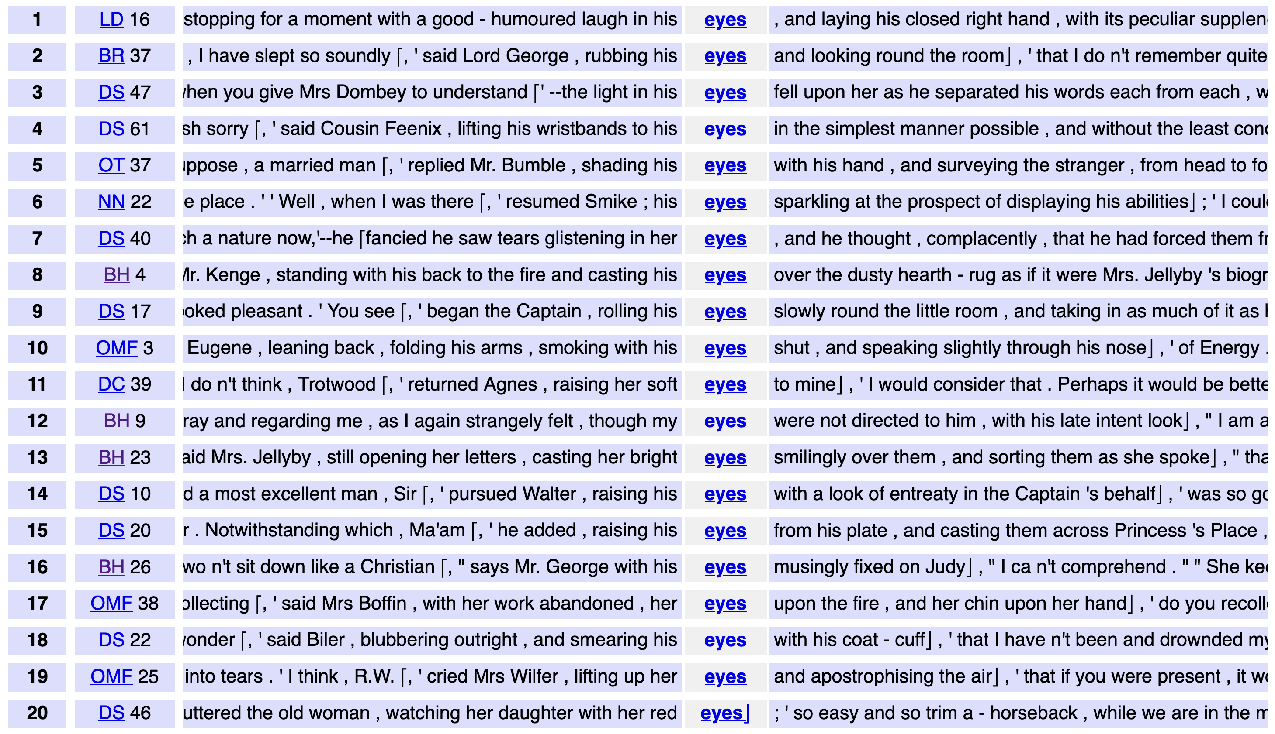
DNOV-CWB
Corpus
"eyes" %c
Query
root node
Partition / Cluster ▼
Analysis Tree
Sort
⨁
arrangement node
random ❎
Query result (4031)
▸ sort: random
• select: within suspension (276)
Make selection ▼
🎔 Bookmark
subset node
images do not represent actual gameplay

Slide 18
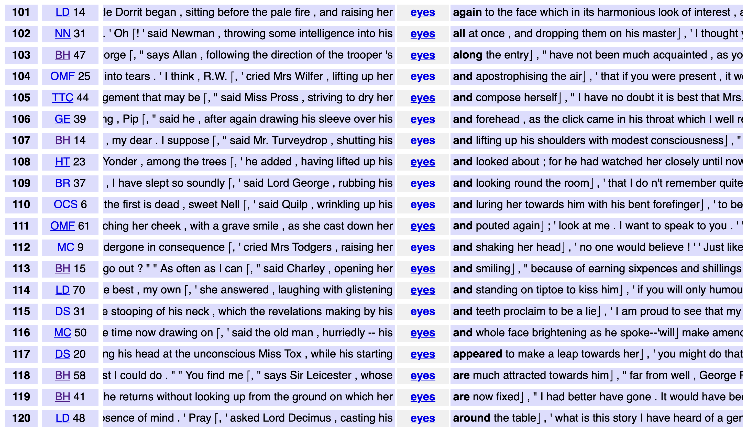
DNOV-CWB
Corpus
"eyes" %c
Query
root node
Partition / Cluster ▼
Analysis Tree
by right context ❎
⨁
arrangement node
Sort
Query result (4031)
▸ sort: random
▸ select: within suspension (276)
• sort: right context
Make selection ▼
🎔 Bookmark
subset node
images do not represent actual gameplay

Slide 19
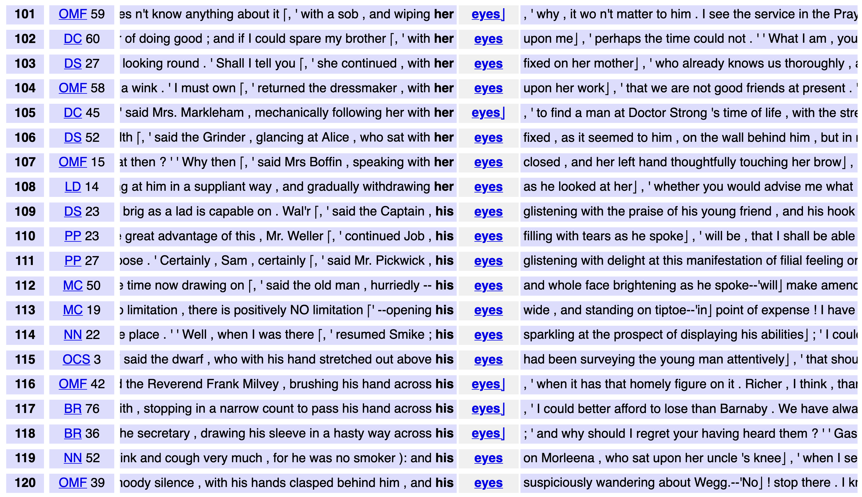
DNOV-CWB
Corpus
"eyes" %c
Query
root node
Partition / Cluster ▼
Analysis Tree
by left context ❎
⨁
arrangement node
Sort
Query result (4031)
▸ sort: random
▸ select: within suspension (276)
• sort: right context
• sort: left context
Make selection ▼
🎔 Bookmark
siblings
subset node
images do not represent actual gameplay

Slide 20
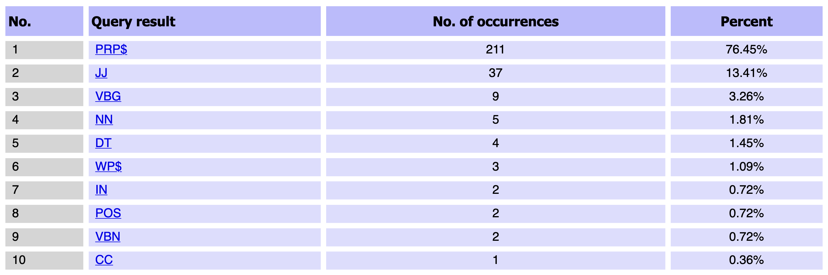
DNOV-CWB
Corpus
"eyes" %c
Query
root node
partition by POS tag of token L1
Analysis Tree
Partition / Cluster ▼
by left context ❎
⨁
arrangement node
Sort
Query result (4031)
▸ sort: random
▸ select: within suspension (276)
• sort: right context
• sort: left context
• partition: by POS tag @ L1,
sort: left context
Make selection ▼
🎔 Bookmark
siblings
subset node
images do not represent actual gameplay

Slide 21
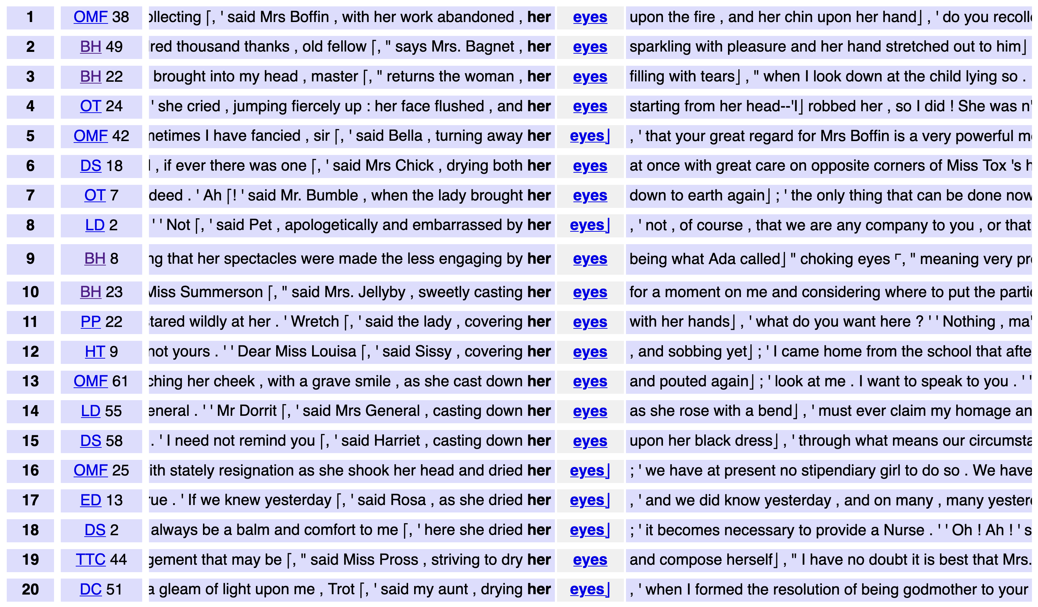
DNOV-CWB
Corpus
"eyes" %c
Query
root node
Partition / Cluster ▼
Analysis Tree
by left context ❎
⨁
arrangement node
Sort
Query result (4031)
▸ sort: random
▸ select: within suspension (276)
• sort: right context
• sort: left context
• partition: by POS tag @ L1,
sort: left context
▸ select: set [PRP$] (211)
Make selection ▼
🎔 Bookmark
siblings
subset node
subset
images do not represent actual gameplay

Slide 22
DNOV-CWB
Corpus
"eyes" %c
Query
root node
Partition / Cluster ▼
Analysis Tree
by L1 ❎
⨁
arrangement node
Sort
Query result (4031)
▸ sort: random
▸ select: within suspension (276)
• sort: right context
• sort: left context
• partition: by POS tag @ L1,
sort: left context
▸ select: set [PRP$] (211)
• sort: by L1
Make selection ▼
🎔 Bookmark
siblings
subset node
subset
images do not represent actual gameplay

Slide 23
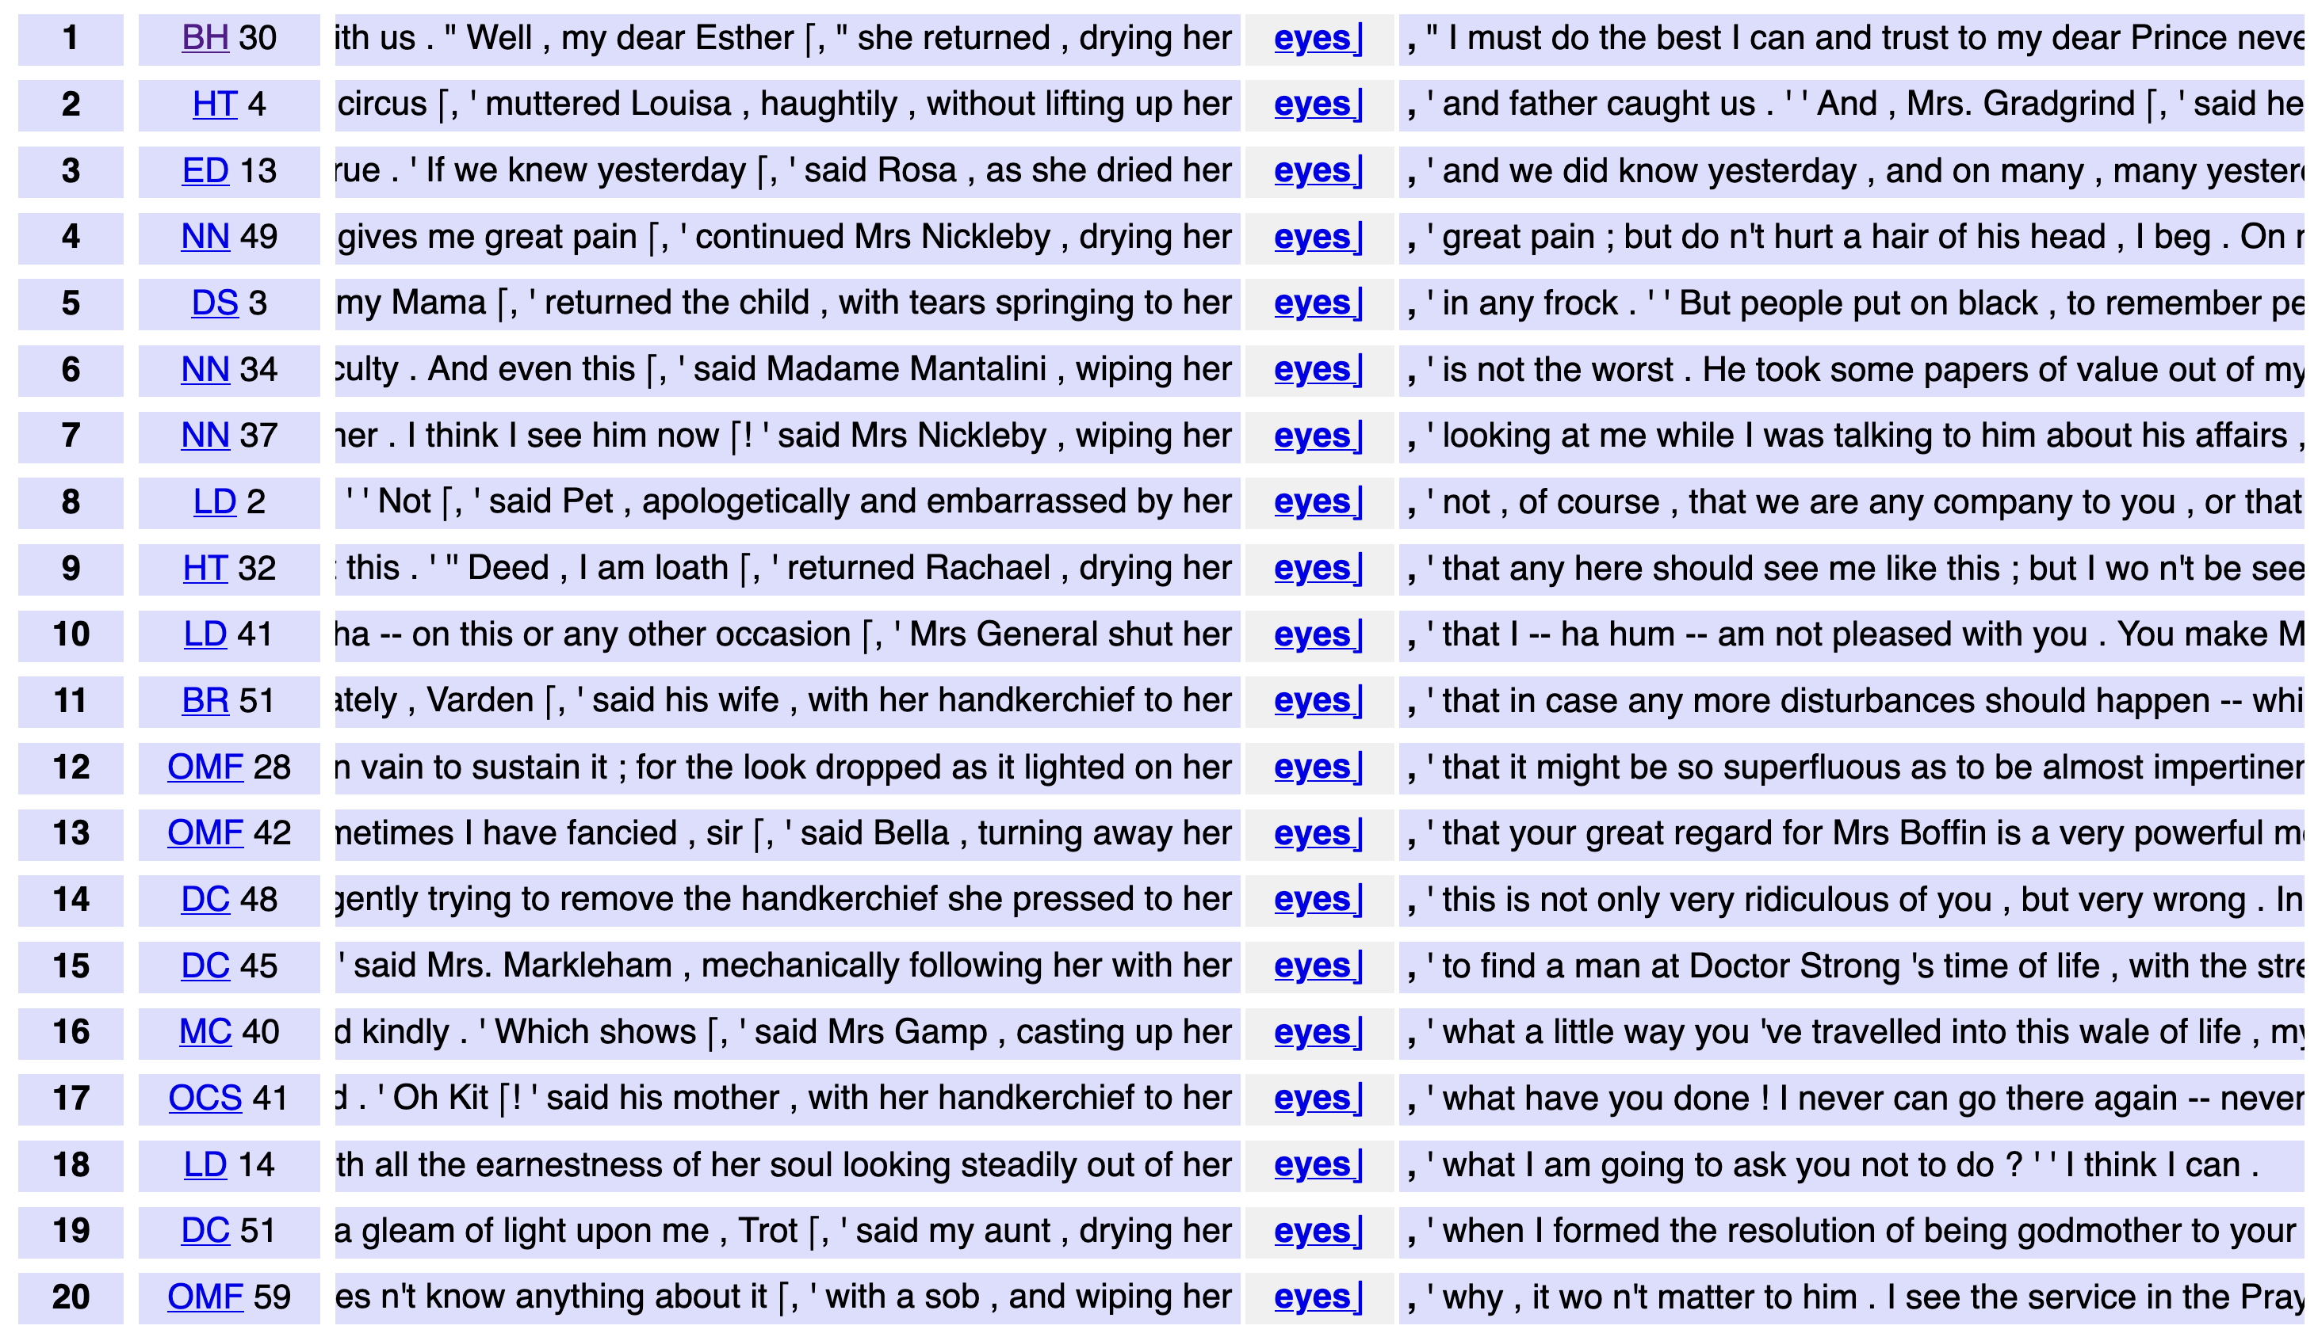
DNOV-CWB
Corpus
"eyes" %c
Query
root node
Partition / Cluster ▼
Analysis Tree
by L1 ❎
⨁
Sort
by right context ❎
arrangement node
Sort
Query result (4031)
▸ sort: random
▸ select: within suspension (276)
• sort: right context
• sort: left context
• partition: by POS tag @ L1,
sort: left context
▸ select: set [PRP$] (211)
• sort: by L1
• sort: by L1,
sort: right context
Make selection ▼
🎔 Bookmark
siblings
subset node
subset
images do not represent actual gameplay

Slide 24
DNOV-CWB
Corpus
"eyes" %c
Query
root node
Partition / Cluster ▼
Analysis Tree
by L1 ❎
⨁
Sort
by right context ❎
arrangement node
Sort
Query result (4031)
▸ sort: random
▸ select: within suspension (276)
• sort: right context
• sort: left context
• partition: by POS tag @ L1,
sort: left context
▸ select: set [PRP$] (211)
• sort: by L1
• sort: by L1,
sort: right context 🎔
Make selection ▼
🎔 Bookmark
siblings
subset node
subset
path from root node
bookmark
images do not represent actual gameplay

Slide 25
A mathematical model of organising conc.
Concordance reading = analysis tree consisting of subset nodes
and arrangement nodes
  subset nodes form the structure of the tree ➞ focus on part of conc.
  arrangement nodes = alternative views of the same subset (➞ parent)
  arrangement nodes are siblings, subset nodes can be children of either kind
  root node = subset node corresponding to full concordance
Subset node = Selecting algorithm with parameters
Arrangement node = ≤ 1 Grouping algorithm with parameters
+ sequence of Ordering algorithms with parameters
  each arrangement node completely overwrites any prior arrangement

Slide 26
Concordance view
Each node in the analysis tree represents a concordance view,
i.e. an arrangement of a subset of the concordance
Identifies subset + ordering of conc. lines via line № as unique ID
With Grouping algorithm: list of sets of conc lines specified by line №
  Partitioning: ordering of the sets (≠ ordering of lines)
  Clustering: ordered tree of the sets + prototypical examples for each set
Optional: supplementary information on concordance lines, sets, and relevant token spans returned by algorithms

Slide 27
Formalising algorithms
Application of an algorithm is conceptualised mathematically as annotation of concordance lines:
Selecting = annotation of a Boolean variable
Sorting = annotation of an integer variable (surrogate keys)
Ranking = annotation of a floating-point variable (preference scores)
Partitioning = annotation of a categorical variable (set membership)
Clustering = annotation of ordered tree of subsets
➞ concordance view derived from annotations

Slide 28
Strategy 1: Selecting
Selecting = add Boolean variable to lines
  keep concordance line if value is True
  exclude selected lines by logical negation of variable (all algorithms)
Examples
selection based on metadata categories or numerical ranges
select random subset (reproducible, stratified, …)
KWIC filter (lines containing certain words, lemmas, POS tags, …)
manual selection of individual concordance lines (will get back to this)

Slide 29
Strategy 2: Sorting [Ordering]
Sorting = add integer variable with sort keys
  pairwise comparison of lines (A < B, A = B, A > B)
  resulting sort order ➞ integers as surrogate keys (A < B, A = B, A > B)
  ties (A = B) can be broken by additional Sorting or Ranking algorithms
Examples
sort alphabetically by left or right context
sort by POS tag of first (L1) or second (L2) token before node
sort by numerical (e.g. year) or categorical (e.g. author) metadata
random shuffling (reproducible)

Slide 30
Strategy 3: Ranking [Ordering]
Ranking = add floating-point variable to lines
  values = preference score assigned to each line
  decreasing order: lines with highest scores shown at top
  ties can occur e.g. if scores happen to be integer values
Examples
rank by readability, GDEX algorithm, or fit to selected CEFR level
rank by frequency of the node string
rank by similarity to query (for fuzzy search)
rank by number of significant collocates of the node in context, or by number of user-specified keywords (KWIC grouper)

Slide 31
Strategy 4: Partitioning [Grouping]
Partitioning = add partition № to each line
  each line assigned to exactly one partition,
  based on a property of the concordance line (not on comparisons)
  also provide ordered list of partitions with display labels, etc.
Examples
frequency breakdown of node strings
partition by POS tag of first (L1) or second (L2) token before node
partition by categorical metadata (variety, genre, speaker info, …)
partition by lemma trigram R1+R2+R3 (similar to KWIC patterns)

Slide 32
Strategy 5: Clustering [Grouping]
Clustering = add ordered tree over lines
  based on pairwise similarities of concordance lines
  hierarchical clustering ➞ deep tree, flat clustering ➞ single-level tree
  tree describes both nesting and preference order of clusters
Examples
clustering based on lexical similarity (shared words), semantic similarity (sentence/word embeddings), or syntactic similarity
clustering based on multiple metadata features ➞ similarity score
all clusterings: either flat or hierarchical, with different algorithms
context tree (on POS tags, lemmas, semantic tags, …)

Slide 33
Aside: Context trees & KWIC patterns
(Evert, ICAME 2007)
➞ sorting algorithm for concordance reading (Anthony 2022)
… but 3 different versions
The Word Tree
(Wattenberg & Viégas, 2008)

Slide 34
Strategy 1': Manual Selecting
Selecting based on manual choice made by user
  also adds Boolean variable & can be inverted
  direct selection of lines vs. indirect (via set ID or supplementary information)
Examples
manual validation of concordance lines (e.g. false positives)
select sets by ID (after Grouping) or range of lines (after Ordering)
threshold based on ranking scores (returned as supplementary info)
“interactive” algorithms (e.g. click individual lines or sets) vs.
“non-interactive” algorithms (e.g. top-n lines in ranking)

Slide 35
Research documentation
Analysis tree as research documentation
  concordance view uniquely determined by path from root node
  bookmarked nodes = basis for interpretation & discussion
Exact reproduction with identical concordance data
  readers can reproduce published results completely
  but also explore further concordance views
Save / load analysis tree ➞ continue concordance reading later
Analysis tree as template for concordance organisation
  “replay” tree on a new concordance (possibly from different corpus)
  interactive manual selection has to be omitted (➞ not meaningful)

Slide 36

Time for a break …
Coffee

Slide 37

Hands-on: analysis tree in CLiC
https://clic-fiction.com/
clic-analysis-tree_head_19c.json

Slide 38
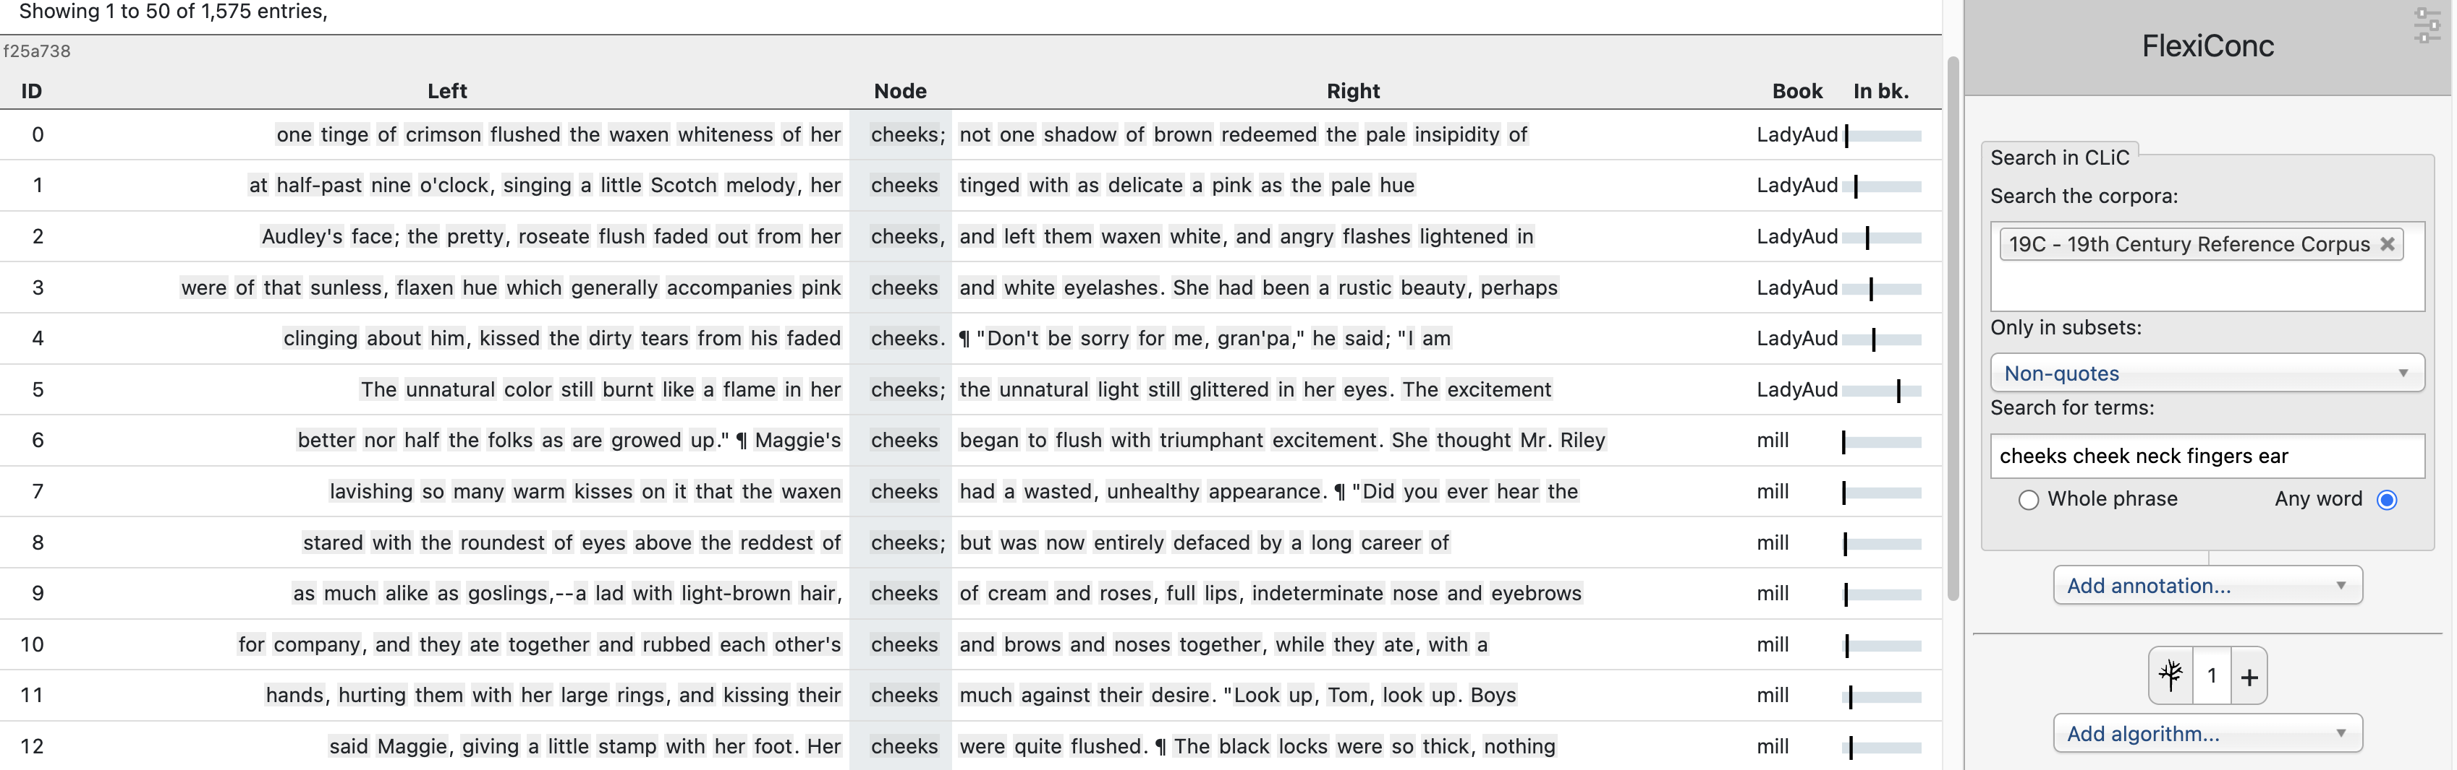
Exercise: body language patterns
Search words: cheeks, cheek, neck, fingers, ear
  corpus: 19C fiction – focus on non-quotes
Your task: work through handout & explore FlexiConc algorithms
You

Slide 39
References
Anthony, L. (2022). What can corpus software do? In O’Keeffe, A. and McCarthy, M. J., editors, The Routledge Handbook of Corpus Linguistics, chapter 9. Routledge, London, 2nd edition
Evert, S. (2007). Context graphs. Presentation at the ICAME 2007 Conference, Stratford upon Avon, UK.
Wattenberg, M. & Viégas, F. B. (2008). The word tree, an interactive visual concordance. IEEE Transactions on Visualization and Computer Graphics, 14(6):1221–1228.

