Slide 1





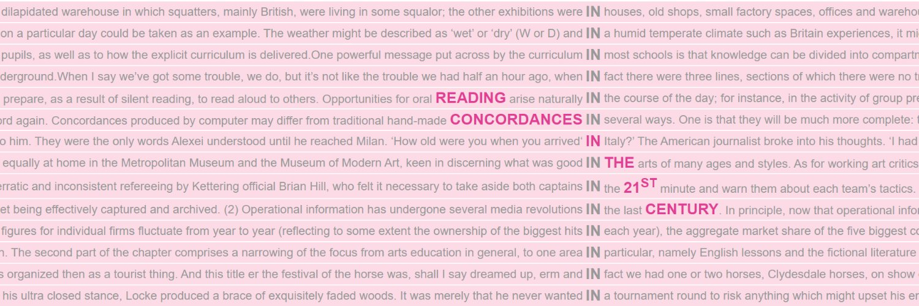
5
Reading Concordances with Algorithms:
a training course in key corpus linguistics methodology
FlexiConc: Implementation & Jupyter
UTN Computational Linguistics Fall School
21–25 September 2026
Stephanie Evert & Michaela Mahlberg

Slide 2
Orientation
What we have learned so far …
Reading concordances with the help of software tools
How to identify recurrent patterns and interpret them
Strategies and algorithms for organising concordance lines (FlexiConc)
The analysis tree as reproducible research documentation
What we're going to look at now …
Using FlexiConc from Jupyter notebooks
How to analyse concordances in your own corpora

Slide 3
FlexiConc
host app
FlexiConc
Python library
CLiC
CandyConc
WMatrix
other?
corpus query & indexing
https://pypi.org/project/FlexiConc/

Slide 4
FlexiConc via Jupyter notebooks
FlexiConc
Python library
Jupyter
notebook
Sketch Engine, KorAP, CLiC, CWB, CQPweb, WMatrix
https://pypi.org/project/FlexiConc/

Slide 5
FlexiConc via Jupyter notebooks
Why FlexiConc? ➞ benefit from algorithmic innovation!
Use FlexiConc library from Python code in Jupyter notebook
Combines (some) interactivity with custom programming, e.g.
to carry out additional anlayses not available in concordancer
Connect with various indexing & search backend to access your
own corpora there ➞ FlexiConc has ready-made functions
The Right Way: install Jupyter Lab + FlexiConc on your computer
The easy way: run notebook in Google Colab … in a moment

Slide 6
Installing FlexiConc (Windows / MacOS)
install Anaconda Python or miniconda (anaconda.com/download)
create a separate environment for FlexiConc
(conda create -n FlexiConc python=3.13)
don't forget to activate it (conda activate FlexiConc)
install PyICU from Anaconda (conda install pyicu)
install JupyterLab (conda install jupyterlab)
install FlexiConc and dependencies from PyPI with pip:
pip install -U "flexiconc[notebooks,web,ICU,partitioning,annotation]"
now start JupyterLab (jupyter lab .) … or ask us for help

Slide 7
Installing FlexiConc (Linux)
create virtualenv: python3 -mvenv --upgrade-deps venv
activate virtualenv: source venv/bin/activate
install ICU (e.g. sudo apt install libicu-dev on Ubuntu)
install JupyterLab (pip install jupyterlab)
install FlexiConc and dependencies from PyPI with pip:
pip install -U "flexiconc[notebooks,web,ICU,partitioning,annotation]"
start JupyterLab in your working directory: jupyter lab .
ask us for help if it doesn't work …

Slide 8

FlexiConc in Jupyter notebooks
First steps: flexiconc_introduction.ipynb
Download from course website
Or copy in Google Colab and run it there
https://colab.research.google.com/drive/1sAC7c0vljy6og_dSwHbvbCs3QTs4a6Lx?usp=sharing

Slide 9
Import from CLiC
https://clic-fiction.com/
Preparation: none
C = Concordance()
C.retrieve_from_clic(query=["head"], corpora="dickens")

Slide 10
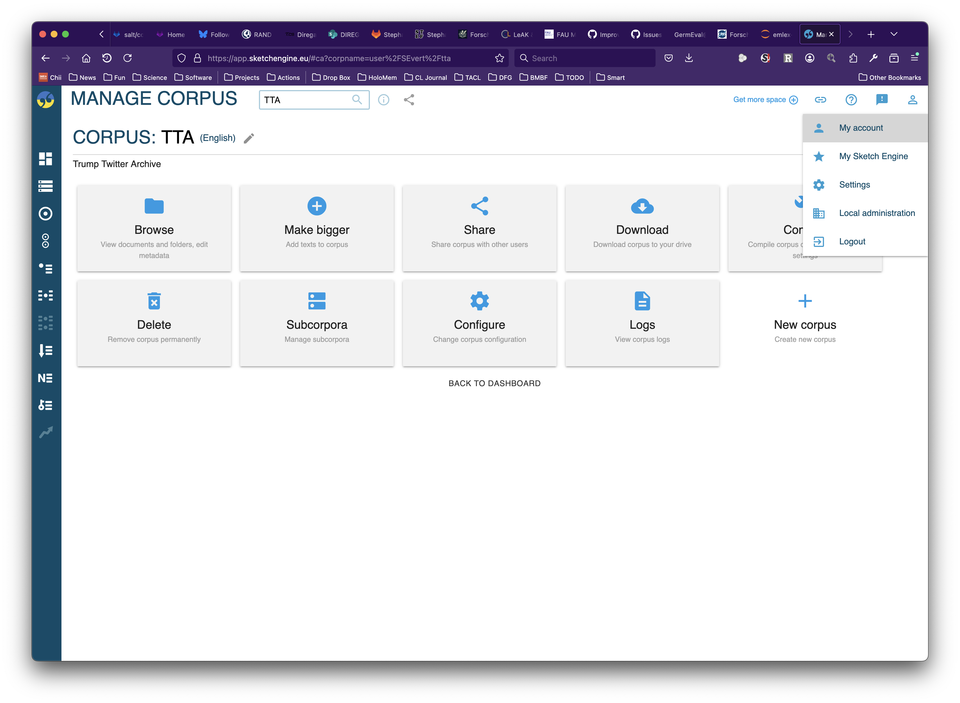
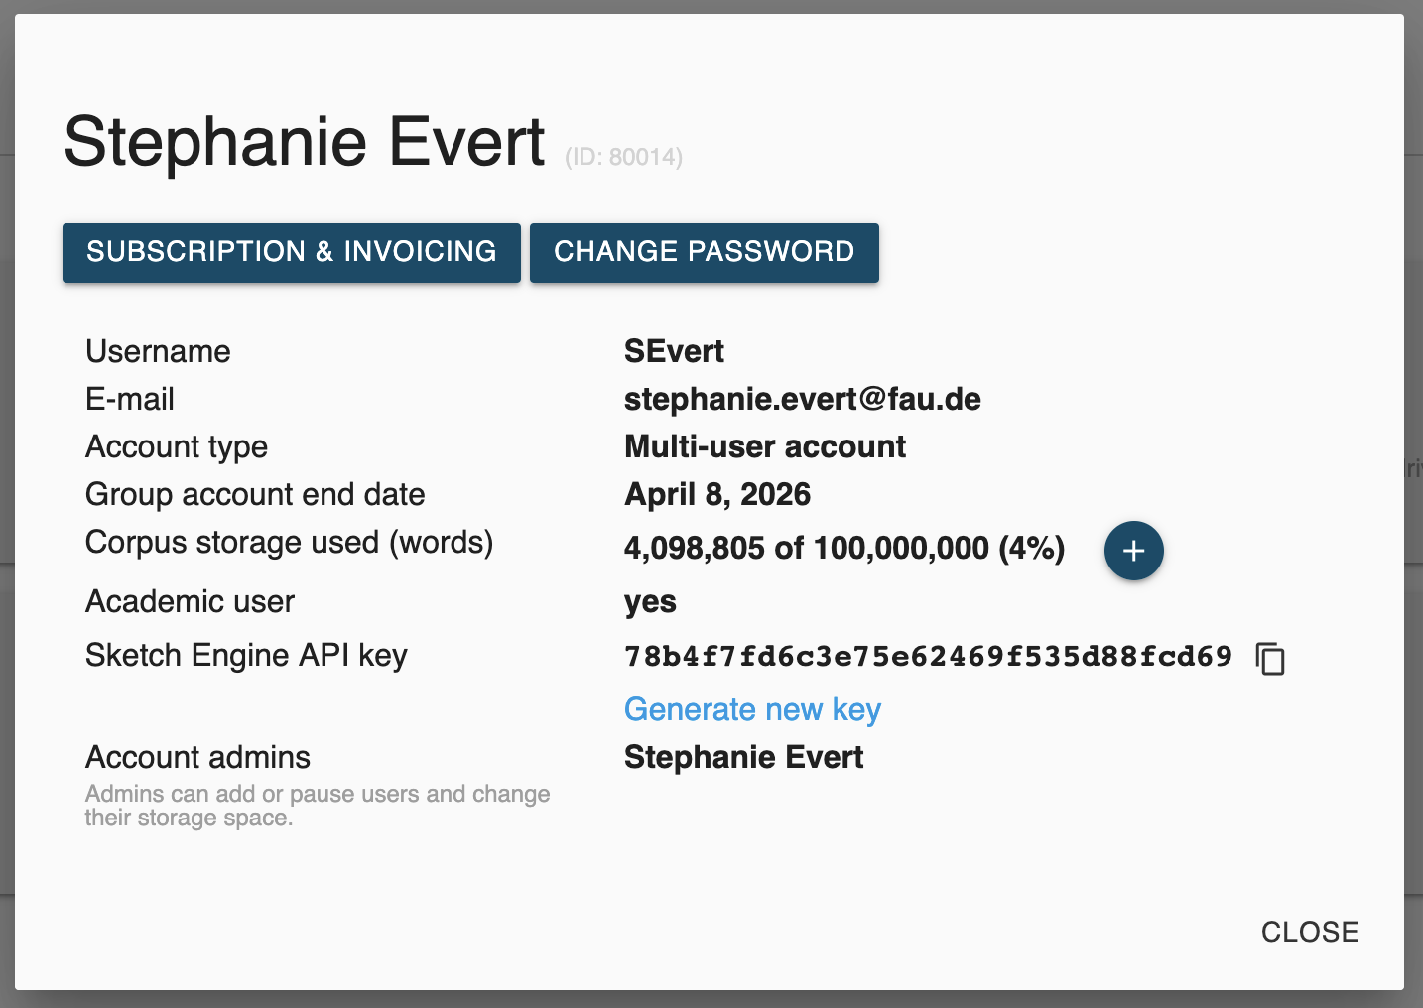
Import from Sketch Engine
https://app.sketchengine.eu/
Prerequisite: paid SkE account (free 30-day trials available)

Slide 11
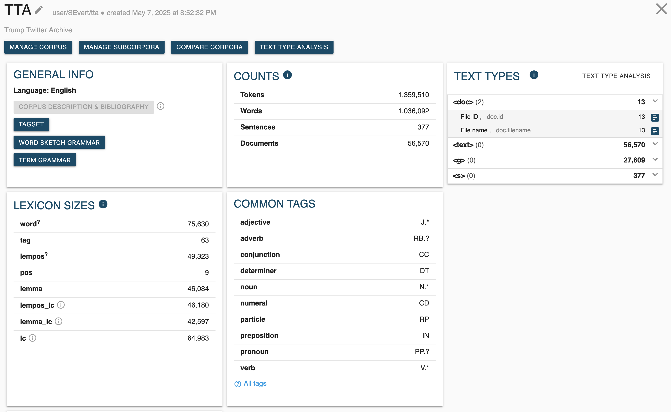
Import from Sketch Engine
https://app.sketchengine.eu/

Slide 12
Import from Sketch Engine
https://app.sketchengine.eu/
Prerequisite: paid SkE account (free 30-day trials available)
Generate API access token (as shown on previous slides)
Note down full path to desired corpus (as shown on previous slides)
C = Concordance()
C.retrieve_from_sketchengine(
query='[lc="fake"] [lc="news"]',
corpus="user/SEvert/tta", # insert your path here
api_key="[YOUR API KEY]")

Slide 13
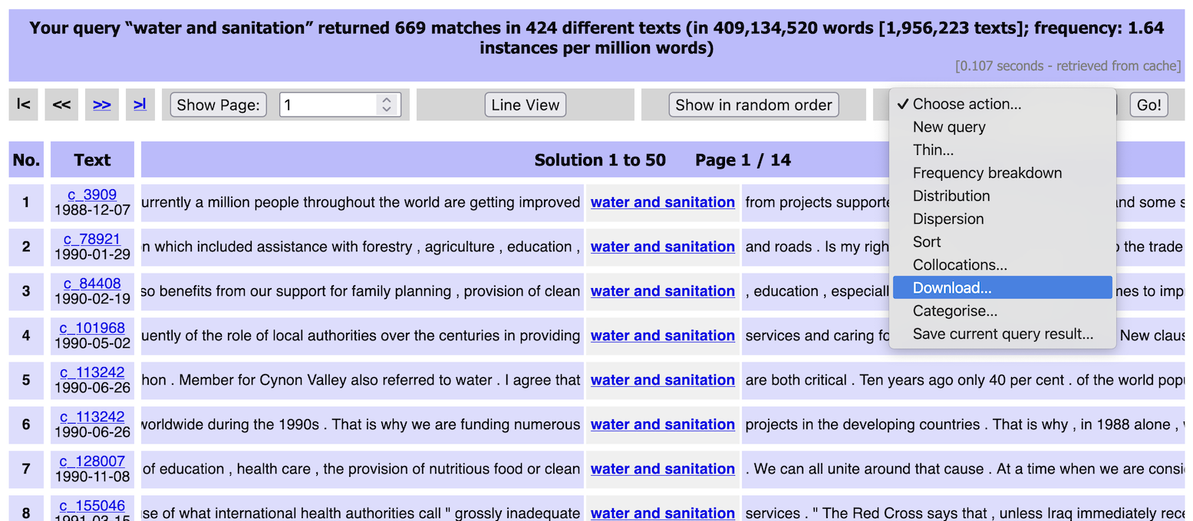
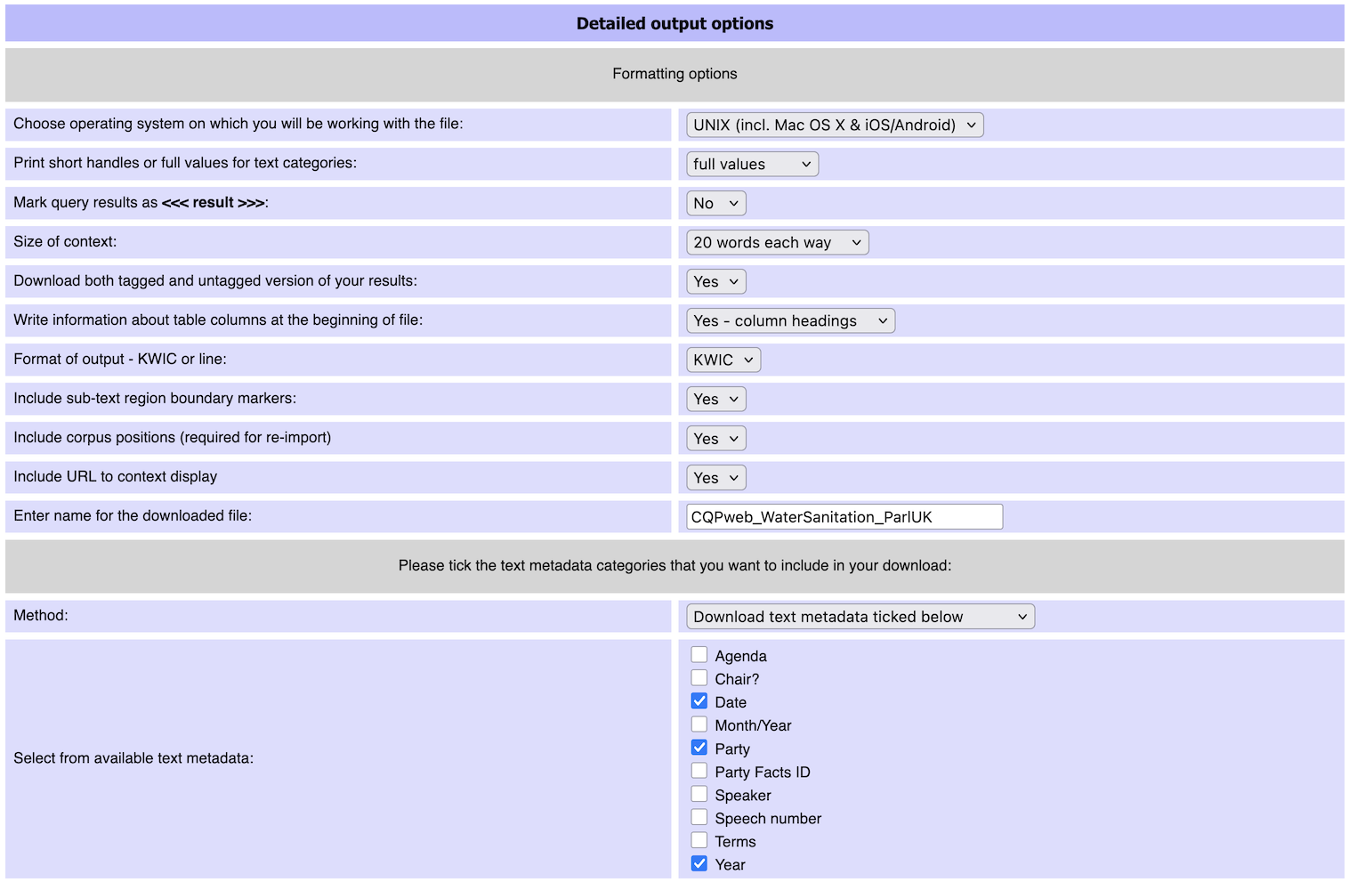
Import from CQPweb
https://corpora.linguistik.uni-erlangen.de/cqpweb/

Slide 14
Import from CQPweb
https://corpora.linguistik.uni-erlangen.de/cqpweb/
Obtain desired concordance in CQPweb and save it with download action (as shown on previous slide)
Make sure to include all relevant metadata
Save the downloaded file in same directory as Jupyter notebook
C = Concordance()
C.load_from_cqpweb_export("CQPweb_WaterSanitation_ParlUK.txt")

Slide 15
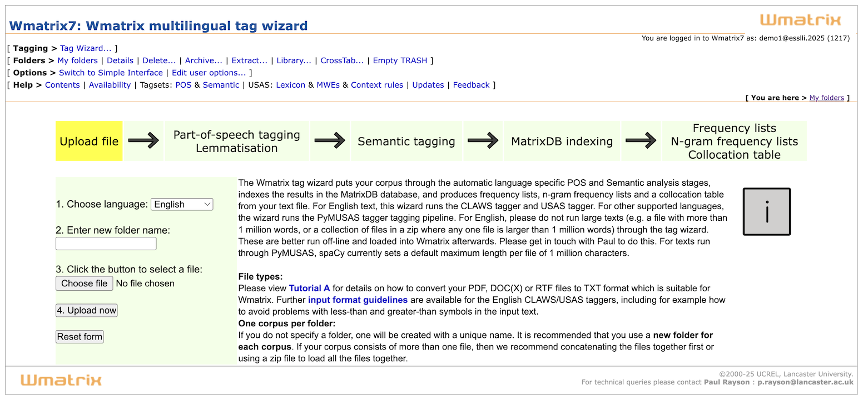
Import from WMatrix
https://ucrel-wmatrix7.lancaster.ac.uk/
Tag Wizard: Create your own corpus from text files in ZIP archive
Annotated with POS, lemma, semantic concept in 9 languages
Corpus (“folder”) can be downloaded in SQLite format

Slide 16
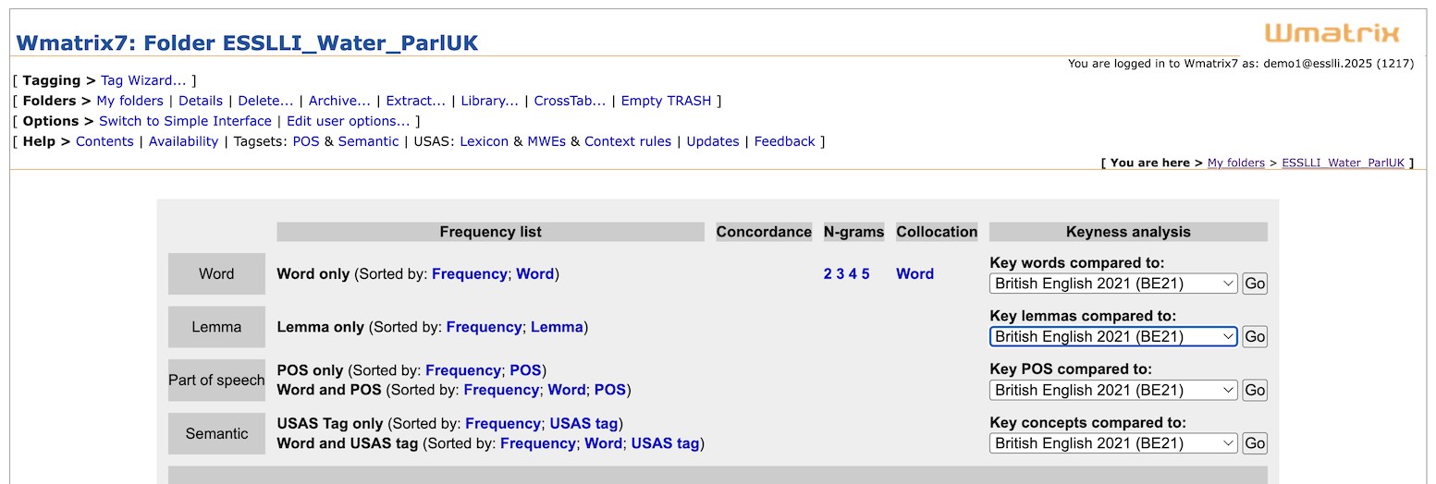
Import from WMatrix
https://ucrel-wmatrix7.lancaster.ac.uk/
Use own corpus (“folder”) or copy ESSLLI_Water_ParlUK from library
Main function: keyword analysis (for word, lemma, POS, concept)
Note interesting keywords ➞ concordance analysis in FlexiConc

Slide 17
Import from WMatrix
https://ucrel-wmatrix7.lancaster.ac.uk/
Get a free WMatrix account (or use our demo account)
Demo account credentials:
username: demo1@esslli.2025 password: u73ripee4y
Download complete annotated WMatrix corpus
Then use query to obtain concordance for desired keyword
labour2005 = wmatrix.load(
corpus_name="LabourManifesto2005",
username="[USER]", password="[PASSWORD]",
db_filename="labour2005.db")
C = labour2005.concordance_from_query("community")

Slide 18
Import your own files
from flexiconc import TextImport
T = TextImport()
T.load_files(
paths=["data"],
shorten_paths=True,
db_name="db.sqlite",
use_spacy=True,
lemma=True,
pos=True,
tag=True
)
C = T.concordance_from_query("stomach")

Slide 19

Pro users: Import from CWB
Install IMS Open Corpus Workbench from cwb.sourceforge.io
Index your favourite corpus (or obtain a pre-indexed one)
Python API: pip install cwb-ccc
NB: will need complete development evironment with C compiler
C = Concordance()
C.retrieve_from_cwb(
corpus_name = "PARLSPEECH_UK",
query = r'[pos="JJ.*"] [lemma="elephant"]',
tokens_attrs = ["word", "pos", "lemma"],
metadata_attrs = ["text_party", "text_year", "text_date"])

Slide 20

FlexiConc in Jupyter notebooks
Loading your own data: flexiconc_import.ipynb
Download from course website
Or copy in Google Colab and run it there
https://colab.research.google.com/drive/1HuVRl748lWe65Mzl5HNge4Wwgq5xiqw2?usp=sharing
After you’ve learned how to load your own data, explore a concordance of your choice. At the end of the session, we’ll discuss your experiences and results.

Slide 21
FlexiConc internals
A FlexiConc Concordance object must include two Pandas dataframes
metadata
  information about concordance lines
tokens
  information about individual tokens

Slide 22
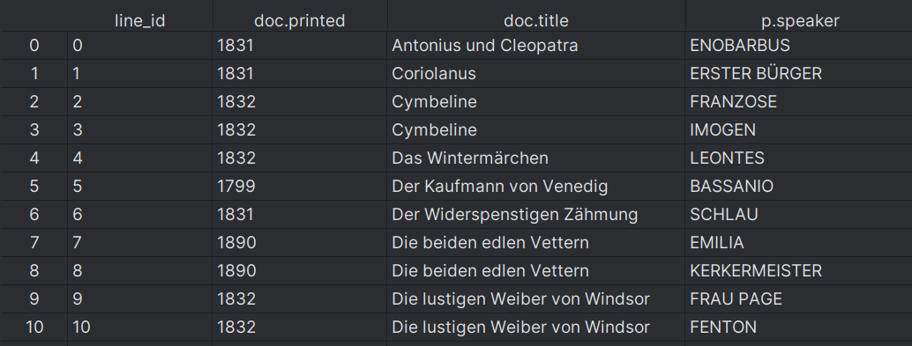
Concordances in FlexiConc: metadata

Slide 23
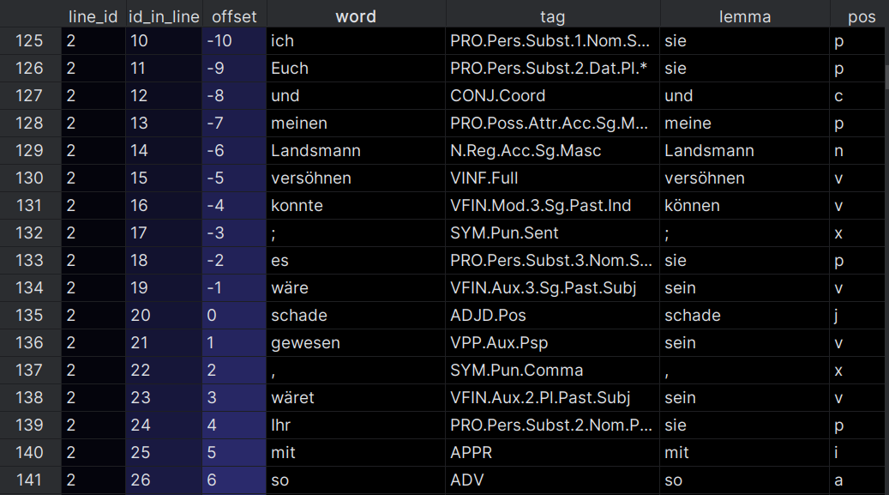
Concordances in FlexiConc: tokens

Slide 24
Representation of algorithms in FlexiConc
Algorithms are stored as individual Python files (.py) in the algorithms folder of the flexiconc package
Algorithms can also be loaded from user-specified folders
Each algorithm includes an exact specification of its API as a JSON schema, which can be updated dynamically for each node
  name
  description
  algorithm type
  arguments
  availability of an algorithm for a node

Slide 25
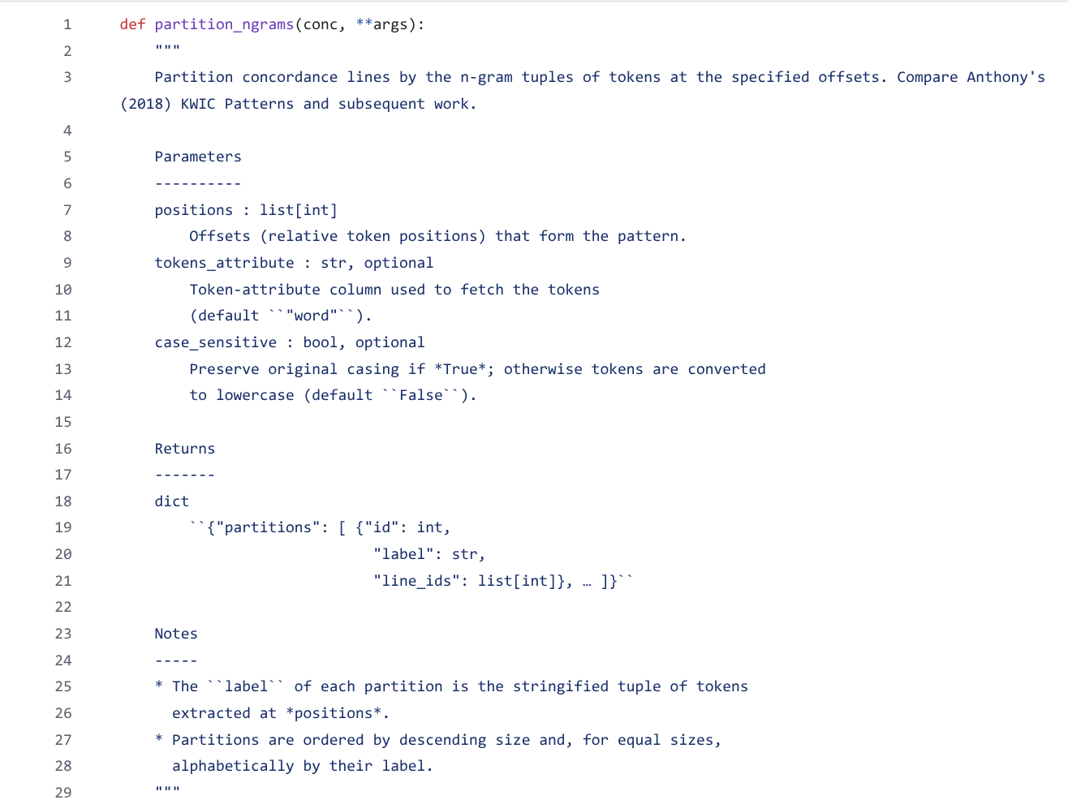
Implementation of a FlexiConc algorithm
Docstring

Slide 26
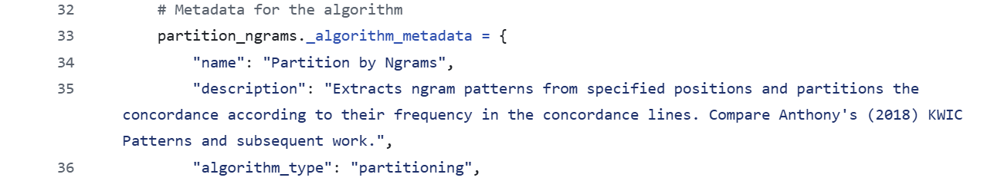
Implementation of a FlexiConc algorithm
Metadata

Slide 27
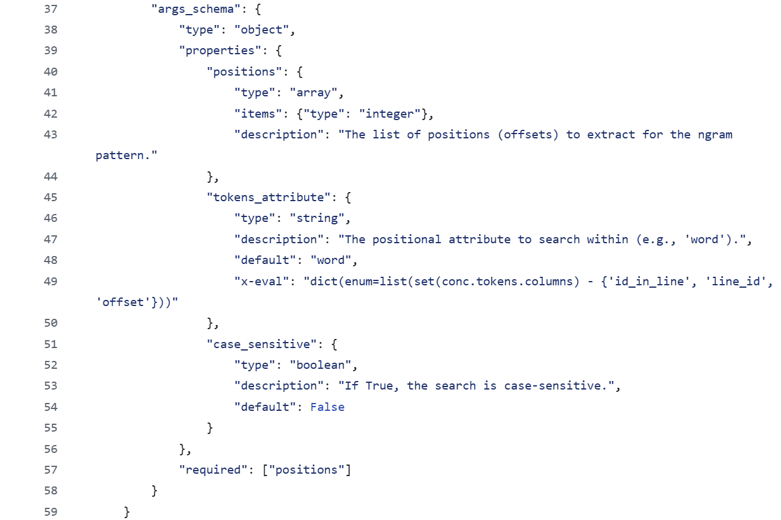
Implementation of a FlexiConc algorithm
Argument schema
Dynamic list of possible values

Slide 28
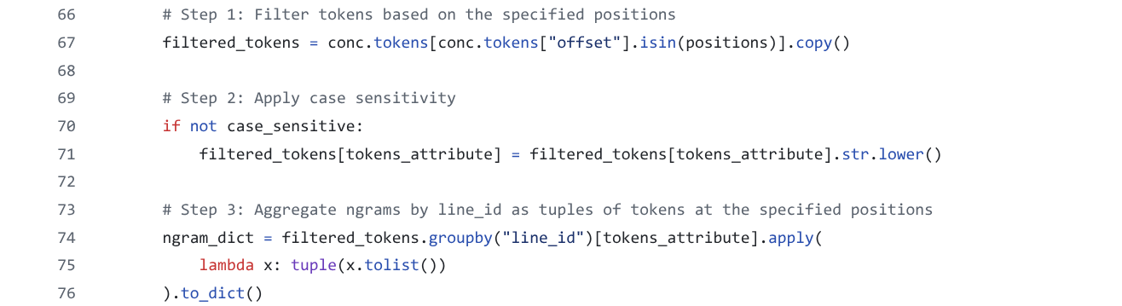
Implementation of a FlexiConc algorithm

Slide 29
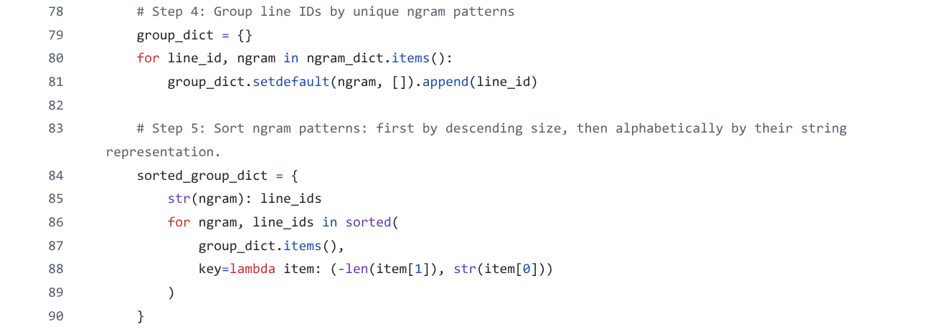
Implementation of a FlexiConc algorithm

Slide 30
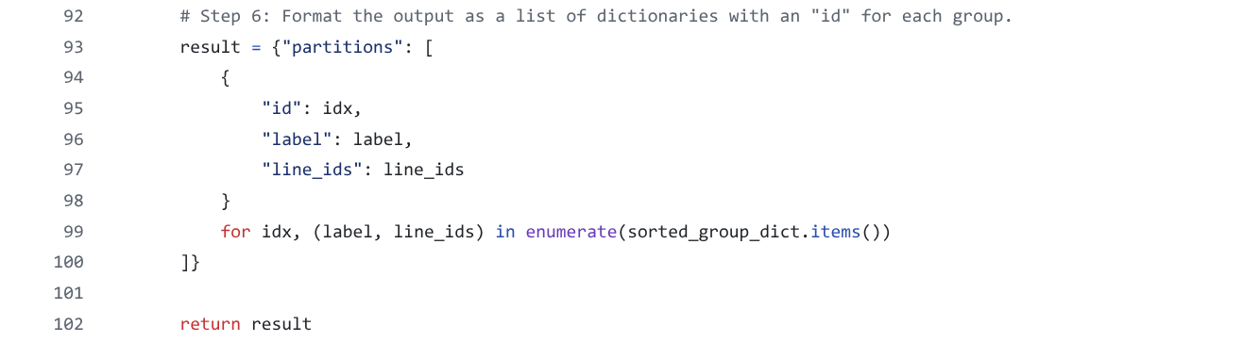
Implementation of a FlexiConc algorithm
Creating custom algorithms should be doable!

Slide 31
Executing algorithms
Algorithms are applied to subsets of concordance lines and return information about
  selected lines
  ordering of lines
  grouping of lines
  token spans to be highlighted in the concordance view
Algorithms can only be accessed via add_subset_node and add_arrangement_node, ensuring that
  only permissible algorithm combinations are used
  any algorithm call is documented in the analysis tree
  the results of algorithm execution are stored correctly

Slide 32
Wrapping up …
Concordance reading as link between quantitative and qualitative perspectives on corpora (“distant vs. close reading“)
Many applications: literary stylistics, discourse analysis, language teaching, lexicography, query refinement, topic models, …
Aim: identify recurrent patterns at different levels ➞ interpretation
Computational algorithms support organising concordance lines
Strategies: Selecting, Sorting, Ranking, Partitioning, Clustering
Analysis tree as reproducible research documentation & template
FlexiConc Python library as open-source software implementation

Slide 33

Farewell & materials
Thank you!
Project homepage:
https://www.dhss.phil.fau.eu/research/reading-concordances/
Open course materials for reuse:
https://github.com/reading-concordances/teaching/

Slide 34

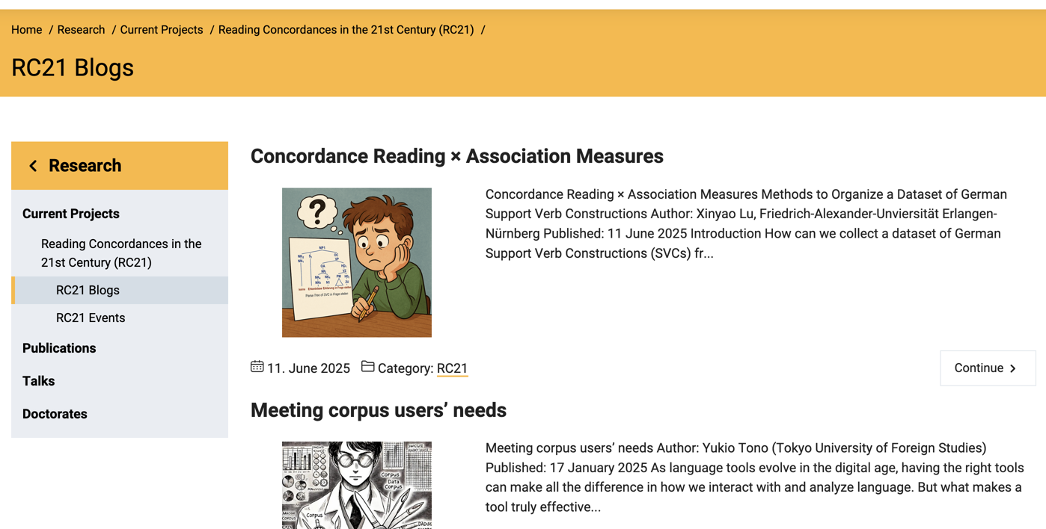
Feedback and contributions welcome!
Please fill in our feedback form for this course!
https://forms.gle/k7n6ViVhNfjNgDZr7
Get in touch with us to contribute to our project blog!
experience with FlexiConc
concordance reading for
your own research
needs/ideas for algorithms

