Slide 1
Fusebox 3.0
Notes:
1997: Steve Nelson and Gabe Roffman introduce Fusebox
2000: Hal Helms introduces eXtended FuseBox (XFB) consisting of both project management tools and techniques and technical innovations
2001: Fusebox + technical innovations of XFB = Fusebox 3.0

Slide 2
The Fusebox Philosophy
There are two ways of constructing a software design: One way is to make it so simple that there are obviously no deficiencies, and the other way is to make it so complicated that there are no obvious deficiencies. The first method is far more difficult.
C.A.R. Hoare
Notes:
From beginning, Fusebox’s aim has been “power through simplicity”
Fusebox 3.0 continues in this tradition

Slide 3

State of Application Development: Failure
Notes:
Several studies over the last five years tell us that failure rates for corporate custom software hovers at 70%.
Definition of insanity: Doing the same thing repeatedly--and expecting different results.
Our development methodologies have let us down.

Slide 4
Problems of Application Development
Software is very expensive to develop and very expensive to maintain
Code is buggy or does not do what clients need
Development cycle is protracted; often by time software is completed, the problem has shifted
Notes:
Current practices impact:
Expense: Custom software development must be done by developers in the same room.
Expense: Maintenance is very slow work, as there is seldom adequate documentation, nor is there a known system in place
Expense: Almost all development must be done by expensive, scarce developers
Quality: Requirements are seldom fully understood, leading developers to develop the wrong software
Quality: Time pressure causes software to be deployed before it is well tested
Timeliness: The first 90% of a job takes as long as the last 10%
Timeliness: Very difficult to schedule software releases
Timeliness: The farther into the development cycle we go, the fewer people can participate in the process, meaning that fewer resources can be deployed when they are most needed due to the requirements for encycolpedic knowledge on the part of developers

Slide 5

Point-to-Point Routing
New York
Tampa
Notes:
Airlines used to use “point-to-point” routing.
If you wanted to go from one place to another, you looked for a plane heading there.
This was very efficient—as long as you could wanted to go where the plane was headed.

Slide 6
Hub-and-Spoke System
Chicago
Seattle
New York
Atlanta
Los Angeles
Tampa
Notes:
In order to create a more scalable, robust system, airlines moved to a hub-and-spoke system.
This proved to be a much more capable system under stress.

Slide 7
Point-to-Point Programming
Module F
Module E
Module B
Module C
Module A
Module D
Notes:
In software, we don’t work with cities and towns; we work with code files and modules
Software has its own version of point-to-point routing, where one module “talks” directly to another
This is known as “spaghetti code”, and the more of it there is, the more fragile a system becomes, the more expensive and difficult changes are to make and the longer it takes to deploy

Slide 8
Fusebox Programming
Module F
Module C
Module E
Fusebox
Module A
Module D
Module B
Notes:
Fusebox is the software equivalent of hub-and-spoke routing
Modules remain independent of each other, promoting code reuse, distributed development and easier and cheaper maintenance.

Slide 9
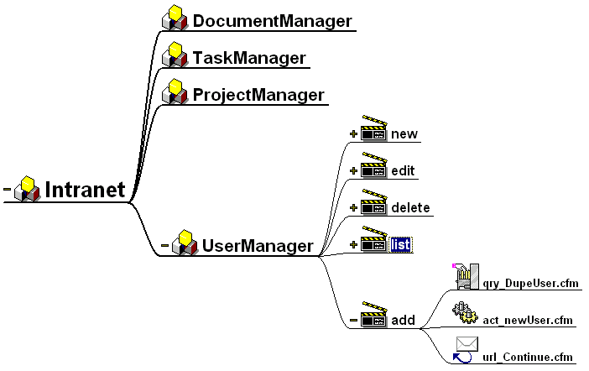
Fusebox Architecture
Notes:
The entire application is architected before coding is done

Slide 10
Fusebox Architecture
Fuseactions
Circuits
Fuses
Notes:
Circuits handle fuseaction requests by calling fuses

Slide 11
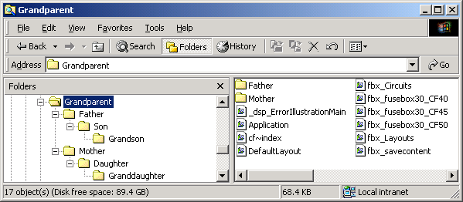
Nested Circuits
Notes:
In Fusebox, these modules are called “circuits”
Each circuit handles a specific area of functionality
These circuits can exists in parent-child relationships, making for nested circuits that allow children to inherit from their parents and grandparents

Slide 12
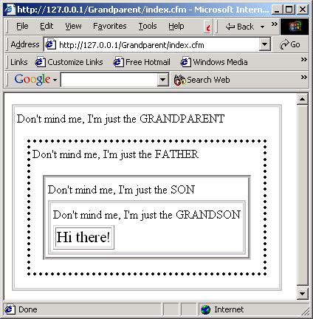
Nested Layouts
Notes:
The same parent-child relationship structure that allows for nested circuits allows for nested layouts.
Each circuit in the “fuseaction path” can—but does not have to—apply its own layout, allowing for greater code reuse
Circuits can make layout decisions based on events that occur during execution of their descendants—e.g. Father may decide to use a different layout if Grandson returned no information, allowing circuits to be written once and used in multiple contexts

Slide 13
The Structure of a Fuseaction
A request made of the server to perform some action is known as a fuseaction.
Fuseactions are made up of the circuit name, a dot separator, and the actual request.
  Cart.addItem
  Users.login
  Scheduler.requestMeeting
Notes:
All actions occur as the result of a fuseaction request.

Slide 14
A Fusebox Request
A fuseaction request is sent to the web server’s default page:
  <a href=“index.cfm?fuseaction=Users.new”>
  Register Now
  </a>
Notes:
Fuseaction requests are typically sent as either form or URL variables
Here, the fuseaction is meant for the Users circuit and the request is new

Slide 15
A Fusebox Request
The default page includes the core Fusebox file:
  <cfinclude template=“FBX_Fusebox30_CF50.cfm”>
Notes:
There are separate core Fusebox files for versions 4.0x, 4.5x, and 5.x of ColdFusion server

Slide 16
A Fusebox Request
The fusebox file determines which circuit the request belongs to and includes that circuit’s FBX_Switch.cfm file.
This switch file includes one or more fuses needed to fullfill the request:
  <!--- snippet from Users circuit’s FBX_Switch.cfm --->
  <cfcase value=“new”>
  <cfinclude template=“dsp_userInfo.cfm”>
  </cfcase>
Notes:
One of the core Fusebox files, FBX_Circuits, lets the developer map directory names to circuit names
This eliminates the potential problem of several directories with the same name
The Fusebox core code translates a compound fuseaction into a “fuseaction path”
In our example, Users.new might be translated into Intranet/Admin/Users.new
Along the way down the fuseaction path, any settings files are included, providing inheritance while allowing an individual circuit to override any previous values

Slide 17
A Fusebox Request
The request is completed and the fuse can begin again, making a new fuseaction request:
  <!--- snippet from dsp_userInfo.cfm--->
  <form
  action=“index.cfm?fuseaction=Users.addUser” method=“post”>
  ...
Notes:
Once a new call is made to the application’s default page (index.cfm in this case), one fusebox request is finished and a new one begins.

Slide 18
Setting XFAs
XFAs represent exit points for a fuseaction.
XFA values are set in FBX_Switch.cfm
  <cfcase value=“validateLogin”>
  <cfset XFA.success = “Home.main”>
  <cfset XFA.failure = “Login.badLogin”>
  <cfinclude template=“qry_findUser.cfm”>
  <cfinclude template=“act_findUser.cfm”>
  </cfcase>
Notes:
Typically, fuseactions have exit points—conditions that cause a new fuseaction request to be made.
XFAs can be encoded in the fuse directly or a separate url_ file can be called.

Slide 19
Exit Fuseactions (XFAs)
A hardcoded value for the next fuseaction...
  <cflocation
  url=“index.cfm?fuseaction=Catalog.main” addtoken=“yes”>
…is replaced with a variable:
  <cflocation
  url=“index.cfm?fuseaction=#XFA.success#” addtoken=“yes”>
Notes:
Hardcoded values reduce reusability and hamper maintainability.
XFAs substitute variables for hard-coded values.

Slide 20
Fusedoc
A standardized documentation/program definition language for use with Fusebox
XML-based (DTD available)
Fusedoc tools (in the works)
Notes:
Most code is either undocumented or has cursory documentation
Coders are exhorted to “document your code” but never told what to document or how
Fusedoc answers these questions
Easily readable by humans and machines

Slide 21
Fusebox: Who Benefits?
Client
  sees what they will get before they get it
  can track progress by having known deliverables
  pays less since there is less risk to development shop
Notes:
Most code is either undocumented or has cursory documentation
Coders are exhorted to “document your code” but never told what to document or how
Fusedoc answers these questions
Easily readable by humans and machines

Slide 22
Fusebox: Who Benefits?
Development shop
  leverages their investment in tools and training
  allows for distribution of labor on a project
    architecture
    database
    graphics
    user interface
    coder
  reduces risk of project failure
  faster development cycles at lower cost
Notes:
Most code is either undocumented or has cursory documentation
Coders are exhorted to “document your code” but never told what to document or how
Fusedoc answers these questions
Easily readable by humans and machines

Slide 23
Fusebox: Who Benefits?
Coder
  knows what s/he is building
  can concentrate on writing code
  active online community available
  able to reuse fuses and modules
  makes coding fun again
Notes:
Most code is either undocumented or has cursory documentation
Coders are exhorted to “document your code” but never told what to document or how
Fusedoc answers these questions
Easily readable by humans and machines

Slide 24
One Methodology,
Many Languages
Fusebox now exists for:
  ColdFusion
  PHP
  JSP
  ASP
Notes:
Fusebox began with ColdFusion, which still has the largest Fusebox community, and has spread to other languages

Slide 25
Resources
Fusebox core files are freely available from www.fusebox.org
Various sites have free tutorials, white papers, sample code, etc.
  www.halhelms.com
  www.grokfusebox.com
  Fusebox email list (very active and responsive)
Notes:
Fusebox core files are free.
A very active community tests and improves Fusebox functionality while improving ease of use and simplicity of learning.

