Slide 1
stark101_verifier
keep@2024/8/31

Slide 2
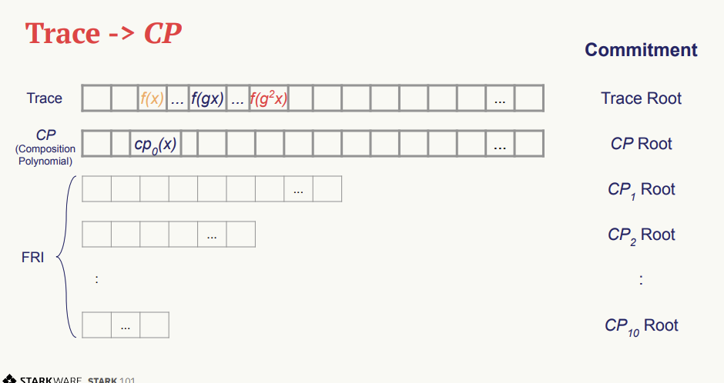
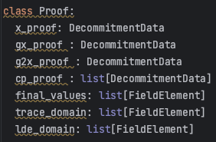
cp0(-x)

Slide 3

cp0(-x)
cp0(-x)

Slide 4
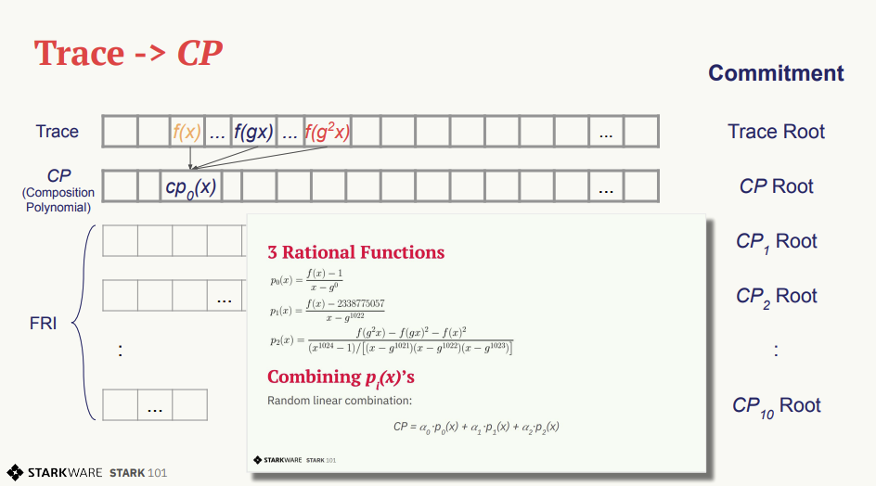


Slide 5
