Slide 1
Phase 1 Project: Risk Analysis for AR_Air’s Expansion
Presented by: Reagan Adajo
Moringa School
DSF-PT08
reagan.adajo@student.moringaschool.com

Slide 2
Introduction
The project showcases AR_Air’s problem in its expansion to diversify its portfolio by informing on the potential risks for the new venture through a data-driven approach
The data outcomes are used to recommend to AR_Air’s management the lowest-risk airplanes to be purchased for their operations.
Notes:
AR_Air is a hypothetical name incorporated for the company in the new business venture

Slide 3
Business Problem
AR_Air is deliberate on its expansion plans but challenged about the risks involved in executing them. Thus, the need to gain more knowledge for a better understanding and development of actionable insights
Business Aim
To diversify the business portfolio by venturing into air transport business
Business Interest
To purchase and operate airplanes for private and commercial enterprises

Slide 4
Business Objective
To determine the airplane with the lowest risk for AR_Air to start the new endeavor
Business Questions/Metrics
How often do airplanes cause accidents (annually)?
What type of airplanes are more prone to accidents for private and/or commercial flights?
What are the major causes of airplane accidents?
Business Gap
AR_Air needs to know the potential risks of aircraft, with emphasis on airplanes, to suit their interests, address the objective, and answer their queries

Slide 5
Methodology
Secondary data source:
National Transport and Safety Board [Online] at; https://www.kaggle.com/datasets/khsamaha/aviation-accident-database-synopses
Data Analysis Tool
Python (Jupyter Notebook)
Data Representation
Tableau Public version 2024.2

Slide 6
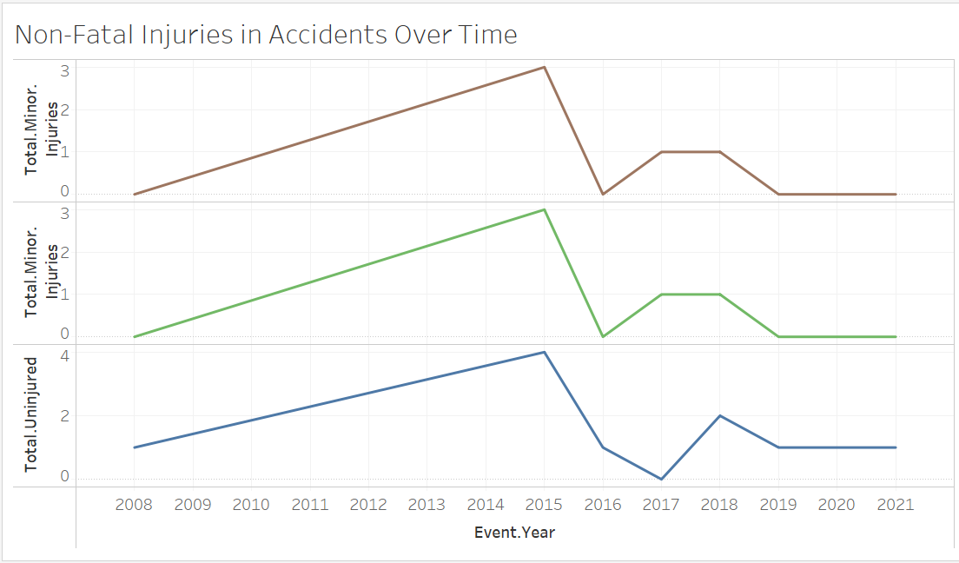
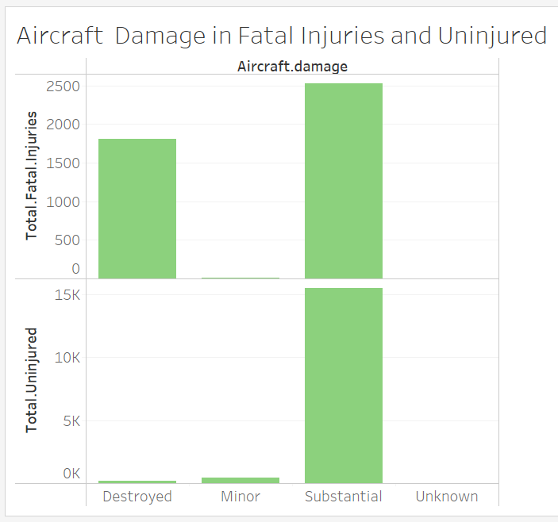
Data Visualization
No correlation in different injuries over time
Substantial Damage evident in both Fatal Injuries and Uninjured

Slide 7
Recommendations
Future airplane accidents should not be predicted from the previous years since no correlation exists.
A wide range of airplanes of makes with low risks exist that AR_Air should consider for their private and commercial operations, such as Degraw, LEINEKE WALTER L, DOVA AIRCRAFT SRO, DARROW, STEPHEN TAYLORCRAFT CORP, etc
AR_Air should invest in continuous professional development among pilots to reduce aviation accidents.
Purchase and operations decisions for air transport ventures should not be made solely on safety data
More research is required for better decision-making in the new venture

