Slide 1



NLP Model for Analysis of Twitter Sentiments on Google and Apple Products
Presenter: Reagan Adajo

Slide 2
Introduction
With the increasing use of Tweets, companies constantly need to find ways to analyze texts to improve product/service delivery
Reading Texts can be overwhelming, BUT each Word has a meaning, there is a need for automation
Tweets can convey useful user-emotions and/or experience
This project explores the effectiveness of using such models, Thanks to Data Science…

Slide 3
Business Understanding
Overview
The project is on building a natural language processing (NLP) model that will rate the sentiments of a Tweet based on its content
Business Problem
The company needs to develop a model that will assist in judging people's emotions about brands and products using Tweets on Apple and Google products

Slide 4
Intro cont..
Business Aim
To build a model that predicts customer's emotions on brands and products using their sentiments
Business Objectives
To find out if a Tweet can demonstrate a sentiment on Apple and Google products
To identify the products with the most positive and negative sentiments
To establish the best classification model for analyzing sentiments on Twitter texts(automatically)

Slide 5
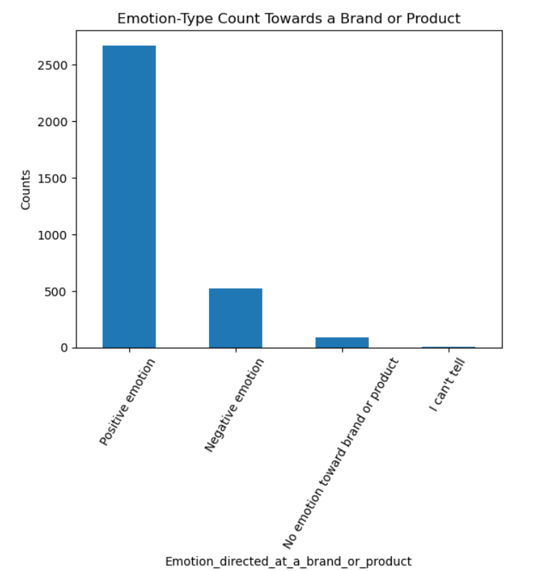
Data on Different Emotions on Tweets
Highest counts on ‘Positive emotion’ group on both Google and Apple products
Positive and Negative emotions constitute majority of tweets
‘I can’t tell’ category had the lowest count

Slide 6
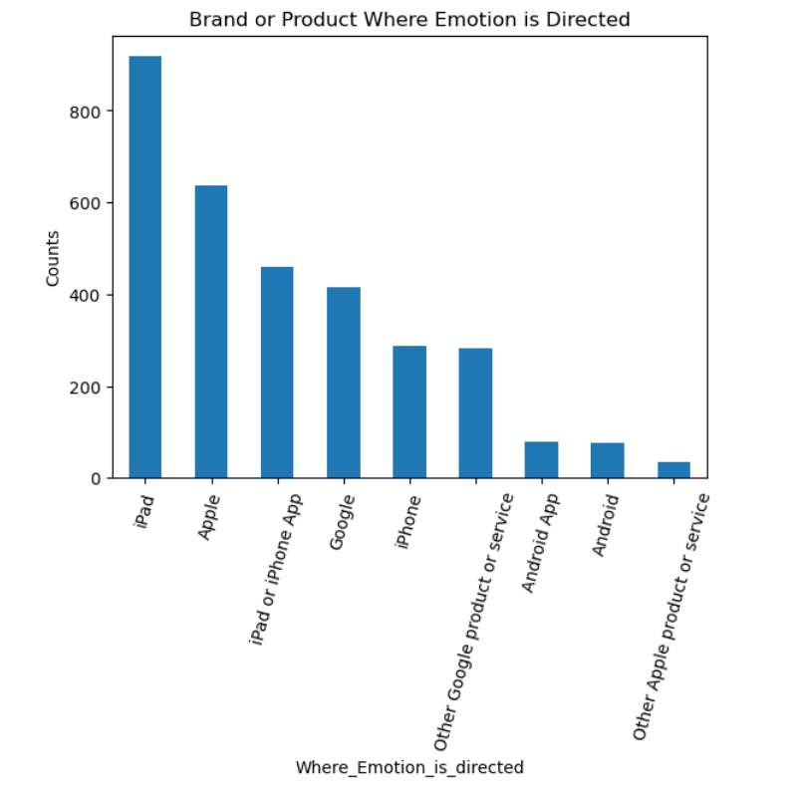
Data on Brands/Product Tweet is Directed
Apple and its related products received the highest emotional reaction on Tweets
‘iPad’ had the most common
‘Other Apple product or service’ was the least common

Slide 7
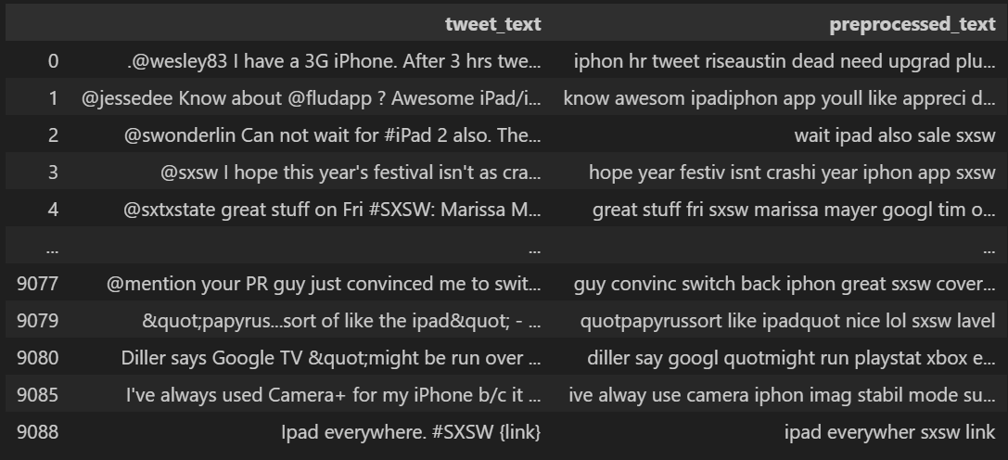
Unprocessed vs. Preprocessed Tweet-Text

Slide 8
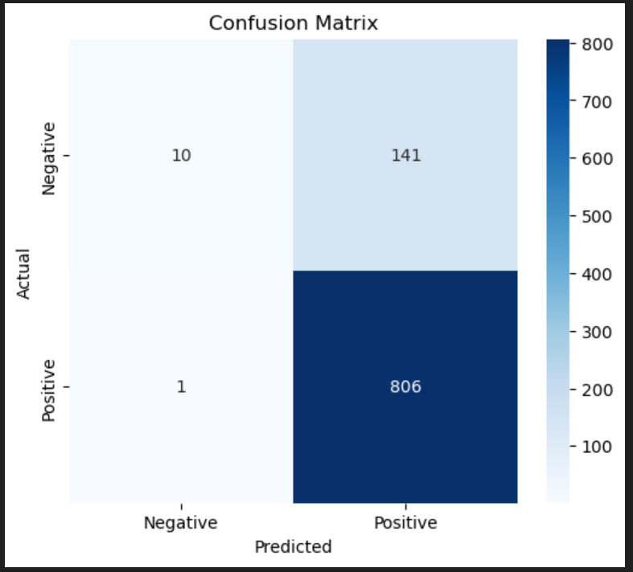
Confusion Matrix
The logistic regression model did perform so well on predicting unseen data with a baseline accuracy level of 0.8517…

Slide 9
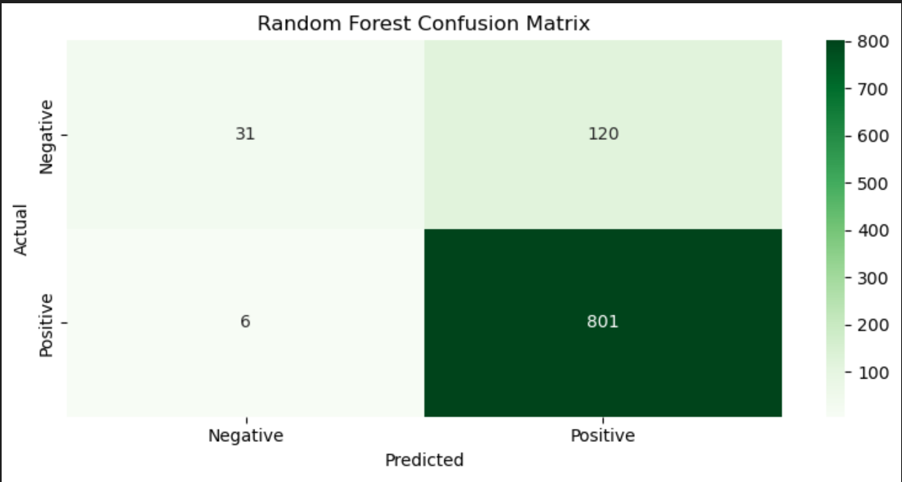
Confusion Matrix
The Random Forest Model had a higher baseline accuracy score of 0.865…

Slide 10
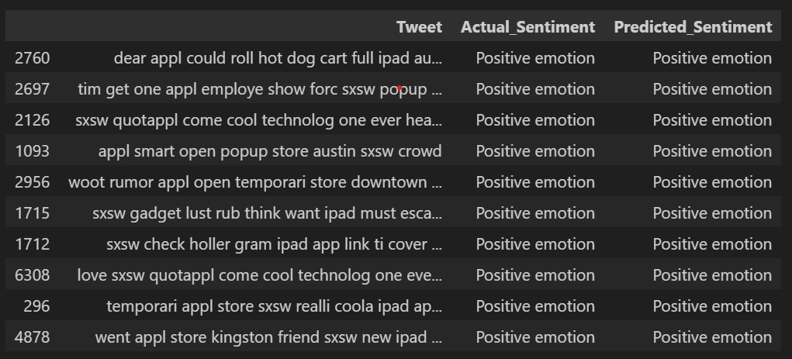
Validation of the RF Model

Slide 11
Insights
Random Forest is the best classification model for Postiive and Negative emotions due to it’s his baseline accuracy scores
This implies that the actual verses predicted emotions in the tweets will be subject to higher accuracy in classification
Actual and Predicted labels demonstrate alignment;
This implies that there will be no confusion in the interpretation of the emotions
The balanced color mapping highlights clear distinctions between positive and negative emotions
This depiction is useful in determining areas to be improved in the model but for this case, it performs well

Slide 12
Conclusion
A single Tweet from Apple or Google can be use in predicting the emotions towards the product or brand.
Classification models have high accuracy in predicting the emotions from a tweet text
Possible errors in the LogisticRegression Model can be reduced further by implementing the RandomForest Model
Tweet_texts are useful in identifying a problem with a product or brand from either Google or Apple, this informs on areas for improvement.

Slide 13
-- THANK YOU --

