Slide 1



NLP Model for Analysis of Twitter Sentiments on Google and Apple Products
Presenter: Reagan Adajo

Slide 2
Introduction
With the increasing use of Tweets, companies need to find ways to analyze texts to improve product/service delivery
Reading Texts can be overwhelming, BUT each Word has a meaning
Sentiments from Tweets can convey user emotions or experience
This project explores the effectiveness of using such models, Thanks to Data Science…

Slide 3
Business Understanding
Overview
The project is on building a natural language processing (NLP) model that will rate the sentiments of a Tweet based on its content
Business Problem
The company needs to develop a model that will assist in judging people's emotions about brands and products using Tweets on Apple and Google products

Slide 4
Intro cont..
Business Aim
To build a model that predicts customer's emotions on brands and products using their sentiments
Business Objectives
To find out the overall sentiments on Apple and Google products
To identify the products with the most positive and negative sentiments
To establish how the negative sentiments would be improved

Slide 5
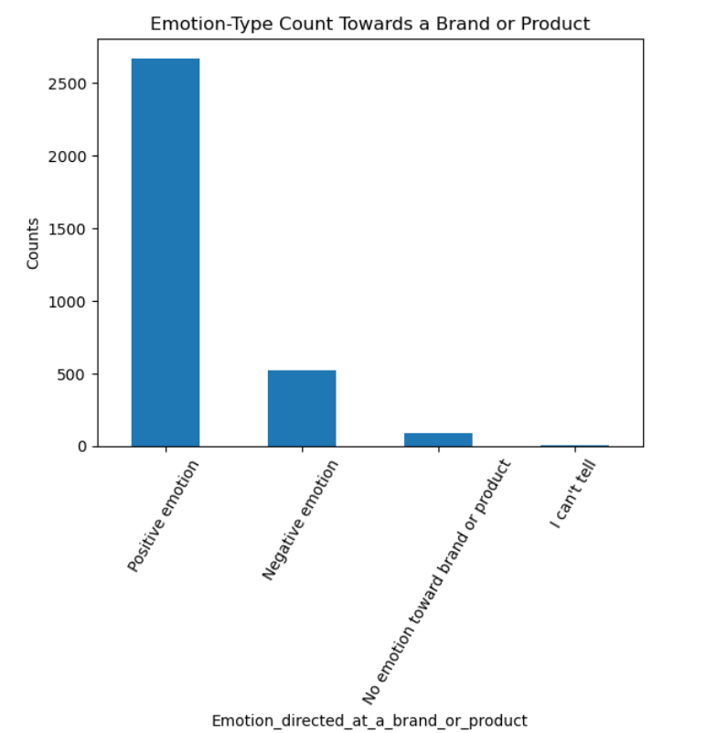
Data on Different Emotions on Tweets
Highest counts on ‘Positive emotion’ group on both Google and Apple products
‘I can’t tell’ category had the lowest count

Slide 6
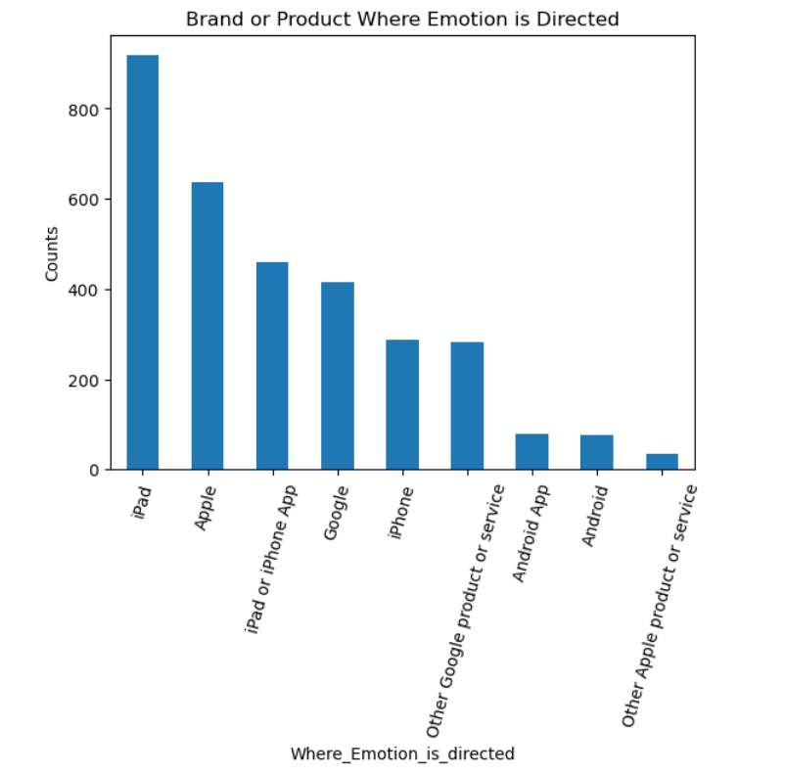
Data on Brands/Product Tweet is Directed
Apple and its related products received the highest emotional reaction on Tweets
‘iPad’ had the most common
‘Other Apple product or service’ was the least common

Slide 7
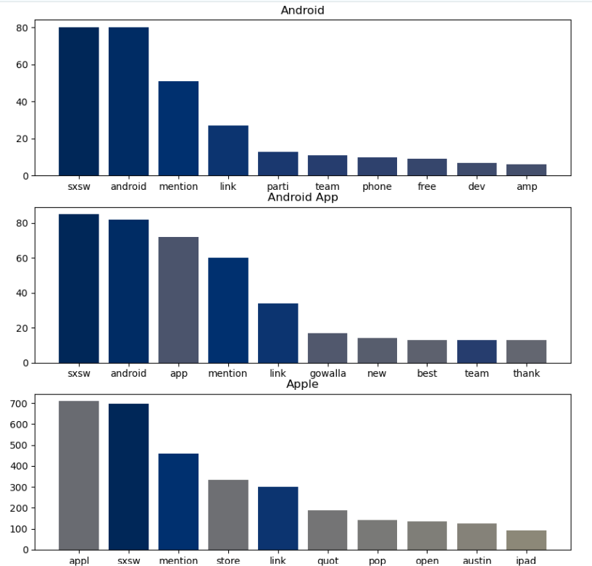
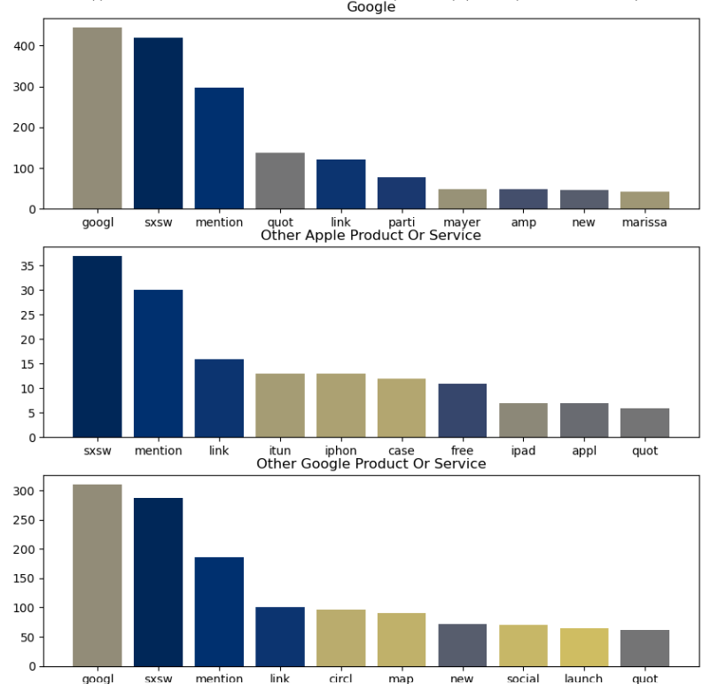
Processed texts on Different Products

Slide 8
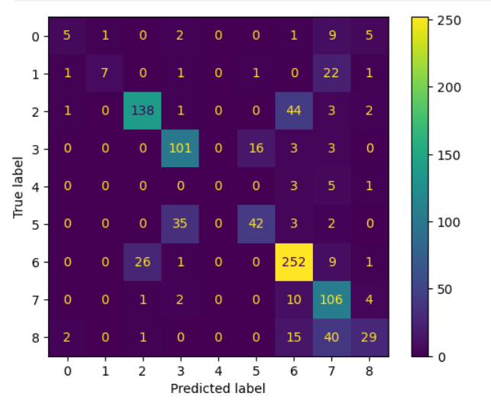
Confusion Matrix
The model did not perform so well on predicting unseen data with more errors and low accuracy levels

Slide 9
Insights
The color orientation in the Confusion Matrix visualizes the poor performance of the classification model;
This implies that the actual versus predicted emotions in the tweets will be subject to misclassification.
The True and Predicted labels demonstrate a misalignment;
This implies that there will be a confusion in the results interpretation from the model.
The imbalanced color mapping highlights areas with problems in the model;
This pinpoints areas that need to be improved in the model

Slide 10
Conclusion
A single Tweet cannot predict the overall emotion towards their products or brand.
The NLP model alone is relatively insufficient in predicting the emotions from a tweet text due to its low accuracy and increased errors
Tweet_texts are useful in identifying a problem with a particular product or brand, this informs on areas for improvement
Emotions can be overfitting and underfitting

Slide 11
-- THANK YOU --

