Slide 1
Pytorch Q8.5 - Q8.8
Train/Loss Plots, Validation Accuracy Plots, and Weight Visuals for the following:
Q8.5: Softmax
Q8.6: Two layer NN
Q8.7: ConvNet
Q8.8: Experiment (MyModel)

Slide 2
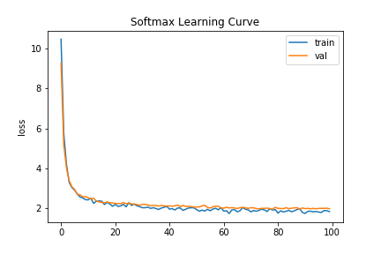
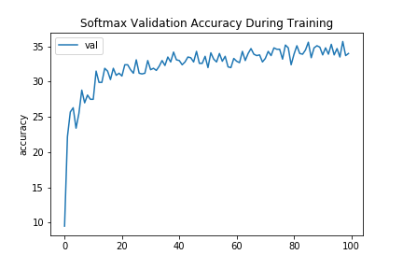
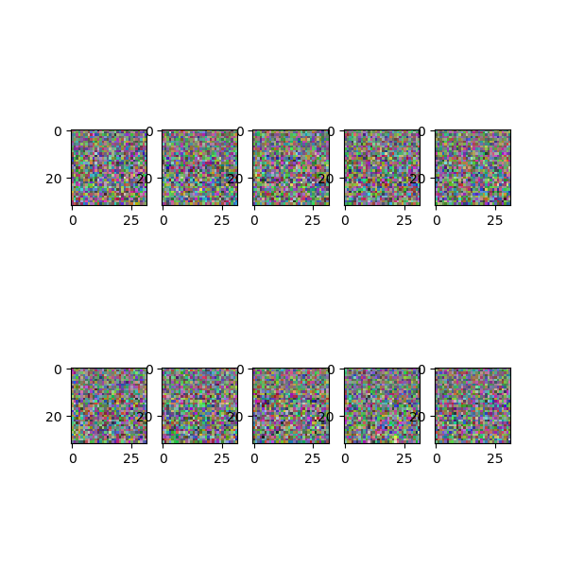
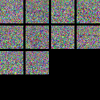
Q8.5: Softmax
softmax_lossvstrain.png
softmax_valaccuracy.png
softmax_filt.png
softmax_gridfilt.png

Slide 3
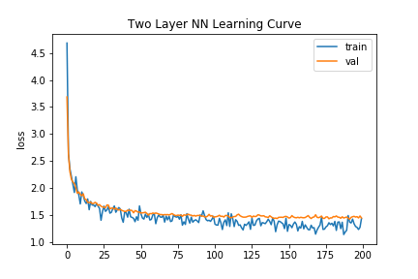
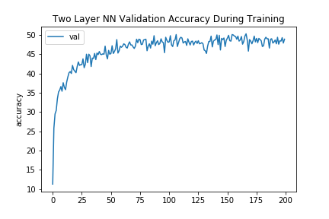
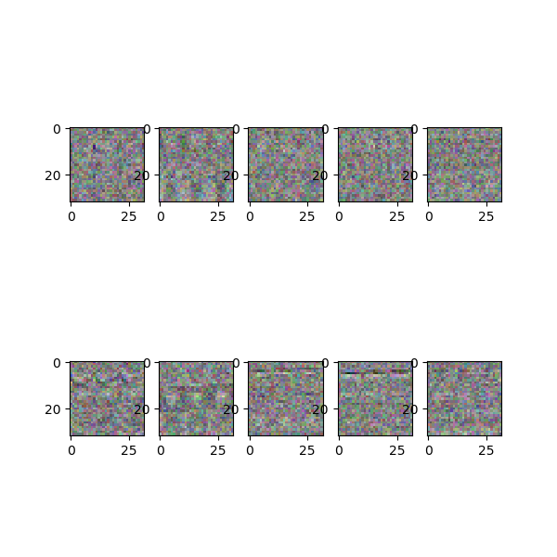
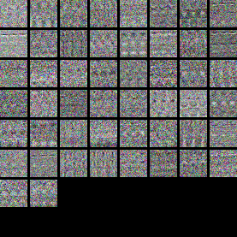
Q8.6: TwoLayerNN
twolayernn_lossvstrain.png
twolayernn _valaccuracy.png
twolayernn _filt.png
twolayernn _gridfilt.png

Slide 4
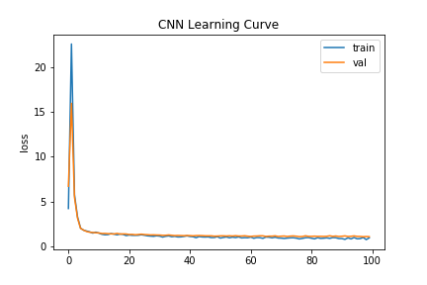
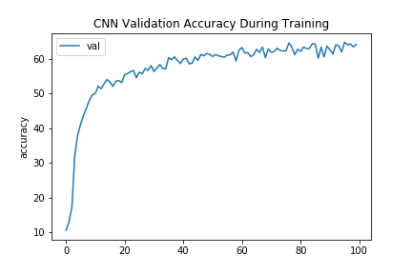
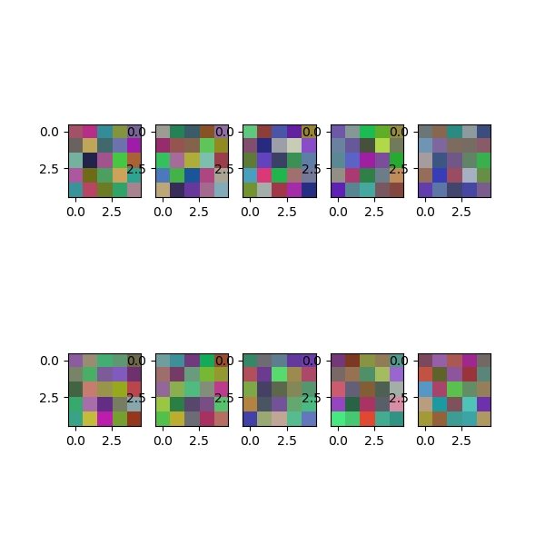

Q8.7: ConvNet
convnet_lossvstrain.png
convnet _valaccuracy.png
convnet _filt.png
convnet _gridfilt.png

Slide 5
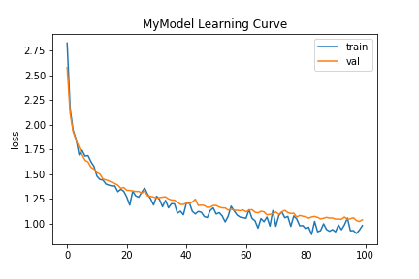
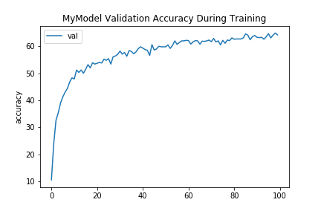
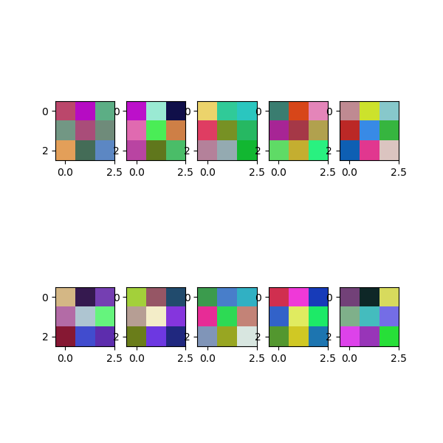

Q8.8: Experiment (MyModel)
mymodel_lossvstrain.png
mymodel_valaccuracy.png
mymodel _filt.png
mymodel _gridfilt.png

