Slide 1
PreseMkaer Module 3: AI Providers and API Keys: Setting Up Your Connection
A step-by-step guide to connecting PreseMaker to external AI services using API keys.
Notes:
Welcome to this training on how PreseMaker connects to AI providers. By the end of this presentation, you will understand what AI providers are, how API keys work, how to obtain and enter your key, and how PreseMaker keeps your credentials secure. Let's get started.

Slide 2
How PreseMaker Connects to AI Providers
PreseMaker uses AI to generate courses, quizzes, and activities.
AI capabilities come from external, third-party providers.
A direct internet connection to the provider is required.
API keys authenticate every request sent to the provider.
Users choose the provider that best fits their needs.
Notes:
PreseMaker is an AI-assisted course authoring application. It can generate presentations, text lessons, quizzes, assignments, and interactive activities — but it does not run its own AI model. Instead, it connects to external AI providers: third-party companies that host large language models accessible via the internet. This direct connection is essential because PreseMaker must send your content requests and receive AI-generated responses in real time. The API key is the unique credential that authenticates those requests on your behalf. Because PreseMaker supports multiple providers, you have the flexibility to select the one that suits your workflow and budget.

Slide 3
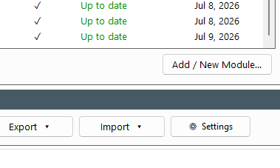
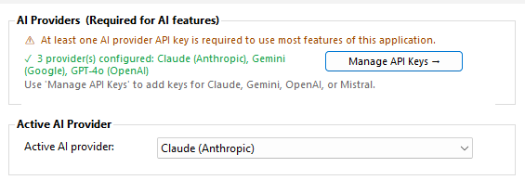
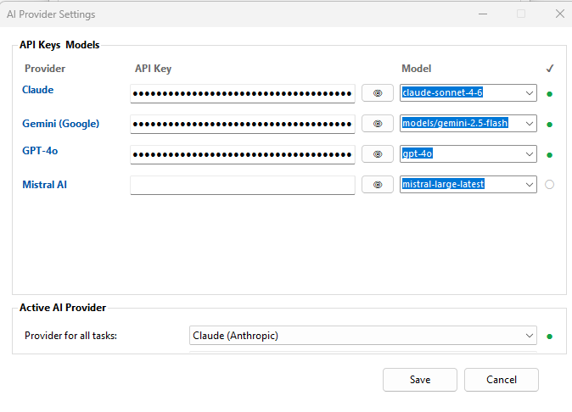
Overview of Supported AI Providers
PreseMaker supports four external AI providers.
Anthropic Claude — detailed, nuanced, safety-focused responses.
Google Gemini — integrated with Google's research ecosystem.
OpenAI — widely adopted GPT models used globally.
Mistral — efficient, cost-effective European open-weight models.
Notes:
PreseMaker currently supports four AI providers, each with distinct strengths. Anthropic Claude is known for producing thorough, safety-conscious outputs. Google Gemini draws on Google's deep research capabilities and broad ecosystem. OpenAI offers the GPT model series, among the most widely recognized in the industry. Mistral is a European provider offering competitive performance at a lower cost, making it attractive for budget-conscious users. All four providers are capable of powering PreseMaker's full feature set, so your choice comes down to preference, cost, and organizational requirements.

Slide 4




Choosing the Right AI Provider
Evaluate providers across cost, quality, and availability.
Consider data privacy policies for your organization.
Review model performance for educational content tasks.
Check provider availability in your region.
You may configure multiple provider keys simultaneously.
Notes:
When selecting an AI provider, consider several important dimensions. Cost varies significantly between providers and often depends on usage volume. Evaluate the quality of outputs for the specific tasks you need — such as generating quiz questions or detailed lesson text. Data privacy policies matter, especially for organizations with compliance requirements. Confirm the provider operates in your region without restrictions. Importantly, PreseMaker allows you to enter API keys for multiple providers at the same time, giving you flexibility to switch or compare as needed.

Slide 5
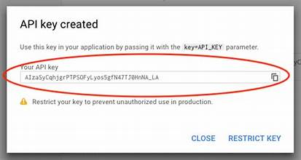
Understanding API Keys
An API key is a unique alphanumeric credential string.
Providers issue keys to authorize access to their models.
The key links your PreseMaker session to your provider account.
Each supported provider issues its own separate key.
The key is attached to every AI request PreseMaker sends.
Notes:
An API key is a unique alphanumeric string issued by an AI provider. It identifies and authorizes your application — in this case, PreseMaker — to use their service. Without a valid key, the provider will reject all requests. Think of it as the primary credential that links PreseMaker to your chosen provider account. It is important to understand that each provider — Anthropic Claude, Google Gemini, OpenAI, and Mistral — issues its own separate key. There is no universal key. When PreseMaker makes an AI request, it automatically attaches your stored key to that request so the provider can authenticate and process it.

Slide 6
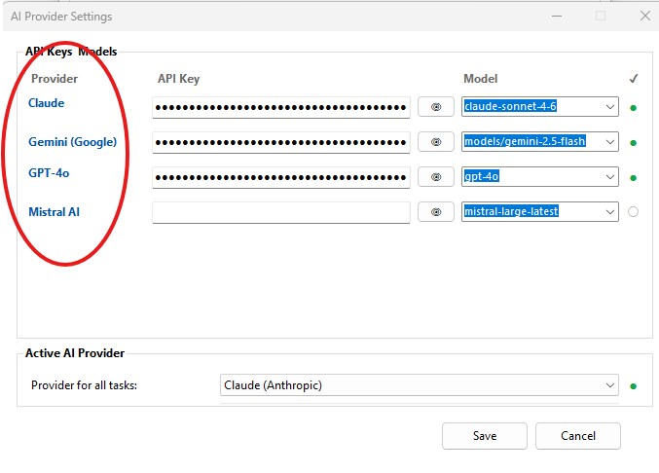
Obtaining Your API Key — Getting Started
Decide which AI provider you want to connect first.
Visit the provider's official website to register.
Create an account using your email and credentials.
Log in to access the provider's developer dashboard.
Locate the API Keys section within account settings.
Notes:
Before you can enter an API key in PreseMaker, you must obtain one directly from your chosen provider. Start by deciding which provider you want to use — Anthropic, Google, OpenAI, or Mistral. Navigate to that provider's official website and create an account if you don't already have one. Once registered and logged in, you will need to find the API Keys section. This is typically located within account settings, developer settings, or a dedicated API management dashboard. The exact location varies by provider, so refer to each provider's documentation if needed.

Slide 7
Generating and Securing Your API Key
Use the provider's dashboard to generate a new key.
Name the key clearly for easy identification later.
Copy the key immediately after it is displayed.
Most providers will not show the key again after creation.
Store the key in a secure password manager or vault.
Notes:
Once inside the API Keys section, you can generate a new key by clicking the appropriate button — commonly labeled 'Create Key,' 'Generate Key,' or similar. Give the key a descriptive name so you can identify it later. After generation, the provider will display the full key value — copy it immediately. This is critical: most providers will not show the raw key again after you navigate away. If you lose it, you will need to generate a new one. Store the copied key somewhere secure, such as a password manager, before entering it into PreseMaker. Before proceeding, confirm the key shows an active or enabled status in the provider dashboard.

Slide 8
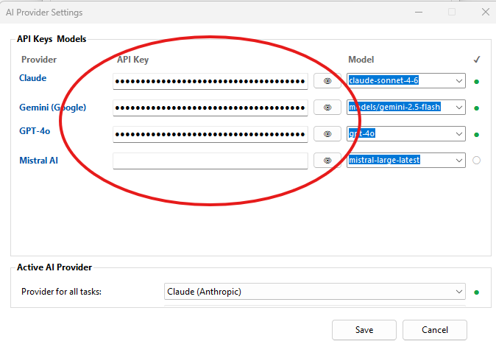
Entering Your API Key in PreseMaker Settings
Open PreseMaker and navigate to the Settings screen.
Find the AI Provider Keys configuration section.
Each provider has its own dedicated key entry field.
Paste your API key into the correct provider's field.
Double-check the key for accuracy before saving.
Notes:
With your API key copied and ready, open PreseMaker and navigate to the Settings screen. Within Settings, locate the AI Provider Keys section — this is where all provider credentials are managed. You will see a separate input field for each supported provider: Anthropic Claude, Google Gemini, OpenAI, and Mistral. You do not need to activate or select a provider first; simply paste each key into its corresponding field. Accuracy is critical — even a single incorrect character will cause the connection to fail. Take a moment to verify the key is pasted completely and correctly before proceeding.

Slide 9
Saving and Confirming Your API Key Entry
Click Save after entering your API key.
PreseMaker will store and activate the connection.
Look for a confirmation message or success indicator.
Test AI features to verify the connection is working.
Re-enter the key if PreseMaker reports an error.
Notes:
After entering your API key, click the Save button to store the settings. PreseMaker will encrypt and activate the key as part of the save process. Look for a visual confirmation — such as a success message or status indicator — that the key has been accepted. You can also verify the connection by attempting to use an AI-powered feature, such as generating a presentation or quiz. If PreseMaker returns an error, double-check the key for typos, confirm it is active in the provider's dashboard, and ensure you pasted it into the correct provider's field.

Slide 10

Troubleshooting Common Key Entry Issues
Verify the key is copied in full — no truncation.
1
Confirm the key is active in the provider's dashboard.
2
Ensure the key is in the correct provider's field.
3
Check for accidental spaces before or after the key.
4
Generate a new key if the original has been revoked.
5
Notes:
If PreseMaker does not recognize your API key after entry, a few common issues are usually responsible. First, check that the entire key was copied — partial keys will always fail. Second, log back into your provider's dashboard and confirm the key is in an active or enabled state; some providers require manual activation. Third, make sure you entered the key into the correct provider field in PreseMaker Settings. Fourth, check for invisible whitespace characters that may have been included when pasting. Finally, if the key has been revoked or expired, generate a new one from the provider's dashboard and repeat the entry process.

Slide 11
API Key Encryption and Local Storage
PreseMaker stores API keys locally on your device only.
Keys are never sent to PreseMaker's servers or cloud.
Encryption is applied before writing the key to storage.
Raw key values are never stored in a readable format.
Local storage eliminates risk from large-scale data breaches.
Notes:
PreseMaker is designed with your security in mind. When you save an API key, it is stored directly on your own device — not transmitted to any PreseMaker server or cloud database. Before writing the key to local storage, PreseMaker encrypts it so that the raw value is never saved in a readable format. This architecture means that even if someone gained access to your device's storage, they would not find a plaintext copy of your key. Keeping keys off external servers also eliminates the risk of a large-scale credential breach — a scenario where many users' keys could be exposed at once through a compromised central database.

Slide 12

Addressing Privacy Concerns
Entering a key into PreseMaker is safe by design.
Keys are only transmitted to your chosen AI provider.
PreseMaker's architecture prevents third-party key exposure.
Your key authenticates requests — it is not shared further.
PreseMaker does not log or transmit your key externally.
Notes:
It is natural to feel cautious about entering sensitive credentials into a third-party application. PreseMaker's architecture is specifically designed to address those concerns. Your API key leaves your device only when PreseMaker attaches it to a request directed to your chosen AI provider — the same provider that issued the key. It is not shared with PreseMaker's servers, logged, or transmitted to any other third party. The local encryption model ensures that your key is protected at rest, and the direct-to-provider request model ensures it is protected in transit to the right destination.

Slide 13

Your Responsibilities for Key Security
Never share your API key with unauthorized individuals.
Revoke and replace keys you suspect are compromised.
Avoid storing keys in plaintext documents or emails.
Monitor your provider account for unexpected usage.
Generate separate keys for different applications or teams.
Notes:
While PreseMaker handles encryption and secure local storage, you also play an important role in keeping your API credentials safe. Do not share your key with people who should not have access to your provider account. If you suspect a key has been exposed, revoke it immediately from the provider's dashboard and generate a replacement. Avoid writing keys in plaintext files, emails, or messaging apps. Regularly review your provider account's usage logs to spot any unexpected activity that might indicate unauthorized use. As a best practice, generate dedicated keys for different applications or team environments so you can revoke individual keys without disrupting others.

Slide 14
Summary and Key Takeaways
PreseMaker connects to AI providers via API keys.
Four providers are supported: Claude, Gemini, OpenAI, Mistral.
Obtain your key from the provider's dashboard before starting.
Enter keys in PreseMaker Settings — one field per provider.
PreseMaker encrypts and stores keys locally for your security.
Notes:
Let's recap what we covered. PreseMaker is an AI-powered authoring tool that requires a direct connection to an external AI provider to generate content. It supports four providers: Anthropic Claude, Google Gemini, OpenAI, and Mistral — each with distinct strengths worth evaluating before choosing. An API key is the unique credential that authenticates PreseMaker's requests to your provider. You obtain it by creating a provider account, generating a key from their dashboard, and copying it securely. In PreseMaker's Settings screen, you paste each key into its dedicated provider field and save. PreseMaker then encrypts and stores the key locally on your device, protecting it from exposure. You also share responsibility for key security by safeguarding credentials and monitoring account usage. You are now ready to set up your AI connection in PreseMaker.

