Slide 1
PreseMaker Module 4: Configuring AI Providers per Task and Using the Prompt Button
A professional guide to setting up AI providers, managing API keys, and diagnosing generation issues in PreseMaker.
Notes:
Welcome to this training session on configuring AI providers in PreseMaker. We will cover how PreseMaker uses AI providers, how to obtain and enter API keys, how the Active AI Provider setting works, why per-task routing does not exist, how to use the Prompt button, and how to respond to generation failures. By the end, you will have a clear, practical understanding of every aspect of AI provider configuration in PreseMaker.

Slide 2
Introduction to AI Providers in PreseMaker
PreseMaker uses AI providers exclusively for text-based generation tasks.
Four providers are supported: Claude, Gemini, GPT-4o, and Mistral AI.
API keys are encrypted and stored securely on your local machine.
One Active AI Provider setting controls all AI requests.
The specified provider handles everything.
Notes:
PreseMaker integrates with four AI providers to power its course-building workflow. All AI work in the application is text-based — there are no image or vision requests. The four supported providers are Claude by Anthropic, Gemini by Google, GPT-4o by OpenAI, and Mistral AI. When you enter an API key, PreseMaker encrypts it and stores it locally. A single dropdown in Settings — the Active AI Provider — determines which provider handles every task. There is no mechanism to route different tasks to different providers; the design is intentionally unified.

Slide 3




The Four Supported AI Providers
Claude (Anthropic) — conversational, instruction-following AI.
Gemini (Google) — Google's multimodal large language model.
GPT-4o (OpenAI) — OpenAI's high-capability text model.
Mistral AI — efficient, open-weight language model provider.
Each provider requires its own separately obtained API key.
Notes:
PreseMaker supports exactly four AI providers, and each one is a distinct commercial service. Claude is developed by Anthropic and is known for strong instruction-following. Gemini is Google's large language model offering. GPT-4o is OpenAI's latest high-performance model. Mistral AI provides efficient open-weight models. You must obtain an API key directly from whichever provider you choose to use. Each key is unique to that provider's platform and cannot be used interchangeably.

Slide 4
Obtaining and Entering API Keys
Create a developer or API account with your chosen provider.
Generate an API key through the provider's platform.
Enter the key in PreseMaker's Settings panel.
Keys are associated with their corresponding provider in Settings.
One valid key for one provider is the minimum requirement.
Notes:
To begin using AI features in PreseMaker, you must first obtain an API key from at least one of the four supported providers. Visit the provider's developer platform, create an account if you do not already have one, and generate an API key. Once you have the key, open PreseMaker's Settings panel and enter it in the field associated with that provider. You do not need to configure all four providers — a single valid key for a single provider is sufficient to enable all AI features in PreseMaker.

Slide 5
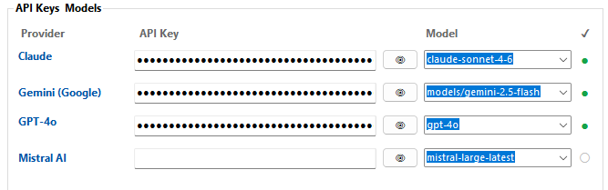
How API Keys Are Stored and Secured
PreseMaker encrypts every API key using Windows DPAPI.
Keys are protected at rest on your local machine.
Keys are never embedded in course content or files.
Keys are never transmitted to a remote repository.
Your credentials remain entirely local and private.
Notes:
Security is a core consideration in how PreseMaker handles API keys. Every key you enter is immediately encrypted using Windows Data Protection API, commonly known as DPAPI. This means the key is protected at rest and cannot be read by other applications or users on the machine without the appropriate credentials. Importantly, API keys are never stored inside course files, never embedded in exported content, and never sent to any external server or repository. Your API keys stay entirely on your machine.

Slide 6
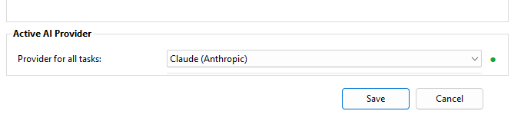
The Active AI Provider Setting
A single dropdown in Settings called Active AI Provider.
The selected provider handles all generation tasks simultaneously.
Switch providers anytime by updating the dropdown.
Your key for that provider must already be entered.
The setting applies universally — no exceptions exist.
Notes:
The Active AI Provider is a single dropdown control located in PreseMaker's Settings panel. Whichever provider you select from this dropdown becomes responsible for every AI-driven task in the application — from generating course outlines to writing quiz questions and narration scripts. You can change the active provider at any time by simply selecting a different option from the dropdown, but the selected provider must have a valid API key already entered. The setting applies universally to every task without exception.

Slide 7
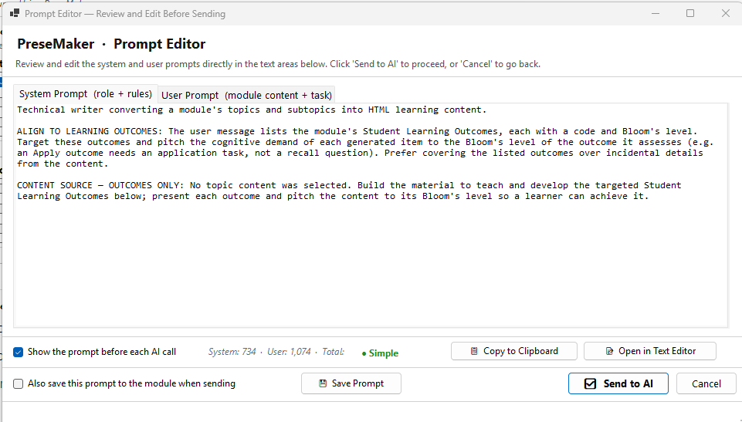
Using the Prompt Button to Inspect AI Requests
The Prompt button shows the exact text sent to the provider.
Use it before or during generation to verify input.
All prompts are text-based — no image or vision requests.
The prompt always targets the currently active provider.
Use it to diagnose unexpected or incorrect AI output.
Notes:
The Prompt button is a transparency and diagnostic tool built into PreseMaker. When you click it, you can see the exact text that will be — or has been — sent to your active AI provider. This is particularly valuable when AI output does not match your expectations, because it lets you determine whether the problem originated on the input side. All requests in PreseMaker are text-based, so every prompt you inspect will be a plain text request. Because PreseMaker uses a single active provider, the prompt you view is always destined for that one selected provider — there is no ambiguity about where the request is going.

Slide 8
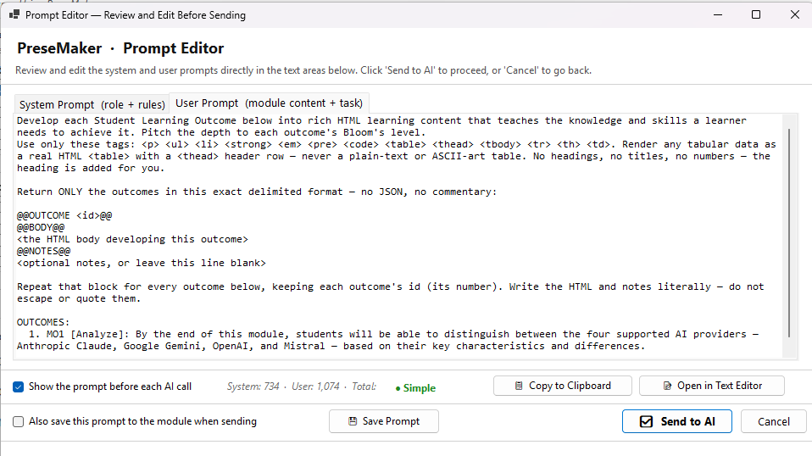
When and Why to Use the Prompt Button
Use it when output does not match your expectations.
Use it to verify input before committing to full generation.
Use it to understand how PreseMaker structures requests.
Helps rule out input-side problems during troubleshooting.
Confirms your active provider is receiving correct instructions.
Notes:
The Prompt button serves multiple practical purposes. Before running a full generation, you can inspect the prompt to confirm the instructions are correct and complete. If generation has already run and the results are unexpected, the Prompt button helps you rule out input-side problems — if the prompt looks correct, the issue likely lies with the provider's response rather than with PreseMaker's configuration. It also helps users understand how PreseMaker structures its AI requests, which can be useful for learning and quality assurance purposes.

Slide 9
Interpreting Generation Failures
A failure means the provider did not return a successful response.
Most common cause: missing, incorrect, or revoked API key.
Second common cause: wrong provider selected in Settings.
Provider-side issues: outages, rate limits, or quota exhaustion.
Failures always trace back to one of these three causes.
Notes:
A generation failure in PreseMaker means that a request was sent to the active AI provider but a successful response was not received. The three most common causes are: first, the API key for the active provider is missing, incorrectly entered, or has been revoked by the provider; second, the wrong provider is selected as active and its key has not been entered; and third, the provider itself is experiencing an outage, rate limiting, or quota exhaustion. Understanding these categories helps you move quickly to the right corrective action.

Slide 10
Diagnosing and Resolving Generation Failures
Step 1: Verify which provider is currently active in Settings.
Step 2: Confirm a valid API key is entered for that provider.
Step 3: Check the provider's platform for outages or limits.
Re-enter or regenerate the key if it appears invalid.
Switch to a working provider if the issue is provider-side.
Notes:
Effective diagnosis of a generation failure follows a consistent order. Start by opening Settings and confirming which provider is set as active — this is the most common oversight. Next, verify that a valid API key for that provider has been entered correctly. If the key looks correct but failures persist, visit the provider's status page or developer dashboard to check for outages, rate limit errors, or quota exhaustion. Once you identify the cause, corrective action is straightforward: re-enter or regenerate the key in Settings, or temporarily switch the active provider to one that is functioning. No other application changes are required.

Slide 11
Summary and Key Takeaways
PreseMaker supports four AI providers for text-based tasks only.
API keys are encrypted locally using Windows DPAPI.
One Active AI Provider handles every task — no per-task routing.
The Prompt button lets you inspect and verify AI input.
Most failures stem from key issues or wrong provider selection.
Notes:
Let's bring everything together. PreseMaker integrates with four AI providers — Claude, Gemini, GPT-4o, and Mistral AI — and uses them exclusively for text-based generation. API keys are encrypted with Windows DPAPI and stored locally; they never appear in course files or external systems. A single Active AI Provider dropdown in Settings controls all AI tasks, and there is no per-task routing of any kind. The Prompt button is your primary tool for verifying and troubleshooting AI input. When failures occur, start by checking the active provider and its associated key, then look to the provider's platform if everything on the PreseMaker side appears correct. With these fundamentals in place, you are fully equipped to configure and manage AI providers in PreseMaker.

