Slide 1
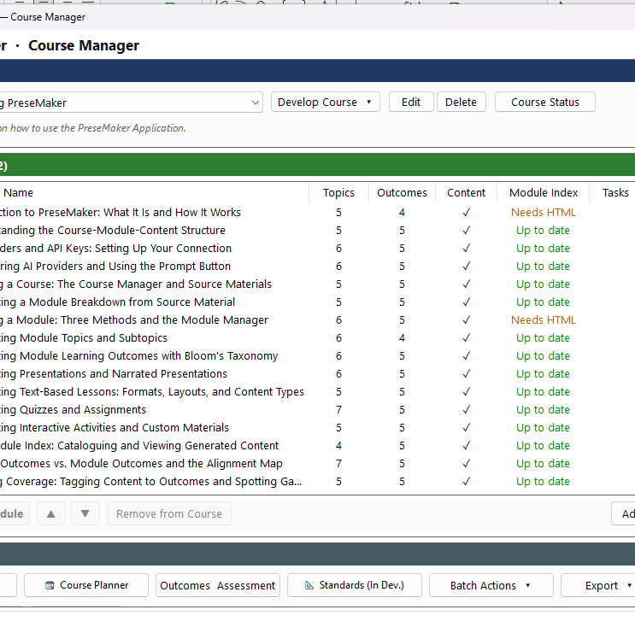
Introduction to PreseMaker: What It Is and How It Works
A guided overview of PreseMaker's purpose, audience, structure, and AI-powered authoring workflow.
Notes:
Welcome to this introduction to PreseMaker. In this presentation, we will cover what PreseMaker is, who it is designed for, how it organizes learning materials, how the authoring workflow operates, and how AI assistance supports the entire process. By the end, you will have a clear understanding of what PreseMaker does and how it can support your course authoring work.

Slide 2
What Is PreseMaker?
PreseMaker is an AI-assisted course authoring tool for Windows.
It guides users from a blank course to fully populated materials.
Built specifically for the Windows environment and interface.
Addresses inconsistent structure, slow content generation, and disorganization.
AI assistance is the defining feature that sets it apart.
Notes:
PreseMaker is a Windows-based application designed to help users create structured learning materials efficiently. Its core purpose is to take authors from a completely blank starting point to a fully built course, using AI to accelerate content generation. The tool is optimized specifically for the Windows platform, so its interface and features reflect that environment. The problems it solves are real and common: inconsistent course structure, the slow pace of writing content from scratch, and the challenge of organizing large volumes of material. The AI component is not an add-on — it is central to what makes PreseMaker different from conventional authoring tools.

Slide 3

Who Is PreseMaker For?
Instructional designers building structured course content efficiently.
Corporate trainers with limited time and resources.
Educators and academic professionals at all levels.
Anyone facing recurring challenges in course authoring.
Users who already work within a Windows environment.
Notes:
PreseMaker is designed for three primary user groups. Instructional designers benefit from its structured authoring framework, which streamlines the complex process of organizing and developing course content. Corporate trainers will appreciate how quickly they can produce training programs without sacrificing quality or consistency. Educators — whether at schools, colleges, or universities — can author professional course materials without needing deep technical expertise. Across all three groups, the tool addresses shared pain points: slow content creation, structural inconsistency, and difficulty managing large amounts of material. The Windows-based design is a deliberate choice, reflecting the platforms these users already rely on in their daily work.

Slide 4
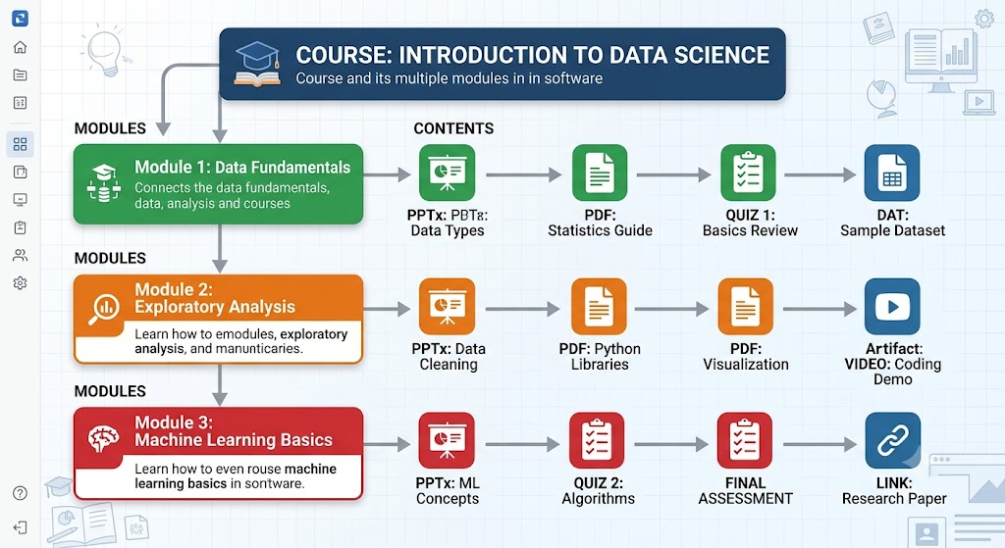
The Course → Module → Content Hierarchy
PreseMaker uses a strict three-level organizational structure.
Course: the top-level container for an entire program.
Module: mid-tier groupings of related content and goals.
Content: individual learning assets learners directly interact with.
Each level depends on the level above it.
Notes:
Understanding the Course → Module → Content hierarchy is essential to working effectively in PreseMaker. At the top level, a Course represents the broadest scope — an entire subject or training program. Below that, Modules break the course into thematically related sections, each focused on a specific topic or learning goal. At the bottom level, Content items are the actual instructional materials: lessons, assessments, activities, and other assets that learners engage with directly. These three levels are interdependent. A Content item cannot exist without a Module, and a Module cannot exist without a Course. This parent-child relationship keeps all materials organized and ensures structural consistency throughout the authoring process.

Slide 5
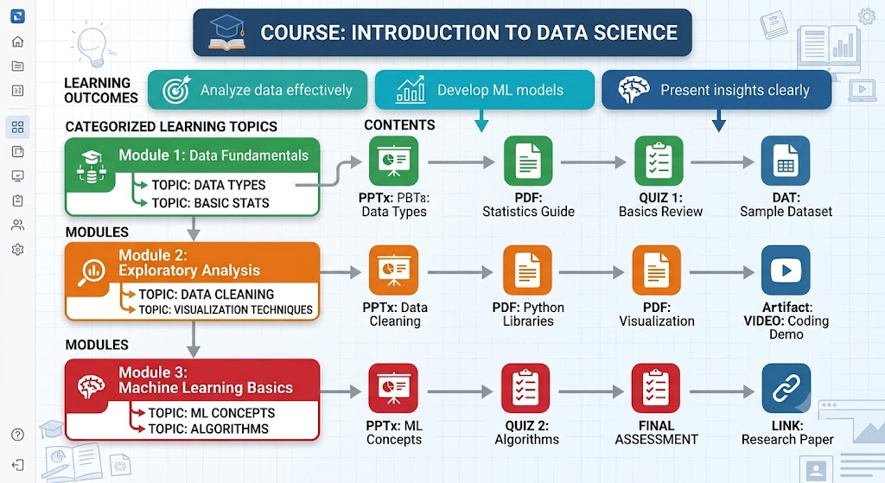
Why the Hierarchy Matters
The hierarchy is the foundation of how PreseMaker operates.
It ensures consistent structure across all course materials.
AI generation and display are built around these levels.
Authors always know where materials belong within the course.
Understanding it is essential before authoring begins.
Notes:
The Course → Module → Content structure is not simply a filing system — it is the architectural backbone of PreseMaker itself. Every feature, including AI content generation, material display, and workflow navigation, is built around these three levels. Because the hierarchy is enforced by the tool, authors benefit from consistent structure without having to manually enforce it themselves. This also means that when AI generates content, it does so with awareness of where that content sits in the hierarchy, producing contextually appropriate materials. Before users begin authoring, understanding this structure is critical, as all subsequent steps in the workflow depend on it.

Slide 6
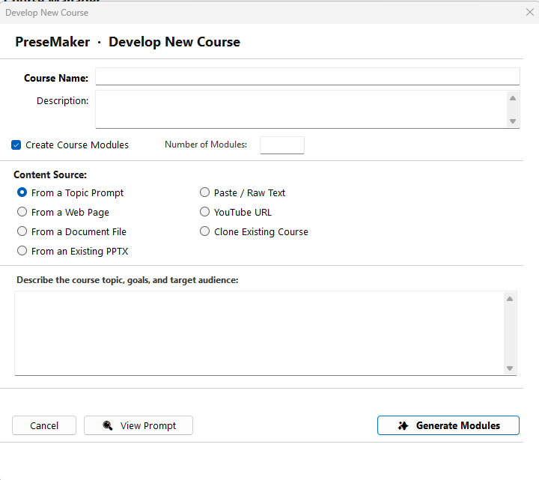
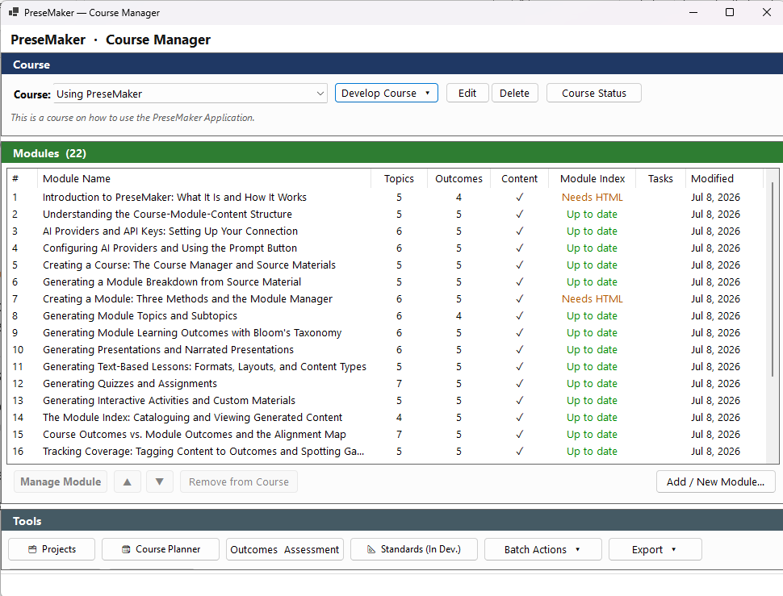
The PreseMaker Workflow: An Overview
Every project starts with a blank, empty course.
Authors then define the course structure using modules.
AI assistance generates content to populate each module.
Authors review, refine, and finalize generated materials.
The result is a complete, ready-to-use training program.
Notes:
The PreseMaker workflow follows a clear, guided progression. It begins with the creation of a blank course — an empty container with no content yet. From there, authors build the structure by adding modules that define the course's sections and topics. Once the structure exists, PreseMaker's AI engine can generate fully developed learning materials to populate each module. The workflow then shifts to a human review phase, where authors examine, refine, and polish what the AI has produced. The process concludes when every module contains finalized content, transforming the original blank course into a complete and deployable training program. This structured approach reduces guesswork and keeps the authoring process on track from start to finish.

Slide 7
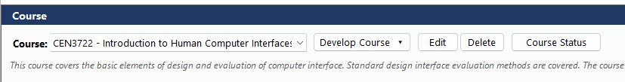
Step 1: Starting with a Blank Course
Every PreseMaker project begins as an empty course.
The course is the top-level container for all materials.
No content or modules exist until the author adds them.
Starting blank ensures a clean, intentional structure from the beginning.
Notes:
The first step in any PreseMaker project is creating a new, empty course. At this stage, nothing exists inside the course — no modules, no content items, no pre-filled material. This intentional blank slate approach ensures that authors make deliberate decisions about structure and scope from the very beginning, rather than working around pre-existing templates that may not fit their needs. The course created at this stage will serve as the container for everything that follows.

Slide 8
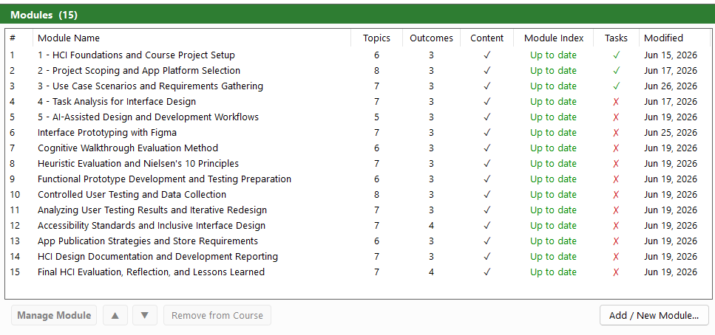
Step 2: Defining the Course Structure
Authors build structure by adding modules to the course.
Modules group related content under a common topic or goal.
Defining modules before content keeps the course organized.
Structure is established before any content is generated.
Notes:
Once the blank course exists, the next step is defining its architecture. Authors do this by adding modules — the mid-level organizational units that divide the course into manageable, thematically related sections. Each module should represent a coherent topic or learning goal. By establishing this structure before generating any content, authors ensure that the materials produced at the next stage have a clear home within the hierarchy. This step is foundational: the quality and clarity of the module structure directly influences the relevance and organization of the content that follows.

Slide 9
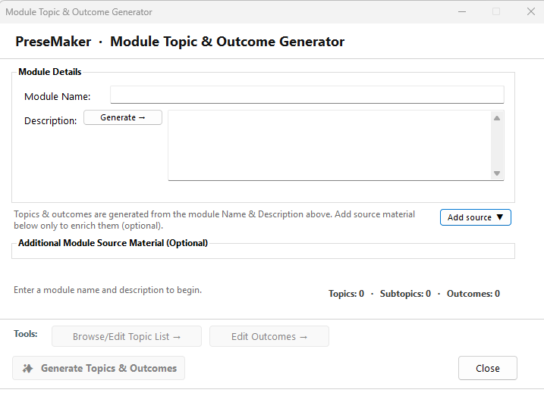
Step 3: Generating Content with AI Assistance
PreseMaker's AI engine generates content for each module.
AI produces fully developed learning materials quickly.
Content is generated within the established course hierarchy.
This step dramatically reduces time spent writing from scratch.
Notes:
With the course structure in place, PreseMaker's AI assistance comes into full effect. The AI engine generates fully developed learning materials — such as lessons, explanations, and assessments — to populate each module. Because the AI operates within the established Course → Module → Content hierarchy, the content it produces is contextually relevant to the module it belongs to. This step is where PreseMaker delivers its most significant time savings, eliminating the need for authors to write every piece of content from a blank page and accelerating the authoring process considerably.

Slide 10
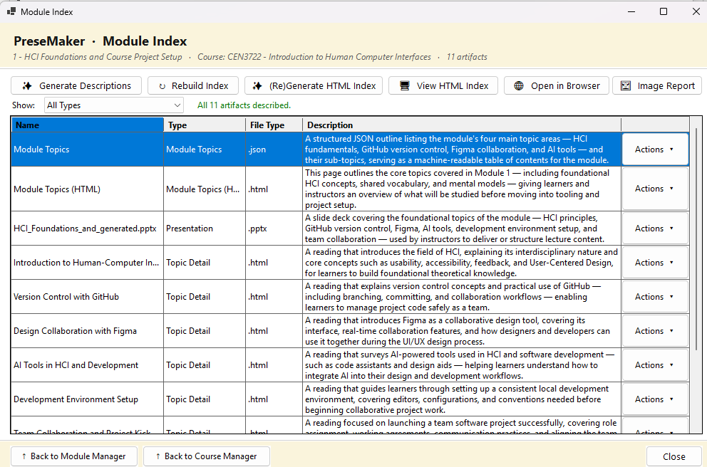
Step 4: Reviewing and Finalizing Content
Authors review all AI-generated materials before finalizing.
Human review ensures accuracy, tone, and instructional quality.
Authors refine, edit, or replace content as needed.
AI supports authoring — humans make all final decisions.
Notes:
After AI generation, the workflow enters a critical human review phase. Authors examine the materials produced by the AI, assessing them for accuracy, appropriateness, instructional quality, and alignment with the intended learning goals. Any content that requires adjustment can be refined, edited, or replaced at this stage. This step reinforces a core design principle of PreseMaker: the AI is a supportive tool, not an autonomous decision-maker. Human judgment governs what ultimately makes it into the final course, ensuring that the finished materials meet the author's standards and the learners' needs.

Slide 11
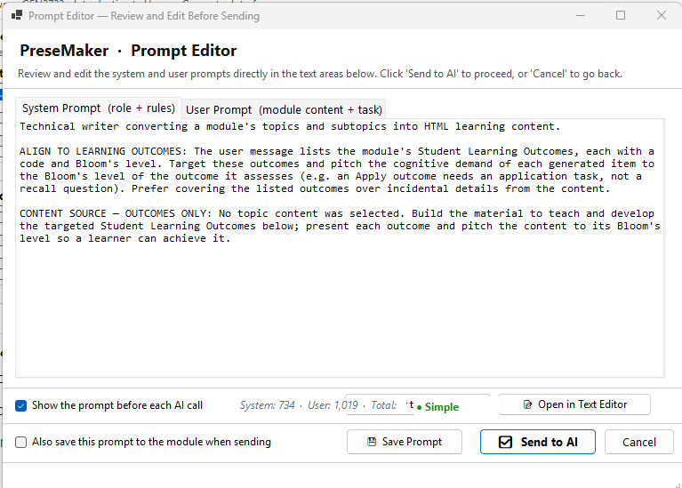
How AI Assistance Works in PreseMaker
AI accelerates content creation across the entire workflow.
It is embedded at every stage, not just one step.
AI addresses slow generation, inconsistency, and disorganization.
It provides contextually relevant help at each hierarchy level.
AI augments human authoring — it does not replace it.
Notes:
PreseMaker's AI assistance is designed as a content acceleration engine that operates throughout the entire authoring workflow, not just during the generation step. At every tier of the Course → Module → Content hierarchy, AI can provide contextually relevant support — whether that means helping structure a module, generating lesson content, or suggesting assessment items. The problems AI directly addresses include the slow pace of writing content from scratch, inconsistent quality across materials, and the difficulty of organizing large amounts of instructional content. Importantly, the AI is always a supportive partner. Authors retain control over all final decisions, and the AI's role is to augment their capabilities, not to replace their expertise or judgment.

Slide 12
AI Assistance and the Course Hierarchy
AI capabilities are tightly integrated with the three-level hierarchy.
Generation is context-aware based on course, module, and content level.
AI output reflects the scope and topic of each module.
Hierarchy-driven AI ensures relevant, organized content every time.
Notes:
One of the more technically significant aspects of PreseMaker's AI is how it relates to the Course → Module → Content hierarchy. AI assistance is not applied generically — it is context-aware, meaning the materials it generates are informed by where in the hierarchy the author is working. Content generated for a specific module reflects that module's topic and learning goals, rather than being generic filler. This integration between the AI engine and the hierarchy is what ensures that AI-generated materials are consistently relevant and well-organized, reducing the need for heavy manual editing after generation.

Slide 13
PreseMaker on Windows
PreseMaker is built exclusively for Windows operating systems.
Interface and features are optimized for the Windows environment.
Reflects the platforms most target users already rely on.
Ensures a familiar, accessible experience for Windows-based professionals.
Notes:
PreseMaker's decision to target the Windows platform is a deliberate one. The majority of instructional designers, corporate trainers, and educators work within Windows-based environments, making a Windows-native application a practical and accessible choice for this audience. By optimizing the interface and feature set for Windows, PreseMaker ensures that the tool integrates naturally into users' existing workflows without requiring them to adopt an unfamiliar operating environment. This platform focus also allows the development team to build a more refined and consistent user experience, rather than spreading resources across multiple operating systems.

Slide 14
Summary: What PreseMaker Is and How It Works
PreseMaker is an AI-assisted course authoring tool for Windows.
Designed for instructional designers, trainers, and educators.
Organizes materials in a Course → Module → Content hierarchy.
Workflow moves from blank course to fully built program.
AI accelerates content creation while humans retain final control.
Notes:
To summarize: PreseMaker is a Windows-based, AI-assisted authoring tool designed to help instructional designers, corporate trainers, and educators create structured learning materials efficiently. Its foundational organizational structure — Course, Module, and Content — ensures consistency and clarity across all materials. The authoring workflow follows a guided progression: create a blank course, define modules, generate content with AI assistance, and review and finalize the results. Throughout this process, AI serves as a powerful accelerator, but human authors always retain control over the final product. PreseMaker is built to solve the most common pain points in course authoring and to make the journey from a blank page to a complete training program as structured and efficient as possible.

