Slide 1
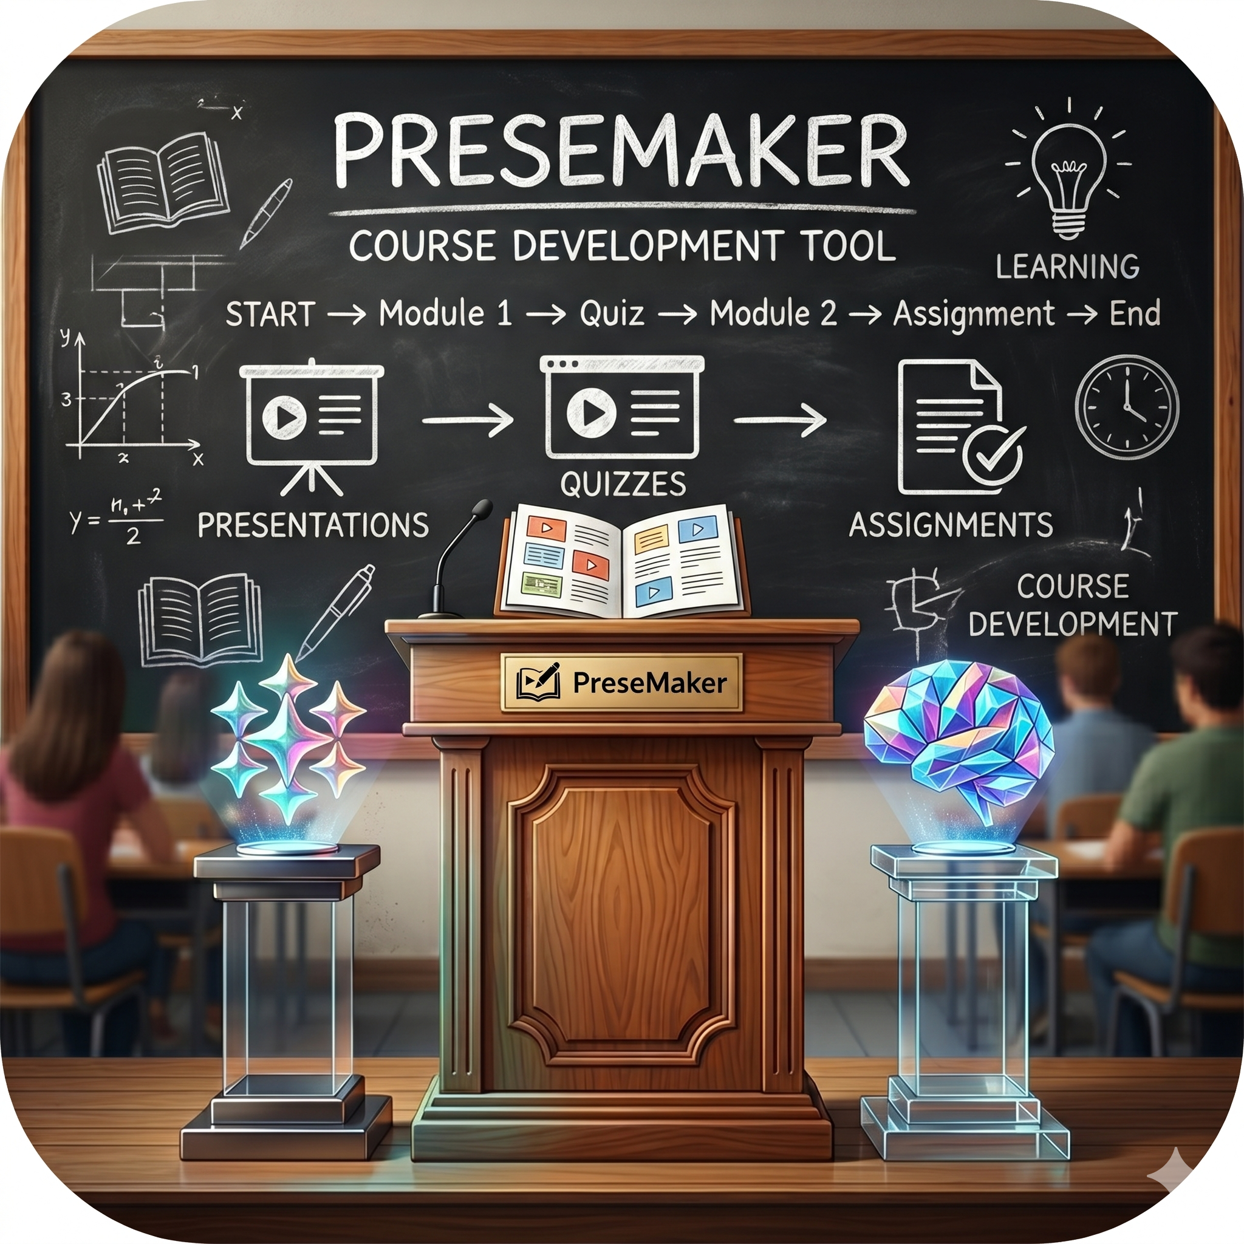
PreseMaker: Understanding the Course-Module-Content Structure
A professional guide to how PreseMaker organizes, generates, and stores your e-learning content.
Notes:
Welcome to this presentation on PreseMaker's course-module-content structure. Whether you are new to PreseMaker or looking to deepen your understanding, this session will walk you through how content is organized, how materials are generated, and how your files are stored and owned. Let's get started.

Slide 2
What Is PreseMaker?
PreseMaker is a structured e-learning authoring tool.
Built around a clear, layered organizational system.
Designed to simplify creating and managing educational content.
Produces tangible learning materials from structured course data.
Notes:
PreseMaker is an e-learning authoring tool that stands apart by organizing content through a deliberate hierarchy. Rather than working with unstructured files, authors build content within a defined system — courses, modules, topics, and generated materials — that keeps everything connected and coherent. This structure is the foundation of everything PreseMaker does.

Slide 3
The Four Levels of the PreseMaker Hierarchy
Level 1: Courses — the broadest organizational container.
Level 2: Modules — thematic sections within a course.
Level 3: Topics — individual lessons within a module.
Level 4: Generated Materials — outputs produced from topics.
Notes:
PreseMaker organizes all content into four nested levels. Courses sit at the top and provide the overarching framework. Inside courses are Modules, which group related instructional content. Within each Module are Topics — focused, single-concept lessons. From each Topic, PreseMaker generates the actual learner-facing materials, such as slides or assessments. These four levels work together as a unified system, not as isolated layers.

Slide 4
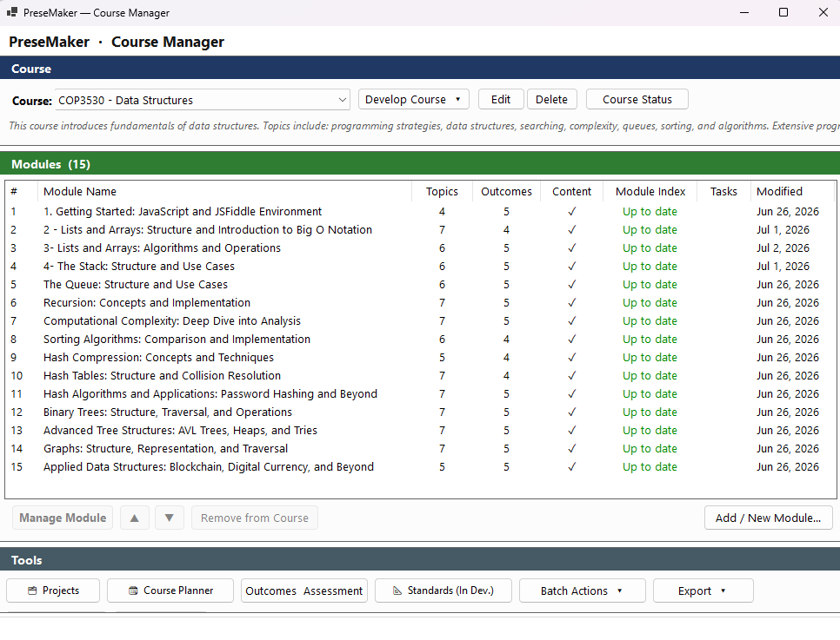
Courses and Modules: The Top Two Levels
A Course is the top-level container for all content.
Courses represent a full subject or learning program.
Modules are the primary building blocks within a course.
Each Module focuses on a distinct theme or instructional goal.
Courses and Modules share a parent-child relationship.
Notes:
A Course is the broadest unit in PreseMaker — it defines the subject or program and houses everything beneath it. Modules are the children of a Course and break it into manageable, thematically focused sections. This parent-child relationship is fundamental: the Course provides the overarching framework, while Modules deliver the structured instructional content within it. Modules are considered the primary building blocks because they are the main units through which content is organized and delivered to learners.

Slide 5
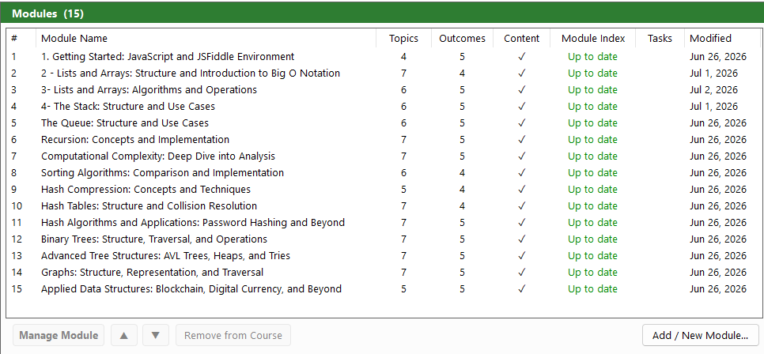
Organizing Modules Within a Course
Modules can be sequenced in a deliberate, logical order.
Sequential arrangement guides learners progressively through content.
Each Module represents a self-contained instructional unit.
Well-organized Modules create a coherent learning journey.
Notes:
When building a course, authors can arrange modules in any order they choose. A deliberate sequence — such as moving from foundational to advanced concepts — helps learners build knowledge progressively. Because each module is self-contained around a theme or goal, the overall course structure remains clear and navigable regardless of the number of modules involved.

Slide 6
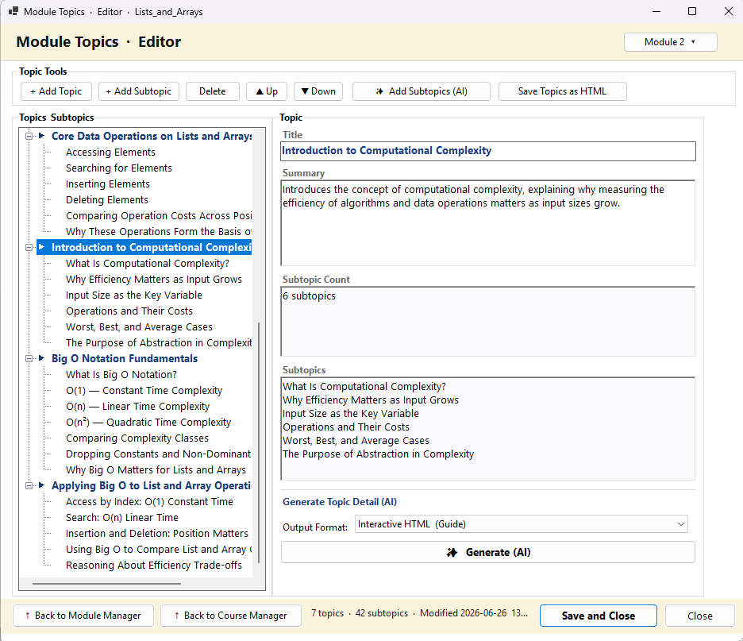
Topics: The Core Instructional Unit
Topics are the smallest structural unit within a module.
Each Topic represents one focused concept or learning objective.
Every Topic belongs to exactly one parent module.
Topics define what PreseMaker will generate as content.
Notes:
Topics sit at the heart of PreseMaker's content creation process. Each topic is scoped to a single, focused concept or skill — keeping lessons precise and manageable. Because every topic belongs to exactly one parent module, the hierarchy remains clean and navigable. Importantly, the topic is also the trigger point for content generation: PreseMaker uses the information defined in a topic to produce the actual learning materials.

Slide 7
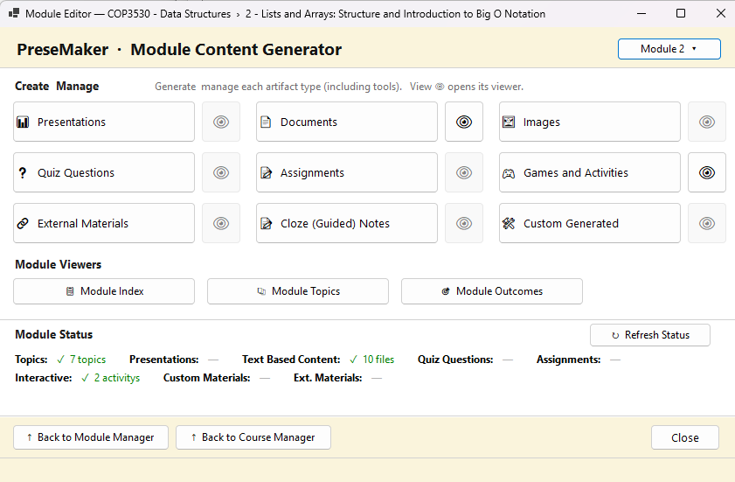
Generated Materials: The Output Layer
Generated Materials are the tangible outputs from each Topic.
PreseMaker uses topic title, summary, and source content.
Outputs include slides, speaker notes, and assessments.
Materials form the actual learner-facing experience.
Generation connects course structure directly to content delivery.
Notes:
Generated Materials are what learners ultimately see and interact with. PreseMaker takes the structured information in a topic — including its title, summary, and any source content provided — and uses it to automatically produce content assets. These can include presentation slides, speaker notes, quizzes, or other formats depending on your configuration. This output layer is where course design becomes a real learning experience.

Slide 8
The Hierarchy as a Unified System
All four levels inform and support each other.
The chain flows: Course → Module → Topic → Materials.
No level operates in isolation from the others.
Structure at the top shapes outputs at the bottom.
Notes:
It is important to view the PreseMaker hierarchy not as four separate layers but as one unified system. Decisions made at the Course level cascade down through Modules and Topics all the way to the generated content. For example, the theme of a Course shapes how Modules are grouped, which in turn defines what Topics are created, which ultimately determines what materials are produced. Understanding this chain helps authors make better structural decisions at every level.

Slide 9
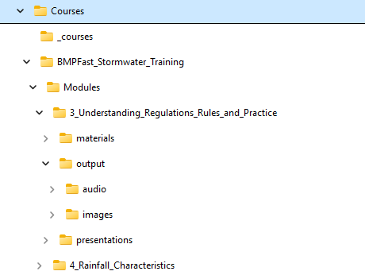
How PreseMaker Stores Files Locally
PreseMaker saves all files directly to your local computer.
Files are not stored exclusively in the cloud.
A predictable folder hierarchy mirrors the course structure.
Common file formats ensure broad compatibility.
No special software is required to open generated files.
Notes:
PreseMaker saves all generated course materials to your local computer. This means your files are always accessible without an internet connection. The folder structure PreseMaker creates on your machine mirrors the course-module-content hierarchy you work with inside the application, making it intuitive to locate specific files. Generated materials are saved in widely supported formats — such as PPTX or DOCX — so they can be opened, edited, and shared using standard software.

Slide 10
File Ownership and Access Rights
All generated files belong entirely to you.
PreseMaker retains no ownership over your content.
No usage restrictions are imposed on generated materials.
There is no platform lock-in for your work.
Notes:
A key principle of PreseMaker is that you own everything you create. The application does not retain ownership, claim licensing rights, or impose any restrictions on the content it generates for you. Your files are yours to use, distribute, edit, or repurpose freely. This no-lock-in approach ensures that your intellectual work remains under your full control at all times.

Slide 11
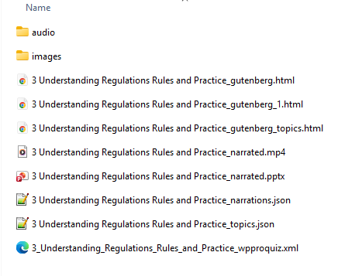
Locating and Verifying Your Saved Files
PreseMaker provides direct access to saved file locations.
Open a file's containing folder from within the application.
Default save locations follow a consistent, predictable pattern.
Verify saves quickly without leaving the application.
Notes:
PreseMaker makes it straightforward to confirm where your files have been saved. From within the application, you can open the containing folder of any generated file with a single action, taking you directly to the file in your operating system's file explorer. The default save location follows the same hierarchical structure as your course content, so even without using the in-app shortcut, you can navigate to your files predictably.

Slide 12
Managing and Backing Up Your Files
Local storage means you manage your own file backups.
Use external drives or cloud sync services for backup.
Organize files consistently to support long-term accessibility.
Generated content persists between application sessions.
Your progress is never lost when you close PreseMaker.
Notes:
Because PreseMaker stores files locally, responsibility for backup and file management rests with you. It is strongly recommended to back up your PreseMaker files regularly using an external drive, a cloud sync service such as OneDrive or Dropbox, or another backup solution of your choice. Maintaining a consistent folder organization strategy will also make it easier to find and build upon previous work over time. Importantly, all generated content persists between sessions — closing PreseMaker will not cause you to lose your work.

Slide 13
Accessing Your Work Across Sessions
All content is saved persistently between sessions.
Completed materials are always available when you return.
Files remain on your machine until you choose to remove them.
Consistent file locations make retrieval straightforward.
Notes:
PreseMaker is designed so that your work is always waiting for you when you return. Because files are saved locally and the application maintains a consistent structure, there is no risk of losing progress between sessions. Whether you are returning to a project after a day or a month, your generated materials and course structure will be exactly as you left them.

Slide 14
Summary: The PreseMaker Structure at a Glance
Courses → Modules → Topics → Generated Materials.
Each level supports and informs the levels below it.
Files are saved locally in a mirrored folder structure.
You retain full ownership of all generated content.
A consistent structure ensures long-term access and control.
Notes:
To summarize: PreseMaker organizes all e-learning content through a four-level hierarchy — Courses at the top, followed by Modules, Topics, and finally Generated Materials as the output layer. This hierarchy functions as a unified system where each level shapes the next. All files are saved locally on your computer in a folder structure that mirrors this hierarchy, using common file formats for maximum compatibility. You own everything PreseMaker generates, with no restrictions or lock-in. Understanding this structure gives you the foundation to use PreseMaker confidently and efficiently.

