Slide 1
Introduction to Operating Systems
CPSC/ECE 3220 Spring 2020
Introduction
(based on the Tom Anderson and Michael Dahlin OSPP textbook)

Slide 2
What is an operating system?
Software to manage a computer’s resources for its users and applications

Slide 3
Question
Could an operating system be built as a hardware device?

Slide 4
1966 Fairchild Symbol IIR Computer
Fairchild's Symbol computer had both the compiler and operating system built with hardware, not software. Several of us on the Symbol design team were experienced programmers, familiar with the high-level languages Cobol, Fortran, and Algol, and with the inner workings of compilers and operating system software. Accordingly, many hardware mechanisms we built were based on known software techniques. For example, the one-pass (hardware) translator generated a symbol table and reverse Polish code as in conventional software interpretive languages. The translator hardware (compiler) operated at disk transfer speeds and was so fast there was no need to keep and store object code, since it could be quickly regenerated on-the-fly. The hardware-implemented job controller performed conventional operating system functions. The memory controller provided a virtual memory for variable-length strings and is described herein.
Stan Mazor, IEEE Annals of the History of Computing, 30:1, Jan.-March 2008

Slide 5
Question
Does it make economic sense?

Slide 6
Question
Does it make economic sense?
Why not?
Hardware markets
ASICs for stable, high-volume components
Coprocessors for well-defined functions
Reconfigurable hardware (e.g., FPGA)
General-purpose microcontrollers / processors

Slide 7
Question
Where do you find operating systems?

Slide 8
Types of Operating Systems
Mobile OS
Android, iOS
Desktop / Server OS
Linux, Windows
Embedded OS
L4, Tizen, QNX, webOS
Real Time OS
VxWorks
Network OS
Cisco IOS
Mainframe OS
z/OS

Slide 9
Customized L4 OS on iPhone
The Secure Enclave is a coprocessor fabricated within the system on chip (SoC). It uses encrypted memory and includes a hardware random-number generator. The Secure Enclave provides all cryptographic operations for Data Protection key management and maintains the integrity of Data Protection even if the kernel has been compromised. Communication between the Secure Enclave and the application processor is isolated to an interrupt-driven mailbox and shared memory data buffers.
The Secure Enclave includes a dedicated Secure Enclave Boot ROM. Similar to the application processor Boot ROM, the Secure Enclave Boot ROM is immutable code that establishes the hardware root of trust for the Secure Enclave.
The Secure Enclave runs a Secure Enclave OS based on an Apple-customized version of the L4 microkernel. This Secure Enclave OS is signed by Apple, verified by the Secure Enclave Boot ROM, and updated through a personalized software update process.
An example of some built-in services that utilize the hardware protected Secure Key Store:
Unlock of device or account (Password & Biometric)
Hardware Encryption / Data Protection / FileVault (Data-at-Rest)
Secure Boot (Firmware and OS Trust and Integrity)
Hardware control of camera (FaceTime)
https://support.apple.com/en-us/HT209632

Slide 10
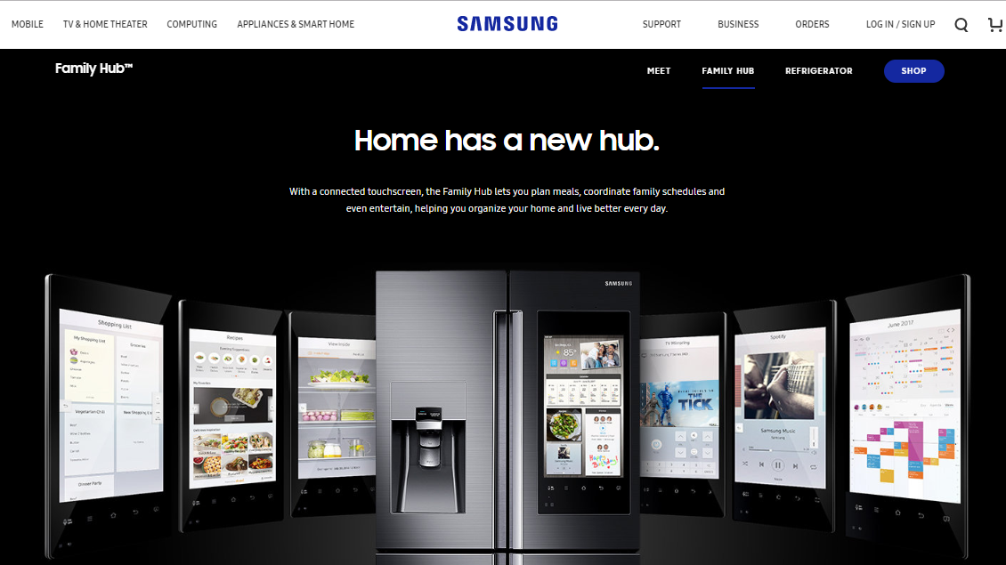
Tizen Embedded OS on a Refrigerator

Slide 11
QNX Embedded OS in Cars

Slide 13
From Caption of Figure 1.3
The application context is much more than a simple abstraction on top of the hardware devices: applications execute in a virtual environment that is: more constrained (to prevent harm), more powerful (to mask hardware limitations), and more useful (via common services) than the underlying hardware.

Slide 14
More Constrained
What is a feature of Chrome that distinguishes it from other browsers and how is it provided?

Slide 15
More Constrained
What is a feature of Chrome that distinguishes it from other browsers and how is it provided?
Wikipedia: “Chrome uses a process-allocation model to sandbox tabs. Using the principle of least privilege, each tab process cannot interact with critical memory functions (e.g. OS memory, user files) or other tab processes ….”

Slide 16
More Powerful
What is something an OS can do that is beyond the ability of the hardware?

Slide 17
More Useful
How does an OS make programming easier than starting with bare hardware?

