Slide 1
Introduction to Operating Systems
CPSC/ECE 3220 Spring 2020
Lecture Notes
OSPP Chapter 10
(adapted by Mark Smotherman from Tom Anderson’s slides on OSPP web site)

Slide 2
Address Translation Uses (Review)
Process isolation
Keep a process from touching anyone else’s memory, or the kernel’s
Efficient interprocess communication
Shared regions of memory between processes
Shared code segments
E.g., common libraries used by many different programs
Program initialization
Start running a program before it is entirely in memory

Slide 3
Address Translation Uses (Review 2)
Dynamic memory allocation
Allocate and initialize stack/heap pages on demand
Program debugging
Data breakpoints when address is accessed
Memory mapped files
Access file data using load/store instructions
Demand-paged virtual memory
Illusion of near-infinite memory, backed by disk or memory on other machines

Slide 4
Address Translation Uses (This Chapter)
Zero-copy I/O
Directly from I/O device into/out of user memory
Efficient support of virtual machines
Checkpoint/restart
Transparently save a copy of a process, without stopping the program while the save happens
Process migration
Transparently move processes between machines
Persistent data structures
Implement data structures that can survive system reboots
Information flow control
Track what data is being shared externally
Distributed shared memory
Illusion of memory that is shared between machines

Slide 5
Web Server

Slide 6
Zero-Copy I/O Block Aligned Read/Write System Calls

Slide 7
Virtual Machines and Virtual Memory

Slide 8
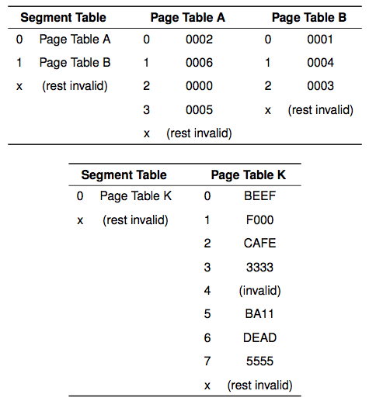

Slide 9
Shadow Page Tables

Slide 10
Hardware Support for Virtual Machines
x86 recently added hardware support for running virtual machines at user level
Operating system kernel initializes two sets of translation tables
One for the guest OS
One for the host OS
Hardware translates address in two steps
First using guest OS tables, then host OS tables
TLB holds composition

Slide 11
VMM Memory Compression

Slide 12
Transparent Checkpoint

Slide 13
Question
At what point can we resume the execution of a checkpointed program?
When the checkpoint starts?
When the checkpoint is entirely on disk?

Slide 14
Incremental Checkpoint

Slide 15
Process Migration
What if we checkpoint a process and then restart it on a different machine?
Process migration: move a process from one machine to another
Special handling needed if any system calls are in progress
Where does the system call return to?

Slide 16
Recoverable Virtual Memory
Data structures that survive failures
Want a consistent version of the data structure
User marks region of code as needing to be atomic
Begin transaction, end transaction
If crash, restore state before or after transaction

Slide 17
Recoverable Virtual Memory
On begin transaction:
Snapshot data structure to disk
Change page table permission to read-only
On page fault:
Mark page as modified by transaction
Change page table permission to read-write
On end transaction:
Log changed pages to disk
Commit transaction when all mods are on disk
Recovery:
Read last snapshot + logged changes, if committed

Slide 18
Deterministic Debugging
Can we precisely replay the execution of a multi-threaded process?
If process does not have a memory race
From a checkpoint, record:
All inputs and return values from system calls
All scheduling decisions
All synchronization operations
Ex: which thread acquired lock in which order

Slide 19
Security
VM “honeypot”
Clone VM to run suspect code
Watch for changes to browser or OS in VM
Information flow control
Track what data is being shared externally
Defense in depth
Keep all system software up to date
Multiple levels of protection

Slide 20
Cooperative Caching
Can we demand page to memory on a different machine?
Remote memory over LAN much faster than disk
On page fault, look in remote memory first before fetching from disk

Slide 21
Distributed Virtual Memory
Can we make a network of computers appear to be a shared-memory multiprocessor?
Read-write: if page is cached only on one machine
Read-only: if page is cached on several machines
Invalid: if page is cached read-write on a different machine
On read page fault:
Change remote copy to read-only
Copy remote version to local machine
On write page fault (if cached):
Change remote copy to invalid
Change local copy to read-write

