Slide 1
Introduction to Operating Systems
CPSC/ECE 3220 Spring 2020
Lecture Notes
OSPP Chapter 2 – Part B
(adapted by Mark Smotherman and Lana Drachova from Tom Anderson’s slides on OSPP web site)

Slide 2
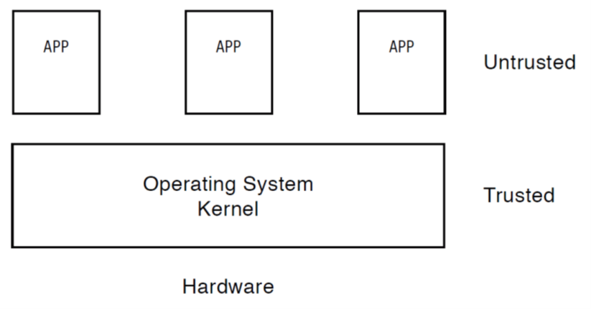
Types of Alerts to Kernel
j
k
l
m
Exceptions, e.g., divide by zero
Intentionally invoke kernel for system calls
Timer interrupts
I/O interrupts, e.g., completion or error

Slide 3
An Interrupt
a signal to the processor indicating an event needs immediate attention.
alerts the processor and serves as a request for the processor to interrupt the currently executing code, so that the event can be processed in a timely manner.
If the request is accepted, the processor responds by suspending its current activities, saving its state, and executing a function called an interrupt handler (or an interrupt service routine, ISR) to deal with the event.
This interruption is temporary, and, unless the interrupt indicates a fatal error, the processor resumes normal activities after the interrupt handler finishes
(Wikipedia)

Slide 4
Interrupt Terminology
Hardware interrupts
An electronic signal issued by some hardware device external to the processor (disk controller, kb, mouse) to communicate that the device needs attention from the OS (Wikipedia)
Asynchronous –> unrelated to current instruction
Arrive asynchronously with respect to the processor clock, and at any time during instruction execution.
Software interrupt - requested by the processor while executing a particular instruction, or when certain conditions exist.
Synchronous –> related to instruction being executed
“Exception”, “Fault”, “Trap”
For some processor manufacturers, these terms are synonyms; for others, there are subtle differences

Slide 5
Hardware Timer
Hardware device that periodically interrupts the processor (after some time or # of instructions)
Each processor has a timer
Expires every few milliseconds
Kernel only can reset timer
User-level process cannot set/disable timer

Slide 6
Timer Interrupt
Hardware transfers control from user process to the kernel timer interrupt handler
Timer or other interrupt do not imply an error!
Interrupt frequency set by the kernel
Not by user code!
Interrupts can be temporarily deferred
Not by user code!
Interrupt deferral crucial for implementing mutual exclusion

Slide 7
User to Kernel Mode Switch
Caused by:
Interrupts (asynchronous)
Triggered by timer and I/O devices
Processor Exceptions
Triggered by unexpected program behavior, privileged instruction, memory trespassing attempt
Or malicious behavior!
System calls (a.k.a. protected procedure calls)
Request by program for kernel to do some operation on its behalf
Only limited # of very carefully coded entry points

Slide 8
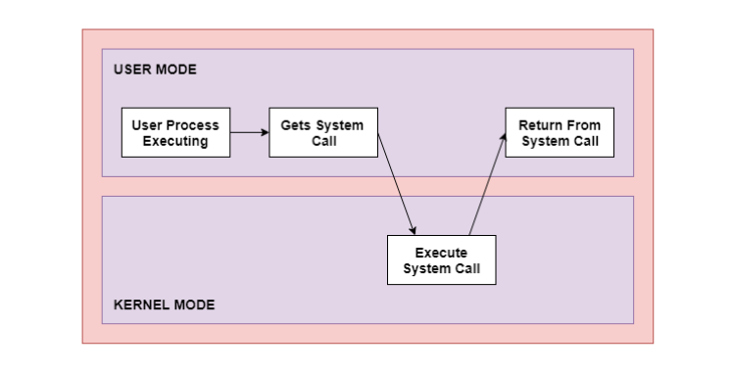
System Calls
System Call is a request for service from a user process to the OS
An interface between user process and OS
Examples:
Managing files
Managing processes
NW connection/send/receive
Access to hardware devices

Slide 9
Kernel to User Mode Switch
Happens when:
New process/new thread start
Copy to meme, set PC, Jump to first instruction in program/thread
Return from interrupt, exception, system call
Resume suspended execution
Process/thread context switch
Save process’ state in pcb, load another process’ pcb
User-level upcall (UNIX signal)
Asynchronous notification to user program

Slide 10
How do we take interrupts safely?
Limited entry onto a kernel
Entry point to kernel is set by kernel
Check permission to enter( can u read file?)
Atomic transfer of control with changes to:
Mode, pc, stack and memory protection changed at the same time
Transparent restartable execution
User program does not know interrupt occurred

Slide 11
Interrupt Vector Table
Processor register points to kernel memory area called IVT.
Table is set up by kernel
An array of pointers to code to run in response to different events - “interrupt handlers” or “interrupt service routines”
IVT table format is processor specific

Slide 12
Interrupt Vector Table

Slide 13
Generic Interrupt Response
Save PC and PSR
Change execution mode to kernel
Disable or restrict further interrupts
Load new PC from interrupt vector table
=> Transfers control into the kernel at a kernel-defined entry point!

Slide 14
Kernel is Interrupt-Driven
Interrupt handlers are the entry points into the kernel
Interrupt handlers are software!
Interrupt Return instruction (IRET) restores PC and PSR

Slide 15
Interrupt Masking
Interrupt handler runs with interrupts off or restricted
Re-enabled when interrupt completes
OS kernel can also turn interrupts off
Eg., when determining the next process/thread to run
On x86
CLI: disable interrrupts
STI: enable interrupts
Only applies to the current CPU (on a multicore)
We’ll need this to implement synchronization in chapter 5

Slide 16
Interrupt Stack
Region of kernel (not user) memory
Per-processor
Interrupt/exception/system call will save PC, registers, and user process SP on the kernel interrupt stack and call the interrupt handler
When handler finished, the context will be restored and execution continues.

Slide 17
Kernel Stacks
Per-process, located in kernel memory
There may still be a per-processor interrupt stack
Fixed size and locked in memory
Only trusted components such as interrupt handlers and kernel routines use them =>
Kernel stack and SP are always in valid states
Access by kernel cannot cause a page fault
No accesses allowed from user code

Slide 18
Kernel Stacks

Slide 20
Kernel System Call Handler
Locate arguments
In registers or on user stack
Translate user addresses into kernel addresses
Copy arguments
From user memory into kernel memory
Protect kernel from TOCTOU attack
Validate arguments
Protect kernel from errors in user code
Copy results back into user memory
Translate kernel addresses into user addresses

Slide 21
Starting a New Process
Kernel builds user and kernel stacks for a new process to look like the process was interrupted before even the first instruction was executed
Avoids special case checking in the dispatcher, so dispatching is slightly faster

Slide 22
Booting the OS

