Slide 1
Introduction to Operating Systems
CPSC/ECE 3220 Spring 2020
Lecture Notes
OSPP Chapter 8 – Part B
(adapted by Mark Smotherman from Tom Anderson’s slides on OSPP web site)

Slide 2
Efficient Address Translation
Translation Lookaside Buffer (TLB)
Cache of recent virtual page -> physical page translations with permissions, in hardware
If cache hit, use that translation
If cache miss, walk multi-level page table
Caches are expensive
Static on-chip memory
Performance gain should be worth it
TLB lookup needs to be faster than full address translation
Some use multiulevel TLBs

Slide 3
Cost of address Translation
Cost of translation =
Cost of TLB lookup (whether in TLB or not +
Cost of full translation (if not in TLB) *
Prob(TLB miss)
Prob(TLB miss) = 1 - Prob(TLB hit)
Design consideration: full address translation should be a rare event -> TLB should be sufficiently large

Slide 4
TLB Lookup

Slide 5
TLB and Page Table Translation

Slide 6
Hardware Design Principle
The bigger the memory, the slower the memory

Slide 7
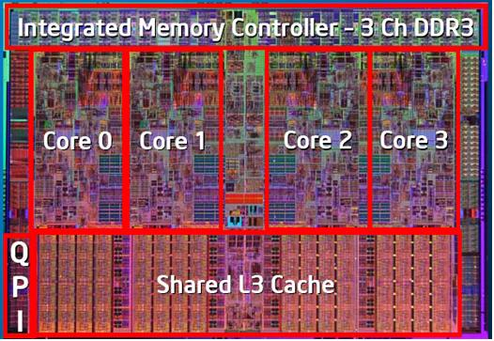
Intel i7

Slide 8
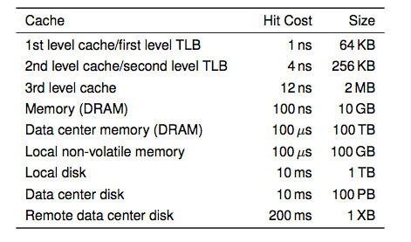
Memory Hierarchy
i7 has 8MB as shared 3rd level cache; 2nd level cache is per-core

Slide 9
Question
What is the cost of a first level TLB miss?
Second-level TLB lookup
What is the cost of a second level TLB miss?
x86: 2-4 level page table walk
How expensive is a 4-level page table walk on a modern processor?

Slide 10
Superpages
Improve TLB hit rate
On many systems, TLB entry can be
A page
A superpage:
a set of contiguous pages in VM that map to contiguous pages in PM, aligned to share same high order address
TLB will have a flag to indicate a superpage
Superpages are at the discretion of the OS.
x86: superpage is set of pages in one page table
x86 TLB entries
4KB
2MB
1GB

Slide 11
Superpages

Slide 12
TLBs Consistency
TLB needs to be in the consistent state
TLB may contain old translation at context switch
On every context switch – change hw page table register to point to new process’ page table
And flush TLB entry
Carries penalty

Slide 13
Tagged TLBs
What happens on a context switch?
Reuse TLB?
Discard TLB?
Solution: Tagged TLB
Each TLB entry has process ID
TLB hit only if process ID matches current process

Slide 14
Multiprocessor TLB
Any or all processors may have a cached copy of TLB
Every time entry is modified, need to remove TLB from every processor
OS interrupts every processor to remove old TLB entry – TLB shootdown
Original processor continue executing after other processors remove entry

Slide 15
TLB Shootdown

Slide 17
Multicore and Hyperthreading
Modern CPU has several functional units
Instruction decode
Arithmetic/branch
Floating point
Instruction/data cache
TLB
Multicore: replicate functional units (i7: 4)
Share second/third level cache, second level TLB
Hyperthreading: logical processors that share functional units (i7: 2)
Better functional unit utilization during memory stalls
No difference from the OS/programmer perspective
Except for performance, affinity, …

Slide 18
Address Translation Uses
Process isolation
Keep a process from touching anyone else’s memory, or the kernel’s
Efficient interprocess communication
Shared regions of memory between processes
Shared code segments
E.g., common libraries used by many different programs
Program initialization
Start running a program before it is entirely in memory
Dynamic memory allocation
Allocate and initialize stack/heap pages on demand

Slide 19
Address Translation Uses (2)
Program debugging
Data breakpoints when address is accessed
Memory mapped files
Access file data using load/store instructions
Demand-paged virtual memory
Illusion of near-infinite memory, backed by disk or memory on other machines
Zero-copy I/O
Directly from I/O device into/out of user memory
Efficient support of virtual machines

Slide 20
Address Translation Uses (3)
Checkpointing/restart
Transparently save a copy of a process, without stopping the program while the save happens
Persistent data structures
Implement data structures that can survive system reboots
Process migration
Transparently move processes between machines
Information flow control
Track what data is being shared externally
Distributed shared memory
Illusion of memory that is shared between machines

Slide 21
(if time permits)

Slide 22
Virtually Addressed vs. Physically Addressed Caches
Too slow to first access TLB to find physical address, then look up address in the cache
Instead, first level cache is virtually addressed
In parallel, access TLB to generate physical address in case of a cache miss

Slide 23
Virtually Addressed Caches

Slide 24
Physically Addressed Cache
Notes:
Note that the TLB miss walks the page table in the physical cache, so you may not even need to go to physical memory on a TLB miss

Slide 25
Question
With a virtual cache, what do we need to do on a context switch?
Notes:
Need to invalidate the cache, or tag the cache with process ID’s
If tagged, and the virtual cache is > page size, means that it is possible to have multiple cache blocks that have different contents

Slide 26
Aliasing
Alias: two (or more) virtual cache entries that refer to the same physical memory
A consequence of a tagged virtually addressed cache!
A write to one copy needs to update all copies
Typical solution
Keep both virtual and physical address for each entry in virtually addressed cache
Lookup virtually addressed cache and TLB in parallel
Check if physical address from TLB matches multiple entries, and update/invalidate other copies

