Slide 1
Introduction to Operating Systems
CPSC/ECE 3220 Spring 2020
Lecture Notes
OSPP Chapter 9
(adapted by Mark Smotherman from Tom Anderson’s slides on OSPP web site)

Slide 2
Definitions
Cache
General concept in memory hierarchy, not just a processor cache
Copy of data that is faster to access than the original
Hit: if cache has copy
Miss: if cache does not have copy
Cache block
Unit of cache storage (multiple memory locations)
Temporal locality
Programs tend to reference the same memory locations multiple times
Example: instructions in a loop
Spatial locality
Programs tend to reference nearby locations
Example: data in a loop

Slide 3
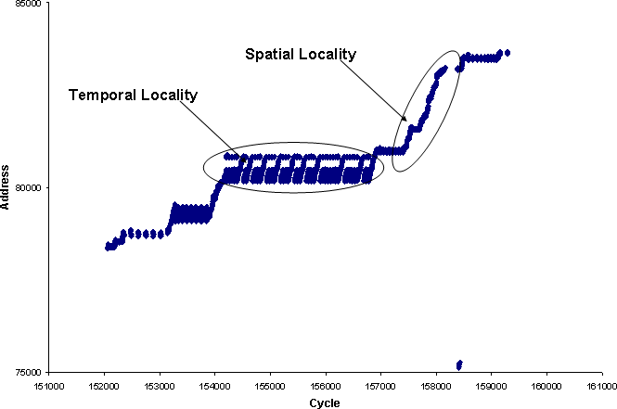
Locality of Reference
Diagram from Amir Kleen, et al., “Optimizing for instruction caches,” EE Times, Oct. 29, 2007, http://www.eetimes.com/document.asp?doc_id=1275470

Slide 4
Cache Concept (Read)

Slide 5
Cache Concept (Write)
Write-through: changes sent
immediately to next level of storage
Write-back: changes stored in cache until cache block is replaced

Slide 6
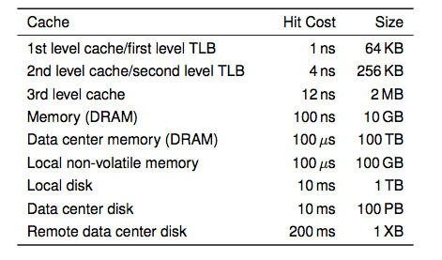
Memory Hierarchy
i7 has 8MB as shared 3rd level cache; 2nd level cache is per-core

Slide 7
Main Points
Can we provide the illusion of near infinite memory in limited physical memory?
Demand-paged virtual memory
Memory-mapped files
How do we choose which page to replace?
FIFO, MIN, LRU, LFU, Clock
What types of workloads does caching work for, and how well?
Spatial/temporal locality vs. Zipf workloads

Slide 8
Hardware address translation is a power tool
Kernel trap on read/write to selected addresses
Copy on write
Fill on reference
Zero on use
Demand paged virtual memory
Memory mapped files
Modified bit emulation
Use bit emulation

Slide 9
Demand Paging (Before)

Slide 10
Demand Paging (After)

Slide 11
Demand Paging
TLB miss and HW page table walk
Page fault (when page is marked as invalid / not present)
--Traps to kernel--
Convert virtual address to file offset
Allocate page frame, initiate disk block read into page frame, and schedule another process or thread
Disk interrupt when DMA complete
Mark page as valid / present
Resume thread at faulting instruction
TLB miss
HW page table walk to fetch translation and load TLB

Slide 12
Demand Paging on MIPS
Remember that MIPS uses a software-loaded TLB, so:
TLB miss
--Traps to kernel--
SW page table walk
Find page is marked as invalid / not present
Convert virtual address to file offset
Allocate page frame, initiate disk block read into page frame, and schedule another process or thread
Disk interrupt when DMA complete
Mark page as valid / present
Load TLB entry
Resume process at faulting instruction

Slide 13
Allocating a Page Frame
Select page to evict
Find all page table entries that refer to that page
Look at core map to see where page frame is shared
Set each page table entry invalid / not present
Remove any TLB entries
Copies of now invalid page table entry
Write changes on page back to disk, if necessary
Notes:
Why didn’t we need to shoot down the TLB before?

Slide 14
How do we know if page has been modified?
Page table entries contain bookkeeping bits
Dirty bit: has page been modified?
Set by hardware on first store instruction to clean page
In both TLB and page table entry
Use bit: has page been recently used?
Set by hardware in page table entry on TLB miss
Bookkeeping bits can be reset by the OS kernel
When changes to page are flushed to disk
To track whether page is recently used

Slide 15
Terminology
Different terms have been used by the processor manufacturers and OS programmers
Modified == changed == dirty
Recently used == use == accessed == reference

Slide 16
Keeping Track of Page Modifications (Before)

Slide 17
Keeping Track of Page Modifications (After)

Slide 18
Virtual or Physical Dirty/Use Bits
Most machines keep dirty/use bits in the page table entry
Physical page is
Modified if any page table entry that points to it is modified
Recently used if any page table entry that points to it is recently used
On MIPS, simpler to keep dirty/use bits in the core map
Core map: map of physical page frames

Slide 19
Intel x86-32 Paging Control Bits
P – presence
R/W – read/write
Writes only allowed if bit is 1
U/S – user/supervisor
User-mode accesses only allowed if bit is 1
A – accessed (i.e., use)
D – dirty
XD – execution disabled
G – global page
All processes share a global page using the same protection, e.g., kernel
PWT – write-through (for cache control)
PCD – cache disable (for cache control)
PAT – page attribute table (for cache control)

Slide 20
Intel x86-32 Paging Control Bits (2)
Presence and accessed bits are not needed in TLB entry for PTE
Why not?
To correctly record page accesses and writes, a page's TLB entry must be invalidated when the OS resets the accessed bit or dirty bit in the PTE, and when the page is replaced
Why?

Slide 21
Models for Application File I/O
Explicit read/write system calls
Data copied to user process using system call
Application operates on data
Data copied back to kernel using system call
Memory-mapped files
Open file as a memory segment
Program uses load/store instructions on segment memory, implicitly operating on the file
Page fault if portion of file is not yet in memory
Kernel brings missing blocks into memory, restarts process

Slide 22
Advantages to Memory-mapped Files
Programming simplicity, esp. for large files
Operate directly on file, instead of copy in/copy out
Zero-copy I/O
Data brought from disk directly into page frame
Pipelining
Process can start working before all the pages are populated
Interprocess communication
Shared memory segment vs. temporary file

Slide 23
From Memory-Mapped Files to Demand-Paged Virtual Memory
Every process segment backed by a file on disk
Code segment -> code portion of executable
Data, heap, stack segments -> temp files
Shared libraries -> code file and temp data file
Memory-mapped files -> memory-mapped files
When process ends, delete temp files
Unified memory management across file buffer and process memory

Slide 24
Cache Replacement Policy
On a cache miss, how do we choose which entry to replace?
Assuming the new entry is more likely to be used in the near future
In direct mapped caches, not an issue!
Policy goal: reduce cache misses
Improve expected case performance
Also: reduce likelihood of very poor performance

Slide 25
A Simple Policy
Random?
Replace a random entry
FIFO?
Replace the entry that has been in the cache the longest time
What could go wrong?

Slide 26
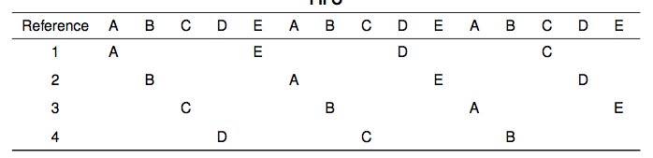
FIFO in Action
FIFO
Worst case for FIFO is if program strides through memory that is larger than the cache

Slide 27
MIN, LRU, LFU
MIN
Replace the cache entry that will not be used for the longest time into the future
Optimality proof based on exchange: if evict an entry used sooner, that will trigger an earlier cache miss
Least Recently Used (LRU)
Replace the cache entry that has not been used for the longest time in the past
Approximation of MIN
Least Frequently Used (LFU)
Replace the cache entry used the least often (in the recent past)

Slide 28
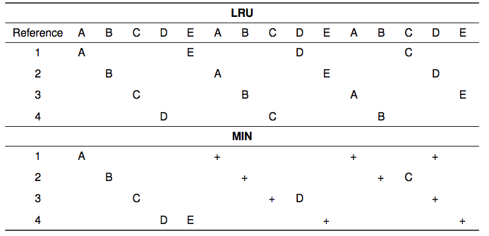
LRU/MIN for Sequential Scan

Slide 29
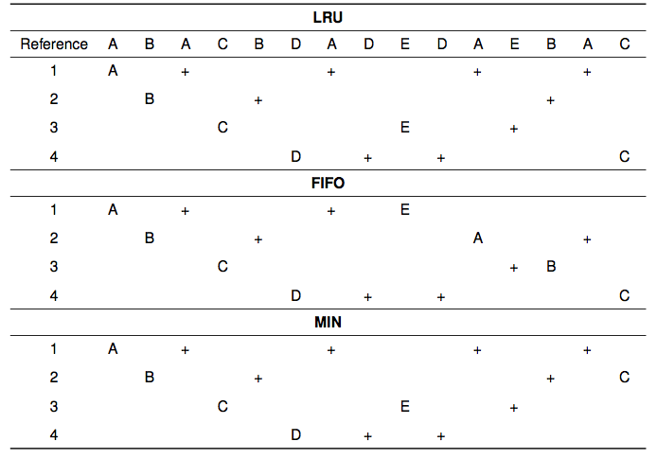
Notes:
For a reference pattern that exhibits locality

Slide 30
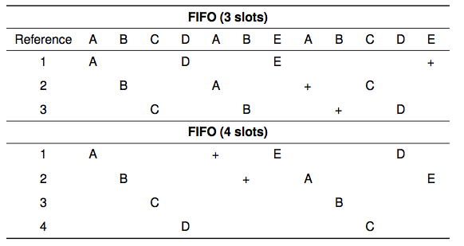
Belady’s Anomaly

Slide 31
Clock Algorithm: Estimating LRU
Periodically, sweep through all pages
If page is unused, reclaim
If page is used, mark as unused

Slide 32
Nth Chance: Not Recently Used
Instead of one bit per page, keep an integer
notInUseSince: number of sweeps since last use
Periodically sweep through all page frames
if (page is used) {
notInUseSince = 0;
} else if (notInUseSince < N) {
notInUseSince++;
} else {
reclaim page;
}

Slide 33
Implementation Note
Clock and Nth Chance can run synchronously
In page fault handler, run algorithm to find next page to evict
Might require writing changes back to disk first
Or asynchronously
Create a kernel thread to maintain a pool of recently unused, clean pages
Find recently unused dirty pages, write mods back to disk
Find recently unused clean pages, mark as invalid / not present and move to pool
On page fault, check if requested page is in pool! (like VAX/VMS victim buffer)
If not, evict that page

Slide 34
DEC VAX/VMS Fast Reclaim
VAX-11/780 did not provide use bits
OS designers used FIFO with victim buffer replacement policy
Oldest pages in FIFO list placed into a victim buffer
Victim pages are still in memory but unmapped
A page fault to a victim page allowed fast reclaim, i.e., no disk access
Performance almost as good as LRU

Slide 35
Recap
MIN is optimal
Replace a page or cache entry that will not be used again or the one used farthest into the future
LRU is an approximation of MIN
For programs that exhibit spatial and temporal locality
Clock/Nth Chance is an approximation of LRU
Can bin pages into sets of “not recently used”

Slide 36
Working Set Model
Working Set: set of memory locations that need to be cached for reasonable cache hit rate
Thrashing: when system has too small a cache

Slide 37
Cache Working Set
Notes:
This graph isn’t as useful as it should be! Try a log scale miss rate.
If miss cost is 1000x cache, then is hit rate is 99.9% -- spending half your time handling misses.

Slide 38
Phase Change Behavior

Slide 39
Question
What happens to system performance as we increase the number of processes?
If the sum of the working sets > physical memory?

Slide 40
Prevent Over-Commitment
Working Set (WS) page allocation policy
Track working sets
If sum of working sets is too large then suspend a process
Can use a periodic inquiry and reset of the use bits to determine working set membership
Page Fault Frequency (PFF) page allocation policy
Track page fault rate of each process
If the rate for a process goes above a "high-water" threshold then steal a page from a process with a rate below a "low-water" threshold
If there are no pages available to steal then suspend a process
No need for use bits to implement this policy

Slide 41
(if time permits)

Slide 42
Emulating Modified/Use Bits w/ MIPS Software-Loaded TLB
MIPS TLB entries have an extra bit: modified/unmodified
Trap to kernel if no entry in TLB, or if write to an unmodified page
On a TLB read miss:
If page is clean, load TLB entry as read-only; if dirty, load as rd/wr
Mark page as recently used
On a TLB write to an unmodified page:
Kernel marks page as modified in its page table
Reset TLB entry to be read-write
Mark page as recently used
On TLB write miss:
Kernel marks page as modified in its page table
Load TLB entry as read-write
Mark page as recently used

Slide 43
Emulating a Modified Bit (Hardware-Loaded TLB)
Some processor architectures do not keep a modified bit per page
Extra bookkeeping and complexity
Kernel can emulate a modified bit:
Set all clean pages as read-only
On first write to page, trap into kernel
Kernel sets modified bit, marks page as read-write
Resume execution
Kernel needs to keep track of both
Current page table permission (e.g., read-only)
True page table permission (e.g., writeable, clean)

Slide 44
Emulating a Recently Used Bit (Hardware-Loaded TLB)
Some processor architectures do not keep a recently used bit per page
Extra bookkeeping and complexity
Kernel can emulate a recently used bit:
Set all recently unused pages as invalid / not present
On first read/write, trap into kernel
Kernel sets recently used bit
Marks page as read or read/write
Kernel needs to keep track of both
Current page table permission (e.g., invalid / not present)
True page table permission (e.g., read-only, writeable)

Slide 45
Cache Lookup: Fully Associative

Slide 46
Cache Lookup: Direct Mapped

Slide 47
Cache Lookup: Set Associative

Slide 48
Page Coloring
What happens when cache size >> page size?
Direct mapped or set associative
Multiple pages map to the same cache line
OS page assignment matters!
Example: 8MB cache, 4KB pages
1 of every 2K pages lands in same place in cache
What should the OS do?

Slide 49
Page Coloring

Slide 50
Zipf Distribution
Notes:
Alpha between 1 and 2

Slide 51
Zipf Distribution
Caching behavior of many systems are not well characterized by the working set model
An alternative is the Zipf distribution
Popularity ~ 1/k^{α}, for k^{th} most popular item, 1 < α < 2

Slide 52
Zipf Examples
Web pages
Movies
Library books
Words in text
Salaries
City population
…
Common thread: popularity is self-reinforcing

Slide 53
Zipf and Caching

