Slide 1
Introduction to Operating Systems
CPSC/ECE 3220 Spring 2020
Lecture Notes
OSPP Chapter 11
(adapted by Mark Smotherman from Tom Anderson’s slides on OSPP web site)

Slide 2
File Systems
Abstraction on top of persistent storage
Magnetic disk
Flash memory (e.g., USB flash drive)
Devices provide
Storage that (usually) survives across machine crashes
Block level (random) access
Large capacity at low cost
Relatively slow performance
Magnetic disk read takes 10-20M processor instructions

Slide 3
File System as Illusionist: Hide Limitations of Physical Storage
Persistence of data stored in file system:
Even if crash happens during an update
Even if disk block becomes corrupted
Even if flash memory wears out
Controlled access to shared data
Naming:
Named data instead of disk block numbers
Byte addressable data even though devices are block-oriented
Directories instead of flat storage
Performance:
Data placement and data structure organization
Cached data

Slide 4
File System Abstraction
File system
Persistent, named data
Operating system crashes (and disk errors) leave file system in a valid state
Access control on data
File: named collection of data
Linear sequence of bytes (or a set of sequences or records)
Read/write
Hierarchical organization (directories, subdirectories)
Performance
Achieve close to the hardware limit in the average case

Slide 5
Files
Metadata
owner, access permissions, timestamps (creation, last written), size, reference count, lock, etc.
Data
May be unstructured or structured:
Stream of bytes (even if stored as blocks)
Records are collections of related fields, often with a key field used for searching and sorting
Alternate data streams (resource forks in Mac OS)

Slide 6
Identifying the File Type
Metadata
Extension identifier (.c, .o)
Can be used to specify usage or structure
OS can associate a specific application with an extension
Magic number within file
Identify usage or structure
First four bytes for ELF file are: 177 E L F

Slide 7
Three File Types in UNIX
Regular file
Text (e.g., ASCII)
Binary (e.g., executable)
Directory
Writes must be restricted to preserve structure
Special file
Maps physical I/O device to the file system

Slide 8
File Type Philosophies
UNIX philosophy as stated by Ritchie and Thompson (inventors):
“the structure of files is controlled by the programs that use them, not by the system”
Alternate approach, e.g., IBM z/OS
“An access method defines the technique that is used to store and retrieve data. Access methods have their own data set structures to organize data, macros to define and process data sets, and utility programs to process data sets.”
Ex: Virtual Sequential Access Method (VSAM)
Ex: Queued Sequential Access Method (QSAM)

Slide 9
Directories
Directory
Group of named files or subdirectories
Mapping from file name to file metadata location
Path
String that uniquely identifies file or directory
Ex: /web/home/mark/public_html/3220.html
Links
Hard link: link from name to metadata location
Soft link: link from name to alternate name
Mount
Mapping from name in one file system to root of another

Slide 10
Directory Levels
 | System-wide | Per-device
Flat |  | CP/M
Two-level | OS/360 – top-level is user name
Tree-structured | UNIX | Windows

Slide 11
Path Names
Absolute path
Fully qualified
Starts at root (“/” in Unix systems)
Relative path
Partially qualified, ex: public_html/3220.html
Unqualified, ex: 3220.html
Starts at current working directory
. => this directory, .. => parent directory

Slide 12
Connection-Oriented Interface
Explicit open and close operations for files
OS creates an internal data structure on open
Read and write ops use descriptor (a.k.a. handle or stream) to identify the internal data structure
No need to reparse file name
Per-open data structure contains:
Access permission under which file was opened
Location of file (e.g., inode number)
Pointer to current byte or record for sequential access

Slide 13
UNIX Data Structures for Open Files
per-process
system-wide
on disk
Diagram from K. Thompson, “UNIX Implementation,” Bell System Tech. Jrnl., 1978

Slide 14
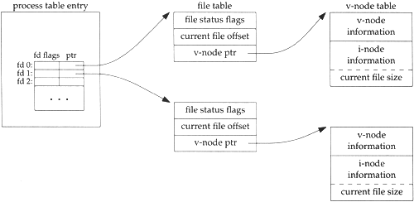
UNIX Data Structures for Open Files (2)
copy inode info
into kernel memory
per-process
system-wide
Diagram from W. Richard Stevens, Chapter 3, “UNIX File I/O,” Advanced Programming in the UNIX® Environment, 2003

Slide 15
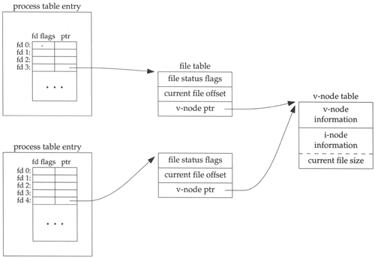
UNIX Data Structures for Open Files (3)
Two processes open the same file – each
has its own current file pointer (“offset”)
Diagram from W. Richard Stevens, Chapter 3, “UNIX File I/O,” Advanced Programming in the UNIX® Environment, 2003

Slide 16
UNIX File System API
create, link, unlink, createdir, rmdir
Create file, link to file, remove link
Create directory, remove directory
open, close, read, write, seek
Open/close a file for reading/writing
Seek resets current position
fsync
File modifications can be cached
fsync forces modifications to disk (like a memory barrier)

Slide 17
File System Workload
File sizes
Are most files small or large?
SMALL
Which accounts for more total storage: small or large files?
LARGE

Slide 18
File System Workload
File access
Are most accesses to small or large files?
SMALL
Which accounts for more total I/O bytes: small or large files?
LARGE

Slide 19
File System Workload
How are files used?
Most files are read/written sequentially
Some files are read/written randomly
Ex: database files, swap files
Some files have a pre-defined size at creation
Some files start small and grow over time
Ex: program stdout, system logs

Slide 20
File System Design
For small files:
Small blocks for storage efficiency
Concurrent ops more efficient than sequential
Files used together should be stored together
For large files:
Storage efficient (large blocks)
Contiguous allocation for sequential access
Efficient lookup for random access
May not know at file creation
Whether file will become small or large
Whether file is persistent or temporary
Whether file will be used sequentially or randomly

