Slide 1
Introduction to Operating Systems
CPSC/ECE 3220 Spring 2020
Lecture Notes
OSPP Chapter 12
(adapted by Mark Smotherman and Lana Drachova from Tom Anderson’s slides on OSPP web site)

Slide 2
Storage Devices
Magnetic disks
Storage that rarely becomes corrupted
Large capacity at low cost
Block level random access
Slow performance for random access
Better performance for streaming access
Flash memory
Storage that rarely becomes corrupted
Capacity at intermediate cost (50x disk)
Block level random access
Good performance for reads; worse for random writes

Slide 3
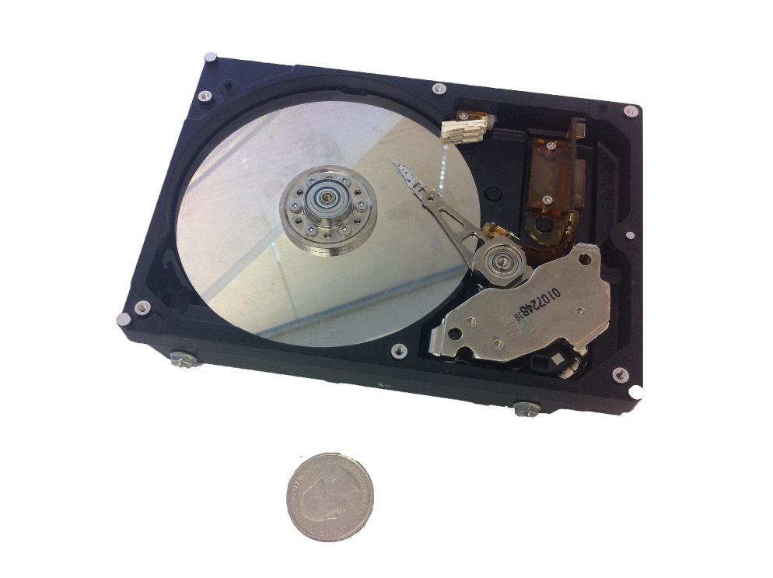
Magnetic Disk

Slide 4
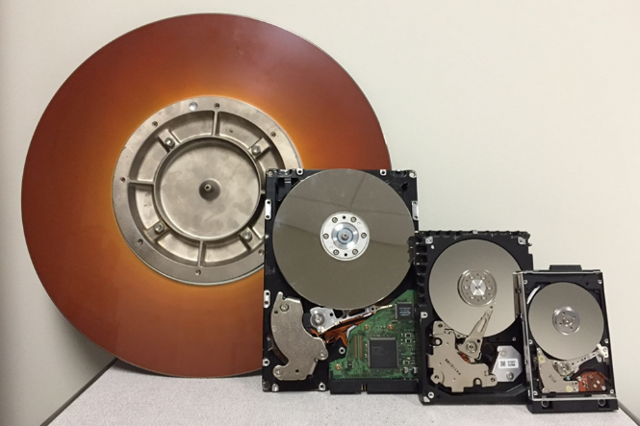

Left-to-right:
Single 14-inch disk platter, 16 MB removable cartridge disk for 1980s rack-mount Ampex DFR-900 series HDD, 3600 rpm, 30 ms avg. seek time
Three 5.12-inch (5.25-inch FF) platters, 19.2 GB internal drive, Quantum Bigfoot TS19A011, 4000 rpm, 10.5 ms seek
Four 3.74-inch (3.5-inch FF) platters, likely 80 GB internal drive, Seagate Barracuda, 7200 rpm, 8 ms seek
Single 2.56-inch (2.5-inch FF) platter, 10.06 GB internal drive, IBM Travelstar 07N5138, 4200 rpm, 12 ms seek

Slide 5
Notes:
Head and track are not to scale – head is actually much much bigger than a track.
Track ~ 1 micron wide
Wavelength of light is ~ 0.5 micron
Resolution of human eye: 50 microns
Outer edge of disk is travelling at 30 mph, with the head riding on top of the disk surface with a cushion of a few atoms

Slide 6
Disk Tracks
~ 1 micron wide
Wavelength of light is ~ 0.5 micron
Resolution of human eye: 50 microns
100K tracks on a typical 2.5” disk
Separated by unused guard regions
Reduces likelihood neighboring tracks are corrupted during writes (still a small non-zero chance)
Track length varies across disk
Outside: More sectors per track, higher bandwidth
Disk is organized into regions of tracks with same # of sectors/track
Only outer half of radius is used
Most of the disk area in the outer regions of the disk

Slide 7
Sectors
Sectors contain sophisticated error correcting codes
Disk head magnet has a field wider than track
Hide corruptions due to neighboring track writes
Sector sparing
Remap bad sectors transparently to spare sectors on the same surface
Slip sparing
Remap all sectors (when there is a bad sector) to preserve sequential behavior
Track skewing
Sector numbers offset from one track to the next, to allow for disk head movement for sequential ops
Notes:
Error correcting code: ex: parity. But you can get more sophisticated.

Slide 8
Disk Performance
Disk Latency =
Seek Time + Rotation Time + Transfer Time
Seek Time: time to move disk arm over track (1-20ms)
Fine-grained position adjustment necessary for head to “settle”
Head switch time ~ track switch time (on modern disks)
Rotation Time: time to wait for disk to rotate under disk head
Disk rotation: 4 – 15ms (depending on price of disk)
On average, only need to wait half a rotation
Transfer Time: time to transfer data onto/off of disk
Disk head transfer rate: 50-100MB/s (5-10 usec/sector)
Host transfer rate dependent on I/O connector (USB, SATA, …)

Slide 9
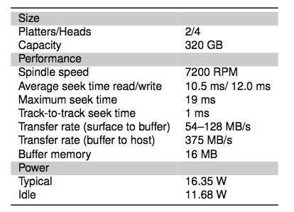
Toshiba Disk (2008)

Slide 10
Question
How long to complete 500 random disk reads, in FIFO order?

Slide 11
Question
How long to complete 500 random disk reads, in FIFO order?
Seek: average 10.5 msec
Rotation: average 4.15 msec
Transfer: 5-10 usec
500 * (10.5 + 4.15 + 0.01)/1000 = 7.3 seconds

Slide 12
Question
How long to complete 500 sequential disk reads?

Slide 13
Question
How long to complete 500 sequential disk reads?
Seek Time: 10.5 ms (to reach first sector)
Rotation Time: 4.15 ms (to reach first sector)
Transfer Time: (outer track)
500 sectors * 512 bytes / 128MB/sec = 2ms
Total: 10.5 + 4.15 + 2 = 16.7 ms
Might need an extra head or track switch (+1ms)
Track buffer may allow some sectors to be read off disk out of order (-2ms)

Slide 14
Question
How long to read all of the bytes off of a disk?

Slide 15
Question
How long to read all of the bytes off of a disk?
Disk capacity: 320GB
Disk bandwidth: 54-128MB/s
Transfer time =
Disk capacity / average disk bandwidth
~ 3500 seconds (1 hour)

Slide 16
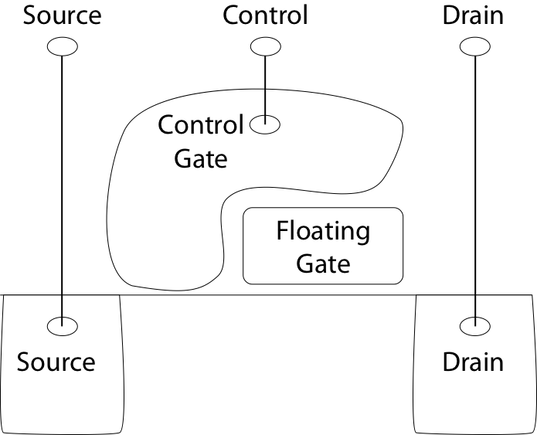
Flash Memory

Slide 17
Flash Memory
Writes must be to “clean” cells; no update in place
Large block erasure required before write
Erasure block: 128 – 512 KB
Erasure time: Several milliseconds
Write/read page (2-4KB)
50-100 usec

Slide 18
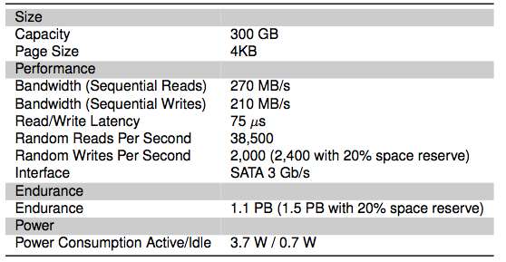
Flash Drive (2011)

Slide 19
Flash Translation Layer
Flash device firmware maps logical page # to a physical location
Garbage collect erasure block by copying live pages to new location, then erase
More efficient if blocks stored at same time are deleted at same time (e.g., keep blocks of a file together)
Wear-leveling: only write each physical page a limited number of times
Remap pages that no longer work (sector sparing)
Transparent to the device user

Slide 20
File System – Flash
How does Flash device know which blocks are live?
Live blocks must be remapped to a new location during erasure
TRIM command
File system tells device when blocks are no longer in use

Slide 21
Device Intelligence
Disk and flash devices now have simple CPUs
Disk head scheduling, remapping, SSD write leveling
Historical trends based on technological ratios
I/O channels and disk controllers in 1960s had a fair amount of processing power since the main CPU was expensive
E.g., to reduce load on CPU, channel could independently search for a record within a file when given a search key
When CPU costs decreased, I/O devices became dumb so that you could build a cheaper overall system => OS file system did more work
Now, CPUs are very cheap so device manufacturers include more intelligence on devices

