Slide 1
Introduction to Operating Systems
CPSC/ECE 3220 Spring 2020
Lecture Notes
OSPP Chapter 13 – Part B
(adapted by Mark Smotherman from Tom Anderson’s slides on OSPP web site)

Slide 2
File Organization - Recap
Want sequential data placement that provides efficient sequential access
Also want placement that provides efficient random access
Typically tree-structured indexing of data
Want to limit overheads to be efficient for small files
Provide scalability for large files
Provide a place for per-file metadata

Slide 3
File Organization Design Options
 | FAT | FFS | NTFS | ZFS
Index structure | linked list | tree (fixed, asymmetric) | tree (dynamic) | tree (COW, dynamic)
Granularity | block | block | extent | block
Free space allocation | FAT array | bitmap (fixed location) | bitmap (file) | space map (log-structured)
Locality | defrag | block groups, first fit, reserve space | extents, best fit, defrag | write-anywhere block groups

Slide 4
Microsoft New Technology File System (NTFS)
Master File Table
Flexible 1 KiB records for metadata and data
Each record contains one or more attributes, which are (type, value) pairs
MFT itself is stored as file 0
Free space, security attributes, etc. are also stored as files
File create can provide hint as to size of file

Slide 5
NTFS Attributes
Used to store metadata and data
Fixed-size header has type code
$STANDARD_INFORMATION
Creation time, modification time, owner ID, etc.
$FILE_NAME
Contains name and file number of parent directory
Can have more than one file name attribute

Slide 6
NTFS Attributes (2)
$DATA
Resident data
Pointers to non-resident data using extents
Sequential runs of file blocks
Similar approach in Linux (ext4)
$ATTRIBUTE_LIST
When attributes don’t fit in one MFT record
Can build variable-depth trees when necessary because of fragmentation

Slide 7
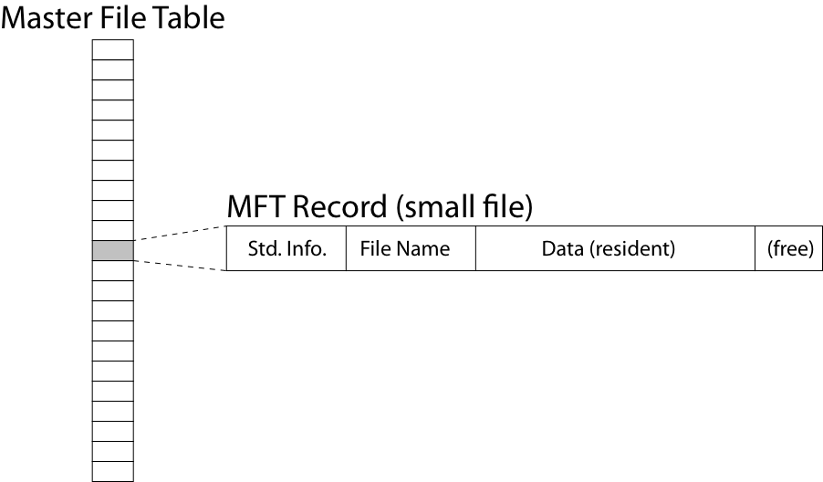
NTFS Small File

Slide 8
NTFS Medium-Sized File

Slide 9
NTFS Indirect Block

Slide 11
NTFS Evaluation
Pros:
Efficient storage
Small files => resident data
Large files => optimum is single nonresident extent
Variable-depth tree is more flexible than FFS
Locality for metadata and data
Cons:
Fragmentation causes inefficiency

Slide 12
Copy on Write File Systems
Key idea
Write new versions of data and metadata to new locations rather than overwrite
FS cache filters out many of the reads
Cost of writes dominates performance
Transforms random I/O to sequential I/O
Reduces seeks
Transforms small updates to block writes
Good for RAID arrays of hard disks and for SSD

Slide 13
CoW File Systems
NetApp Write Anywhere File Layout (WAFL)
Dates from 1993
SUN ZFS
Dates from 2005 (Oracle acquired in 2010)
OpenZFS in 2013
Oracle B-tree file system (btrfs)
Dates from 2007
Microsoft Resilient File System (ReFS)
Introduced in 2012
CoW for metadata by design
CoW for data as selectable option

Slide 14
Update in Place Versus CoW Update

Slide 15
Copy on Write inodes
inodes must be updated with new pointers
Want to write new version of inode in free block
Store inodes in a file and track with pointers
Root inode kept in circular buffer
New versions get new version number and validity checksum to indicate all updates were completed
After a crash, can scan for newest valid version
Also provides snapshot recovery capability

Slide 16
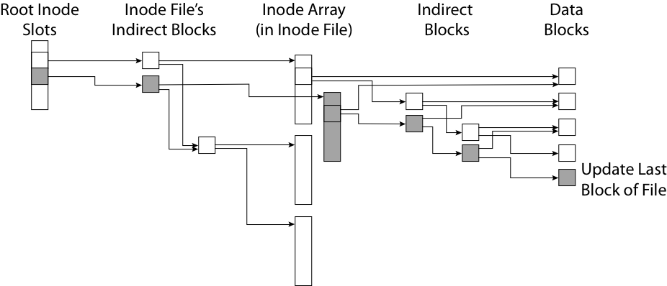
Copy on Write/Write Anywhere
Shaded areas represent new versions

Slide 17
SUN/Oracle ZFS
Uberblock array
Circular buffer of 256 instances
Scan to find the most recent valid instance
File has dnodes
Three block pointers in dnode
Blocks can be 512 B to 128 KiB
Indirection depth is 0 to 7
0 = resident data

Slide 18
Simplified ZFS File Structure

Slide 19
ZFS Free Space Map
Designed to scale up to huge storage systems
Per block group space map
Group space map is AVL tree of extents for fast selection of an extent with needed size
Log-structured updates for freed blocks
New space map is created from the log only when block group is selected for allocation

Slide 20
Copy on Write FS Evaluation
Pros:
Avoids seeks and small writes
Good for RAID and SSD
High throughput (best if updates are batched)
Cons:
Writes more bytes compared to update in place
Have to scan multiple possible root inodes to find correct one on recovery

Slide 21
OrangeFS
Dr. Walt Ligon, Clemson ECE
Open-source high-performance cluster FS
Started as PVFS in 1993
Available in Linux kernel 4.6 and on AWS
Layer of services
Runs on top of local file systems on servers
Abstracts away blocks using an object model
Configurable stripe sizes, replication, etc.

Slide 22
Directory and File Accesses
Read /foo/bar/baz

Slide 23
(if time permits)

Slide 24
ZFS Locality Heuristics
Sequential writes of grouped updates
Good performance even if more total bytes are written as compared to update in place
Batched updates
Several seconds of updates written as batch
Choice to location to write new versions
Variant of RR to choose among devices
Continue to use same block group if possible
Or, prefer a new block group with more free space, near outer edge, and near most recent writes
First fit, then switch to best fit when group almost full

