Slide 1
ECE3501: IOT FUNDAMENTALS
Project J Component
Review 2
TEAM
22MIS1150 DIVYANSHU SINGH
22MIS1142 KRISHNA YADAV
22MIS1167 K.V RAMAKRISHNA

Slide 2
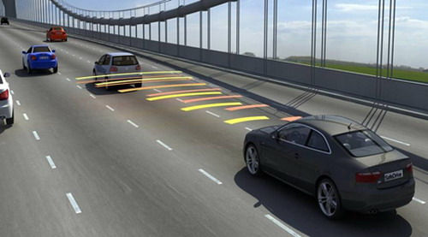
Smart Rear-End Collision Prevention and AI Violation Detection System for Night time Highways
AI-Enhanced Road Safety Using Ultrasonic Sensors, ESP32, & HTTP RealTime Web Alerts
IOT Fundamentals
ECE3501

Slide 3
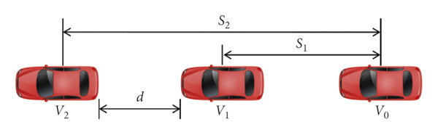
Ultrasonic sensor 1 will record the time-stamp at which Car A passed it, and a fixed distance Ultrasonic sensor 2 will record time-stamp at which Car A passes it
Speed of Car A = Distance between Sensor 1 and 2
Timestamp at Sensor 1 – Timestamp at Sensor 2
A COST-EFFECTIVE METHOD OF CALCULATING SPEED

Slide 4
REVIEW-I FEEDBACK:
Feedback Received:
1. Focus More on V2V Inter Communication
2. Efficient More When Driver is Getting Feedback About the surrounding in Dark/Foggy Highways.

Slide 5
OBSERVATION:
TESLA USES INDUSTRY GRADE 360 degrees LIDAR Cameras for Automated Self Driving Mechanism, Car’s Awareness on Road.
ADAS in cars and Bikes is still a Premium Feature.
Cheaper Alternative will Cater to the People who are more prone to accidents in Foggy and Night-Time Environments.

Slide 6
REFACTORED APPROACH:
Smart Rear-End Collision Prevention for Foggy/Night time Highways
Prioritised V2V Vehicle Communication.
Incorporated RealTime Driver Update Interface for Timely Updates.

Slide 7
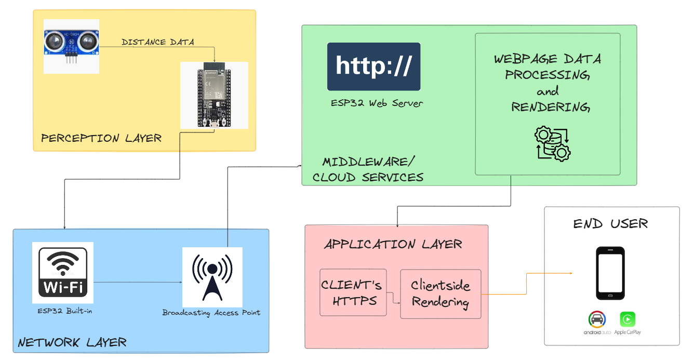
ARCHITECTURE DIAGRAM

