Slide 1




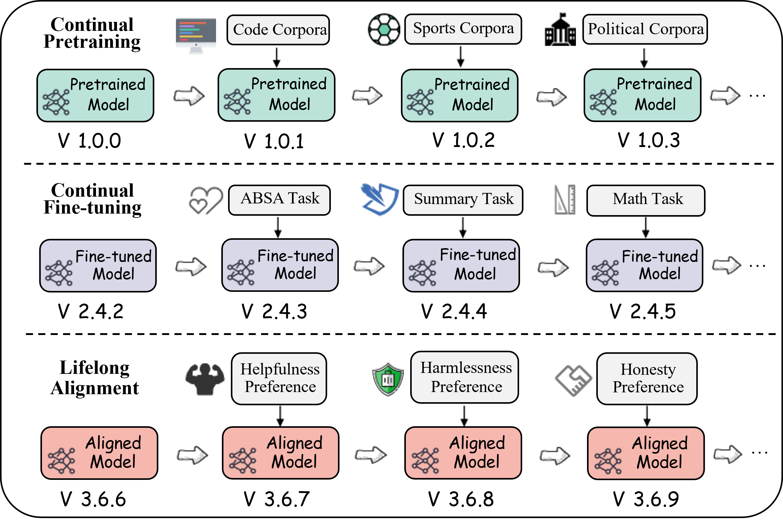
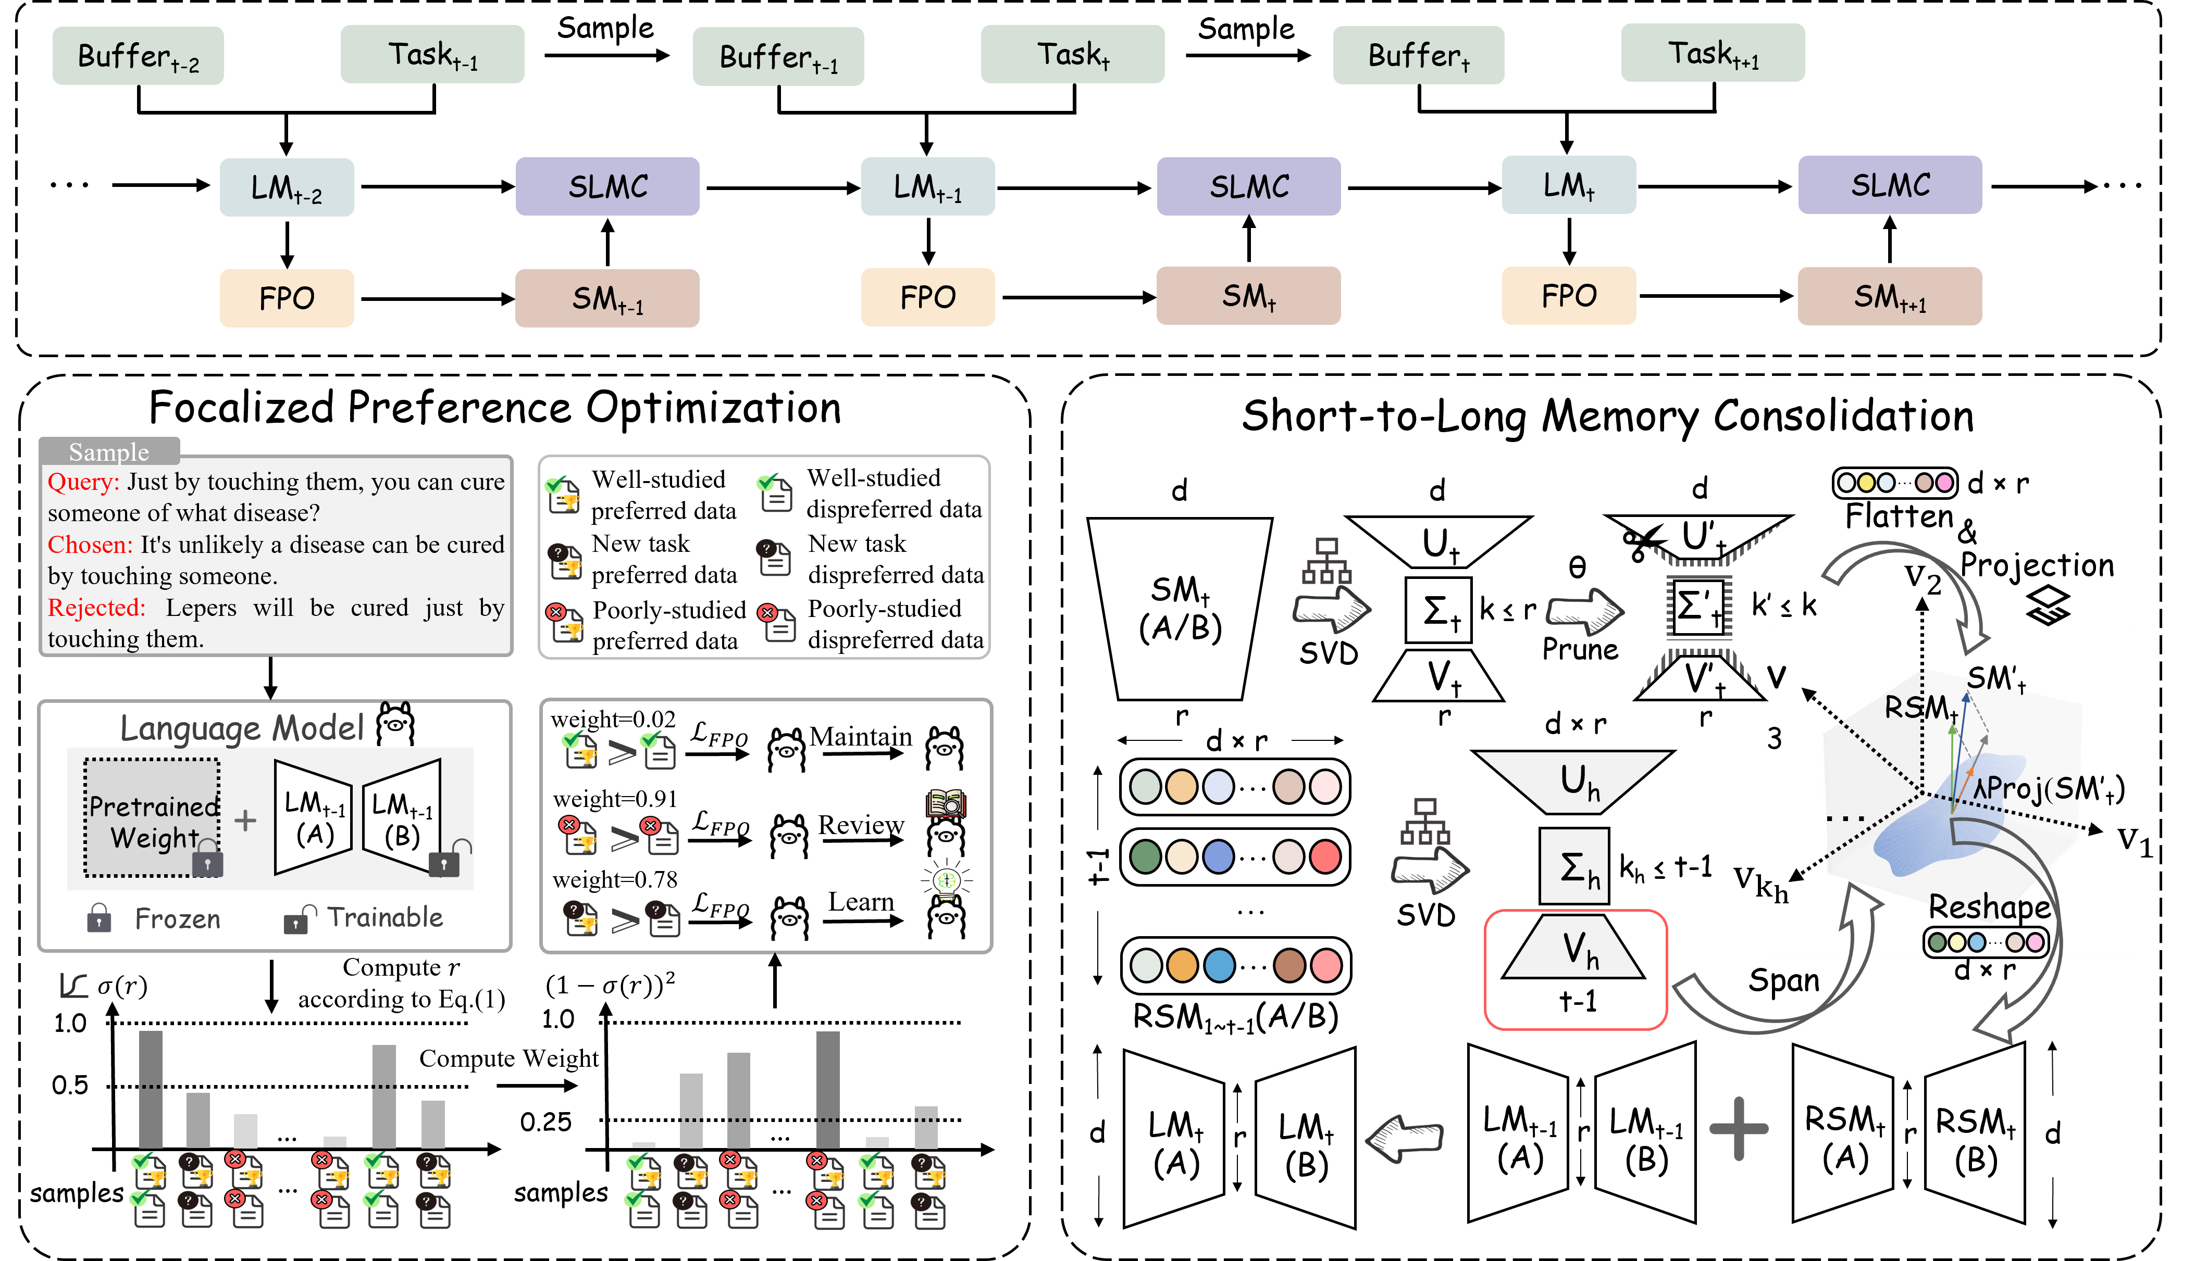
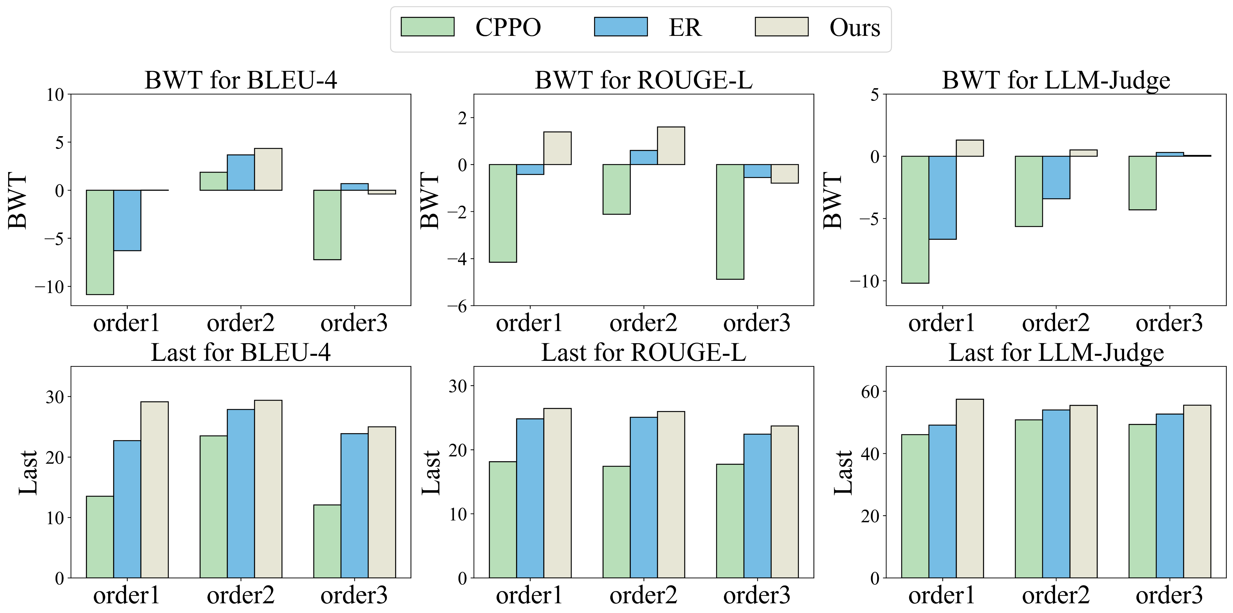
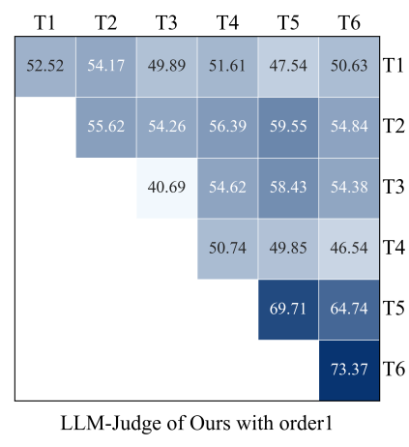
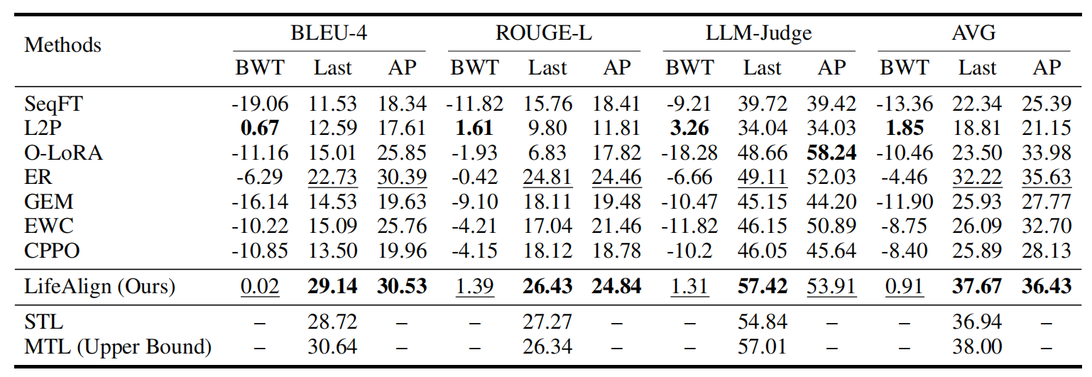
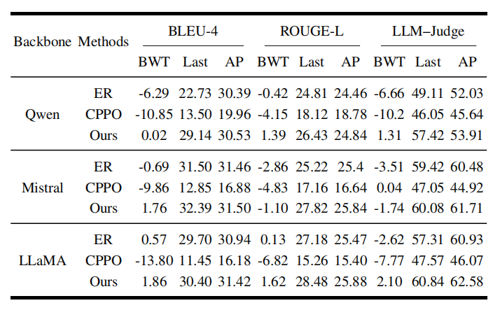
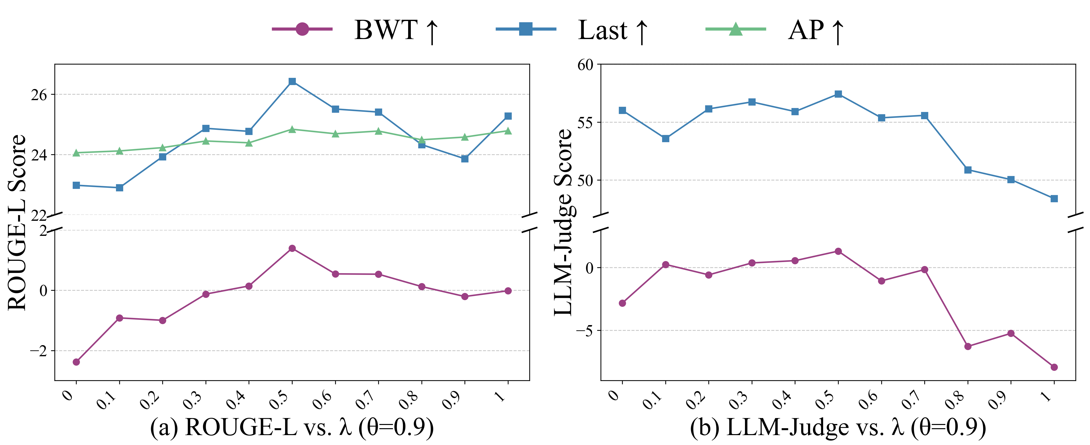
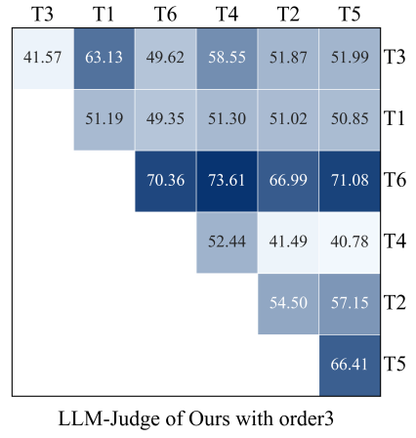
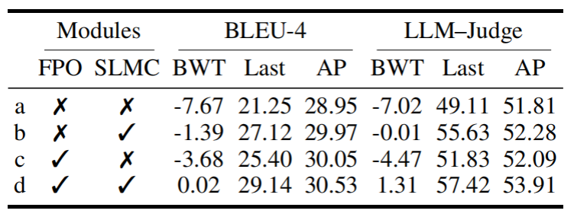
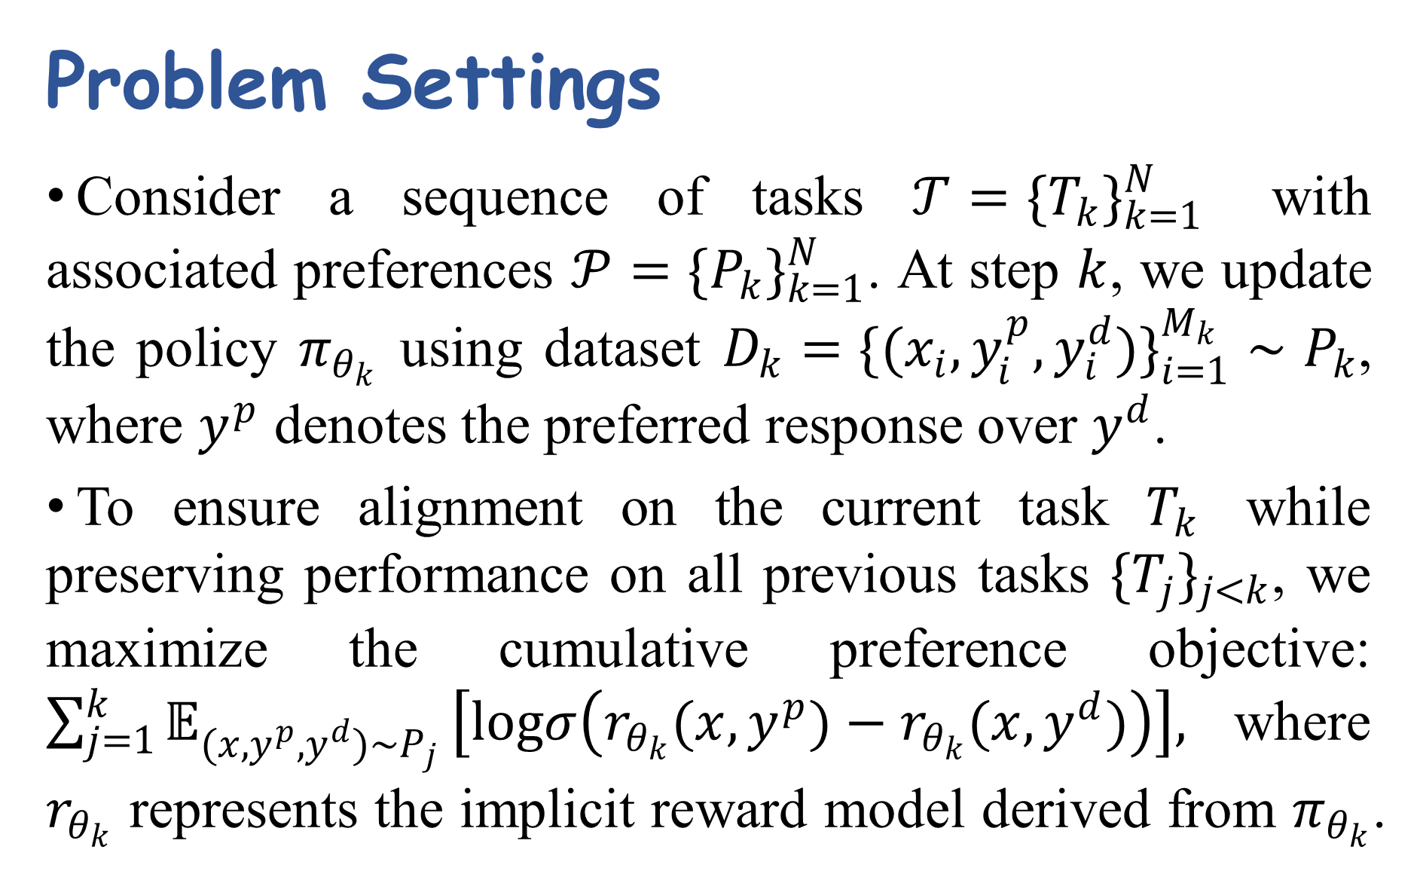

LifeAlign: Lifelong Alignment for Large Language Models with Memory-Augmented Focalized Preference Optimization
Junsong Li¹, Jie Zhou*¹, Bihao Zhan¹, Yutao Yang¹, Qianjun Pan¹,
Shilian Chen¹, Tianyu Huai¹, Xin Li², Qin Chen¹, Liang He¹
¹School of Computer Science and Technology, East China Normal University
²Shanghai AI Laboratory
Background & Motivation
1. Mitigating Catastrophic Forgetting: LLMs suffer from catastrophic forgetting during sequential alignment, often losing previously acquired values when adapting to new domains.
2. Filling the Gap in Lifelong Alignment: Current continual learning research predominantly focuses on continual pre-training(CPT) and continual fine-tuning(CFT), leaving the critical area of lifelong preference alignment largely unexplored.
3. Unlike simple knowledge injection (SFT), enabling a model to adapt to new preference distributions without compromising its ability to judge old preferences due to parameter updates is a challenging technical problem.
Problem Settings
Consider a sequence of tasks $𝒯=\{T_{k}\}_{k=1}^{N}$ with associated preferences $𝒫=\{P_{k}\}_{k=1}^{N}$. At step $k$, we update the policy $π_{θ_{k}}$ using dataset $D_{k}=\{(x_{i},y_{i}^{p},y_{i}^{d})\}_{i=1}^{M_{k}}∼P_{k}$, where $y^{p}$ denotes the preferred response over $y^{d}$.
To ensure alignment on the current task $T_{k}$ while preserving performance on all previous tasks $\{T_{j}\}_{j<k}$, we maximize the cumulative preference objective: $\sum_{j=1}^{k}{𝔼_{(x,y^{p},y^{d})∼P_{j}}}\left[logσ\left(r_{θ_{k}}(x,y^{p})−r_{θ_{k}}(x,y^{d})\right)\right],$where $r_{θ_{k}}$ represents the implicit reward model derived from $π_{θ_{k}}$.
Metrics
The performance on task $j$ after training to task $i,$denoted as $m_{i,j}$
BWT: backward transfer, $BWT=\frac{1}{N−1}\sum_{i=1}^{N−1}{\left(m_{N,i}−m_{i,i}\right);}$
Last: last performance, $Last=\frac{1}{N}\sum_{i=1}^{N}{m_{N,i}}$;
AP:$average performance, AP=\frac{1}{N}\sum_{k=1}^{N}{\frac{1}{k}\sum_{i=1}^{k}{m_{k,i}}}$.
Two Components
Focalized Preference Optimization: One of the core challenges in lifelong alignment is that standard, static loss functions are ill-suited for a dynamic learning process. We extend DPO by gating the implicit reward difference. This mechanism adaptively amplifies learning signals for new or forgotten samples while silencing the loss for well-mastered ones, thereby preserving model performance.
Short-to-Long Memory Consolidation: While FPO targets specific preferences, raw parameter updates can still trigger forgetting. Inspired by human memory consolidation, we introduce the Short-to-Long Memory Consolidation (SLMC) module to stabilize these transient updates. By refining parameters through denoising and projection, SLMC integrates new knowledge without conflicting with established capabilities, ensuring robust lifelong alignment.
Performance Comparison with State-of-the-arts:
LifeAlign achieves state-of-the-art performance across almost all metrics, with scores rivaling the MTL upper bound.
Impact of Task Order
Detailed Performance
Impact of Hyperparameters
Ablation Study
Shanghai, 200062, China
junsong-li@stu.ecnu.edu.cn

