Slide 1
Project 0
Aaron Chee

Slide 2

Agenda
Purpose of these variables
Analyze the data
Q&A

Slide 3



Background: Tech Stack Used
MySQL
Microsoft Excel
Google BigQuery

Slide 4

Questions
What are the average scores across subjects of students grouped by year_group?
What are the average scores across subjects of students grouped by gender?
How does parental_level_of_education affect student test scores?

Slide 5
Questions
How well did the test_preparation_course help students?
Is there a relationship between student test scores and lunch plans?
Is there a significant difference in average test scores based on gender? Is it related to parents education? Is it related to lunches?

Slide 6



Understanding the variables
Students have a one-to-many relationship with exams and its results. They also have a many-to-many relationship with subjects.
Parents are not included in this dataset.
Exam results are the fact table. This describes the results from the students. It contains foreign keys that connect to other tables or entities that have the related primary key.

Slide 7

Understanding the variables
Student_ID: Unique identification combination that serves as a primary key in majority of the tables.
Results_ID: A surrogate key that is inserted into the fact table
Test_ID: A surrogate key inserted into a standalone table or entity.

Slide 8
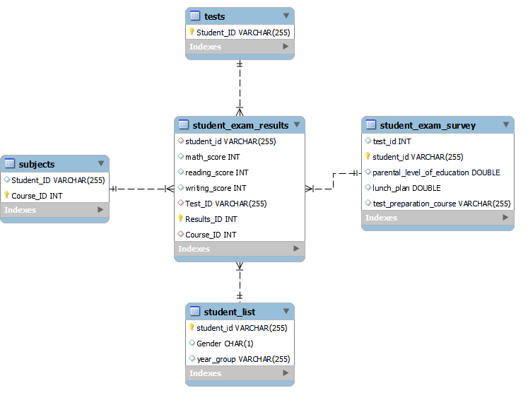
ERD
Based on a star schema design, this ERD has the following outline:
Fact Table: student_exam_results
Dimension tables:
Student_exam_survey
Subjects
Student_list
Tests

Slide 9
Average by year_group

Slide 10
Lunch Plan

Slide 11
Correlation

Slide 12
Correlation

Slide 13
Correlation

Slide 14
Average test scores with test prep course

Slide 15
Average test scores with no test prep course

Slide 16
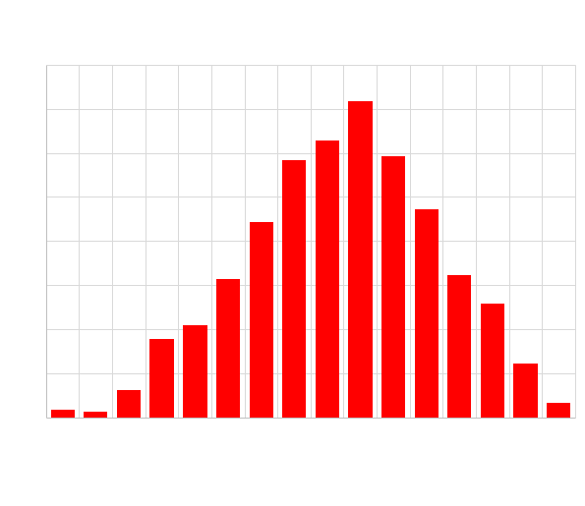
Math_Score Histogram

Slide 17
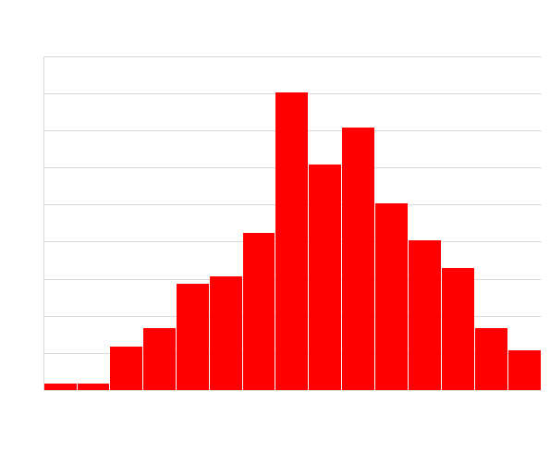
Writing_score histogram

Slide 18
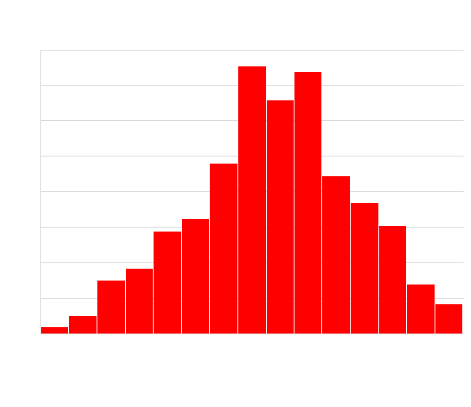
Reading_score histogram

Slide 19
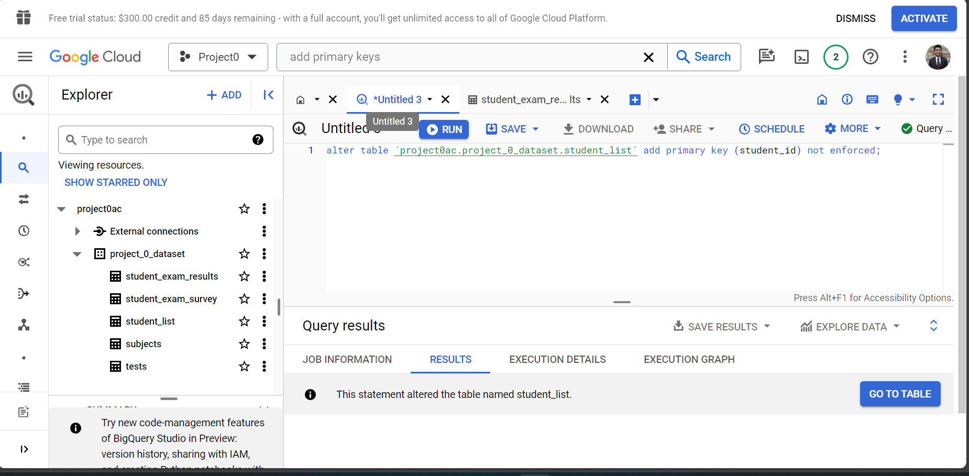
Setting Primary Keys in BigQuery

Slide 20
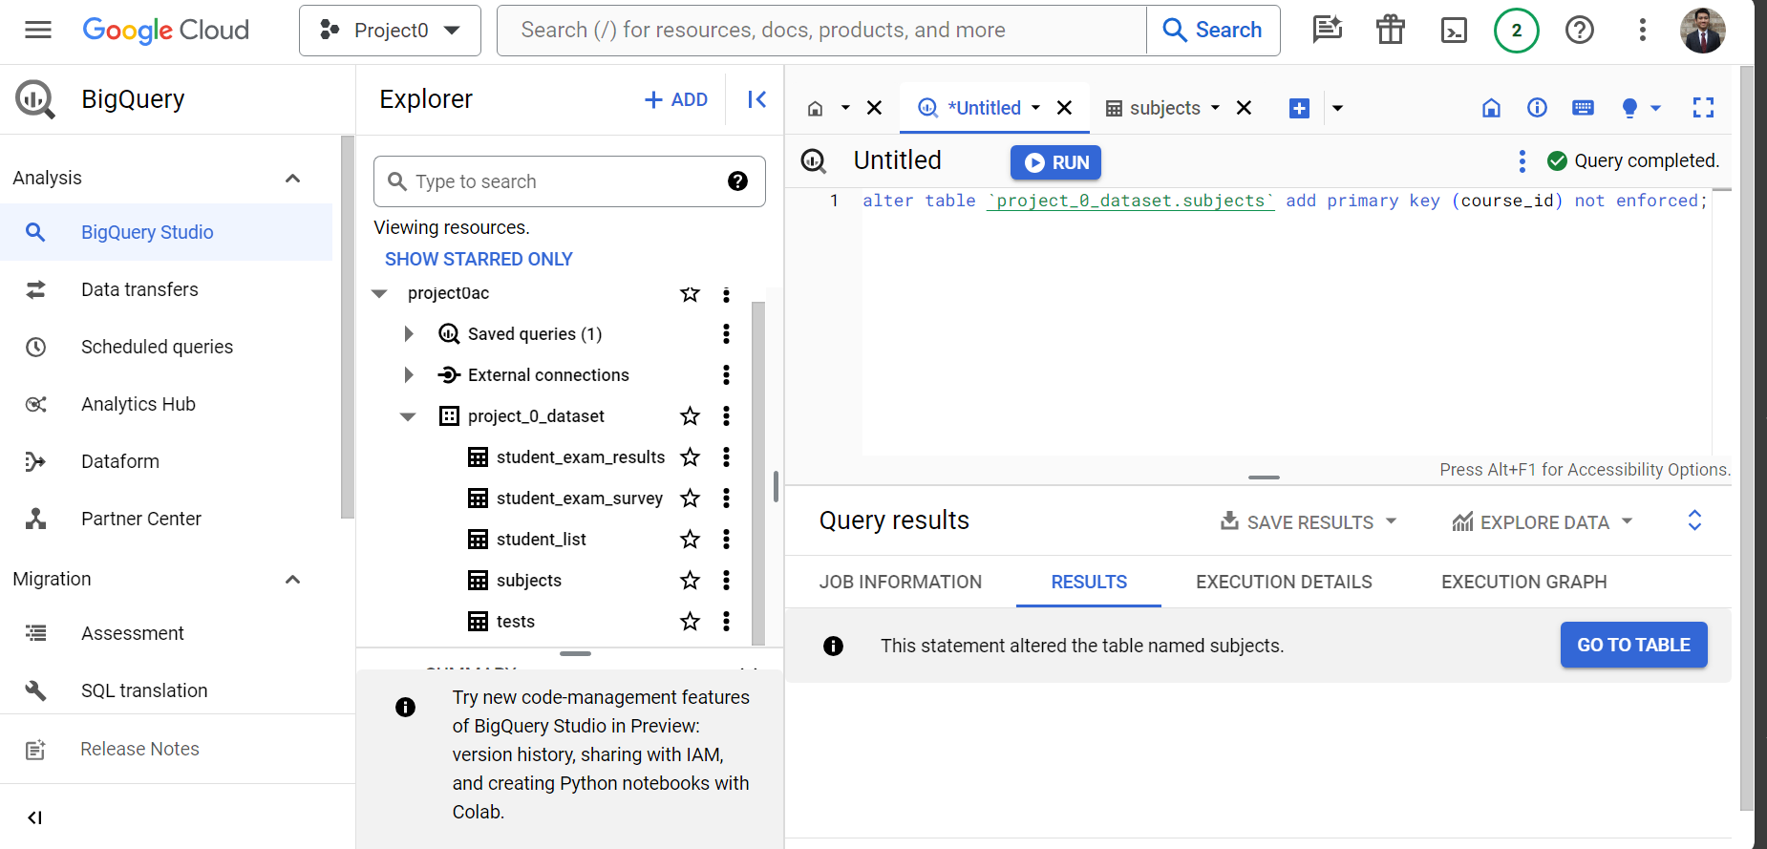
Setting Primary Keys in BigQuery

Slide 21
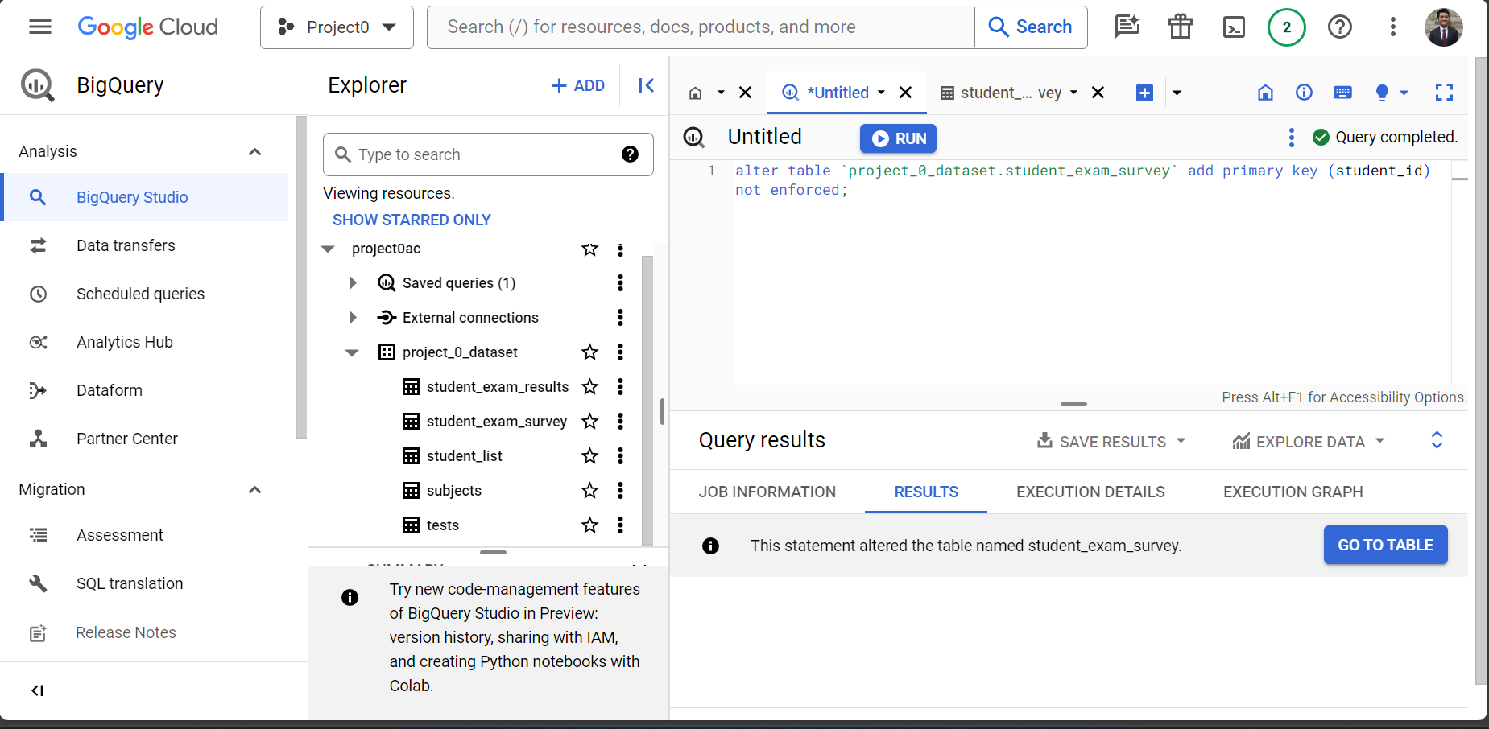
Setting Primary Keys in BigQuery

Slide 22
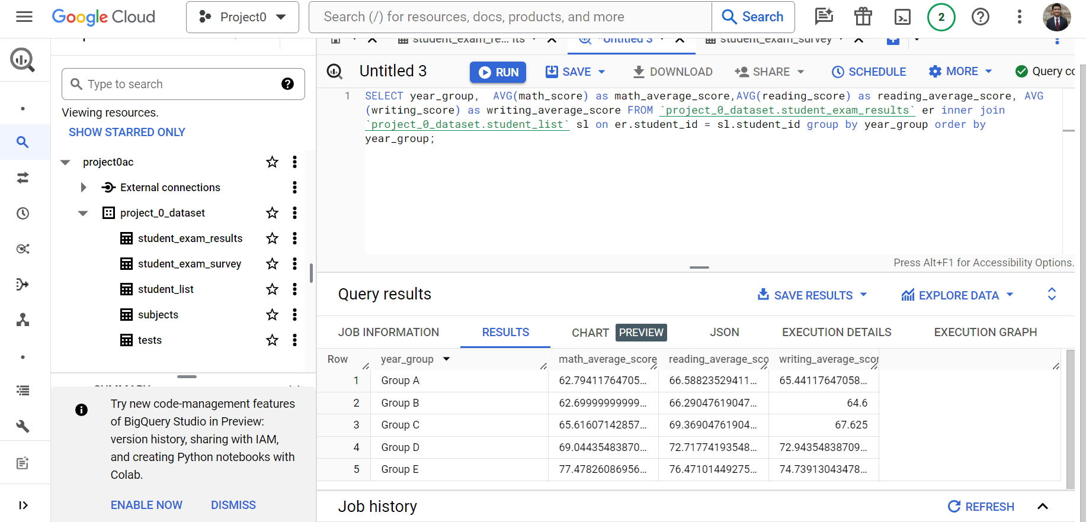
Finding the average grouped by year group

Slide 23
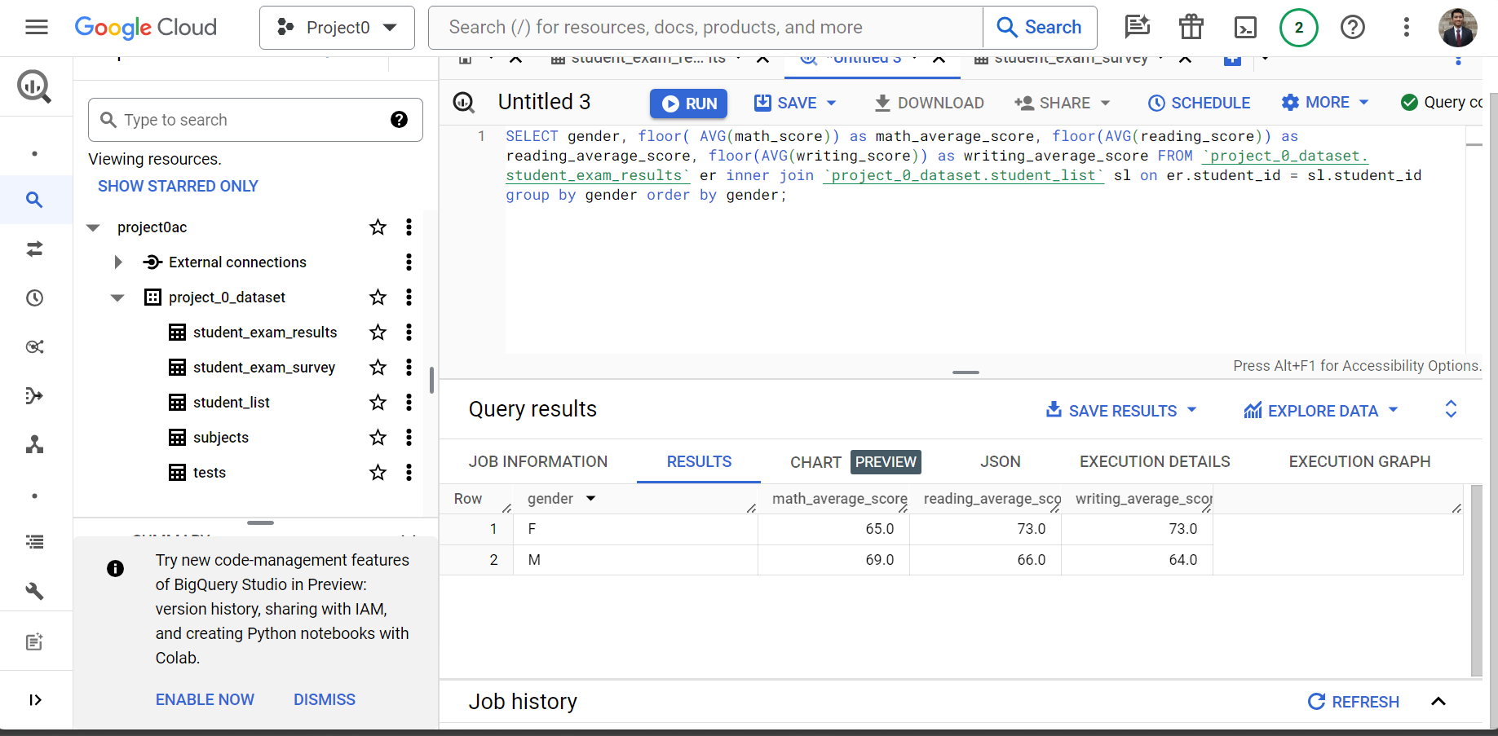
Finding the average grouped by gender

Slide 24
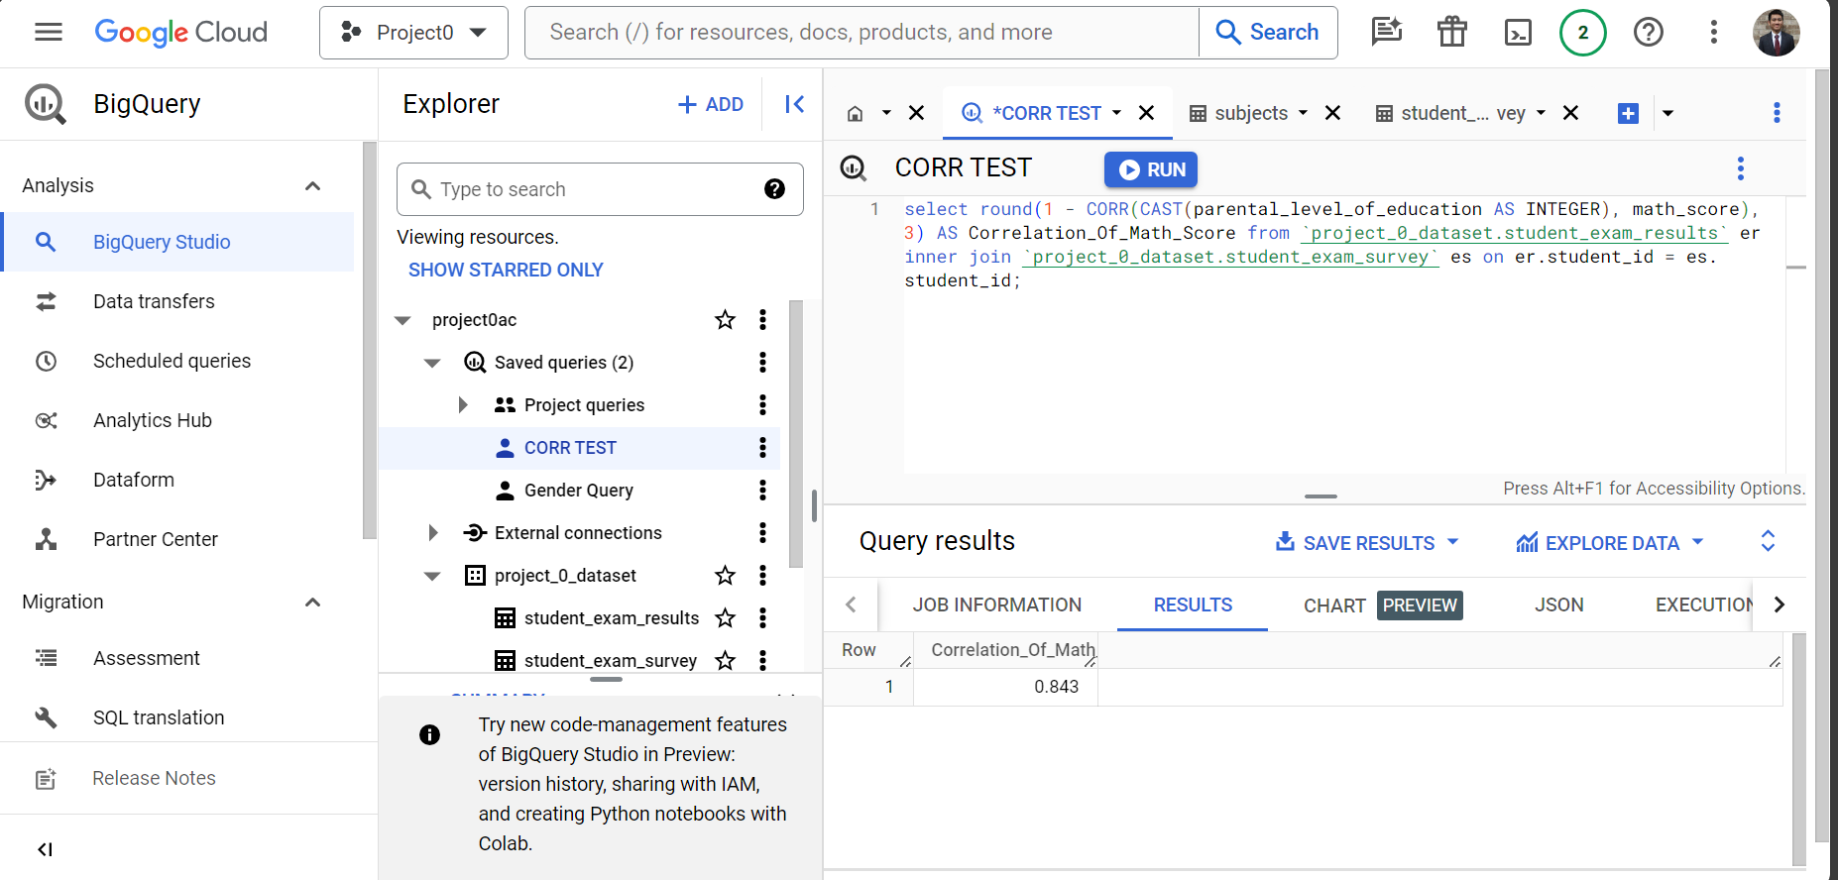
Correlation: education and math score

Slide 25
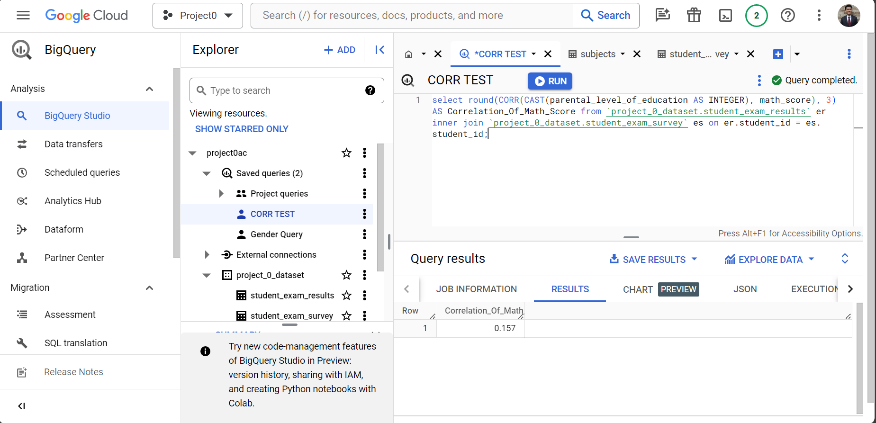
Correlation: education and math score

Slide 26
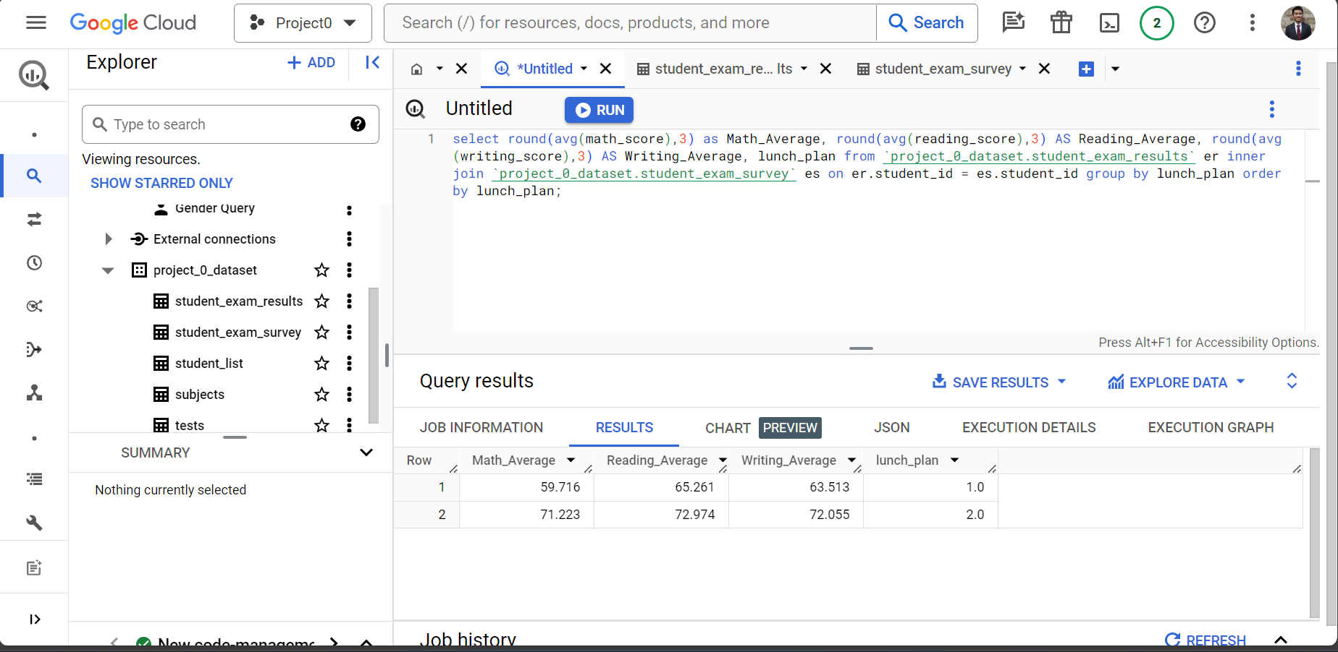
Impact of lunch_plan on test scores

Slide 27
Live Demo
Using BigQuery

Slide 28
Summary of analysis
Test Preparation does help improve test score averages
A trend is evident between parental_level_of_education and average test scores across subjects
Lunch plans have little to no influence on average test score averages
Different subject test scores are influenced by gender

Slide 29
Q&A

Slide 30
Thank you
Aaron Chee

