Slide 1
Project 0
Aaron Chee

Slide 2

Agenda
Purpose of these variables
Analyze the data
Q&A

Slide 3
Tech Stack

Slide 4



Background: Tech Stack Used
MySQL
Microsoft Excel
Google BigQuery

Slide 5
Questions

Slide 6

Questions
What are the average scores across subjects of students grouped by year_group?
What are the average scores across subjects of students grouped by gender?
How does parental_level_of_education affect student test scores?

Slide 7
Questions
How well did the test_preparation_course help students?
Is there a relationship between student test scores and lunch plans?
Is there any correlation between lunch plans and test averages? How about any correlation between test averages and parental_level_education?

Slide 8
Variables

Slide 9



Understanding the variables
Students have a one-to-many relationship with exams and its results. They also have a many-to-many relationship with subjects.
Parents are not included in this dataset.
Exam results are the fact table. This describes the results from the students. It contains foreign keys that connect to other tables or entities that have the related primary key.

Slide 10

Understanding the variables
Student_ID: Unique identification combination that serves as a primary key in majority of the tables.
Results_ID: A surrogate key that is inserted into the fact table
Test_ID: A surrogate key inserted into a standalone table or entity.

Slide 11
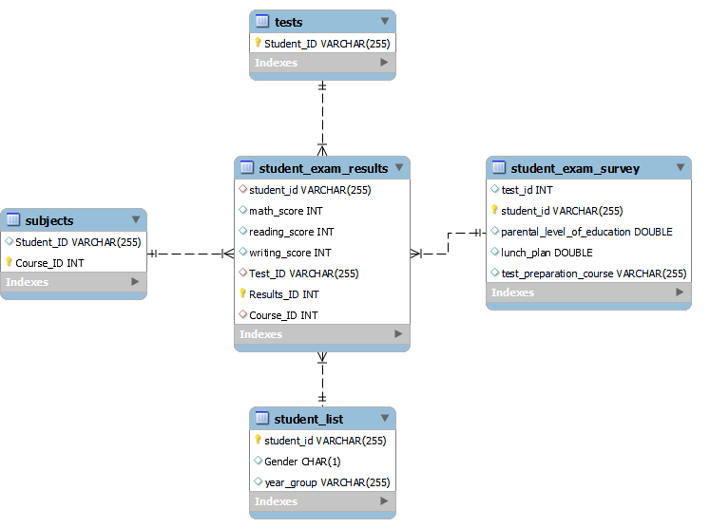
ERD
Based on a star schema design, this ERD has the following outline:
Fact Table: student_exam_results
Dimension tables:
Student_exam_survey
Subjects
Student_list
Tests

Slide 12
Analysis

Slide 13
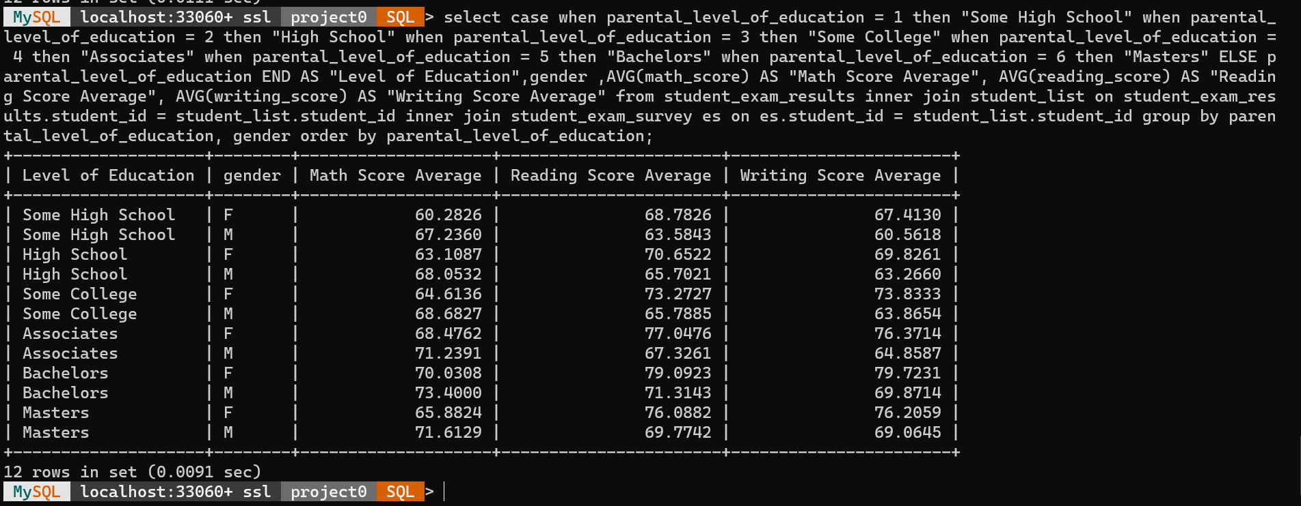
mySQL generated values

Slide 14
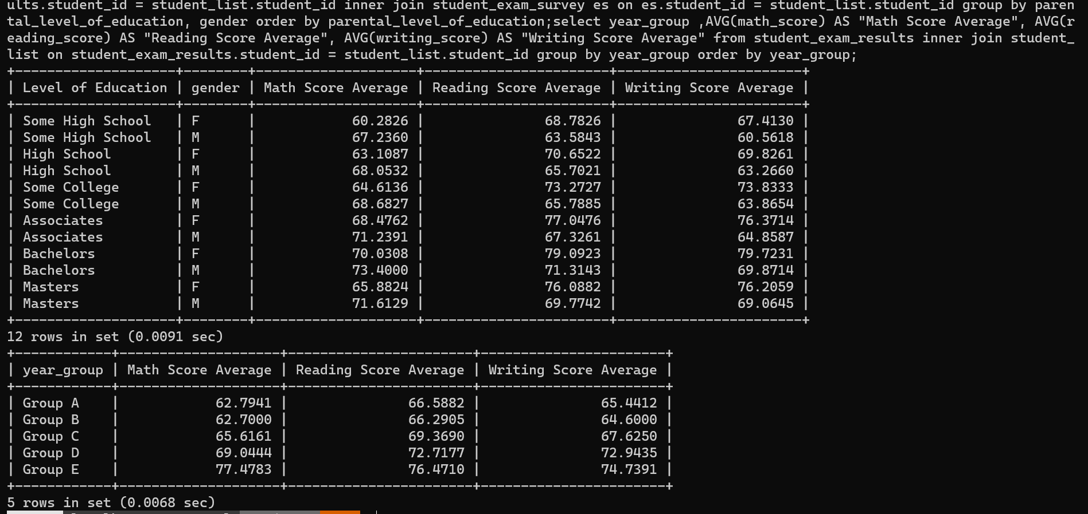
mySQL generated values

Slide 15
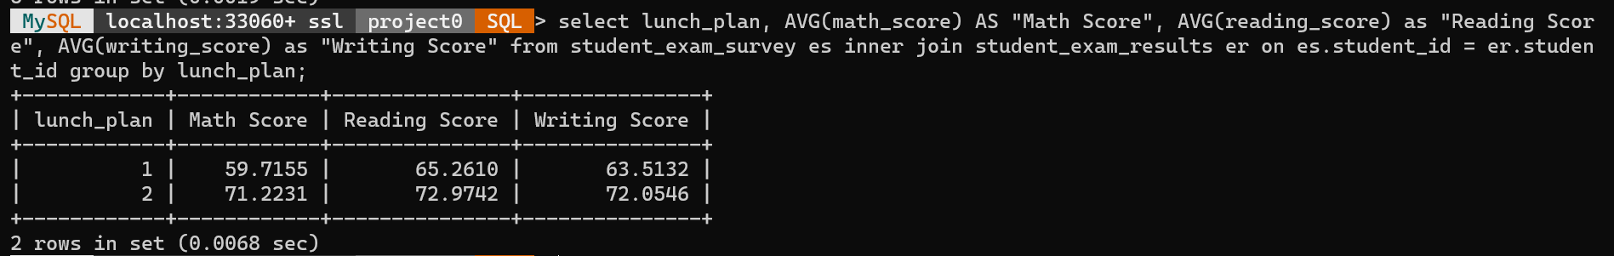
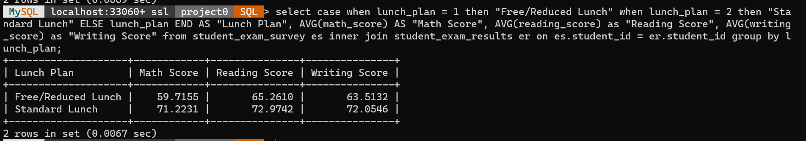
mySQL generated values

Slide 16
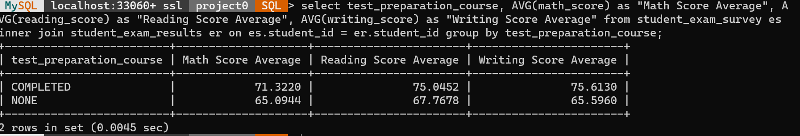
mySQL generated values

Slide 17
Average by year_group

Slide 18
Lunch Plan

Slide 19
Correlation

Slide 20
Correlation

Slide 21
Correlation

Slide 22
Average test scores with test prep course

Slide 23
Average test scores with no test prep course

Slide 24
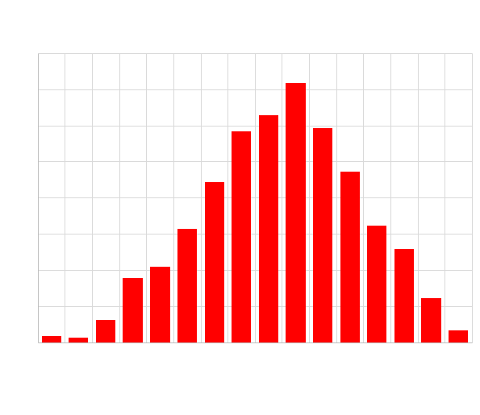
Math_Score Histogram

Slide 25
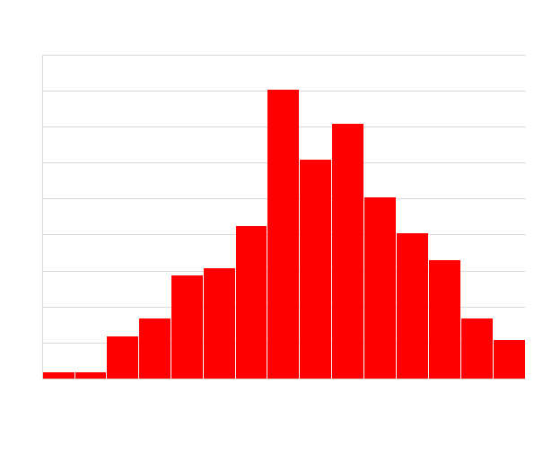
Writing_score histogram

Slide 26
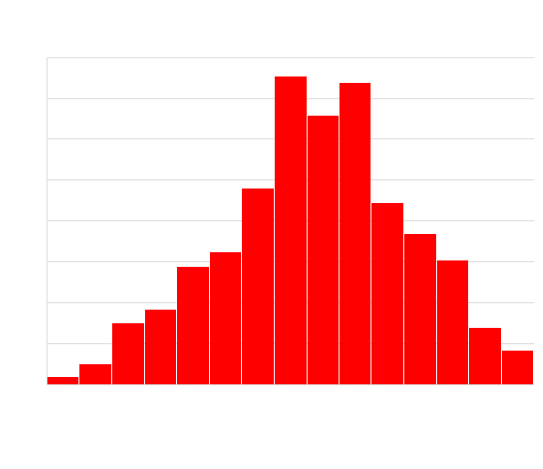
Reading_score histogram

Slide 27
BigQuery
Screenshots of previous queries

Slide 28
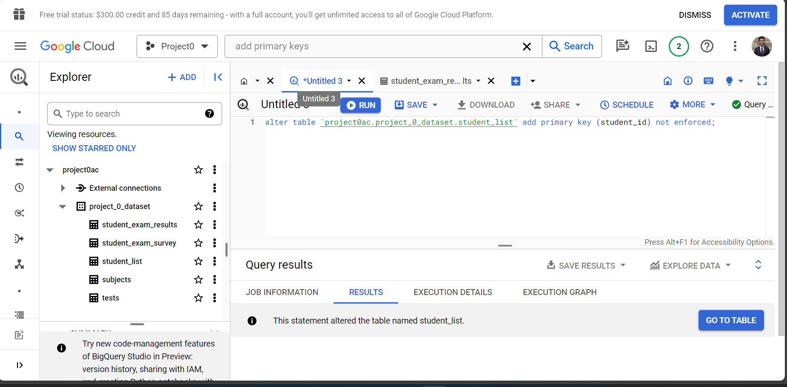
Setting Primary Keys in BigQuery

Slide 29
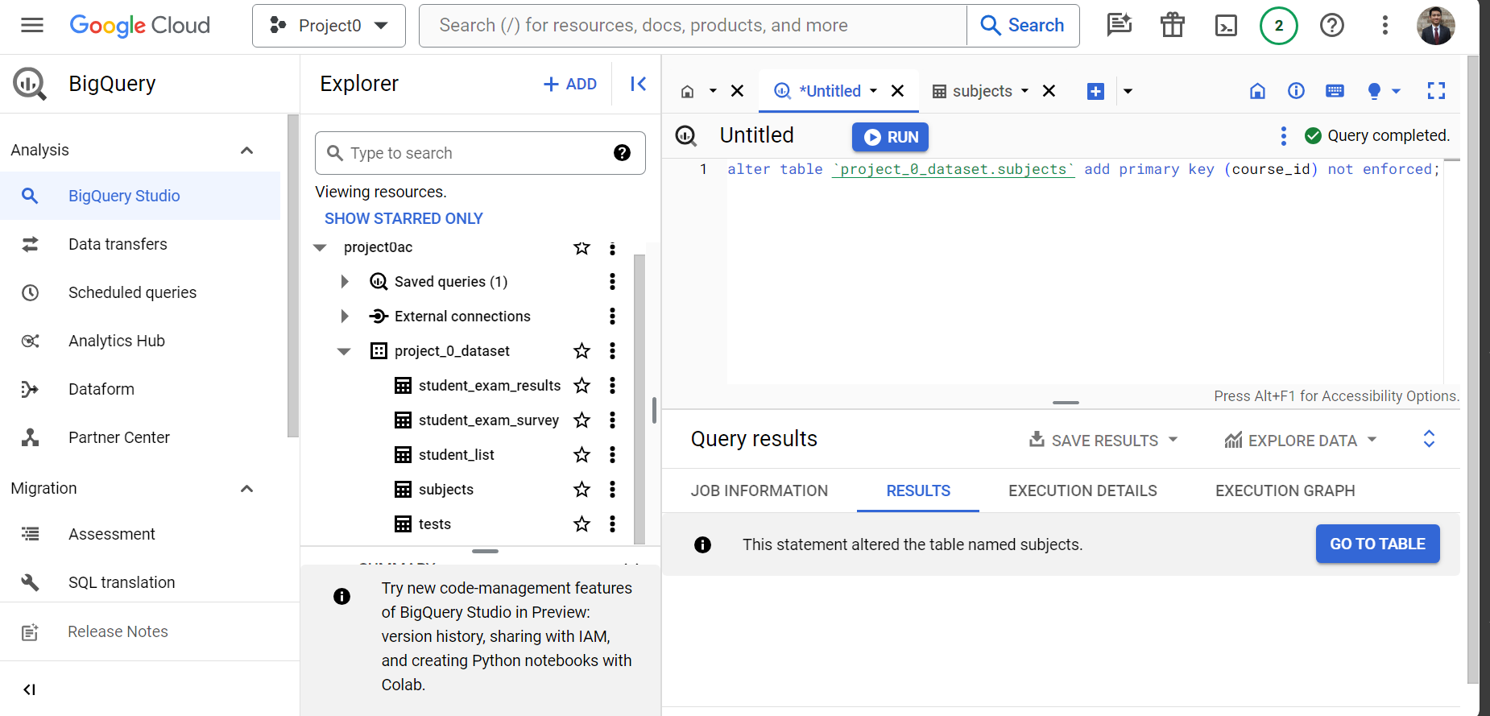
Setting Primary Keys in BigQuery

Slide 30
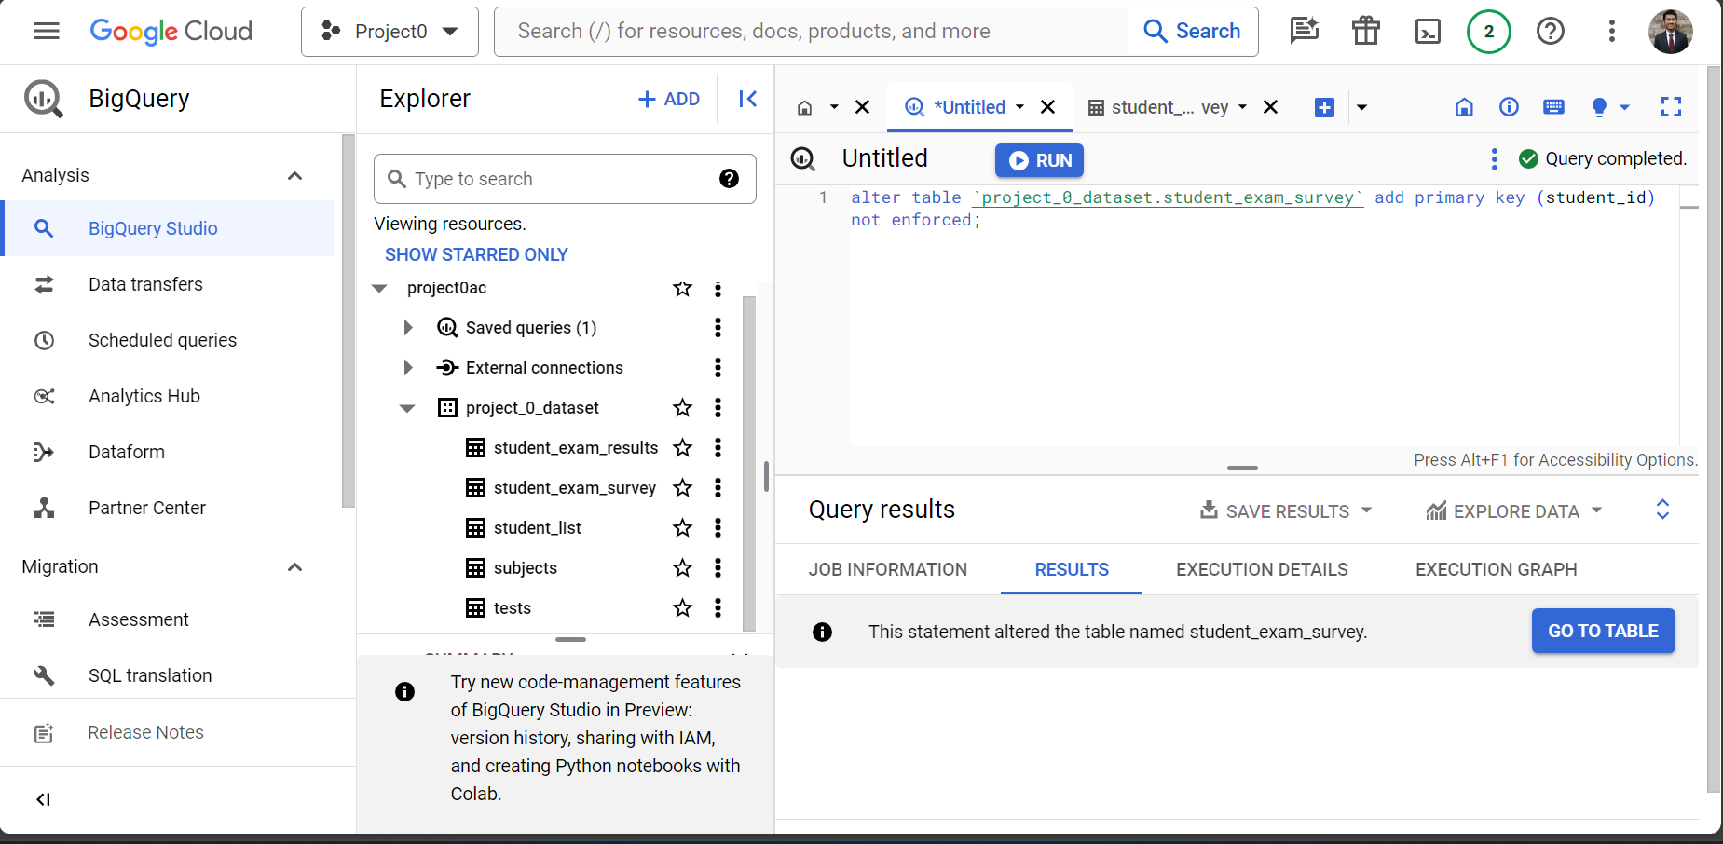
Setting Primary Keys in BigQuery

Slide 31
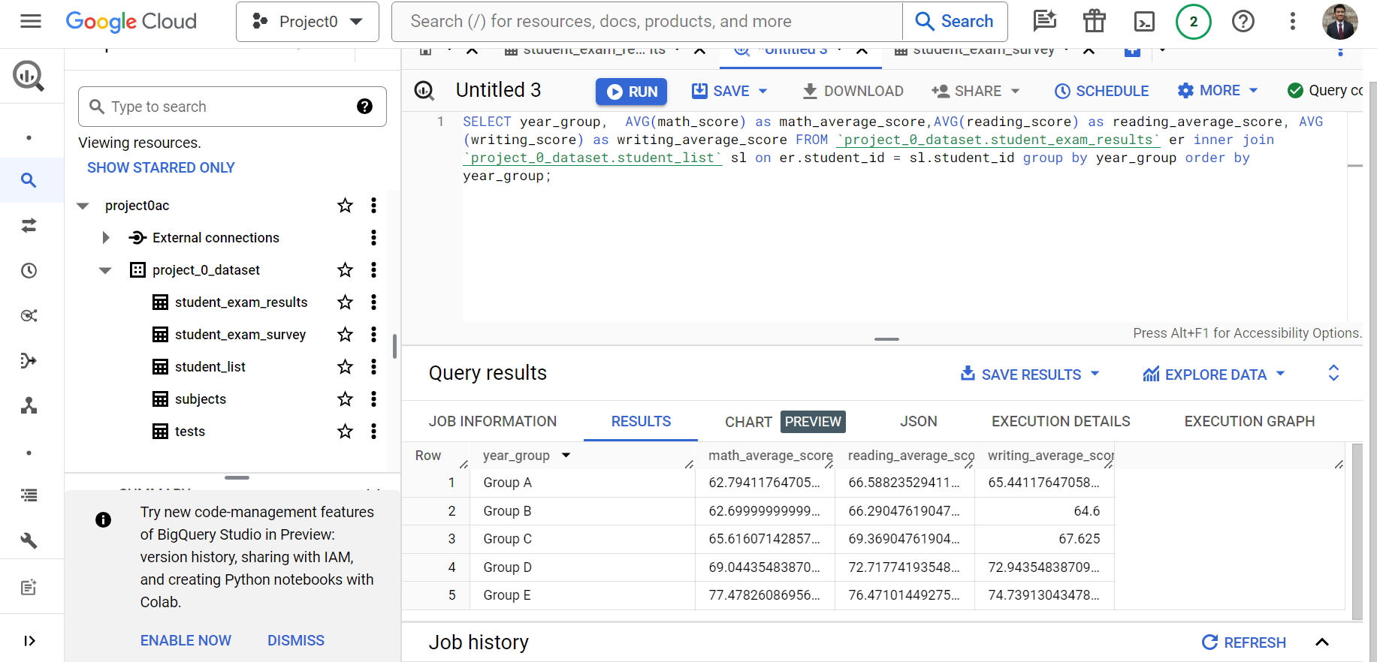
Finding the average grouped by year group

Slide 32
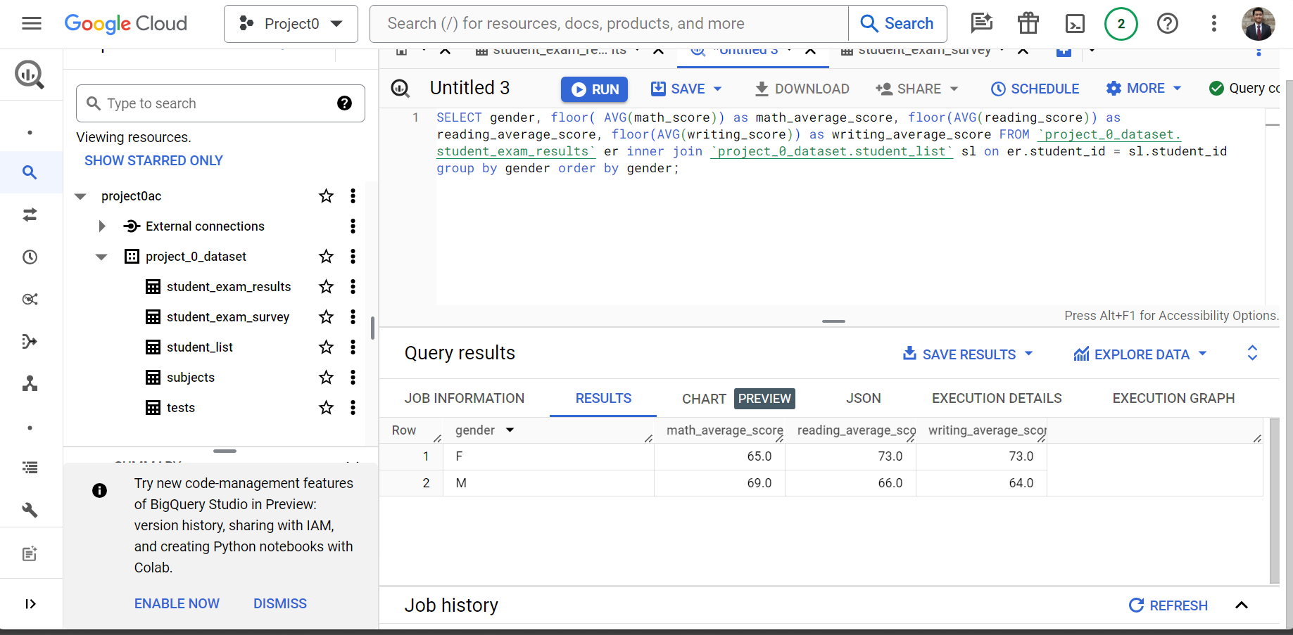
Finding the average grouped by gender

Slide 33
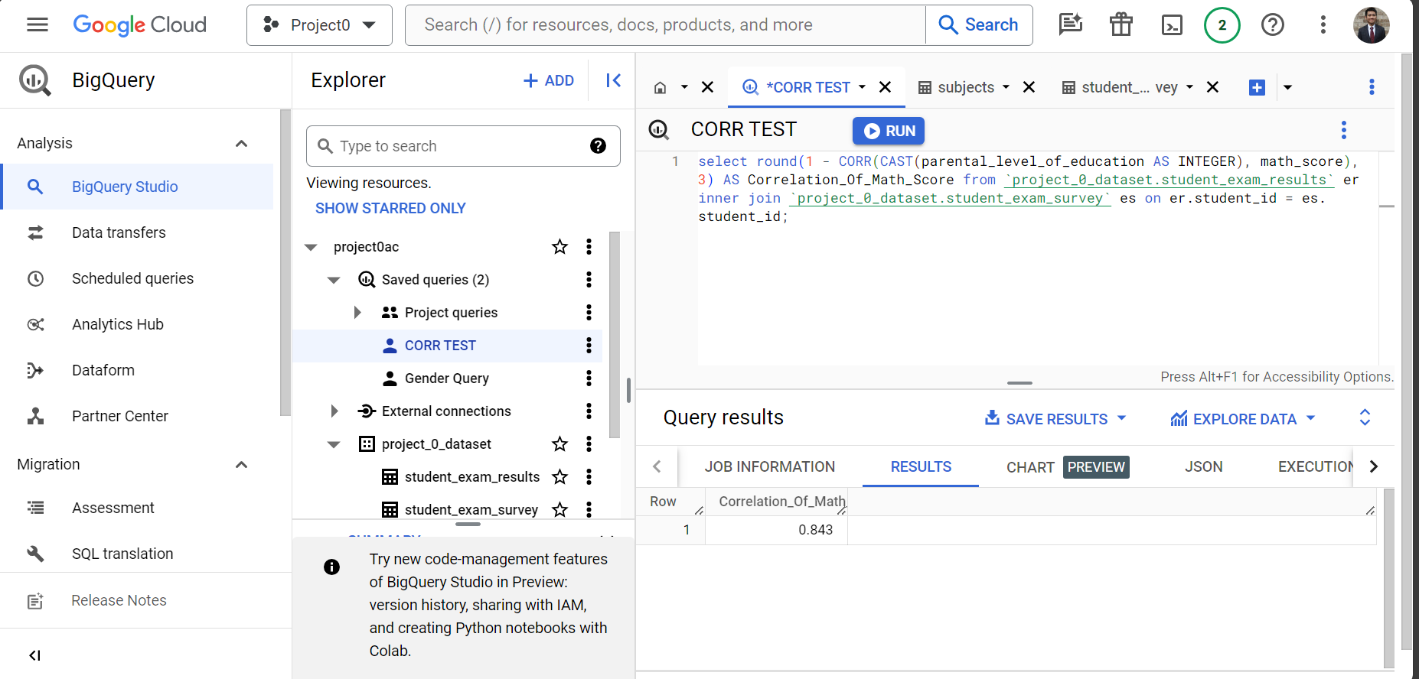
Correlation: education and math score

Slide 34
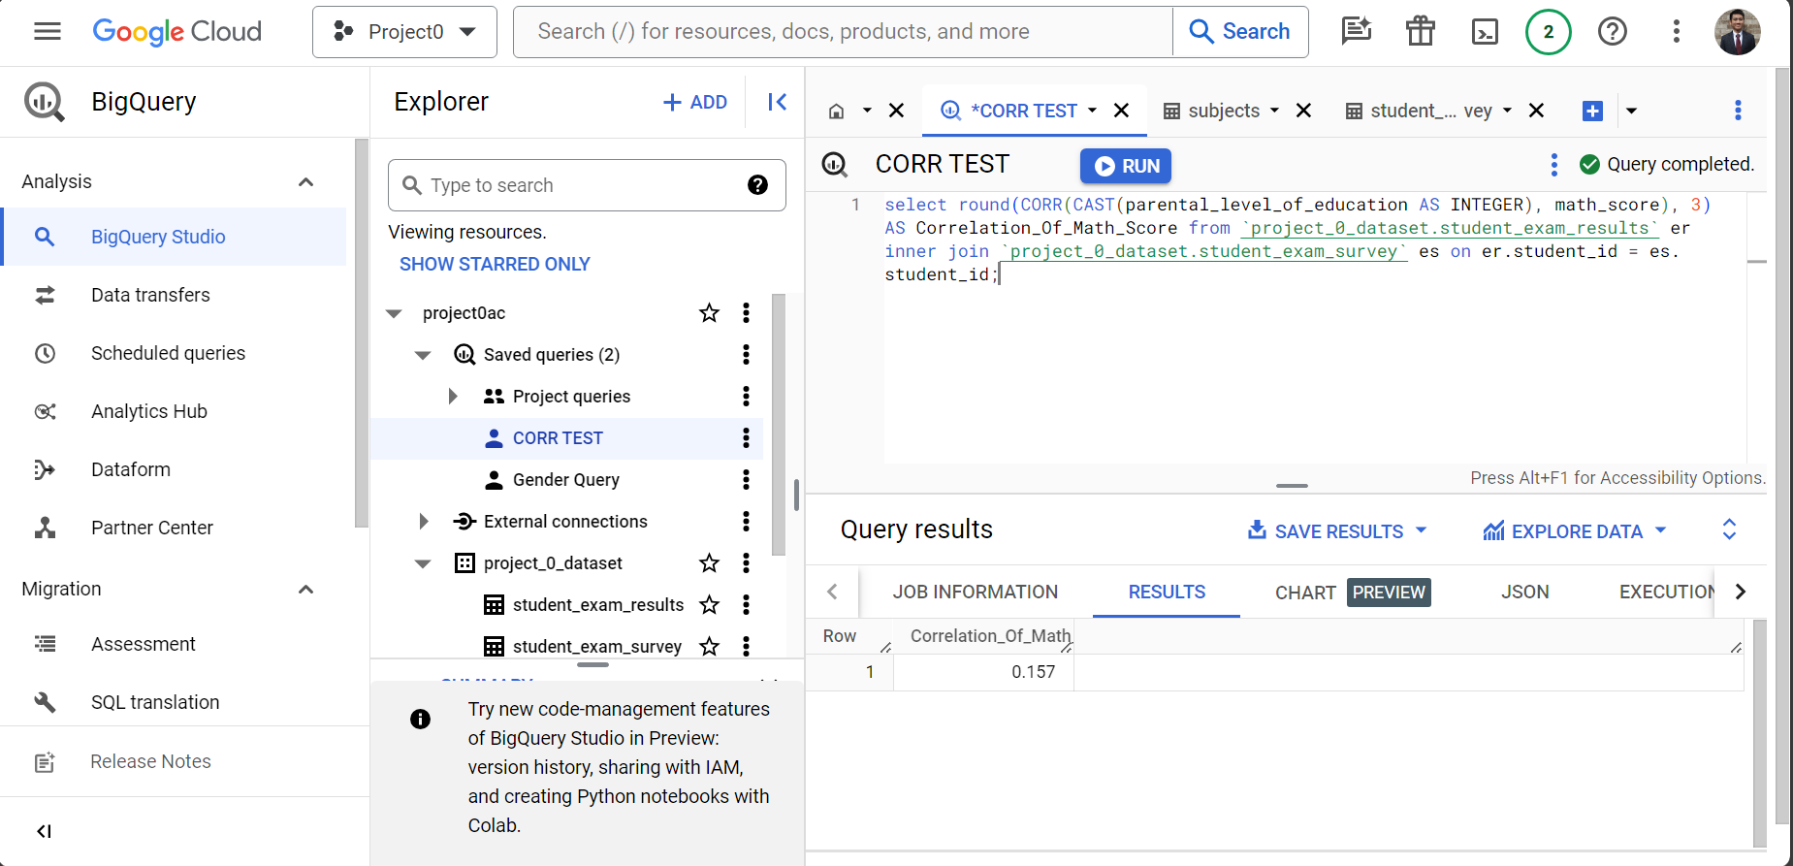
Correlation: education and math score

Slide 35
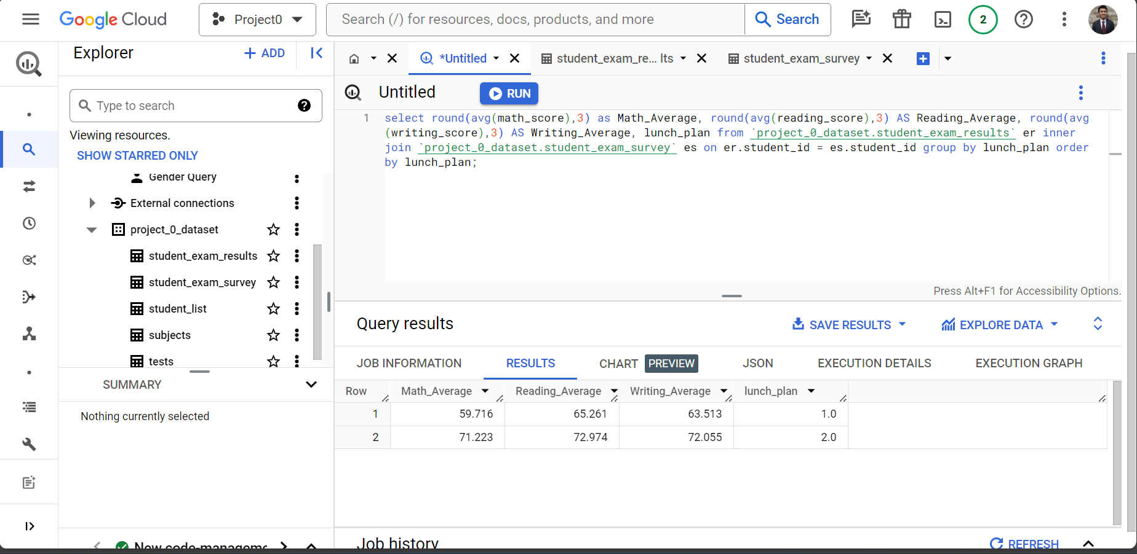
Impact of lunch_plan on test scores

Slide 36
Live Demo
Using BigQuery

Slide 37
Summary of analysis
Test Preparation does help improve test score averages
A trend is evident between parental_level_of_education and average test scores across subjects
Lunch plans have little to no influence on average test score averages
Different subject test scores are influenced by gender

Slide 38
Q&A

Slide 39
Thank you
Aaron Chee

