Slide 1
Functions 1

Slide 2
Definition
A function is a rule that receives an input and produces an output.
Input
Function
Output

Slide 3
For a rule to be a function, it is crucial that only one output is possible for any given input.
The input to a function can usually take many values and so is called a variable.
The output depends on the value of the input and so will also take many values and will also be a variable.
The input variable can also be referred to as the independent variable and the output is referred to as the dependent variable.

Slide 4
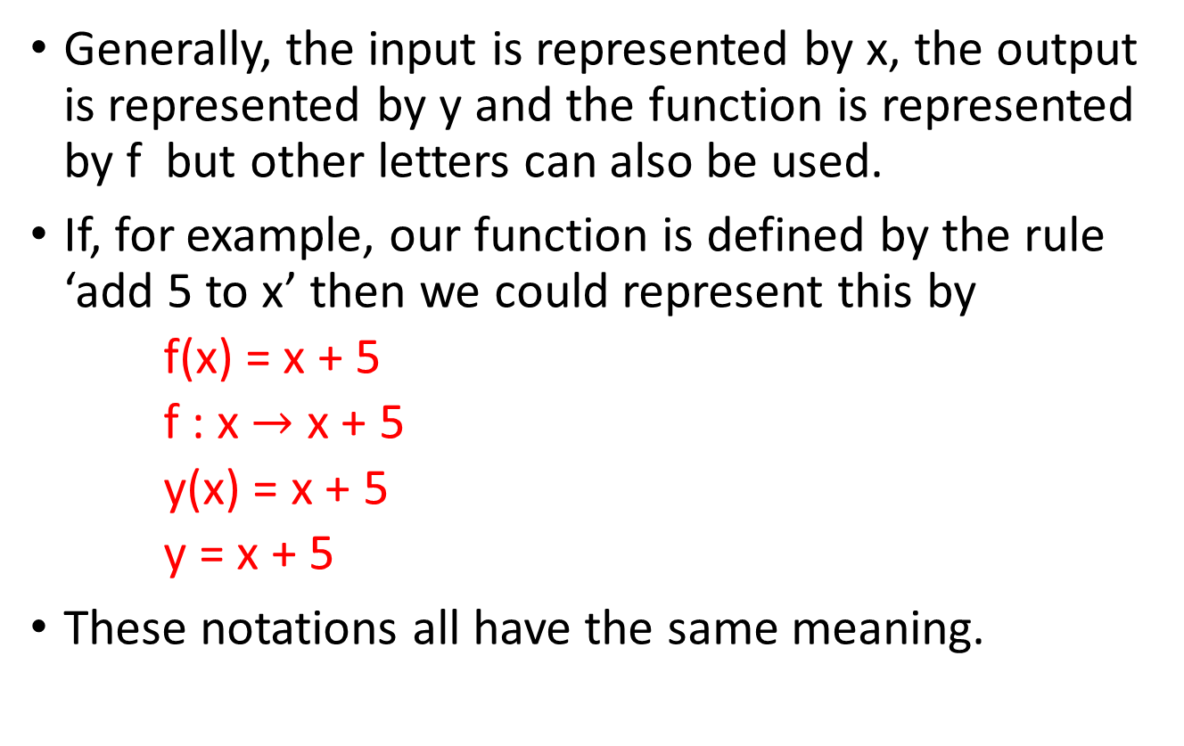
Notation
Generally, the input is represented by x, the output is represented by y and the function is represented by f but other letters can also be used.
If, for example, our function is defined by the rule ‘add 5 to x’ then we could represent this by
f(x) = x + 5
f : x $→$ x + 5
y(x) = x + 5
y = x + 5
These notations all have the same meaning.

Slide 5
Examples
Write the following using function notation:
Multiply the input by 12
f(x) = 12x
Multiply the input by 3 and add 7 to the result
f(x) = 3x +7
Multiply the input by -2 and subtract 5 from the result
f(x) = -2x -5
Square the input, multiply the result by 2 and add 4 times the input to the result
f(x) = 2x² + 4x
The result is 4
f(x) = 4

Slide 6
Generally for a given function, we have to calculate the output for given input values.
To do this we substitute the values for the independent variable to give us the corresponding value for the output or the dependent variable.
Examples
For the following functions find the output for the given input
f(x) = 3x + 7, find f(4), f(2), f(0), f(-1)
f(x) = 2x² + 3x +7, find f(4), f(2), f(0), f(-1)

Slide 7
Example: f(x) = 3x + 7, find f(4),
A function is a rule that receives an input and produces an output.
Input
x = 4
f(x) = 3x + 7
f(4) = 3(4) + 7
Output
f(x) = f(4) = 19

Slide 8
f(x) = 3x + 7, find f(4), f(2), f(0), f(-1)
f(4) = 3(4) + 7 = 12 + 7 = 19
f(2) = 3(2) + 7 = 6 + 7 = 13
f(0) = 3(0) + 7 = 0 + 7 = 7
f(-1) = 3(-1) + 7 = -3 + 7 = 4
f(x) = 2x² + 3x +7, find f(4), f(2), f(0), f(-1)
f(4) = 2(4)² + 3(4) + 7 = 32+12+7 = 51
f(2) = 2(2)² + 3(2) + 7 = 8 + 6 + 7 = 21
f(0) = 2(0)² + 3(0) + 7 = 0 + 0 + 7 = 7
f(-1) = 2(-1)² + 3(-1) + 7 = 2 – 3 +7 = 6

Slide 9
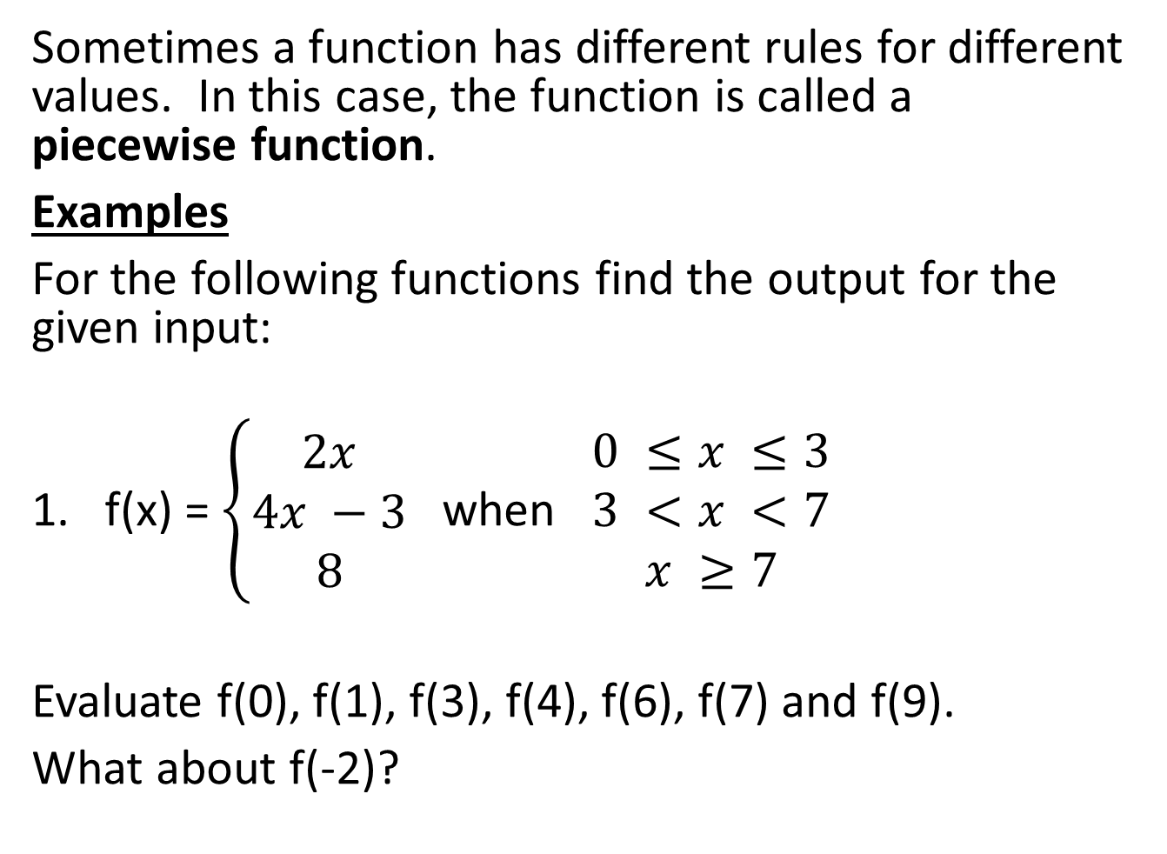
Sometimes a function has different rules for different values. In this case, the function is called a piecewise function.
Examples
For the following functions find the output for the given input:
f(x) = $\left\{\begin{matrix}2x \\ 4x −3 \\ 8\end{matrix}\right.$ when $\begin{matrix}0 ≤x ≤3 \\ 3 <x <7 \\ x ≥7\end{matrix}$
Evaluate f(0), f(1), f(3), f(4), f(6), f(7) and f(9).
What about f(-2)?

Slide 10
f(0) = 2(0) = 0
f(1) = 2(1) = 2
f(3) = 2(3) = 6
f(4) = 4(4) – 3 = 16 – 3 = 13
f(6) = 4(6) – 3 = 24 -3 = 21
f(7) = 8
f(9) = 8
f(-2) is undefined…we can’t work it out.

Slide 11

Try this one
f(x) = $\left\{\begin{matrix}3x^{2} \\ 5x \\ x^{3}\end{matrix}\right.$ when $\begin{matrix}−4 ≤x ≤0 \\ 0 <x <4 \\ x ≥4\end{matrix}$
Evaluate f(-6), f(-4), f(-1), f(0), f(2), f(4) and f(5)

Slide 12
Composite Functions
Sometimes we apply a function to an input value and then apply another function to the output.
For example, if the function f squares the input and the function g multiplies the input by 4 and adds 6 to the result we would have
f(x) = x²
g(x) = 4x +6
f(g(x)) is described as f after g of x
Evaluate f(g(2)) and f(g(4)). What about g(f(2))?

Slide 13
Evaluate f(g(2)) and f(g(4)). What about g(f(2))?
To solve f(g(2)), first find g(2) and then find f of your answer.
f(x) = x²
g(x) = 4x + 6
So g(2) = 4(2) + 6 = 14
and f(g(2)) = f(14) = (14)² = 196.
Solve f(g(4)) ……..first find g(4) and then find f of your answer.
g(4) = 4(4) + 6 = 16 + 6 = 22
and f(g(4)) = f(22) = (22)² = 484.

Slide 14
Solve g(f(2))…….first find f(2) and then find g of your answer.
So f(2) = (2)² = 4
and g(f(2)) = g(4) = 4(4) + 6 = 16 + 6 = 22
Try finding g(f(x)) first and then g(f(2)).
Another example:
Given f(x) = 2x + 3 and g(x) = x² + 1 evaluate the following:
f(g(x)), f(g(3)), f(g(-2), g(f(3)) and g(f(0))

Slide 15
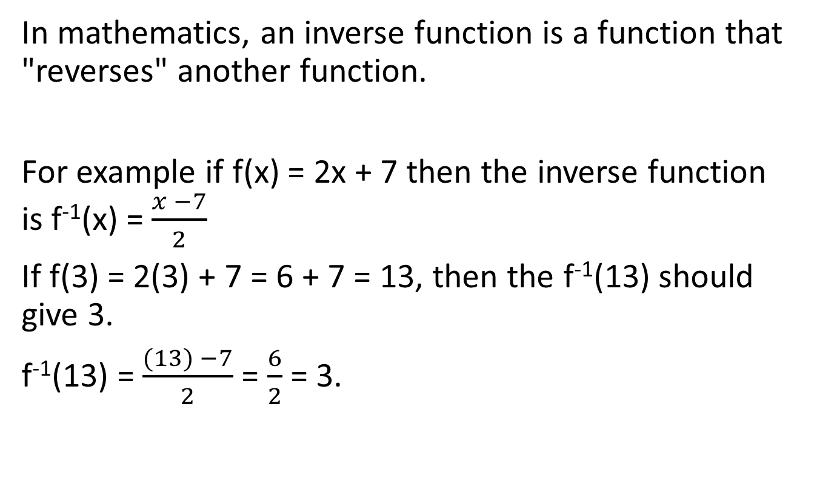
Inverse functions
In mathematics, an inverse function is a function that "reverses" another function.
For example if f(x) = 2x + 7 then the inverse function is f⁻¹(x) = $\frac{x −7}{2}$
If f(3) = 2(3) + 7 = 6 + 7 = 13, then the f⁻¹(13) should give 3.
f⁻¹(13) = $\frac{(13) −7}{2}$ = $\frac{6}{2}$ = 3.

Slide 16
Question
Given f(x) = 3x – 5 and g(x) = x² + 5 find
(i) f(4)
(ii) g(3)
(iii) f(g(2))
(iv) f⁻¹(x)
(v) f⁻¹(7)

Slide 17
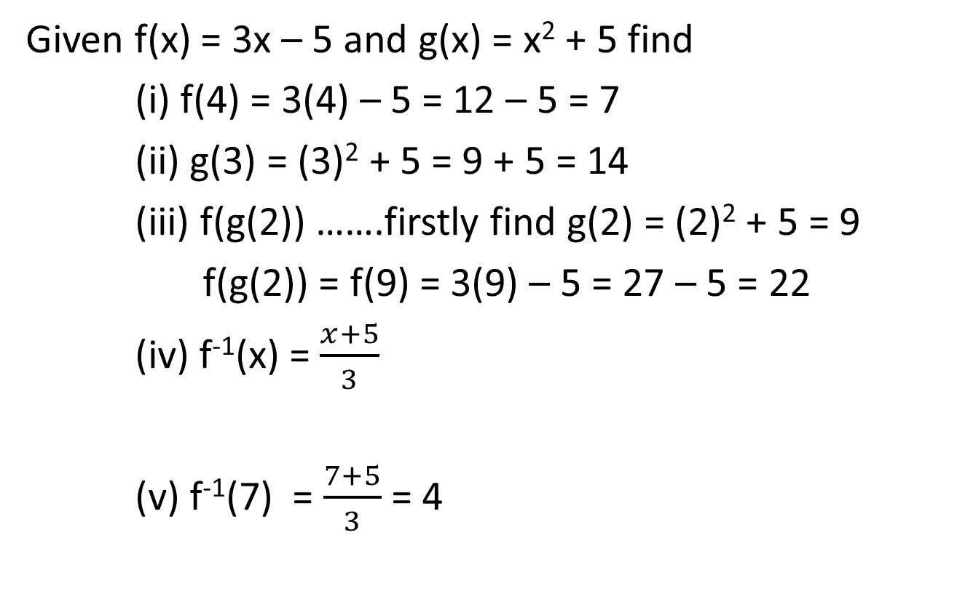
Question
Given f(x) = 3x – 5 and g(x) = x² + 5 find
(i) f(4) = 3(4) – 5 = 12 – 5 = 7
(ii) g(3) = (3)² + 5 = 9 + 5 = 14
(iii) f(g(2)) …….firstly find g(2) = (2)² + 5 = 9
f(g(2)) = f(9) = 3(9) – 5 = 27 – 5 = 22
(iv) f⁻¹(x) = $\frac{x+5}{3}$
(v) f⁻¹(7) = $\frac{7+5}{3}$ = 4

Slide 18
The Linear Function
A linear equation has the form
y = mx + c
where m and c are constants.
When the equation is in the form y = mx + c, then m, the coefficient of x, represents the slope of the line and the constant c represents the y intercept ie. where the line cuts the y axis.
y = 2x + 7 is an example of a linear function where the slope of the line is 2 and the y-intercept is 7.

Slide 19
The graph of y = 3x – 4 is shown below.
x | -4 | -3 | -2 | -1 | 0 | 1 | 2 | 3 | 4
y=3x - 4 | -16 | -13 | -10 | -7 | -4 | -1 | 2 | 5 | 8
Note line cuts y axis at y=-4

Slide 20
The Quadratic Function
A quadratic equation has the form
y = ax² + bx + c
where a, b and c are constants.
For example, y = 2x² – 3x + 2 is a quadratic equation. For the equation to be quadratic an x² term must be present with no higher power of x.
Quadratic equations often provide the most realistic model of a relationship between variables which has a curved graph.

Slide 21
The simplest quadratic curve is y = x². A table of values and graph for y = x² is given below.
x | -3 | -2 | -1 | 0 | 1 | 2 | 3
y = x² | 9 | 4 | 1 | 0 | 1 | 4 | 9

Slide 22
We can see that the points form a U-shape, with the base at (0,0). A completed graph of y=x² is shown below. Such a curve is called a parabola.
A parabola is the geometric representation of a quadratic equation.
Notice that positive and negative values of x give the same value of x² so that the left hand side of the U is a mirror-image of the right hand side. That is, the curve is symmetric about the y axis.
Also note that since x² is never negative the curve never goes below the x axis.

Slide 23
Another simple quadratic equation is y = -x² . As –x² has the opposite sign to x² the graph of y = -x² is a reflection of y = x² in the x axis.
The curve therefore has an inverted U-shape with the maximum at (0,0) as shown below.
A table of values and graph for y = -x² is given below.
x | -3 | -2 | -1 | 0 | 1 | 2 | 3
y=-x² | -9 | -4 | -1 | 0 | -1 | -4 | -9

Slide 25
Adding a constant to an equation such as 5 moves its curve up or down. For example, the graph of y = x² + 5 has the same shape as the graph of y = x² but each value is five units higher, as illustrated below.

Slide 26
Solve the following simultaneous equations:
y = 2x + 5
y = 3x² +2x -7
This problem can be solved algebraically or graphically. We will only look at the graphical solution here.
Plot both functions on the same set of axis.
x | -3 | -2 | -1 | 0 | 1 | 2 | 3
y=2x+5 | -1 | 1 | 3 | 5 | 7 | 9 | 11
y=3x²+2x-7 | 14 | 1 | -6 | -7 | -2 | 9 | 26

Slide 28
The solution can now be read from the graph.
Note: we will look at more linear and quadratic graphs in the lab where we will use Microsoft Excel to draw graphs.
x | -2 | 2
y | 1 | 9

Slide 29
The Exponential Function
An expression of the form a^{x} is called an exponential expression.
a is called the base and x is called the power or index.
One of the most commonly used values for the base is 2.71828... - this number is denoted by e. The exponential expression e^{x} occurs in the modelling of many natural phenomena e.g population growth, radioactive decay etc.
Many scientific calculators are programmed to evaluate e^{x} for many values of x.

Slide 30

The normal laws of indices (covered last semester) also apply when e is the base i.e.
e^{x} . e^{y} = e^{x+y}
(e^{x})^{y} = e^{xy}
$\frac{e^{x}}{e^{y}}$ = e^{x-y}
e⁰ = 1

Slide 31
Questions
Given f(x) = 3e^{2x} find f(0), f(1), f(2), f(3), f(10), f(20)
f(0) = 3
f(1) = 22.17
f(2) = 163.79
f(3) = 1210.29
f(10) = 1455495586
f(20) = 7.06 x 10¹⁷

Slide 32
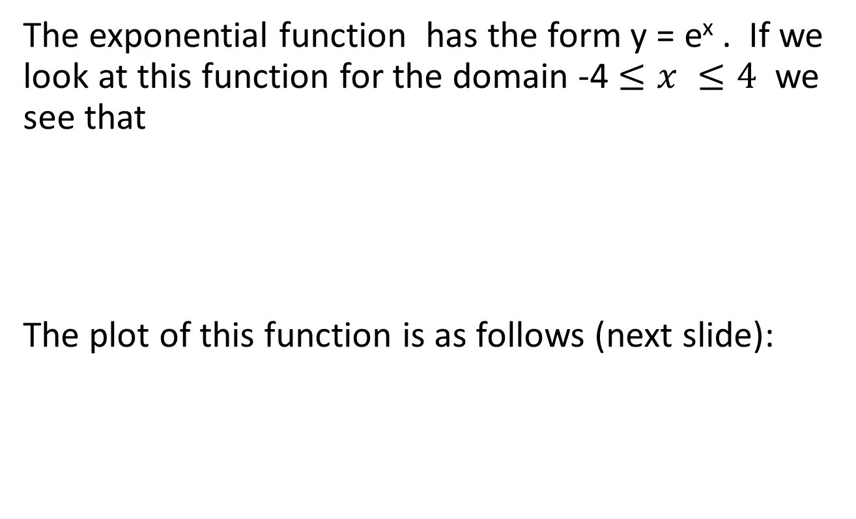
The graph of the exponential function
The exponential function has the form y = e^{x} . If we look at this function for the domain -4 $≤x ≤4$ we see that
The plot of this function is as follows (next slide):
x | -4 | -3 | -2 | -1 | 0 | 1 | 2 | 3 | 4
e^{x} | 0.018 | 0.050 | 0.135 | 0.368 | 1.000 | 2.718 | 7.389 | 20.085 | 54.598

Slide 34
We can see that the graph of y = e^{x} has the following properties:
The exponential function is never negative
When x = 0 the value of y is 1
As the value of x increases, the value of e^{x} also increases. This is known as exponential growth
As the value of x decreases, the value of e^{x} gets nearer to 0.
As x tends towards infinity, the value of e^{x} will be larger than the value of x (which tends towards infinity) so the function is said to increase without bound.

Slide 35
Graph of y = e^{-x}
x | -4 | -3 | -2 | -1 | 0 | 1 | 2 | 3 | 4
e^{-x} | 54.598 | 20.086 | 7.389 | 2.718 | 1.000 | 0.368 | 0.135 | 0.050 | 0.018

Slide 36
In the graph of y = e^{-x} we see that as x increases e^{-x} gets closer and closer to 0 without ever reaching 0.
Exponential growth and decay
Exponential growth occurs when the growth rate of a mathematical function is proportional to the function's current value. A quantity is said to be subject to exponential decay if it decreases at a rate proportional to its value.
With exponential growth of a positive value its rate of increase steadily increases, or in the case of exponential decay, its rate of decrease steadily decreases.

