Slide 1
Functions 2
Trigonometric functions

Slide 2
Trigonometric functions
In mathematics, the trigonometric functions are functions of an angle. They relate the angles of a triangle to the lengths of its sides.
The most familiar trigonometric functions are the sine, cosine, and tangent.

Slide 3
Trigonometric Ratios in a right-angled triangle
The sides of a right angled triangle are labelled according to the angle in question
x
hypotenuse
adjacent
opposite

Slide 4
The sides of a right angled triangle are labelled according to the angle in question
opposite
hypotenuse
x
adjacent

Slide 5

Trigonometric ratios
sin = $\frac{opposite}{hypotenuse}$ = $\frac{o}{h}$
cos = $\frac{adjacent}{hypotenuse}$ = $\frac{a}{h}$
tan = $\frac{opposite}{adjacent}$ = $\frac{o}{a}$

Slide 6
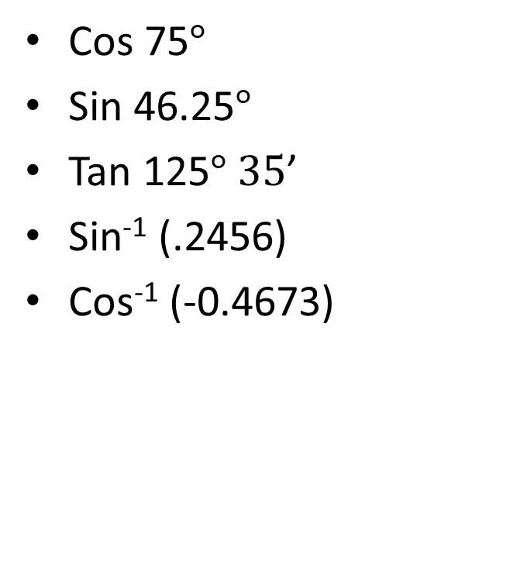
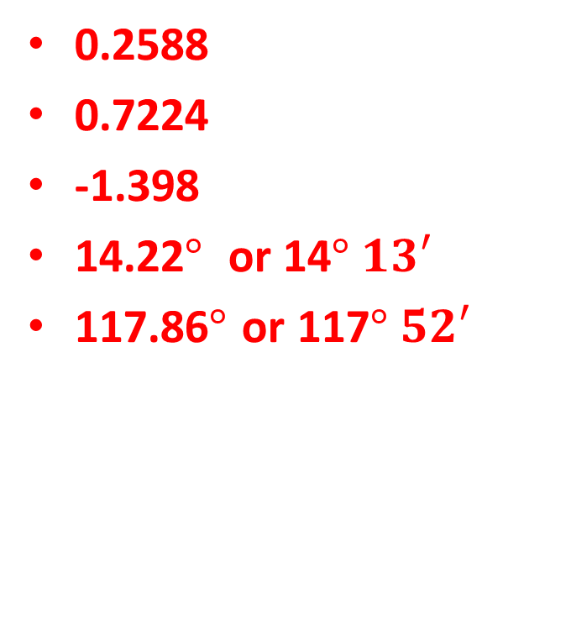
Cos 75$°$
Sin 46.25$°$
Tan 125$° 35$’
Sin⁻¹ (.2456)
Cos⁻¹ (-0.4673)
0.2588
0.7224
-1.398
14.22$°$ or 14$° 13′$
117.86$°$ or 117$° 52′$

Slide 7
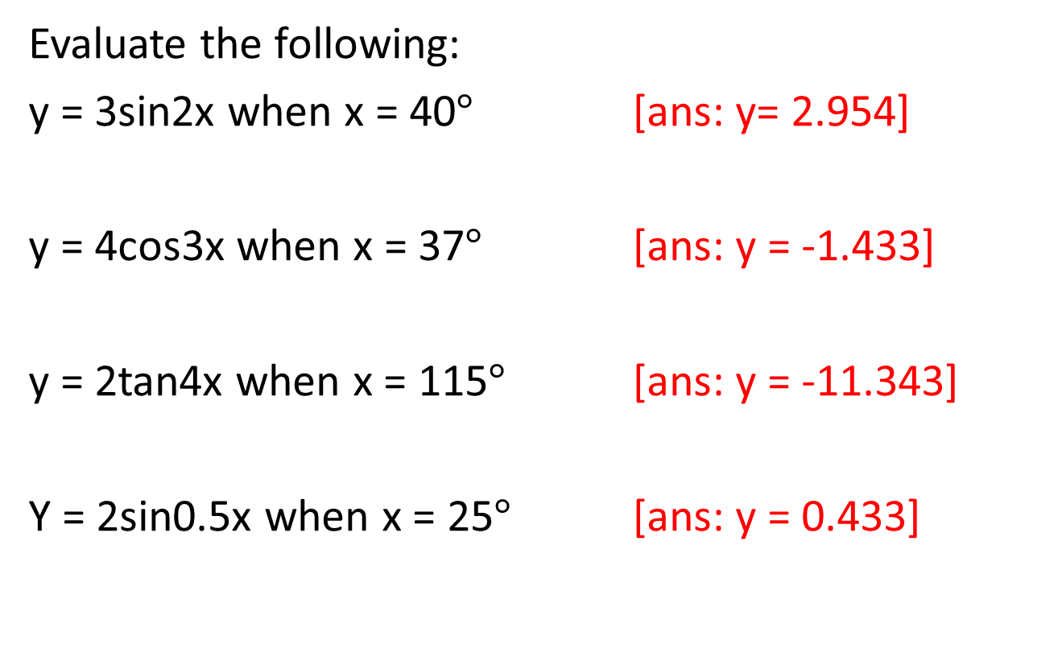
Questions
Evaluate the following:
y = 3sin2x when x = 40$°$ [ans: y= 2.954]
y = 4cos3x when x = 37$°$ [ans: y = -1.433]
y = 2tan4x when x = 115$°$ [ans: y = -11.343]
Y = 2sin0.5x when x = 25$°$ [ans: y = 0.433]

Slide 8
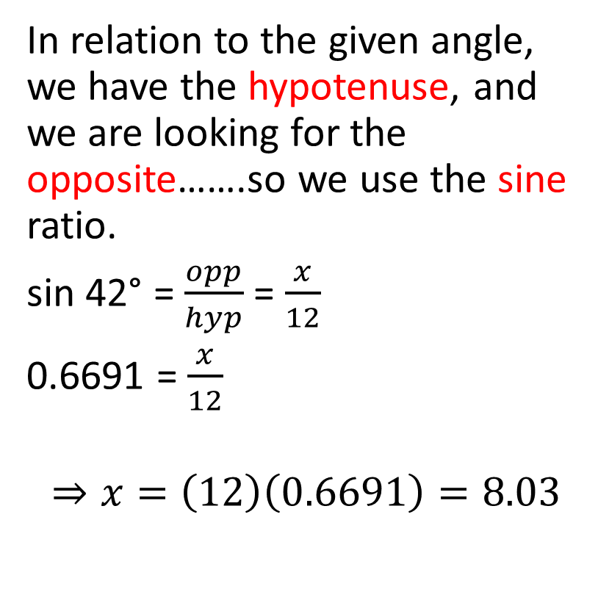
Use of ratios to solve right-angled triangles
In relation to the given angle, we have the hypotenuse, and we are looking for the opposite…….so we use the sine ratio.
sin 42° = $\frac{opp}{hyp}$ = $\frac{x}{12}$
0.6691 = $\frac{x}{12}$
$$⇒x=\left(12\right)\left(0.6691\right)=8.03$$
x
12
42°
Find the value of x

Slide 9
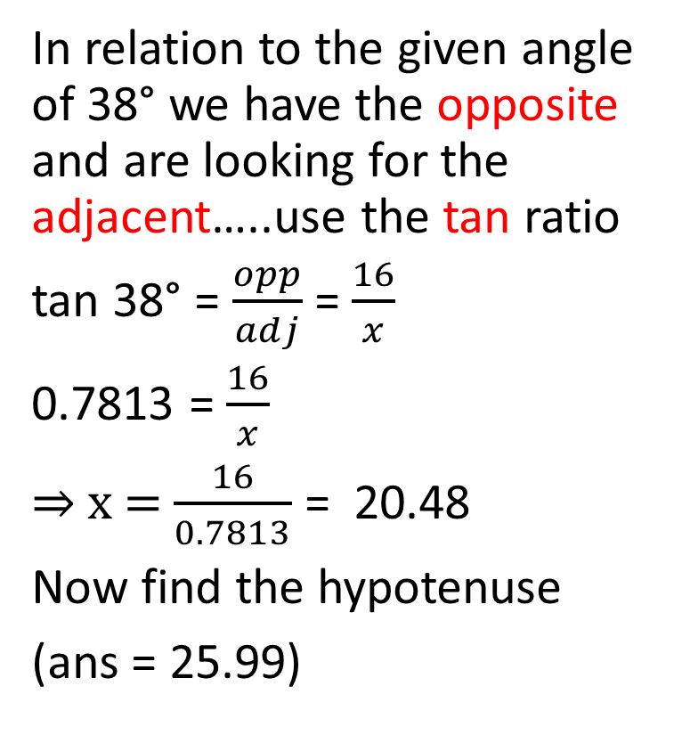
Another example
In relation to the given angle of 38° we have the opposite and are looking for the adjacent…..use the tan ratio
tan 38° = $\frac{opp}{adj}$ = $\frac{16}{x}$
0.7813 = $\frac{16}{x}$
⇒ x = $\frac{16}{0.7813}$ = 20.48
Now find the hypotenuse
(ans = 25.99)
16
38°
x
Find the length of side x

Slide 10
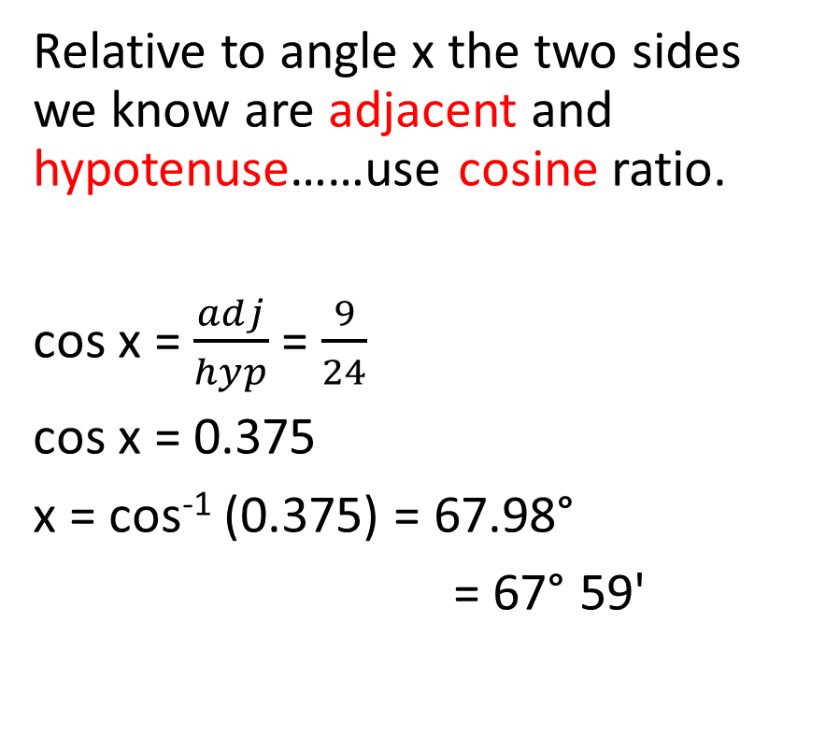
Using the ratios to solve an angle
Relative to angle x the two sides we know are adjacent and hypotenuse……use cosine ratio.
cos x = $\frac{adj}{hyp}$ = $\frac{9}{24}$
cos x = 0.375
x = cos⁻¹ (0.375) = 67.98°
= 67° 59'
24
x°
9
Find angle x

Slide 11
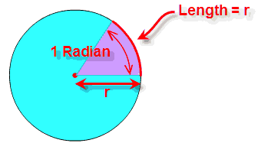
Radian measure
Angles are measured in degrees or radians.
A Radian "cuts out" a length of a circle's circumference equal to the radius.
360° = 2π radians where π = 3.14159…..

Slide 12
360° = 2π radians
1° = 2π/360 radians = 0.01745 radians.
2π radians = 360°
1 radian = 360/2π degrees = 57.296°
Always check your calculator is in correct mode when using degrees or radians.

Slide 13
Trigonometric ratios and radians
Find Sin 1.2 rads. Ans = 0.9320
Find Cos 1.68 rads. Ans = -0.1090
Evaluate Sin⁻¹ (.8660) in rads
Ans = 1.0471 rads
Evaluate Tan⁻¹ (2.688) in rads
Ans = 1.215 rads

Slide 14
Graphs of trigonometric functions
You will need to be able to plot the graphs of y = a sin bx and y = a cos bx using both degrees and radians.
We can use a table of values to plot selected points between x = 0 and x = 360, and draw a smooth curve between them. We can then extend the graph to the right and to the left, because we know that the graph repeats itself.
You will also need to be able to sketch the graph of a sine or cosine function…..you need to know period, amplitude and general shape of curve to do this.

Slide 15
Graph of y = sin x for 0° ≤ x≤ 360°

Slide 16
Graph of y = cos x for 0°≤ x≤ 360°

Slide 17
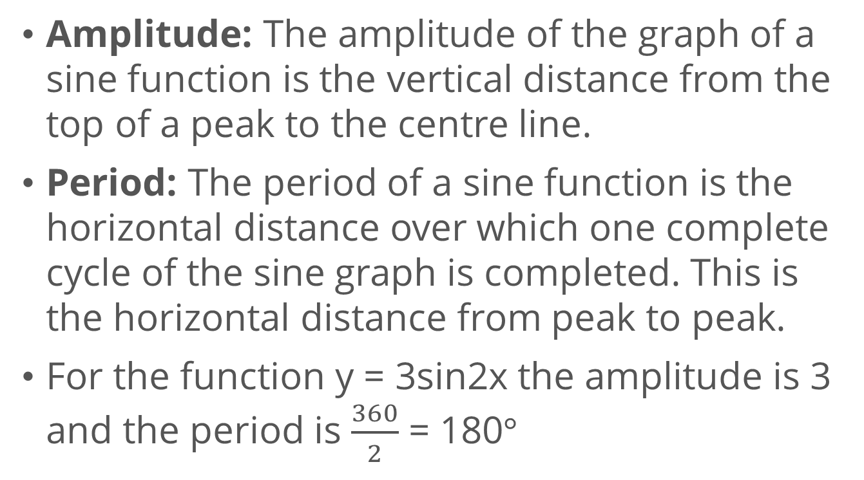
Period and amplitude of a sine or cosine graph.
Amplitude: The amplitude of the graph of a sine function is the vertical distance from the top of a peak to the centre line.
Period: The period of a sine function is the horizontal distance over which one complete cycle of the sine graph is completed. This is the horizontal distance from peak to peak.
For the function y = 3sin2x the amplitude is 3 and the period is $\frac{360}{2}$ = 180$°$

Slide 18
Trigonometric Waveforms
amplitude
Period
(x-axis for 1 complete cycle)

Slide 19
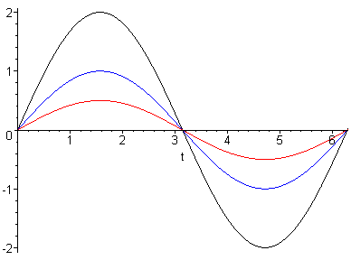
Trigonometric Waveforms
y=Asinθ
Affects amplitude
Amplitude = A

Slide 20
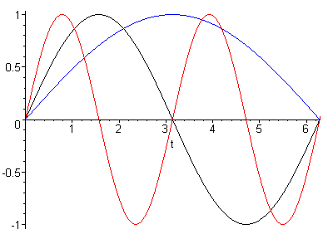
Trigonometric Waveforms
y=sinbθ
Affects period
Period =

Slide 21
Trigonometric Waveforms
Example: State the amplitude and period of the waveform and sketch the curve
for one complete cycle
Amp = 3
Period =
Note: This axis can be
scaled in degrees or
radians

Slide 22
Plot the graph of y = 3cos(2x + 30°) for values of x such that 0 ≤ x ≤ 180° using intervals of 10°.
(i) State the amplitude and period of y = 3cos(2x + 30°)
(ii) Use your graph to solve 3cos(2x + 30°) = 1.2
(iii) Use your graph to find y when x = 25°
(iv) What is the value of y when x = 400°?

Slide 23
First make out the table
x | 0 | 10 | 20 | 30 | 40 | 50 | 60
y=3cos(2x + 30) | 2.598 | 1.928 | 1.026 | 0 | -1.026 | -1.928 | -2.598

Slide 24
Plot your graph

Slide 25
(i) State the amplitude and period of y = 3cos(2x + 30°)
Amplitude = 3
Period = 360/2 = 180°

Slide 26
(ii) Solving 3cos(2x+30) = 1.2………. x = 18° and x = 132°
X =18 and 132
1.2

Slide 27
(iii) Find y when x = 25°…….. ans. y = 0.5
x=25

Slide 28
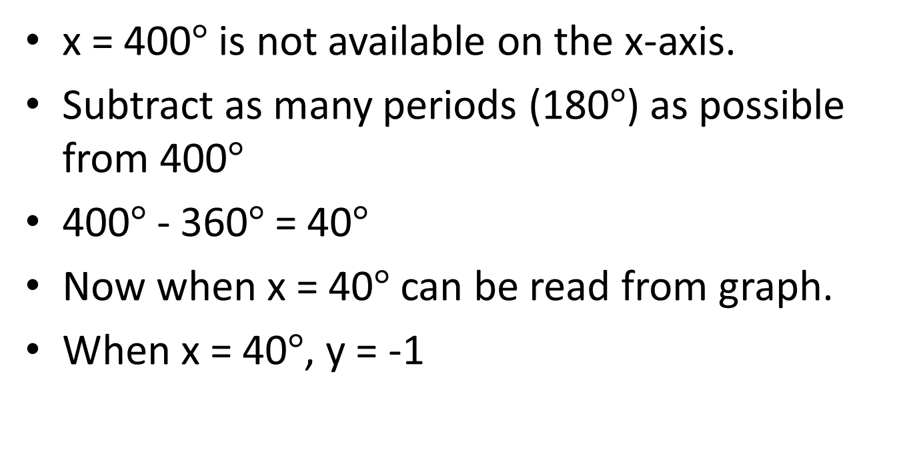

(iv) What is the value of y when x = 400$°$
x = 400$°$ is not available on the x-axis.
Subtract as many periods (180$°$) as possible from 400$°$
400$°$ - 360$°$ = 40$°$
Now when x = 40$°$ can be read from graph.
When x = 40$°$, y = -1

Slide 29
Note: we will look at more trigonometric graphs in the lab where we will use Microsoft Excel to draw graphs.

