Slide 1
Matrices 2

Slide 2
Identity matrix
The transpose of a matrix
Determinant of a matrix
The inverse of a matrix

Slide 3
Identity matrix
Multiplying by the identity matrix does not
change the matrix. (i.e.×1)
A.I = I.A = A

Slide 4
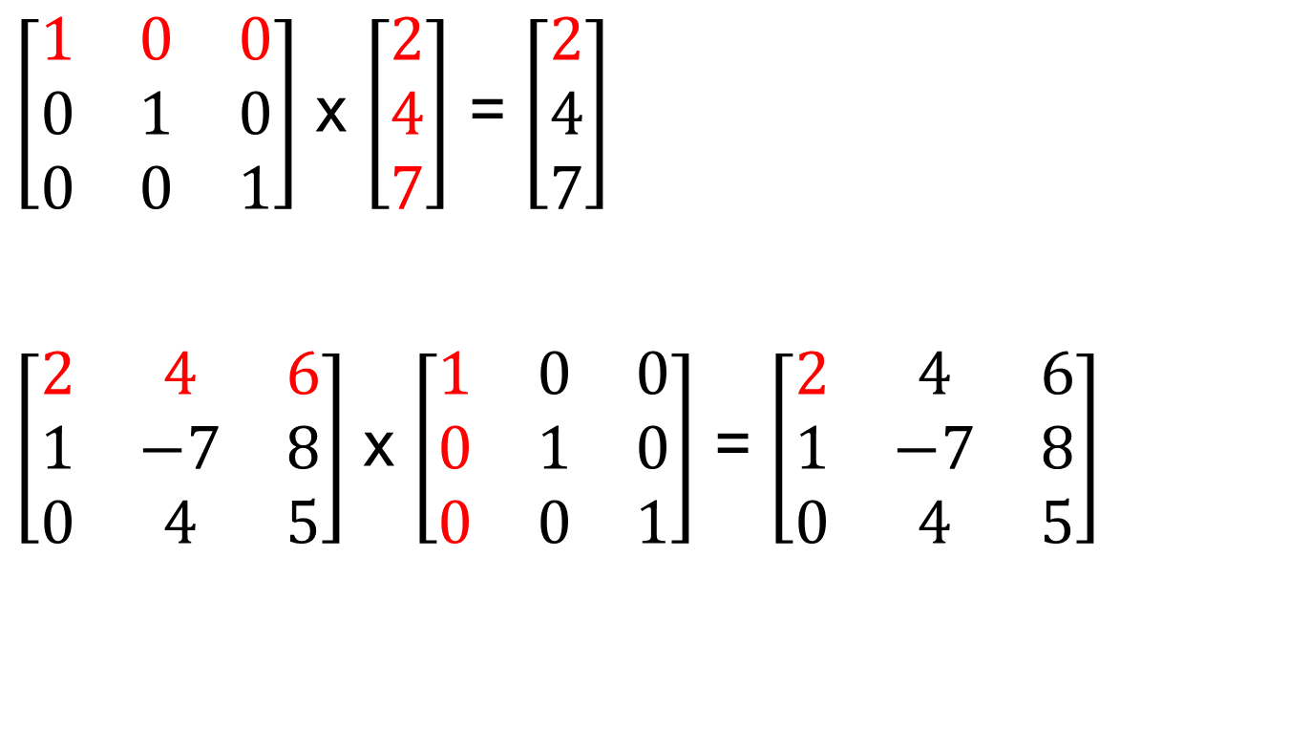
Identity matrix
$\left[\begin{matrix}1 & 0 & 0 \\ 0 & 1 & 0 \\ 0 & 0 & 1\end{matrix}\right]$ x $\left[\begin{matrix}2 \\ 4 \\ 7\end{matrix}\right]$ = $\left[\begin{matrix}2 \\ 4 \\ 7\end{matrix}\right]$
$\left[\begin{matrix}2 & 4 & 6 \\ 1 & −7 & 8 \\ 0 & 4 & 5\end{matrix}\right]$ x $\left[\begin{matrix}1 & 0 & 0 \\ 0 & 1 & 0 \\ 0 & 0 & 1\end{matrix}\right]$ = $\left[\begin{matrix}2 & 4 & 6 \\ 1 & −7 & 8 \\ 0 & 4 & 5\end{matrix}\right]$

Slide 5
The transpose of a matrix
The matrix obtained by interchanging the rows and columns of a matrix A is called the transpose of A (write A^{T} ).
Example:
The transpose of A is

Slide 6
Determinants
Determinant of 2x2 matrix
Consider a 2 × 2 matrix:
Determinant of A, denoted |A| , is a number and can be evaluated by

Slide 7
Determinant of 2 x 2
easy to remember (for order 2 only)..
-
+
Example: Evaluate the determinant:

Slide 8
The following properties are true for determinants of any order.
If every element of a row (column) is zero, e.g., , then |A| = 0.
|A^{T}| = |A|
|AB| = |A||B|
determinant of a matrix = that of its transpose

Slide 9
The Determinant of a 3×3 Matrix
The determinant of a 3×3 matrix is;

Slide 10
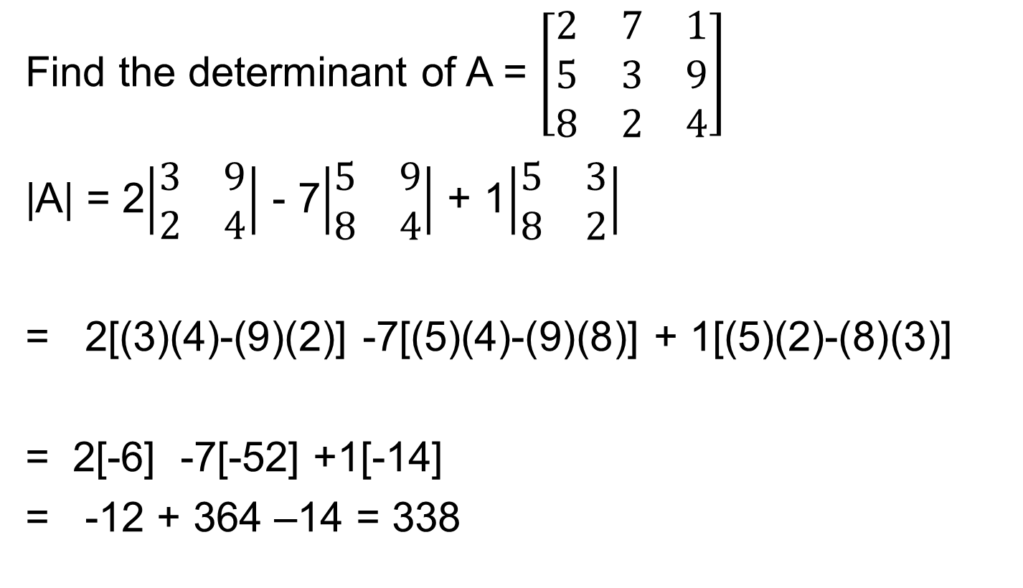
Determinants of 3 x 3 matrix
Find the determinant of A = $\left[\begin{matrix}2 & 7 & 1 \\ 5 & 3 & 9 \\ 8 & 2 & 4\end{matrix}\right]$
|A| = 2$\left|\begin{matrix}3 & 9 \\ 2 & 4\end{matrix}\right|$ - 7$\left|\begin{matrix}5 & 9 \\ 8 & 4\end{matrix}\right|$ + 1$\left|\begin{matrix}5 & 3 \\ 8 & 2\end{matrix}\right|$
= 2[(3)(4)-(9)(2)] -7[(5)(4)-(9)(8)] + 1[(5)(2)-(8)(3)]
= 2[-6] -7[-52] +1[-14]
= -12 + 364 –14 = 338

Slide 11
The inverse of a 2×2 Matrix

Slide 12

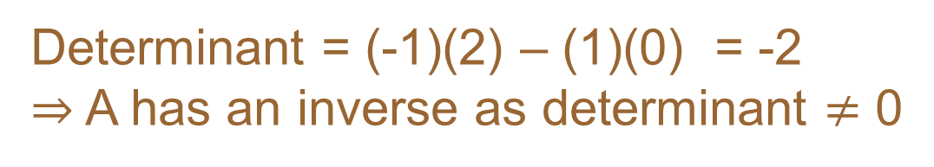
Inverse of a 2 x 2 matrix
Example: Find the inverse of
Determinant = (-1)(2) – (1)(0) = -2
⇒ A has an inverse as determinant $≠$ 0
Hence, the inverse of A is A⁻¹ = $\frac{1}{−2}$ $\left[\begin{matrix}2 & 0 \\ −1 & −1\end{matrix}\right]$

Slide 13
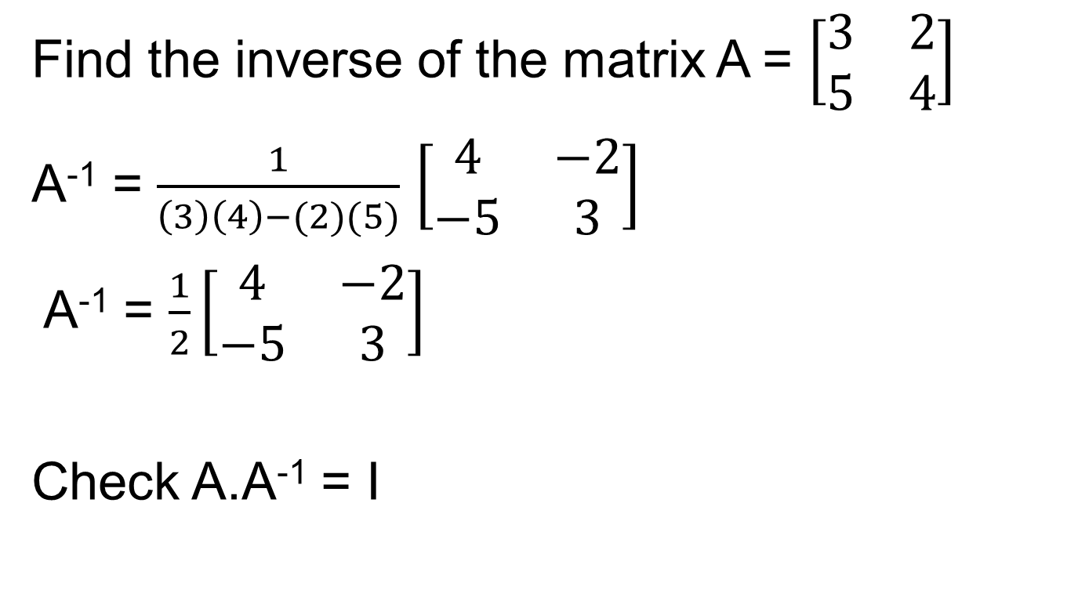
Inverse of a 2 x 2 matrix - example
Find the inverse of the matrix A = $\left[\begin{matrix}3 & 2 \\ 5 & 4\end{matrix}\right]$
A⁻¹ = $\frac{1}{\left(3\right)\left(4\right)−(2)(5)}$ $\left[\begin{matrix}4 & −2 \\ −5 & 3\end{matrix}\right]$
A⁻¹ = $\frac{1}{2}\left[\begin{matrix}4 & −2 \\ −5 & 3\end{matrix}\right]$
Check A.A⁻¹ = I

Slide 14

A.A⁻¹ = I
= $\left[\begin{matrix}3 & 2 \\ 5 & 4\end{matrix}\right]$. $\frac{1}{2}\left[\begin{matrix}4 & −2 \\ −5 & 3\end{matrix}\right]$
= $\frac{1}{2}\left[\begin{matrix}3 & 2 \\ 5 & 4\end{matrix}\right]$. $\left[\begin{matrix}4 & −2 \\ −5 & 3\end{matrix}\right]$
= $\frac{1}{2}\left[\begin{matrix}2 & 0 \\ 0 & 2\end{matrix}\right]$ = $\left[\begin{matrix}1 & 0 \\ 0 & 1\end{matrix}\right]$

Slide 15
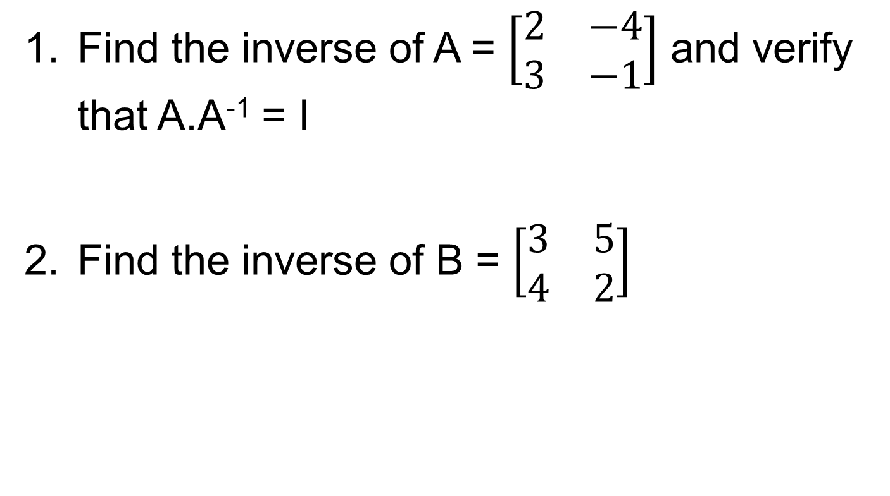
Questions
Find the inverse of A = $\left[\begin{matrix}2 & −4 \\ 3 & −1\end{matrix}\right]$ and verify that A.A⁻¹ = I
Find the inverse of B = $\left[\begin{matrix}3 & 5 \\ 4 & 2\end{matrix}\right]$

Slide 16
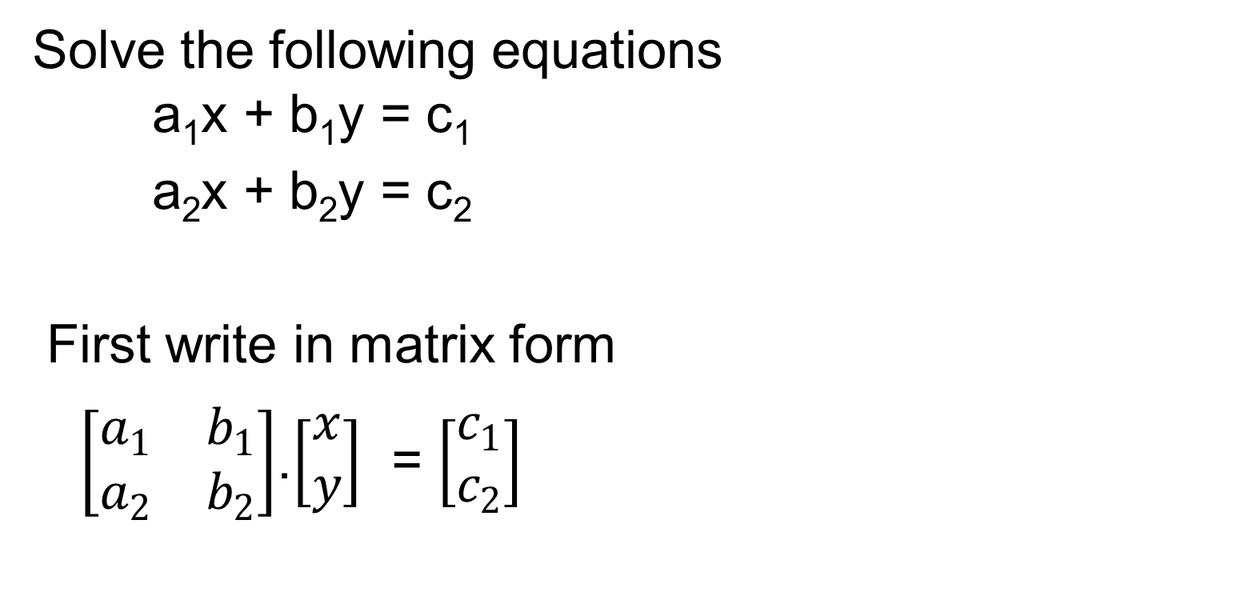
Solving simultaneous equations using the inverse method
Solve the following equations a₁x + b₁y = c₁
a₂x + b₂y = c₂
First write in matrix form
$\left[\begin{matrix}a_{1} & b_{1} \\ a_{2} & b_{2}\end{matrix}\right]$.$\left[\begin{matrix}x \\ y\end{matrix}\right]$ = $\left[\begin{matrix}c_{1} \\ c_{2}\end{matrix}\right]$

Slide 17
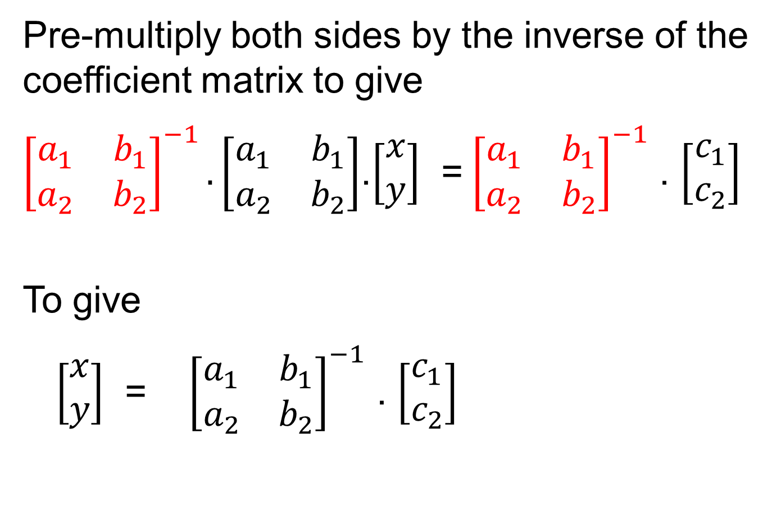
Pre-multiply both sides by the inverse of the coefficient matrix to give
${\left[\begin{matrix}a_{1} & b_{1} \\ a_{2} & b_{2}\end{matrix}\right]}^{−1}.\left[\begin{matrix}a_{1} & b_{1} \\ a_{2} & b_{2}\end{matrix}\right]$.$\left[\begin{matrix}x \\ y\end{matrix}\right]$ =${ \left[\begin{matrix}a_{1} & b_{1} \\ a_{2} & b_{2}\end{matrix}\right]}^{−1}$ . $\left[\begin{matrix}c_{1} \\ c_{2}\end{matrix}\right]$
To give
$\left[\begin{matrix}x \\ y\end{matrix}\right]$ = ${\left[\begin{matrix}a_{1} & b_{1} \\ a_{2} & b_{2}\end{matrix}\right]}^{−1}$ . $\left[\begin{matrix}c_{1} \\ c_{2}\end{matrix}\right]$

Slide 18
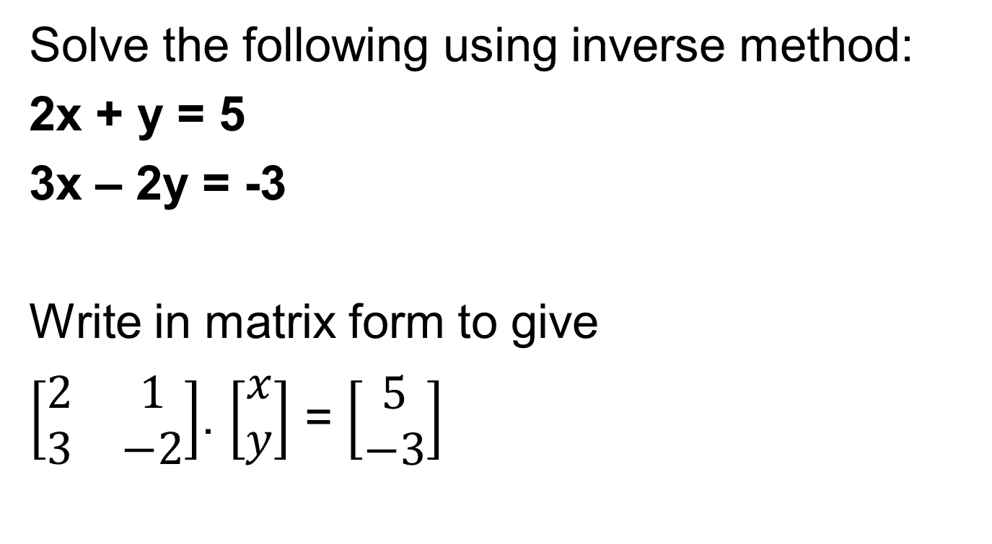
Example 1
Solve the following using inverse method:
2x + y = 5
3x – 2y = -3
Write in matrix form to give
$\left[\begin{matrix}2 & 1 \\ 3 & −2\end{matrix}\right]$. $\left[\begin{matrix}x \\ y\end{matrix}\right]$ = $\left[\begin{matrix}5 \\ −3\end{matrix}\right]$

Slide 19
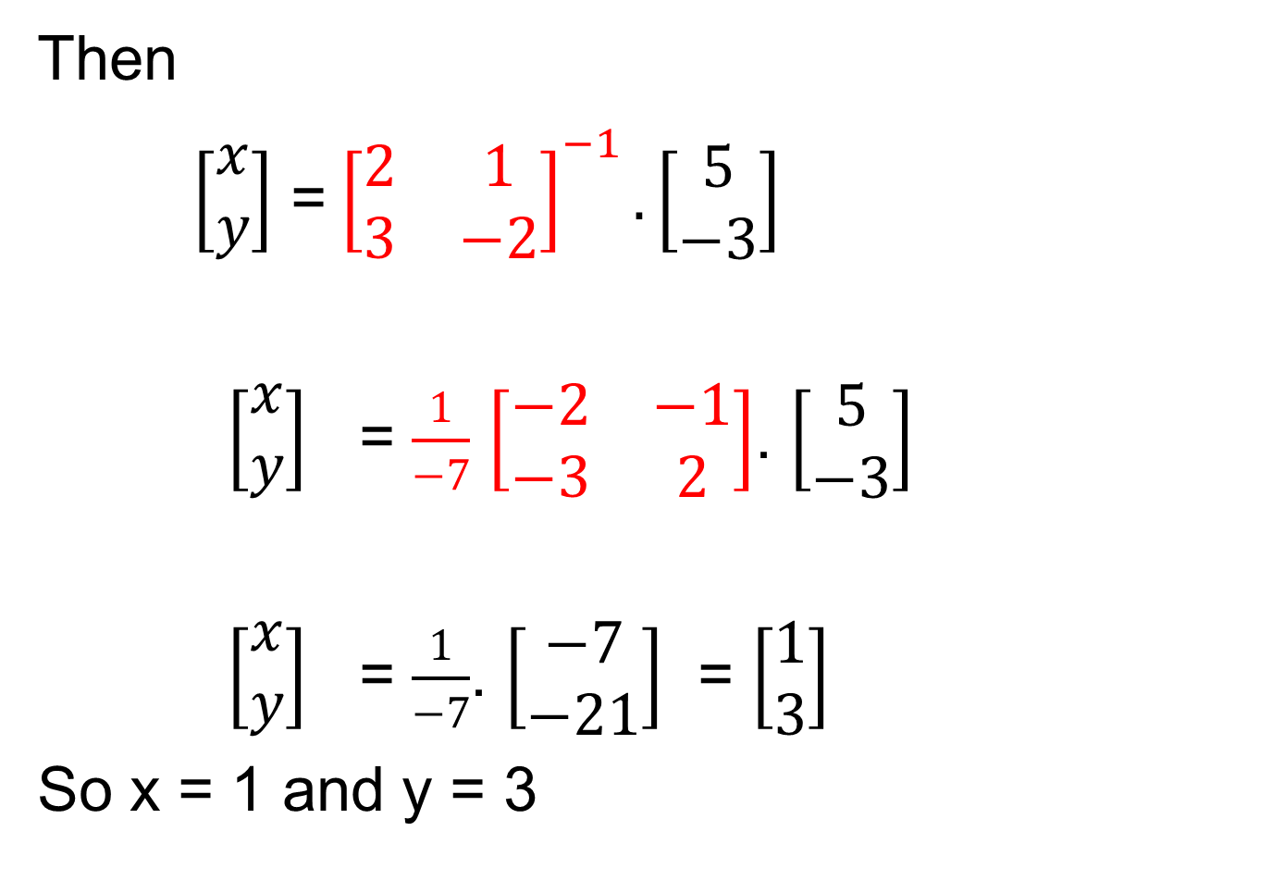
Then
$\left[\begin{matrix}x \\ y\end{matrix}\right]$ =${\left[\begin{matrix}2 & 1 \\ 3 & −2\end{matrix}\right]}^{−1}.\left[\begin{matrix}5 \\ −3\end{matrix}\right]$
$\left[\begin{matrix}x \\ y\end{matrix}\right]$ = $\frac{1}{−7}$ $\left[\begin{matrix}−2 & −1 \\ −3 & 2\end{matrix}\right]$. $\left[\begin{matrix}5 \\ −3\end{matrix}\right]$
$\left[\begin{matrix}x \\ y\end{matrix}\right]$ = $\frac{1}{−7}$. $\left[\begin{matrix}−7 \\ −21\end{matrix}\right]$ = $\left[\begin{matrix}1 \\ 3\end{matrix}\right]$
So x = 1 and y = 3

Slide 20
Example 2
Solve the following using inverse method:
5x – y = 7
3x + 2y = -1
Answer: x = 1; y = -2

