Slide 1
Matrices 2
Determinant Example

Slide 2

Given A = $\left[\begin{matrix}2 & 3 \\ 1 & 7\end{matrix}\right]$ B = $\left[\begin{matrix}5 & 2 \\ 4 & 1\end{matrix}\right]$
prove |AB| = |A| . |B|

Slide 3

Given A = $\left[\begin{matrix}2 & 3 \\ 1 & 7\end{matrix}\right]$ B = $\left[\begin{matrix}5 & 2 \\ 4 & 1\end{matrix}\right]$
so AB = $\left[\begin{matrix}22 & 7 \\ 33 & 9\end{matrix}\right]$

Slide 4
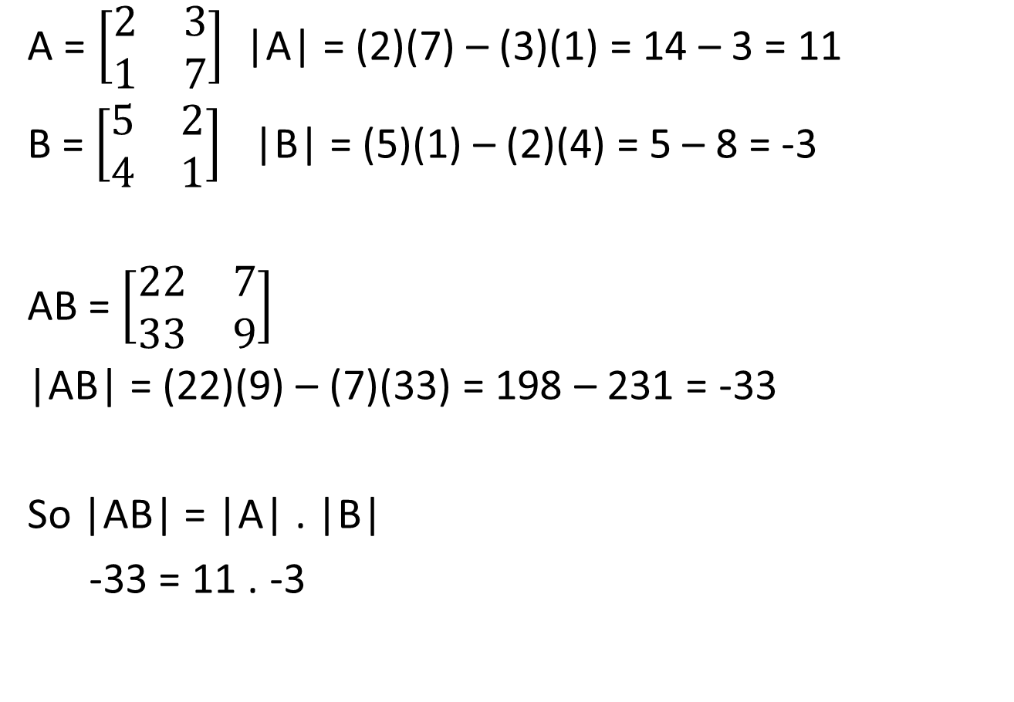
A = $\left[\begin{matrix}2 & 3 \\ 1 & 7\end{matrix}\right]$ |A| = (2)(7) – (3)(1) = 14 – 3 = 11
B = $\left[\begin{matrix}5 & 2 \\ 4 & 1\end{matrix}\right]$ |B| = (5)(1) – (2)(4) = 5 – 8 = -3
AB = $\left[\begin{matrix}22 & 7 \\ 33 & 9\end{matrix}\right]$
|AB| = (22)(9) – (7)(33) = 198 – 231 = -33
So |AB| = |A| . |B|
-33 = 11 . -3

