Slide 1
Matrices

Slide 2
Matrices
Both A and B are examples of a matrix. A matrix is a rectangular array of numbers enclosed by a pair of brackets.
Why matrices?

Slide 3
How about solving
Consider the following set of equations:
It is easy to show that x = 3 and y = 4.
Matrices can help…

Slide 4
In the matrix
Numbers a_{ij} are called elements. First subscript indicates the row; second subscript indicates the column. The matrix consists of mn elements
It is called “the m × n matrix A = [a_{ij}]” or simply “the matrix A ” if number of rows and columns are understood.

Slide 5

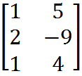

Order of a matrix
The order of A = is 2 x 3
The order of B = is 3 x 2
C = has order of 1 x 3

Slide 6
Square matrices
When m = n, i.e.,
A is called a “square matrix of order n” or “n-square matrix”
elements a₁₁, a₂₂, a₃₃,…, a_{nn} are called diagonal elements.

Slide 7
Equal matrices
Two matrices A and B are said to be equal (A = B) if and only if each element of A is equal to the corresponding element of B.

Slide 8
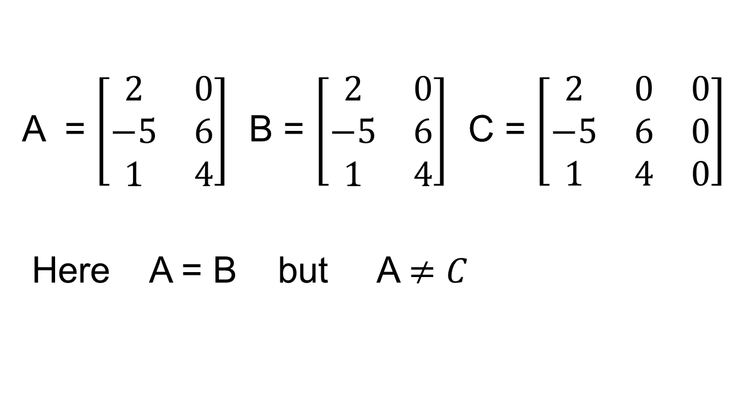
Equal matrices

Slide 9
Equal matrices
Example: and
Given that A = B, find elements a, b, c and d.
if A = B, then a = 1, b = 0, c = -4 and d = 2.

Slide 10
Zero matrices
If every element of a matrix is zero, it is called a zero matrix, i.e.,

Slide 11
Operations of matrices Addition and Subtraction of Matrices
Matrices can be added together or subtracted from each other if and only if they are of the same order. Corresponding elements are added or subtracted.

Slide 12
Example: if and
Evaluate A + B and A – B.

Slide 13
Sums of matrices
Two matrices of the same order are said to be conformable for addition or subtraction.
Two matrices of different orders cannot be added or subtracted, e.g.,
are NOT conformable for addition or subtraction.

Slide 14
Scalar multiplication
Let z be any scalar and A = [a_{ij}] is an m × n matrix. Then zA = [za_{ij}] for 1 ≤ i ≤ m, 1 ≤ j ≤ n, i.e., each element in A is multiplied by z.
Example: . Evaluate 3A.
In particular, l = -1, i.e., -A = [-a_{ij}]. It’s called the negative of A. Note: A - A = 0 is a zero matrix

Slide 15
Properties
Matrices A, B and C are conformable,
A + B = B + A
A + (B +C) = (A + B) +C
z(A + B) = zA + zB, where z is a scalar
(commutative law)
(associative law)
(distributive law)

Slide 16
Matrix Multiplication
Matrix A can only be multiplied by matrix B when the number of columns in matrix A is the same as the number of rows in matrix B.
A and B might be compatible to form AB but not BA.
The product of an m × n matrix with an n × p matrix will result in an m × p matrix.

Slide 17
Example:
and C = AB.
Evaluate c₂₁.

Slide 19

Given A = $\left[\begin{matrix}2 & 5 & 1 \\ −4 & 3 & 6\end{matrix}\right]$ B = $\left[\begin{matrix}4 & 1 \\ 6 & 2 \\ 7 & 5\end{matrix}\right]$
Find C = AB
A B
(2 x 3) (3 x 2)
⇒ C is a (2 x 2)

Slide 20
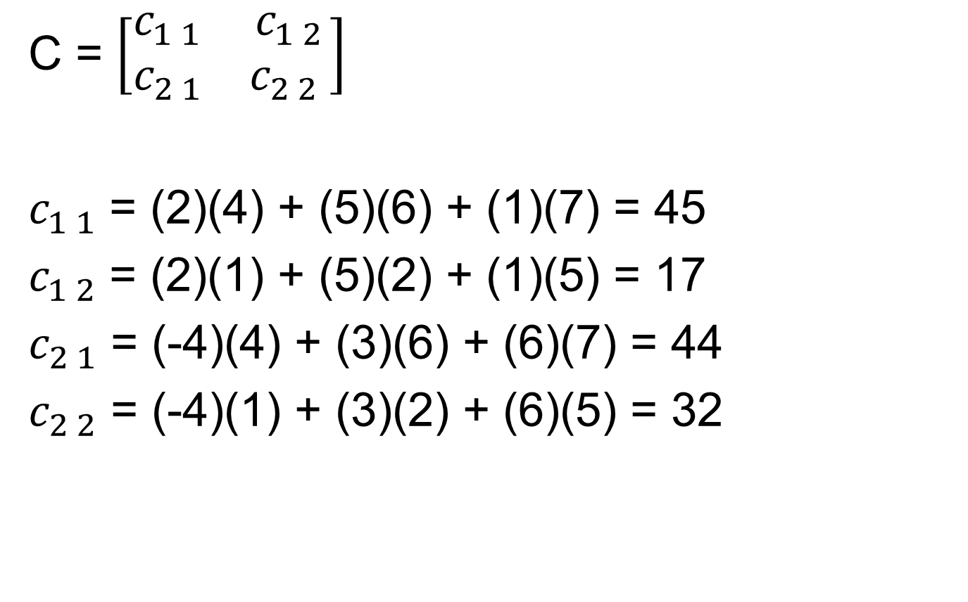
C = $\left[\begin{matrix}c_{1 1} & c_{1 2} \\ c_{2 1} & c_{2 2} \end{matrix}\right]$
$c_{1 1}$ = (2)(4) + (5)(6) + (1)(7) = 45
$c_{1 2}$ = (2)(1) + (5)(2) + (1)(5) = 17
$c_{2 1}$ = (-4)(4) + (3)(6) + (6)(7) = 44
$c_{2 2}$ = (-4)(1) + (3)(2) + (6)(5) = 32

Slide 21

So C = $\left[\begin{matrix}c_{1 1} & c_{1 2} \\ c_{2 1} & c_{2 2} \end{matrix}\right]$ = $\left[\begin{matrix}45 & 17 \\ 44 & 32\end{matrix}\right]$

Slide 22
2 x 2 2 x 3 = 2 x 3

Slide 23
Example: Evaluate C = AB. Given

Slide 25
Properties
Matrices A, B and C are conformable,
A(B + C) = AB + AC
(A + B)C = AC + BC
A(BC) = (AB) C
However
AB ≠ BA in general
AB = 0 NOT necessarily imply A = 0 or B = 0

