Slide 1
Matrices 4
Cramer’s rule on a 3 x 3

Slide 2
Example from Matrices 3
Example 3: Solve the following Cramer’s Rule:
3x + 4y + z = 10
2x – 3y + 5z = -9
x + 2y – z = 6
[ans: x = 1; y = 2; z = -1]

Slide 3
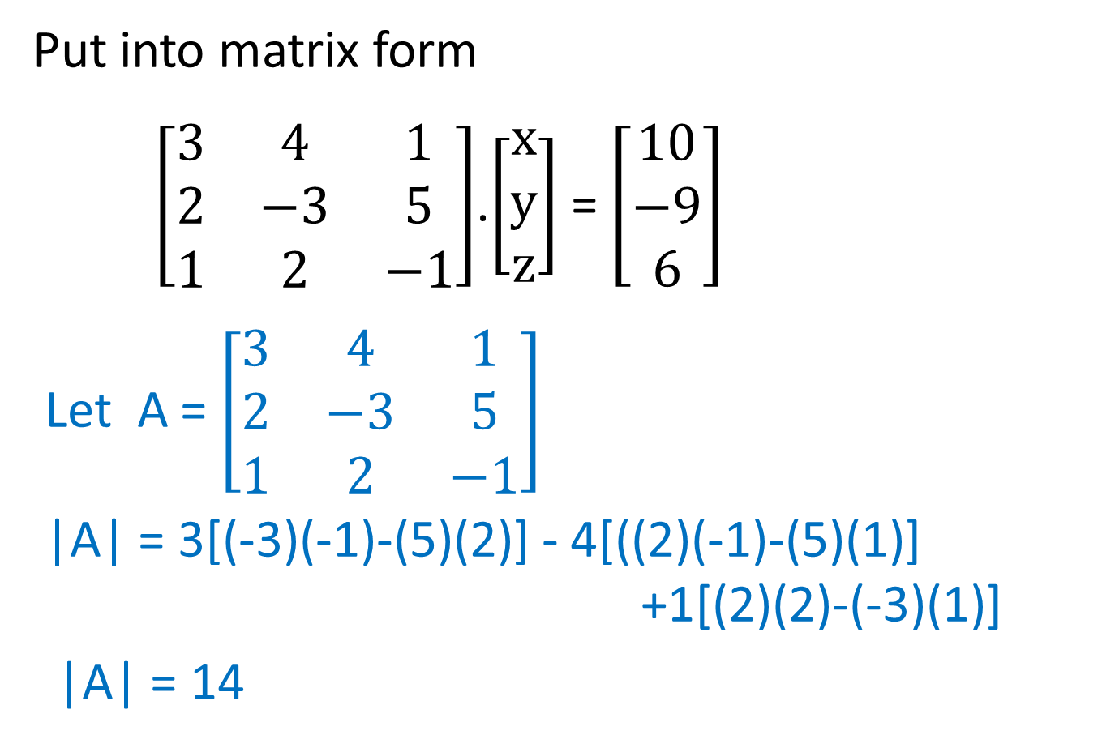
Put into matrix form
$\left[\begin{matrix}3 & 4 & 1 \\ 2 & −3 & 5 \\ 1 & 2 & −1\end{matrix}\right]$.$\left[\begin{matrix}x \\ y \\ z\end{matrix}\right]$ = $\left[\begin{matrix}10 \\ −9 \\ 6\end{matrix}\right]$
Let A = $\left[\begin{matrix}3 & 4 & 1 \\ 2 & −3 & 5 \\ 1 & 2 & −1\end{matrix}\right]$
|A| = 3[(-3)(-1)-(5)(2)] - 4[((2)(-1)-(5)(1)] +1[(2)(2)-(-3)(1)]
|A| = 14

Slide 4

Let A_{x} = $\left[\begin{matrix}10 & 4 & 1 \\ −9 & −3 & 5 \\ 6 & 2 & −1\end{matrix}\right]$
|A_{x}| = 10[(-3)(-1)-(5)(2)] - 4[((-9)(-1)-(5)(6)] +1[(-9)(2)-(-3)(6)]
|A_{x}| = 14

Slide 5

Let A_{y} = $\left[\begin{matrix}3 & 10 & 1 \\ 2 & −9 & 5 \\ 1 & 6 & −1\end{matrix}\right]$
|A_{y}| = 3[(-9)(-1)-(5)(6)] - 10[((2)(-1)-(5)(1)] +1[(2)(6)-(-9)(1)]
|A_{y}| = 28

Slide 6

Let A_{z} = $\left[\begin{matrix}3 & 4 & 10 \\ 2 & −3 & −9 \\ 1 & 2 & 6\end{matrix}\right]$
|A_{z}| = 3[(-3)(6)-(-9)(2)] - 4[((2)(6)-(-9)(1)] +10[(2)(2)-(-3)(1)]
|A_{z}| = -14

Slide 7

x = $\frac{\left|A_{x}\right|}{\left|A\right|}$ = $\frac{14}{14}$ = 1
y = $\frac{\left|A_{y}\right|}{\left|A\right|}$ = $\frac{28}{14}$ = 2
z = $\frac{\left|A_{z}\right|}{\left|A\right|}$ = $\frac{−14}{14}$ = -1

